Slide 1
EarthScope: Cyberinfrastructure to Access USArray Data Products and Services
By
Tim Ahern, IRIS Director of Data Services
Rick Benson, Manoch Bahavar, Alex Hutko, Celso Reyes, Yazan Suleiman Chad Trabant, Bruce Weertman

Slide 2
Overview
Web services
Product Levels
Time series
Derived Products
EarthCube and COOPEUS
Quality Assessment of Seismic Data
Research Ready Data Sets

Slide 3
The DMC Archive ~1/4 petabyte growing at 50 tbytes/year

Slide 4
Data and information available via web services
Raw Waveforms
fdsnws-dataselect
Metadata
fdsn-station
irisws-sacpz
irisws-resp
Event information
fdsnws-event
Processing & Calculation
irisws-timeseries
* Simple DSP & conversion
irisws-rotation
* returns rotated seismograms
irisws-traveltime
irisws-distaz
irisws-flinnengdahl
irisws-evalresp
http://service.iris.edu

Slide 5
How to request data from IRIS web services?
via URL Builders
Use a browser to explore the services
via HTTP clients, such as wget, curl, etc
These often are already on many systems
via DMC-provided tools:
command line: Fetch family of Perl scripts
Java: IRIS Java Web Service Library (IRIS-WS library)
MATLAB: IRIS-WS library, irisFetch.m
JWEED desktop application for event oriented data access
Other solutions:
ObsPy (Python), Waveform Suite, EMERALD, SeisFile, etc.
Notes:
Future DMC clients, whether on the web, scripts, desktop applications, will all use web services.

Slide 6
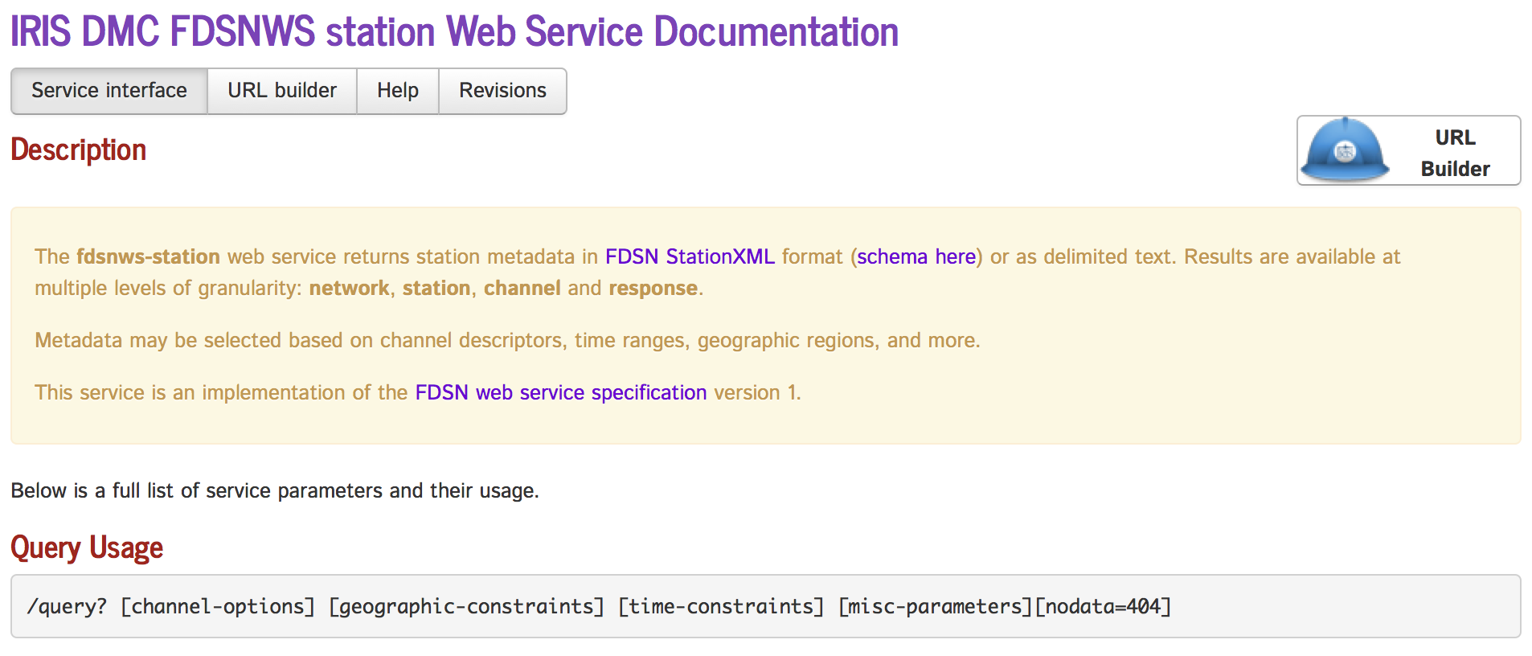
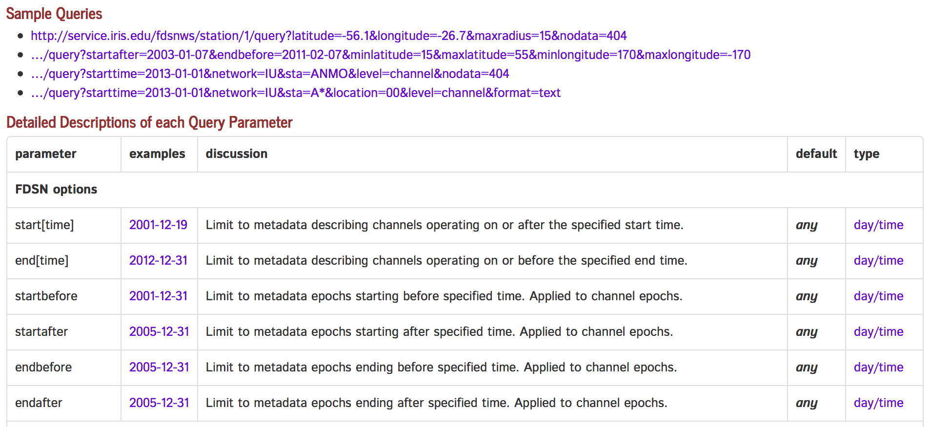
Documentation
Each web service contains documentation at it’s “root” page

Slide 7
Web Services gaining acceeptance over a wide number of users

Slide 8
A large number of different clients have adopted IRIS Web Services

Slide 9
Product Levels Adapted from National Research Council Committee on Data Management and Computation (CODMAC)
LEVEL 4
Integrated Research Products
LEVEL 3
Seismological Research Products
LEVEL 2
Derived Information
Standard Processing
LEVEL 1
Quality Controlled Data
LEVEL 0
Raw Data

Slide 10
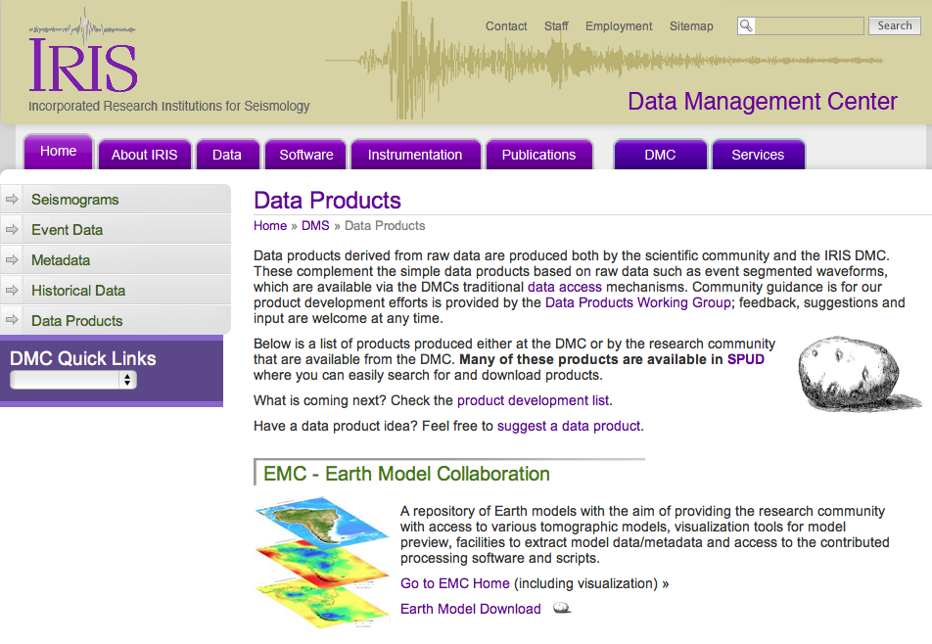
Products from IRIS http://www.iris.edu/dms/products/
PRODUCT

Slide 11
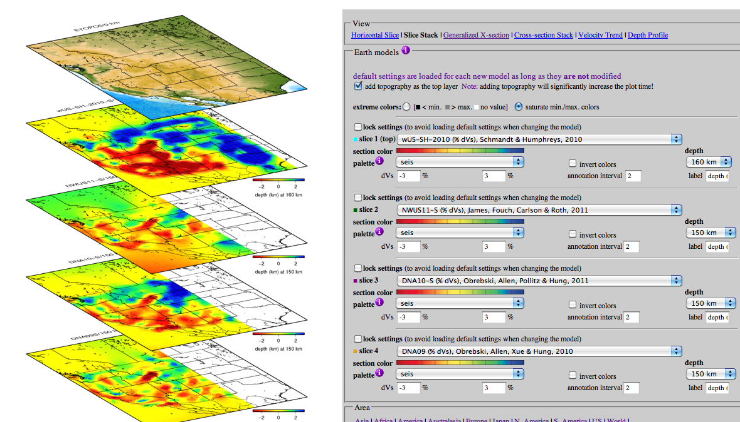

Slide 12
Products have an active use February 2011 until present 2.75 years
Product | Size in tbytes | Count | IPs | Countries
BACK_PROJECTION | 21 | 38340 | 4830 | 96
BUNDLE | 91 | 1045 | 595 | 56
CAL | 0 | 144 | 84 | 28
EARS | 163 | 277989 | 3793 | 106
EMC | 45 | 64403 | 9749 | 178
EMERALD | 656 | 610 | 65 | 18
EM_TF | 0 | 2688 | 131 | 27
EP | 464 | 981632 | 10074 | 116
EQENERGY_BUNDLE | 0 | 4 | 3 | 3
EQ_ENERGY | 2 | 6603 | 117 | 15
EVENT_BULLETIN | 0 | 307 | 158 | 37
FILM_CHIP | 2 | 389 | 165 | 36
GMV | 2,662 | 245387 | 62727 | 168
GMV_C1C | 1 | 234 | 41 | 0
INFRASOUND_EVENT | 4 | 1776 | 420 | 40
MT | 0 | 52935 | 4305 | 222
PDFPSD | 6 | 869 | 20 | 0
SEISSOUND | 5 | 8440 | 1797 | 83
STATION_DIGEST | 0 | 111 | 65 | 18
STF | 5 | 37199 | 692 | 43
TAID | 463 | 119717 | 2276 | 76
WUSNOISE | 18,330 | 20330 | 732 | 58

Slide 13
EarthCube & COOPEUS
RAMADDA
Long Tail Data
GGP
NEON
IRIS
UNAVCO
UTEP
Gravity
NGDC
WS-BB
CUAHSI
SDSC
Caltech
GPlates
Inter
Magnet
OOI
Columbia
IEDA
Unidata
Structural
Geology
WOVODAT
B-Cube
CINERGY

Slide 14
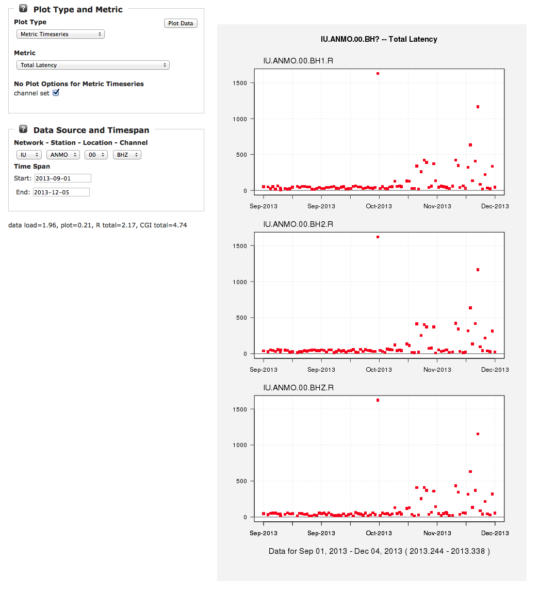
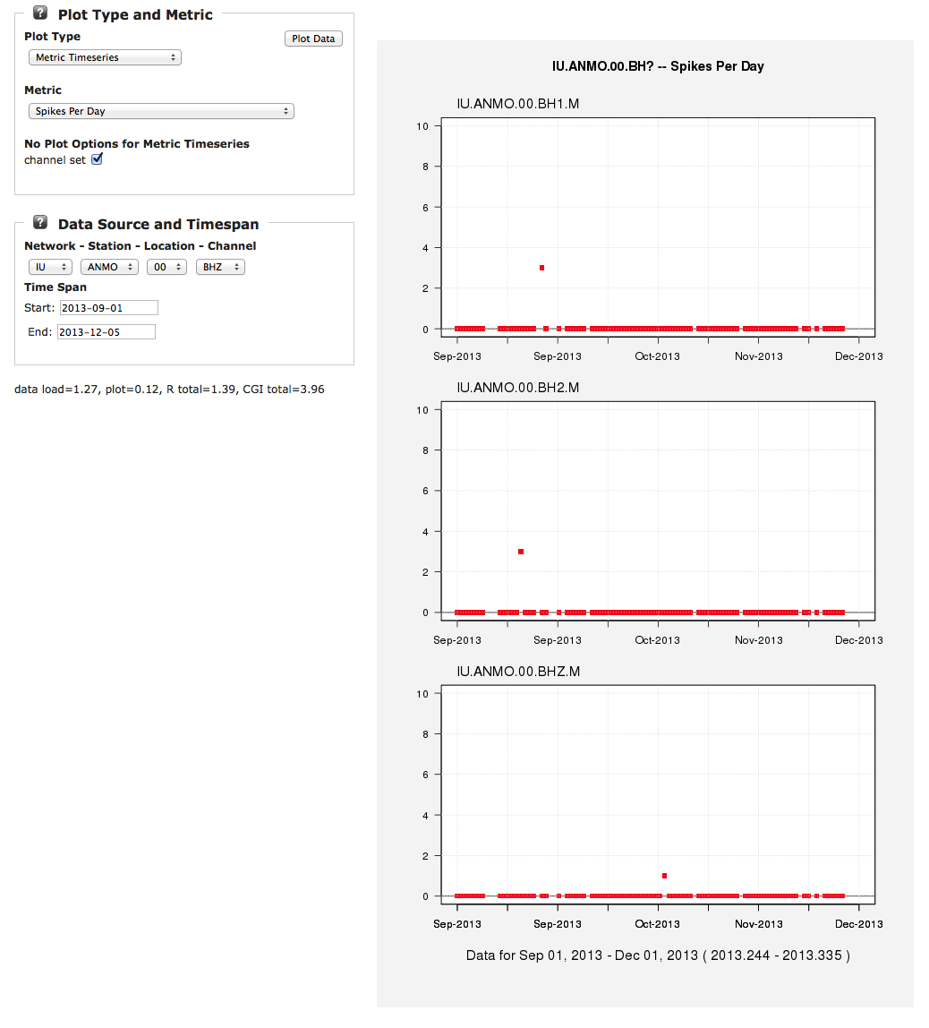
Quack-like single metric plots showing 3 months of data below but time span is user determined

Slide 15
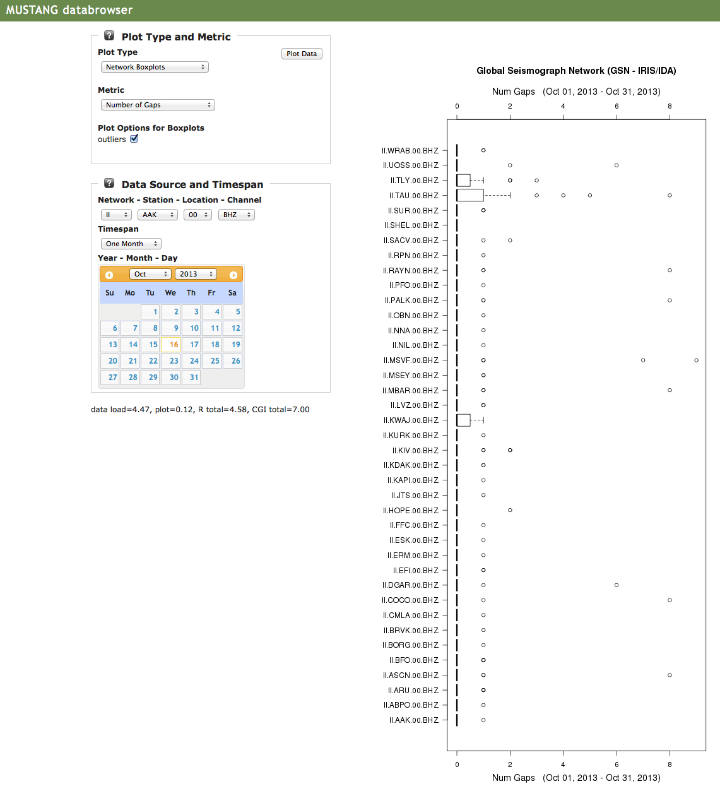
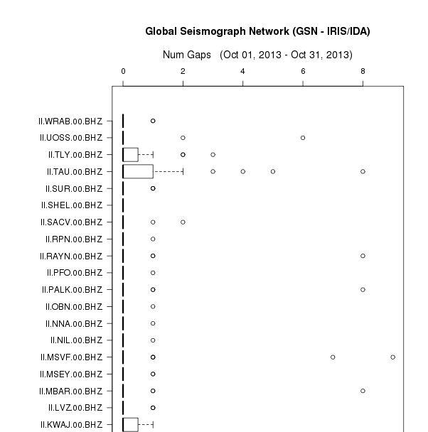
MUSTANG Quality Control System statistical distribution of a given metric

