Slide 1
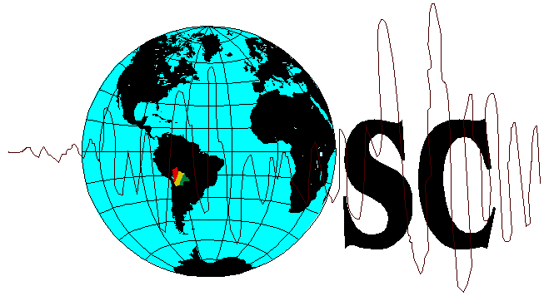
Observatorio San Calixto
Bolivia
The Bolivian Seismic Network
The present and The Future
Billy Edson Burgoa Rosso
Foz de Iguassu, Brazil
August 2010

Slide 2
Summary
The Current Bolivian Seismic Network.
The Seismic Stations of The Current Bolivian Seismic Network.
Data Transmission from The Seismic Stations to Data Center
The New Seismic Stations
The New Acquisition System and Waveform Analysis System

Slide 3
The Current Bolivian Seismic Network
5 short period seismic stations vertical component.
1 short period seismic station three component.
1 Short and Long Period Seismic Station three component.
1 Broad Band three component and 1 Short Period Vertical Component Seismic Station.

Slide 4
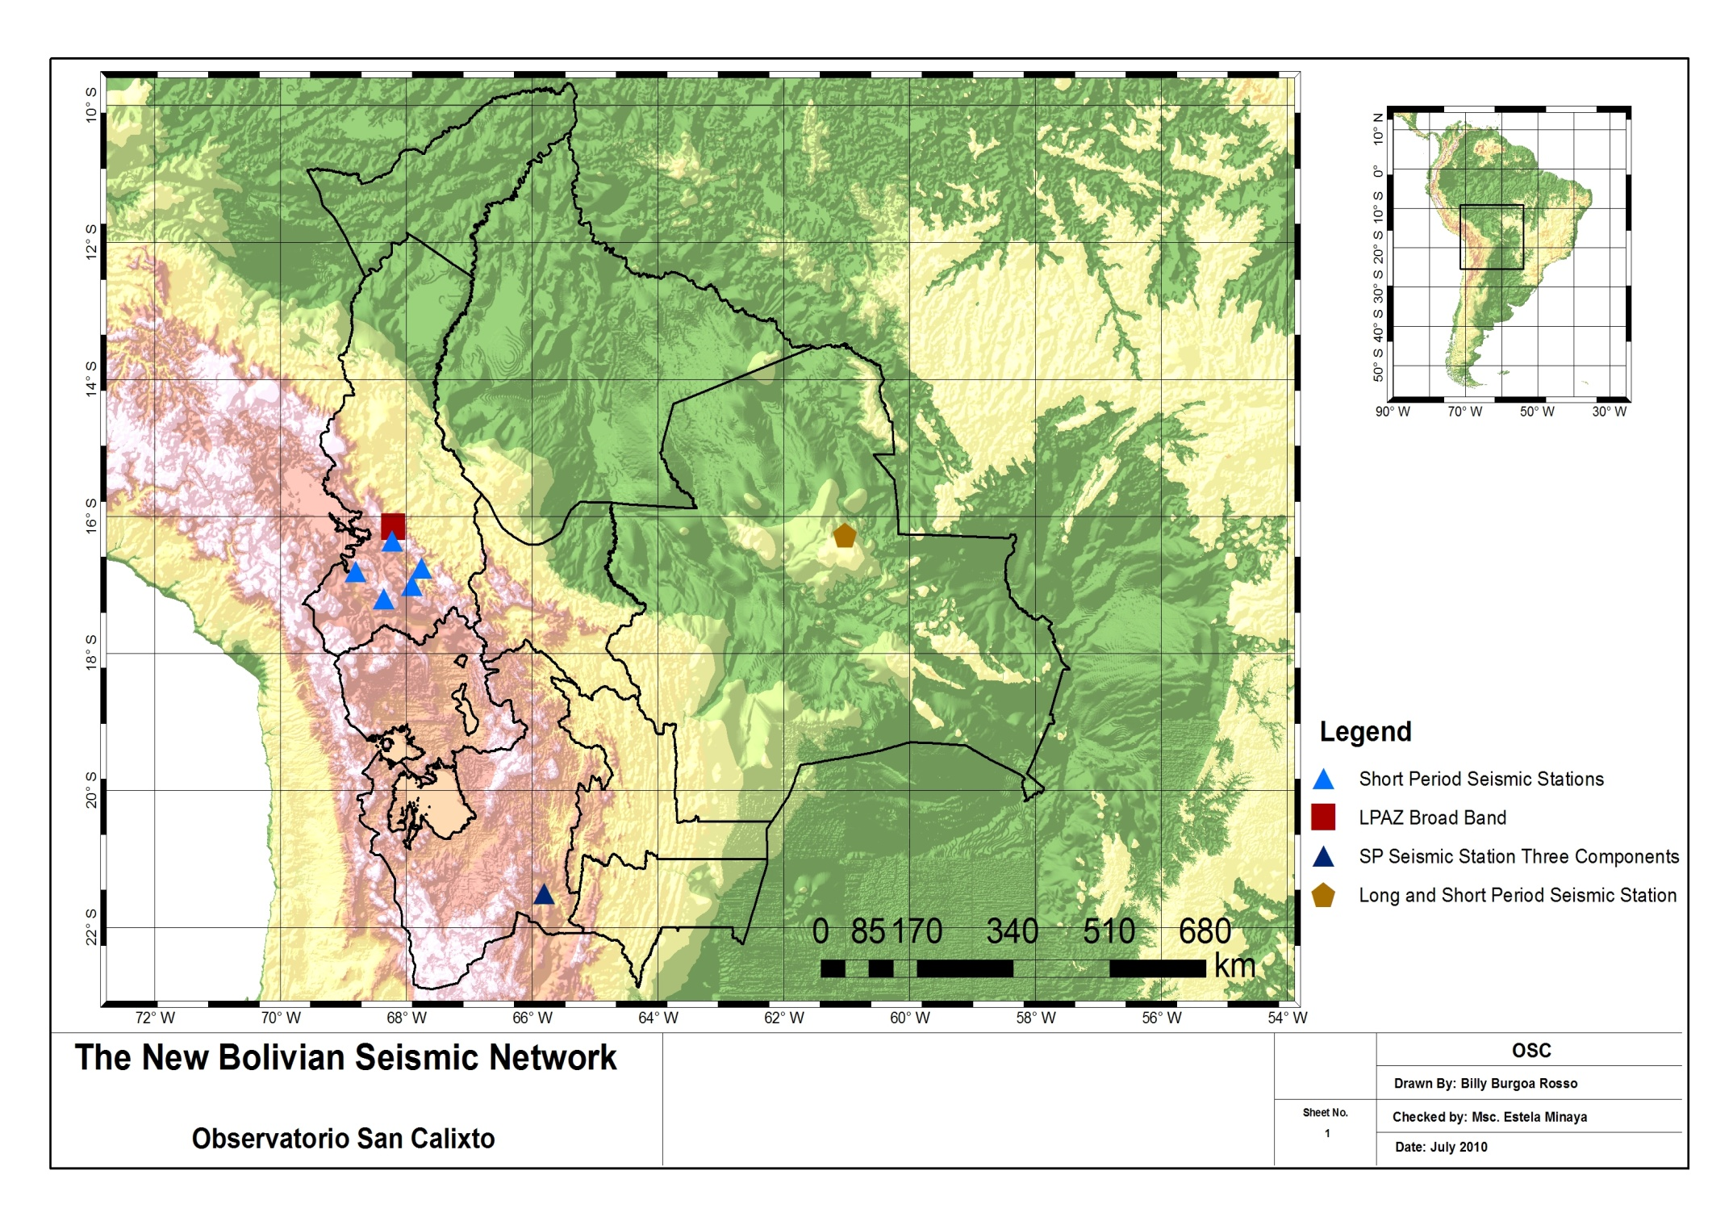

Slide 5
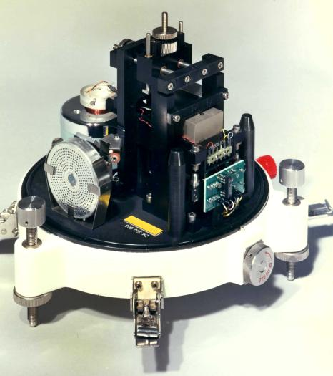
The Seismic Sensors
ZM500 Seismometer
Made by DASE, France
Short Period (1s)
Sensitivity:
2250 V.m-1.s-1
Vertical
a resolution of about 1 Å/s in the 0.1-100 Hz band
Analogic Network (5 stations)
Digital Stations MOC and SIV

Slide 6
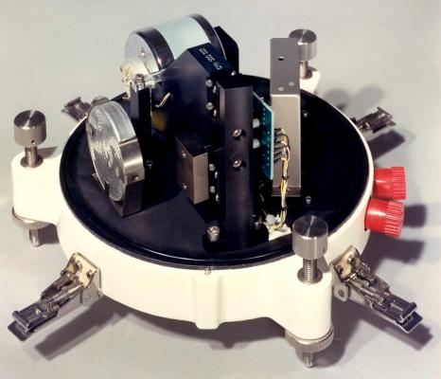
HM500 Seismometer
Short Period (1s)
Sensitivity :
2250 V.m⁻¹.s⁻¹
Horizontal
Digital Stations MOC and SIV

Slide 7
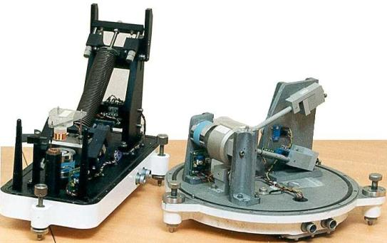
LPZA-12s y LPHA-12s
- DASE Force Balance Seismometer.
Long Period, Natural Period 12s.
Sensitivity as seismometer:
2533 V m⁻¹s
It can work as an accelerometer (below seismometer’s natura frequency)
> 300 000 V.m⁻¹.s²
-
Digital Station SIV

Slide 8
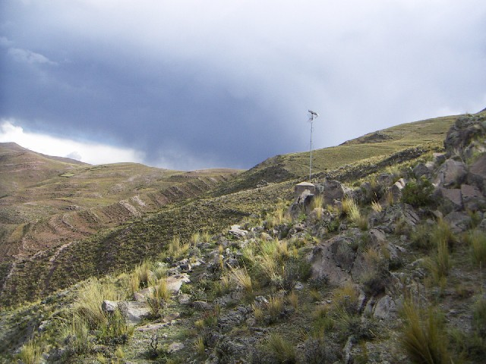
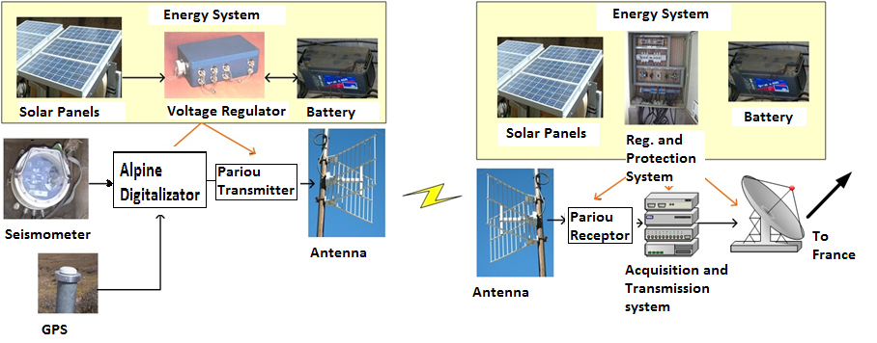
Transmission System from the seismic stations to data center

Slide 9
The Acquisition System and Waveform Format
The Waveform format is FONYX, a French format that is used by the OPALES Acquisition and waveform analysis system

Slide 10
The New Seismic Station
10 Short Period Seismic Stations Three Components
8 Broad Band Seismic Stations
2 Mobile Seismic Stations
3 Accelerometers

Slide 11
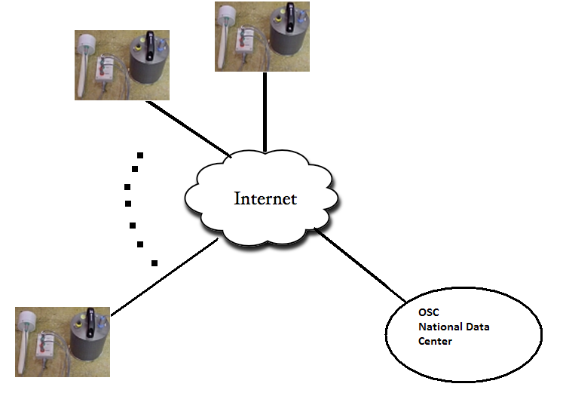
The Acquisition System and Waveform System Analysis
Earthworm (Linux Server)
Autolocation System Earthworm and EW-SEISAN in test, We need your Advice :)
The Waveform Analysis in SEISAN

Slide 13
Thank very much for your attention and thank you for the invitation to this workshop

