Slide 1
Updating SEED Responses in PDCC After Calibration

Slide 2
SEED Fields to Update
Sensitivity:
Sensor gain (Stage 1, Blockette 58)
Total sensitivity (Stage 0, Blockette 58)
The total sensitivity for a channel should be the product of the stage gains (if the frequencies of the stage gains are the same).

Slide 3
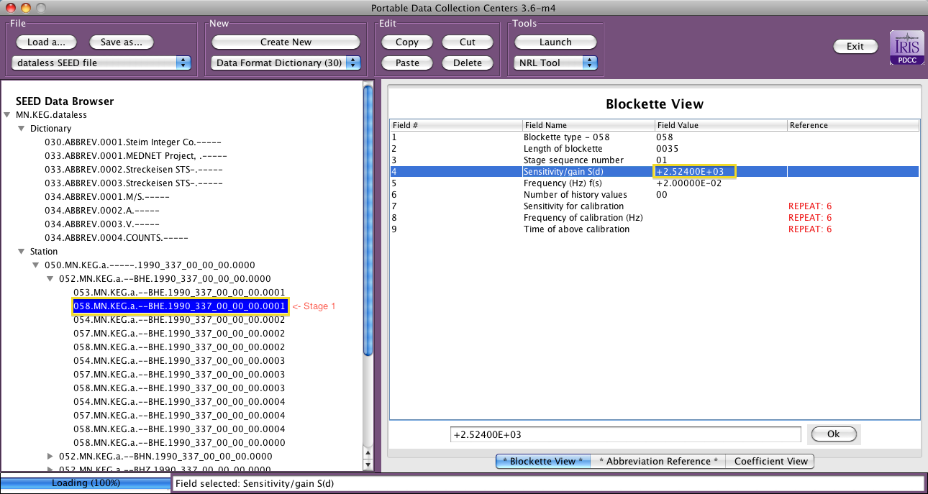
Changing the Sensor Gain

Slide 4
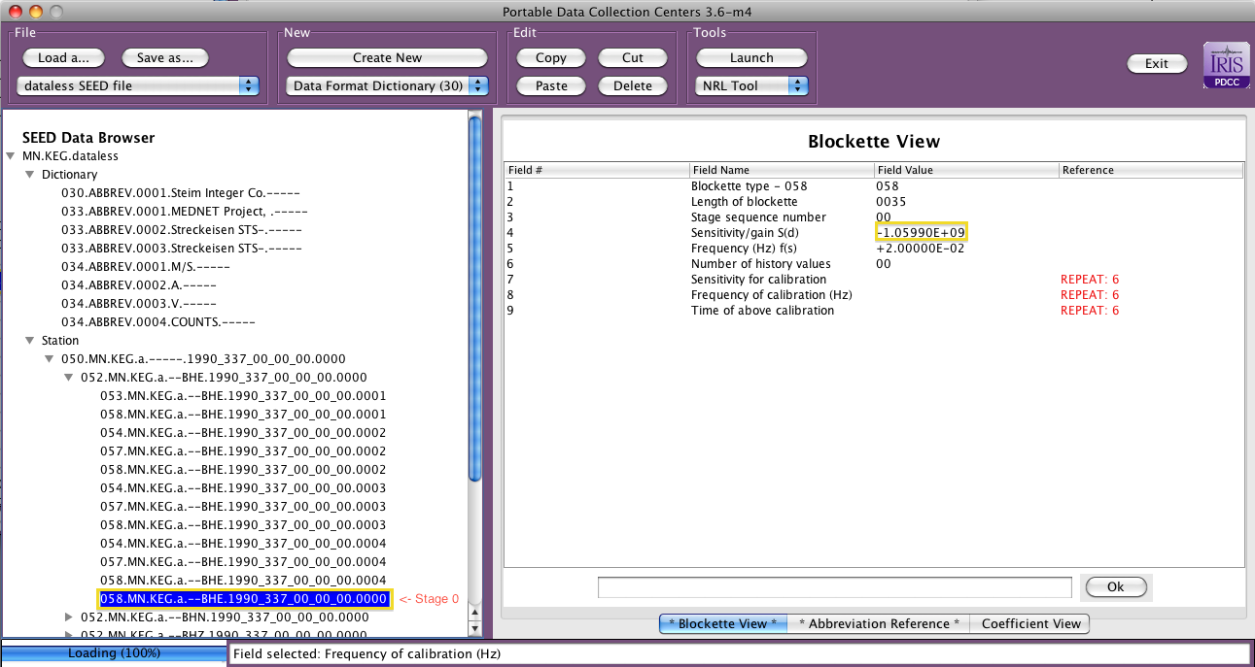
Changing the Total Sensitivity

