Slide 1
Updating SEED Responses in PDCC After Calibration & Input of columnar text into PDCC

Slide 2
SEED Fields to Update
Sensitivity:
Sensor gain (Stage 1, Blockette 58)
Total sensitivity (Stage 0, Blockette 58)
Frequency of gain & sensitivity
The total sensitivity for a channel should be the product of the stage gains (if the frequencies of the stage gains are the same).

Slide 3
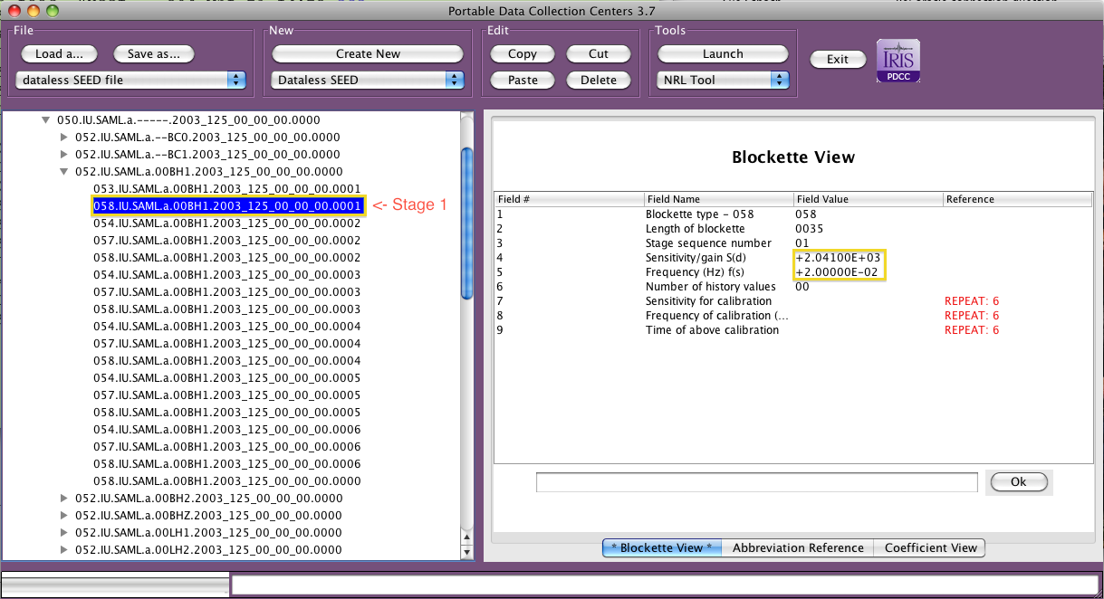
Changing the Sensor Gain

Slide 4
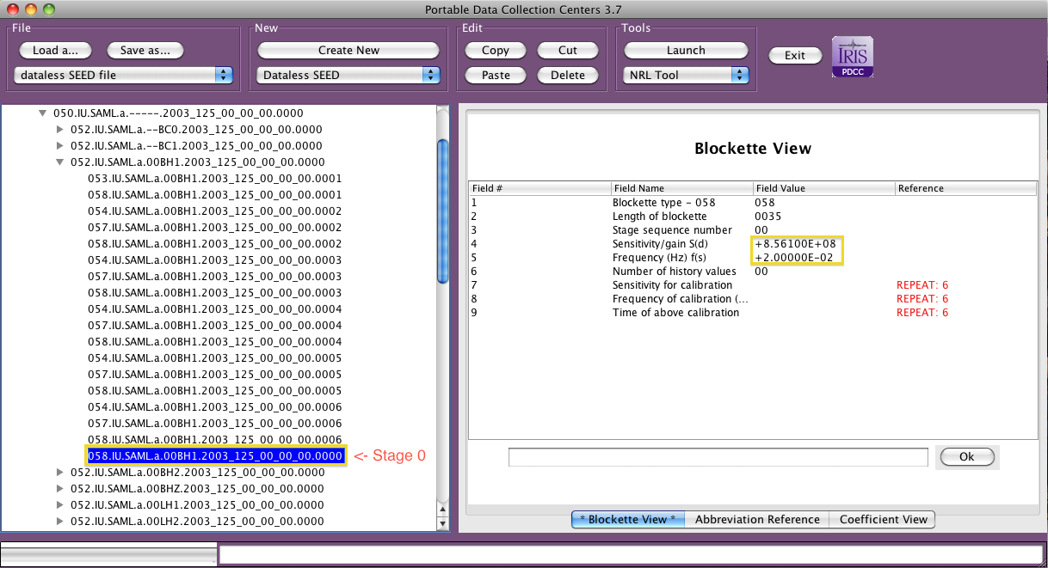
Changing the Total Sensitivity

Slide 5
Importing columnar text for repeat fields
PDCC can import columnar data digital filter coefficients from simple text files.
Alternatively large lists of digital filter coefficients can be imported via RESP or the NRL Tool.

Slide 6
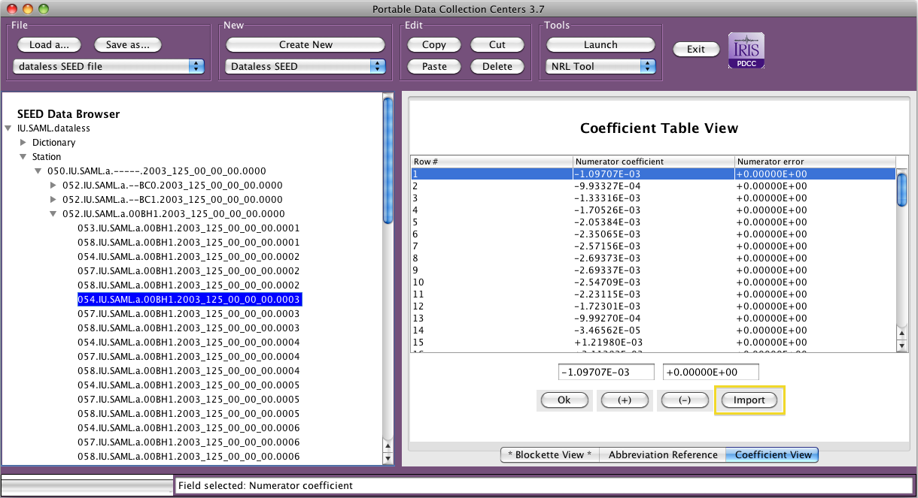
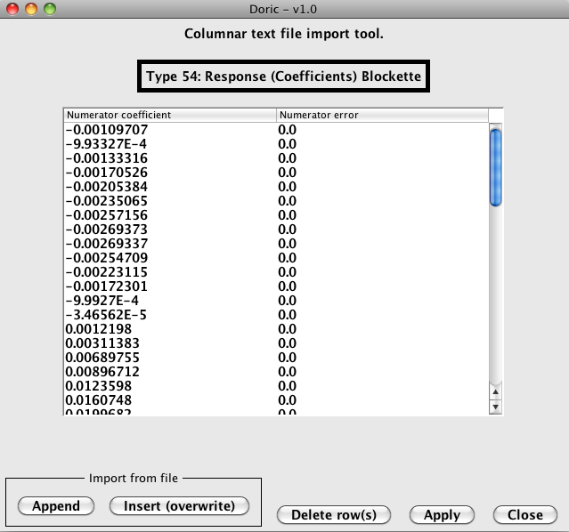
Importing columnar text

