Slide 1
Seismic networks in South Korea

Slide 2
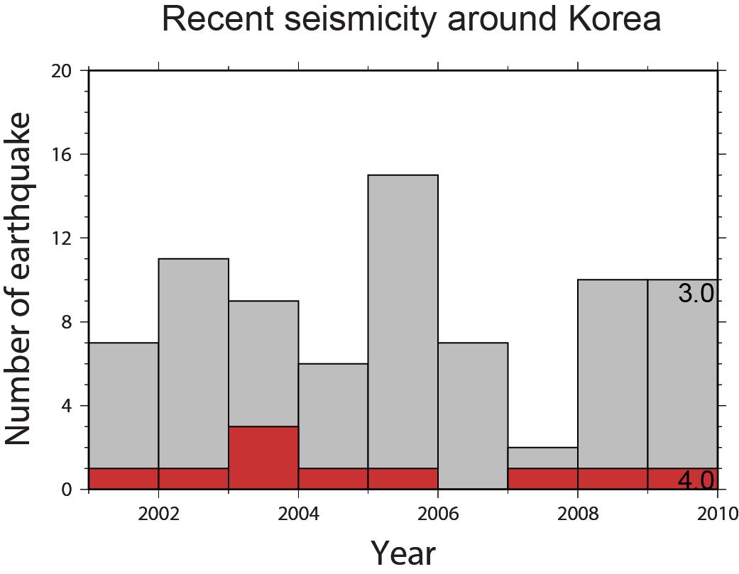
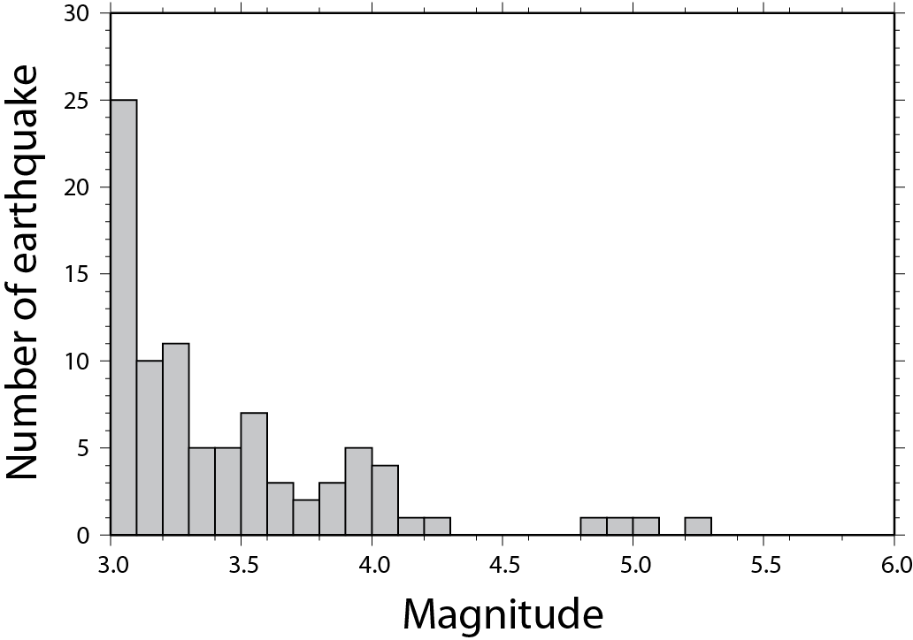
Recent Seismicity in Korea

Slide 3
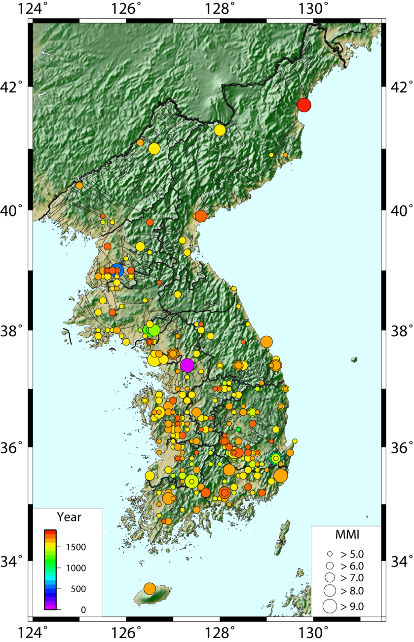
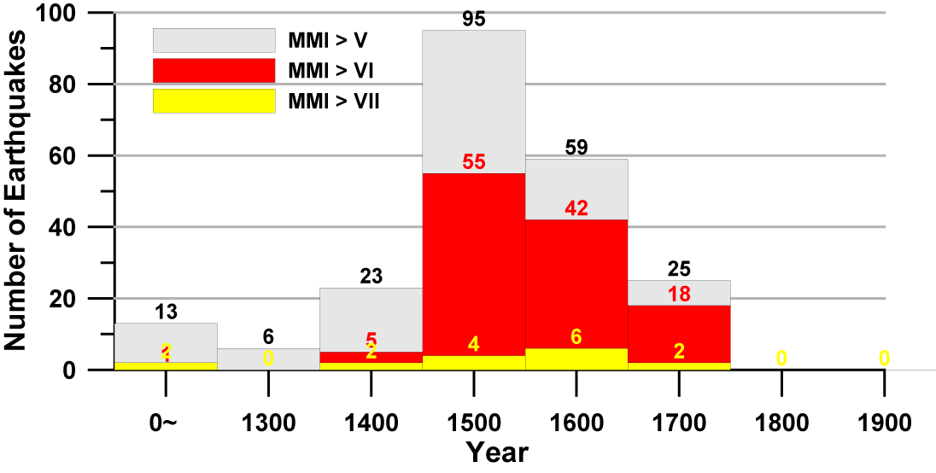
Historical Seismicity in Korea

Slide 4
KMA (Korea Meteorological Administration)
2011/01/01
- 113 seismic stations are operating
STS-1 + ES-T
1
STS-2 + ES-T
11
CMG3TB + ES-DH
7
SS-1/CMG40T + ES-T
31
OBS
1
ES-T
62
(Digitizers: Q4120, Q730, Q330)
(from KMA)

Slide 5
KIGAM (Korea Institute of Geology and Mineral Resources)
CMG3TB + ES-DH
10
STS-2 + ES-T
9
STS-1 + ES-T
1
CMG 40T(1s)
12
(Q4120, Q330, CMG DM-24)
(from KIGAM)

Slide 6
KISS (Korea Integrated Seismic System)
Stations
University
Buffer
KISS
KISS
Industries
KISS Server
(Korea Integrated Seismic System)
KMA
Antelop
Others
Stations
Stations
Buffer
KISS
Buffer
KISS
KEMS
KEMS
KIGAM
KOGAS
Stations
Stations
Buffer
KISS
Buffer
KISS
KEMS
KEMS
Stations
KINS
KTX
Buffer
KISS
KEMS
KEPRI
(from KIGAM)

