Slide 1
Station Installation
Issues and Techniques
IRIS Metadata Workshop
January 9, 2012
Peter Davis
Project IDA
Scripps Institution of Oceanography
University of California, San Diego

Slide 2
Topics to be addressed:
  Sources of seismic noise
  Site selection criteria
  Installation techniques

Slide 3
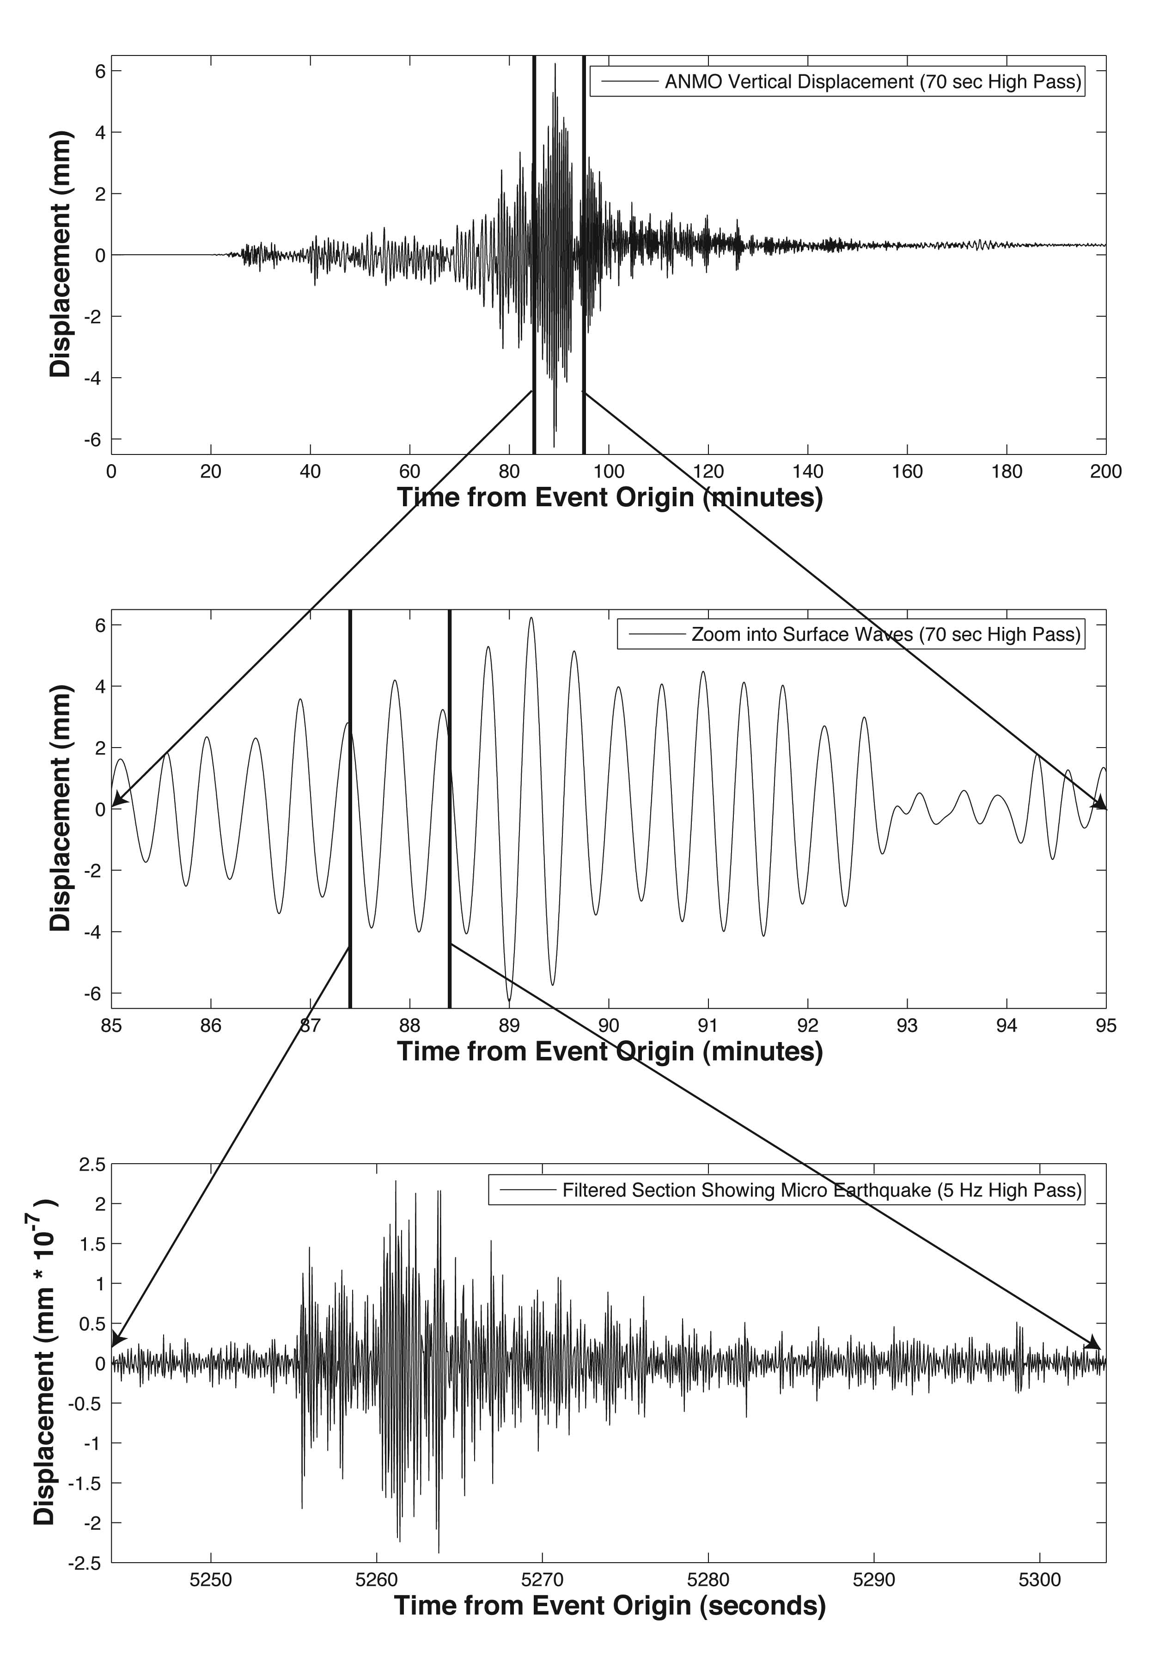
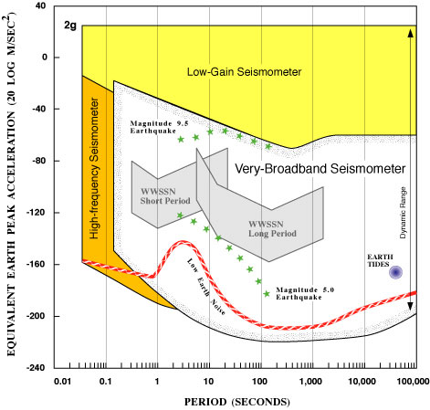
Bandwidth +
Dynamic Range of modern sensors
M~9.2 Sumatra
M~0.5 local
Notes:
Example of goals
Recollection about 20 sps data
about 1 Tb/yr logged, 18 Tb/yr usage

Slide 4
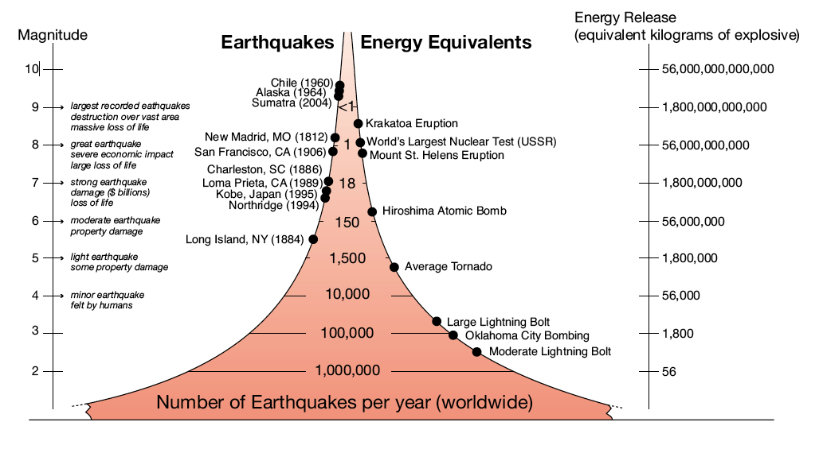
Size of Earthquakes

Slide 5
Sources of noise:
  Ocean waves
  Temperature changes
  Atmospheric pressure changes
  Sensor instability

Slide 6
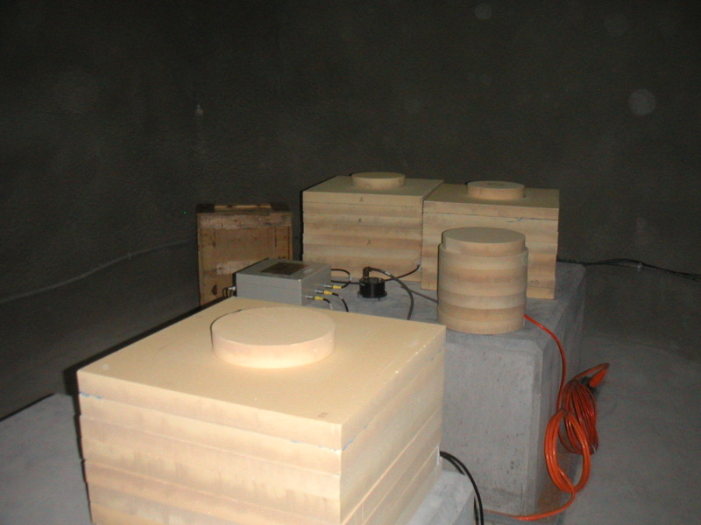
Temperature effects:
Beyond 250 seconds period, temperature becomes very important
Temperature dependence varies with the model of seismometer
Temperature changes of 1e⁻⁶ ºC are important
Foam thermal insulation at GSN station in the UAE

Slide 7
Effect of changes in barometric pressure:
  buoyancy of the seismometer mass
  Newtonian attraction of air mass

Slide 8
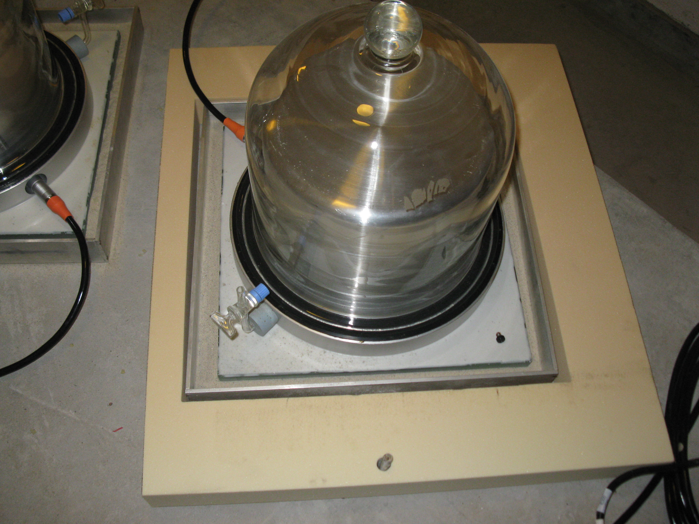
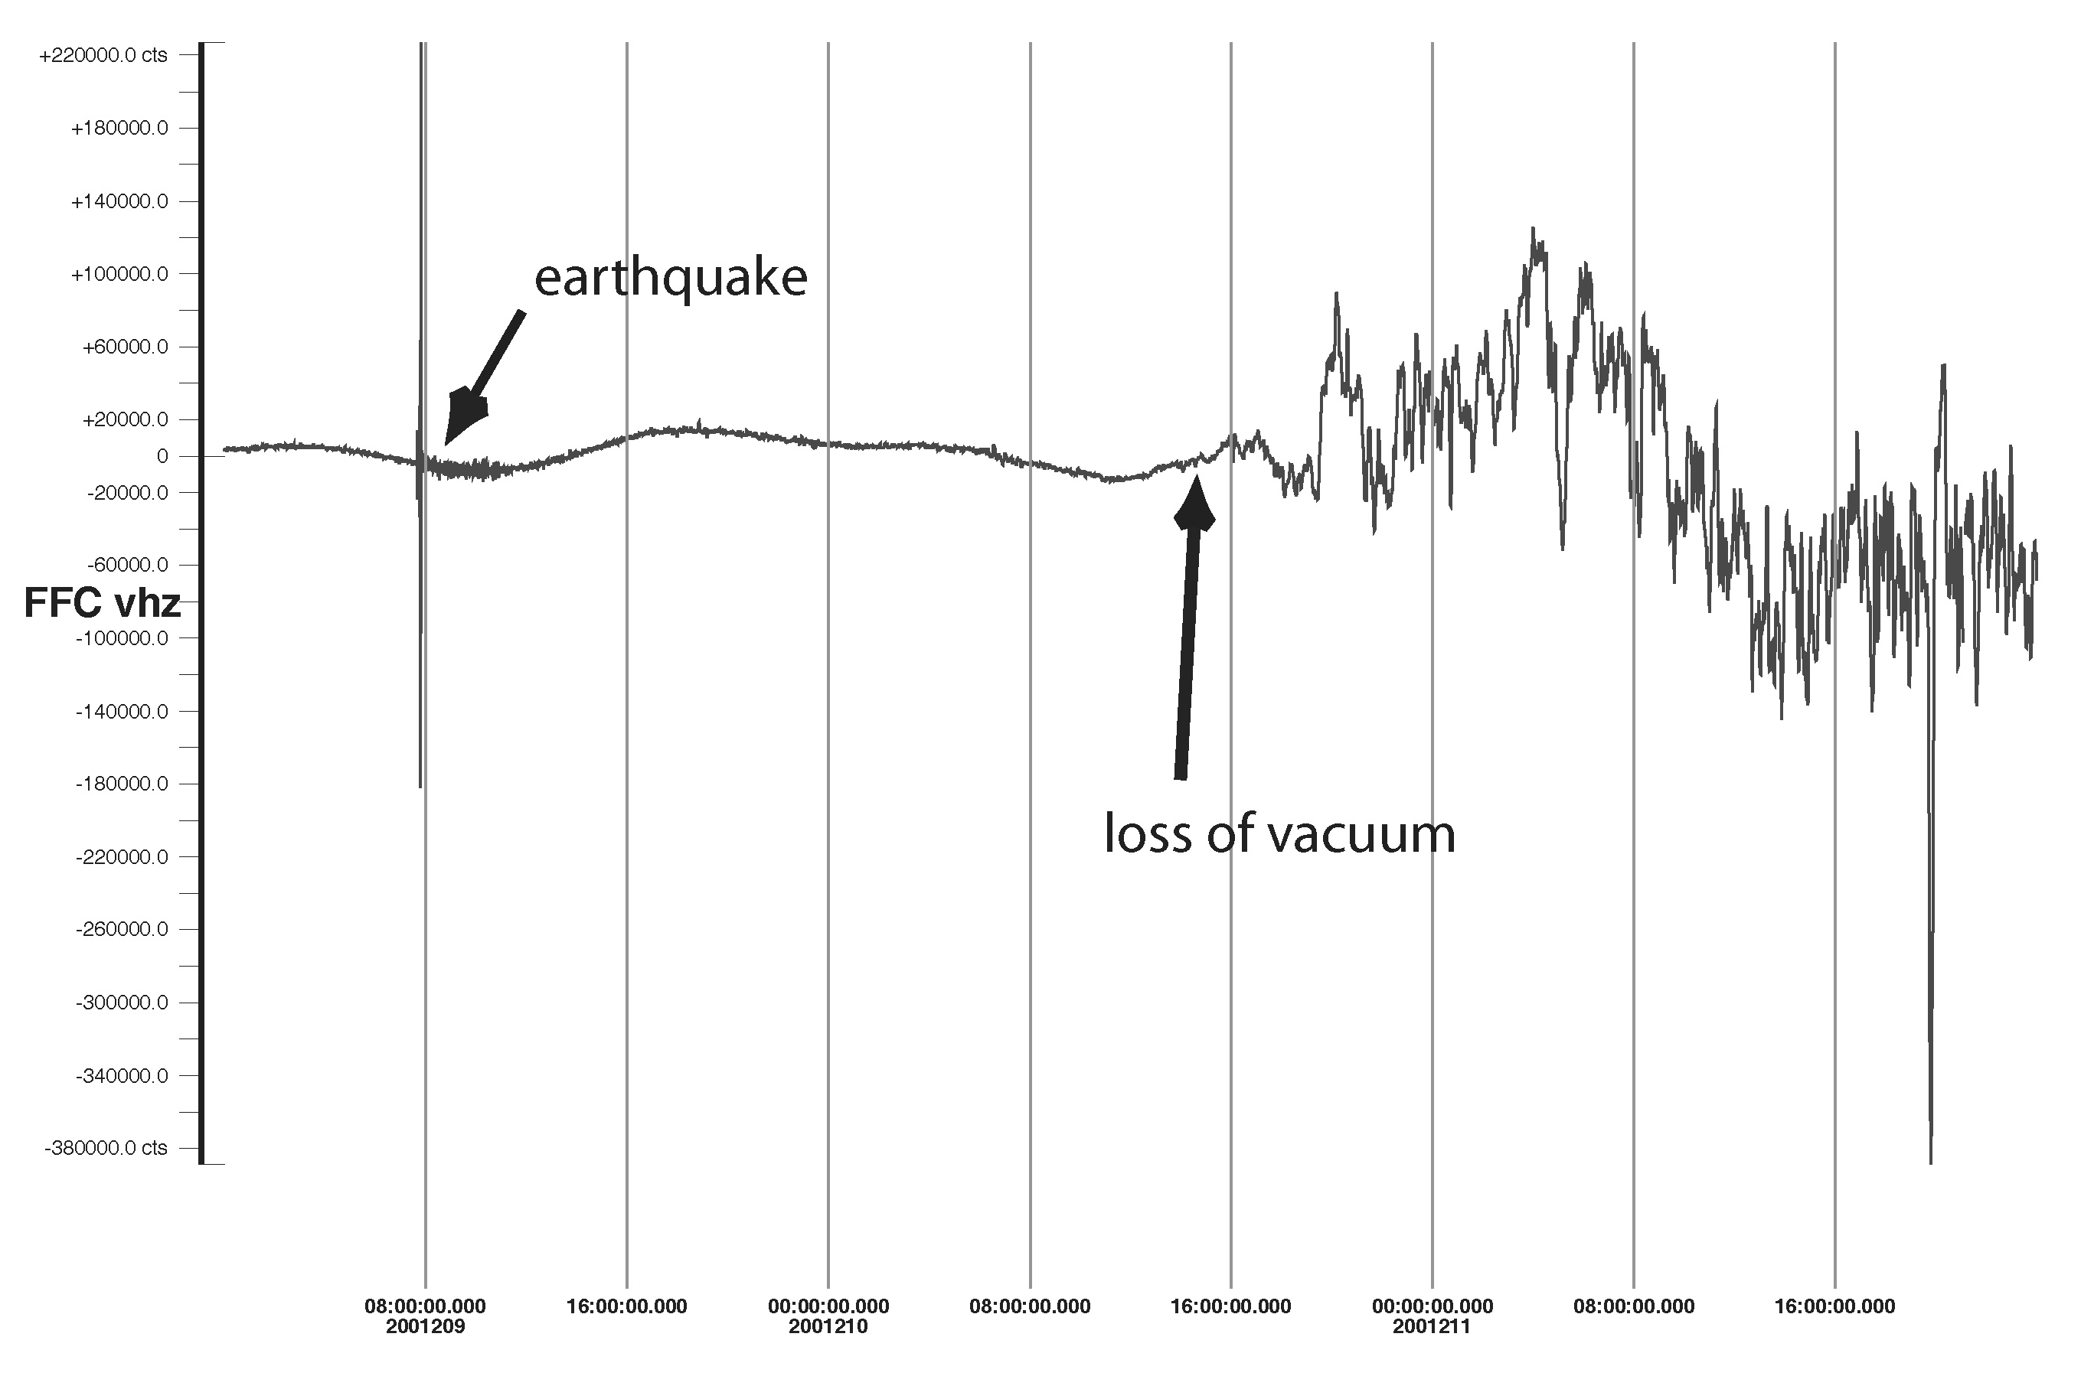
STS1 placed under vacuum at GSN station SUR
Vacuum lost!

Slide 9
Barometer data used to remove effect of air pressure changes in seismic data:
(Zuern and Widmer, 1995)

Slide 10
Effect of changes in barometric pressure:
  buoyancy of the seismometer mass
  Newtonian attraction of air mass
  loading effect of air mass

Slide 11
Change of air pressure in a cavity
Symmetric Case

Slide 12
Change of air pressure in a cavity
Asymmetric Case

Slide 13
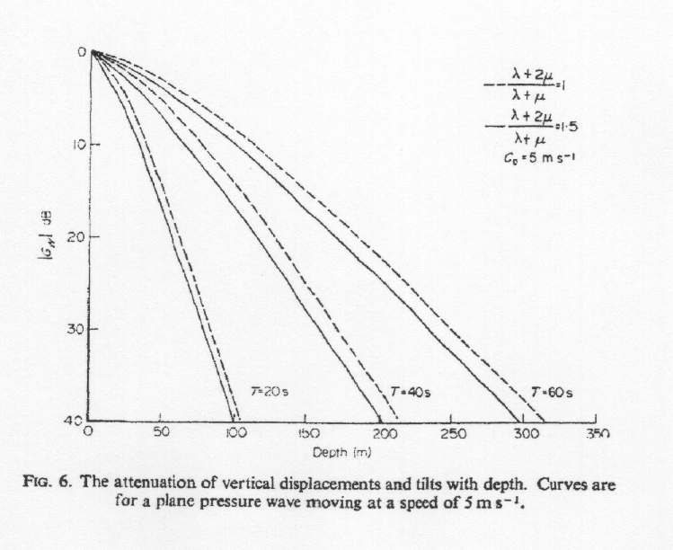
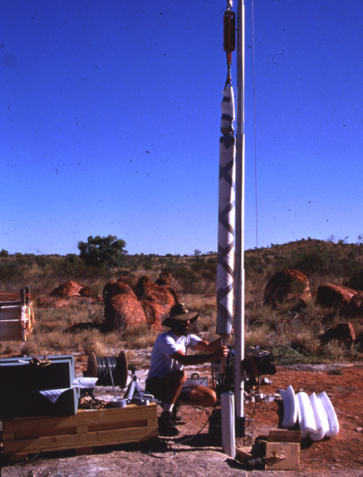
(Sorrels, 1971)
KS-54000 borehole seismometer installed at WRAB GSN station

Slide 14
Examples of human-induced noise:
  Vehicular traffic (cars, trucks, trains)
  Repeating machinery (pumps, generators)

Slide 15
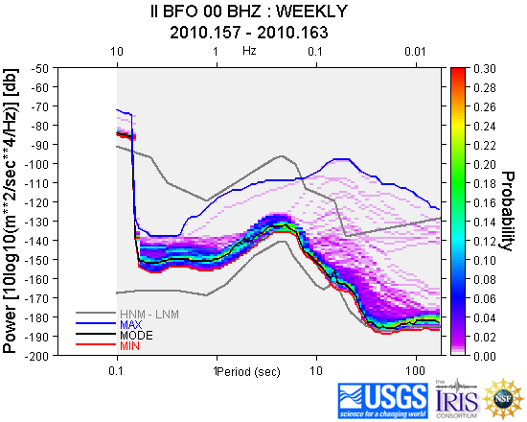
IRIS DMC provides tools to analyze data
http://www.iris.edu/servlet/quackquery/

Slide 16
Goal of a good installation:
  accurate recording of seismic signals
  low background noise
  ease of servicing
  stability

Slide 17
Characteristics of a good site:
  access to bedrock
    The harder the rock, the better

Slide 18
Characteristics of a good site:
  access to bedrock
  far from human-induced noise sources

Slide 19
Characteristics of a good site:
  access to bedrock
  far from human-induced noise sources
  clear of trees or towers

Slide 20
Suggested clearances:
  Hydroelectric turbines – 10 km
  Frequent train traffic – 3 km
  Irrigation pumping stations – 2 km
  Large machinery – 1-2 km

Slide 21
Characteristics of a good site:
  access to bedrock
  far from human-induced noise sources
  clear of trees or towers
  good drainage

Slide 22
Characteristics of a good site:
  access to bedrock
  far from human-induced noise sources
  clear of trees or towers
  good drainage
  secure

Slide 23
Some examples of installation designs:
  GSN underground vault
  STS2 enclosure in a vault
  High frequency sensor deployed at a temporary site
  Broadband sensor vault
  The Earthscope Transportable Array

Slide 24
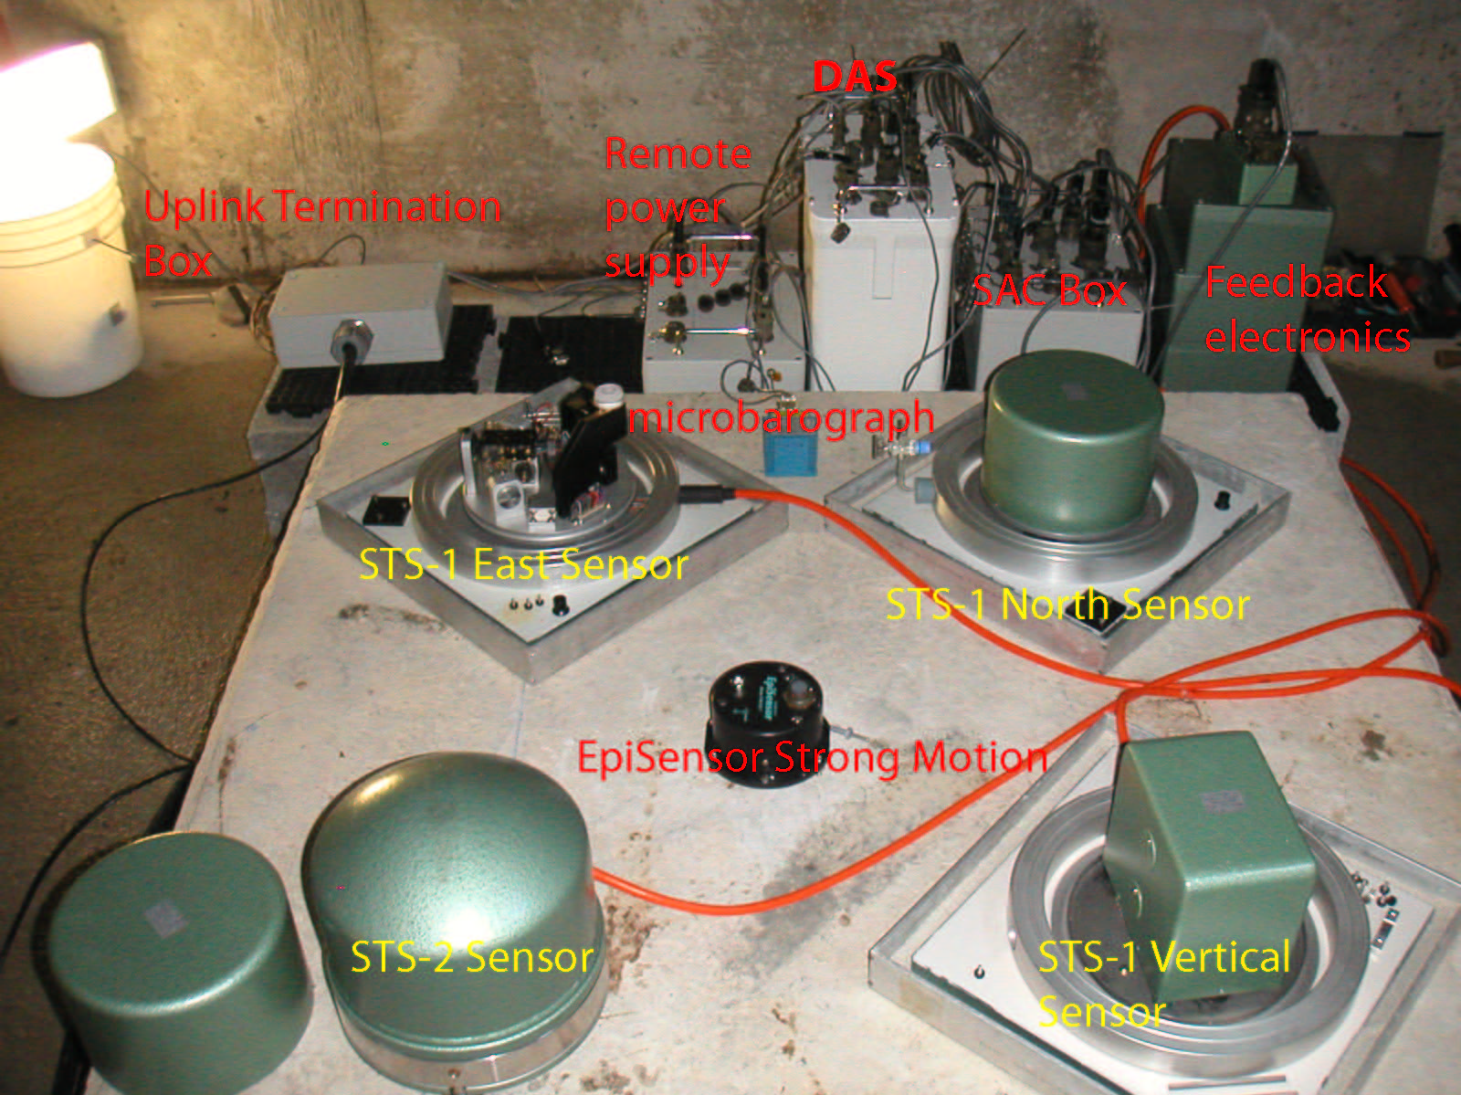
A GSN underground vault

Slide 25
GSN installation in a tunnel

Slide 26
STS2 installation design for the German Regional Seismographic Network (GRSN).
Courtesy E. Wielandt.

Slide 27
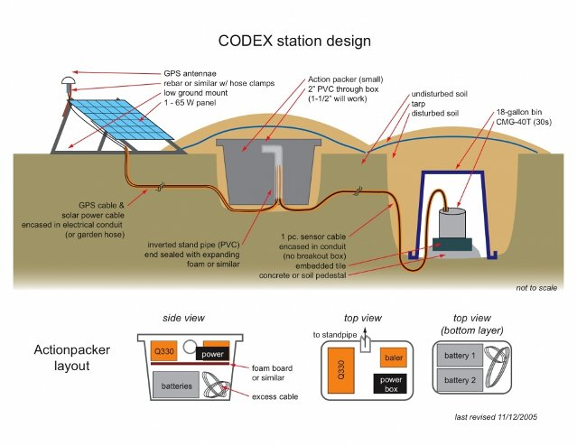
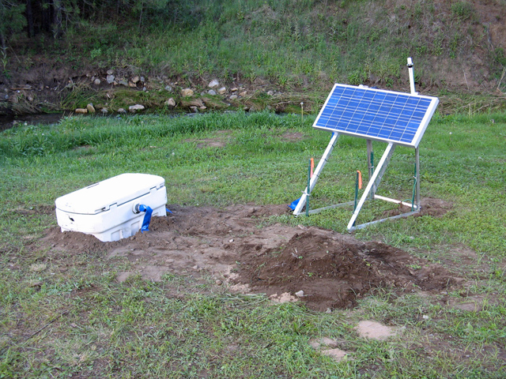
Codex design courtesy M. West.

Slide 28
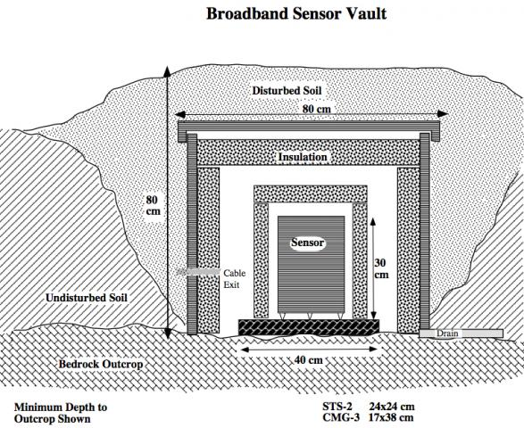

Slide 29
Field Station Design
Transportable Array
Courtesy R. Busby

Slide 30
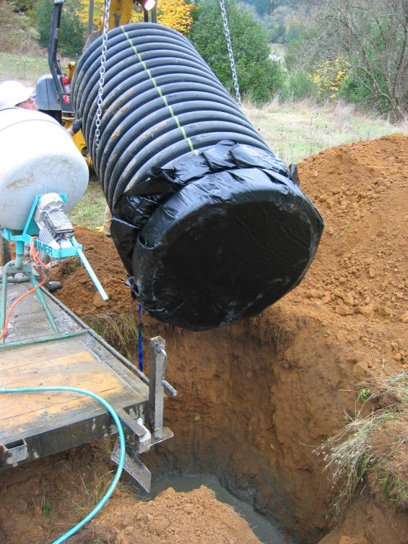
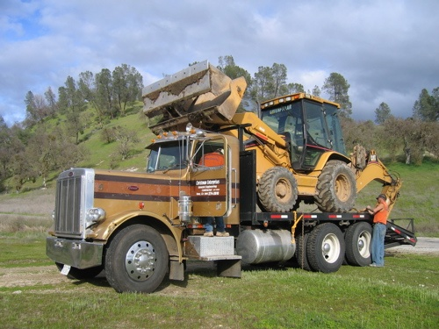
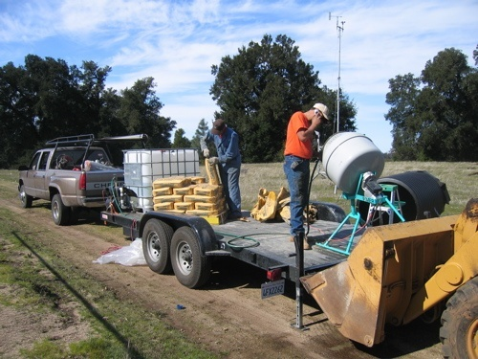
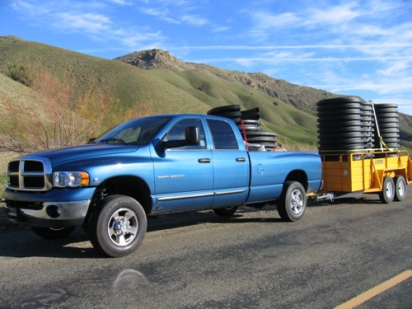
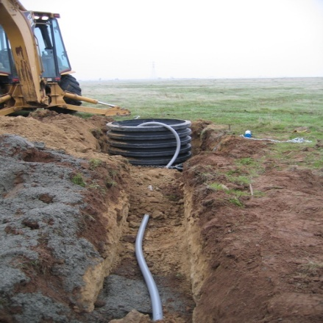
Transportable Array
Current method; custom trailer with water tank, room for cement bags, and onboard mixer
Have truck, will travel
42” dia. pipe set into 7’ deep pit with concrete on either side of rubber membrane
Flex conduit was replaced with straight sticks reducing field time significantly. Wires are pulled during construction phase
Using 3 vehicles, 1 trailers, 1 backhoe, and three people, it is feasible to construct 4 sites in 5 days

Slide 31
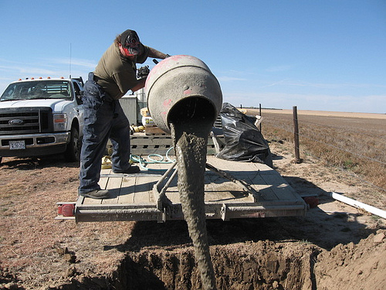
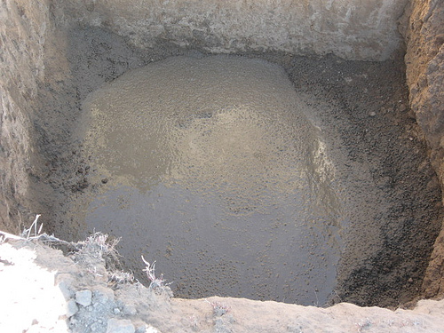
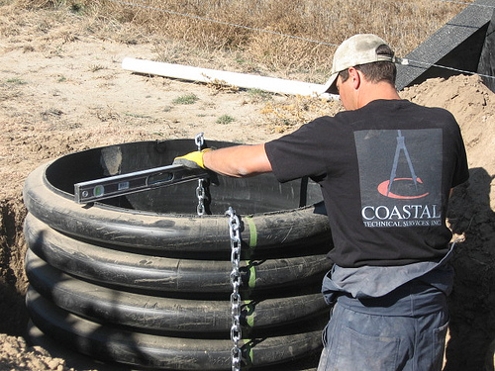
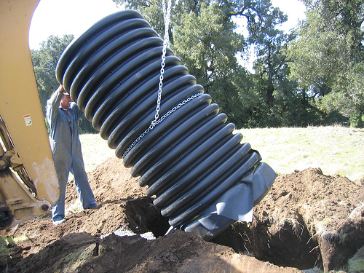
Transportable Array
Concrete pad, vault conduit installation

Slide 32
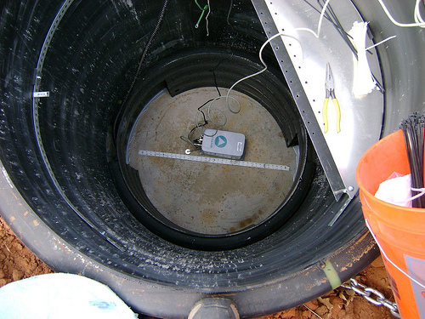
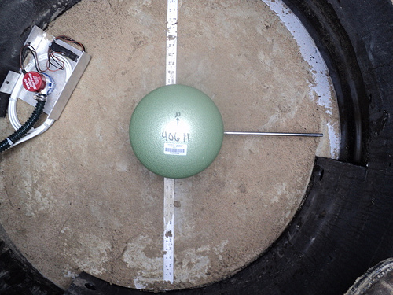
Transportable Array
Gyrocompass used to orient guide tape.
Alignment rod used orient sensor.

Slide 33
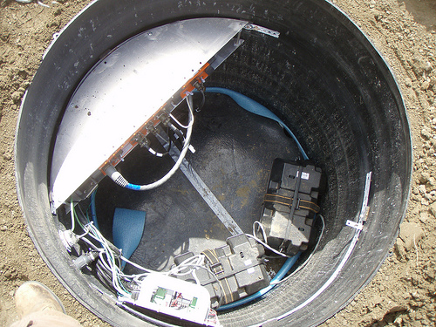
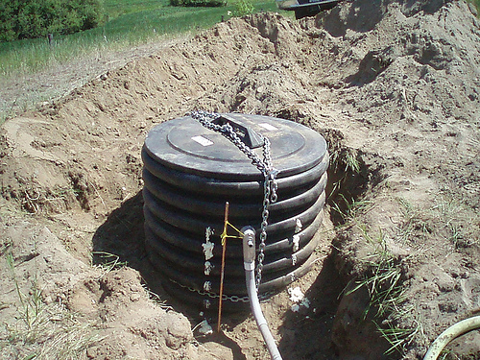
Transportable Array
Insulation separates sensor from system electronics
Cover provides security for equipment.

Slide 34
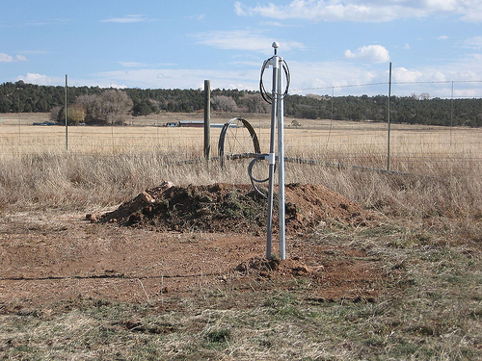
Transportable Array
Soil provides additional thermal insulation.

Slide 35
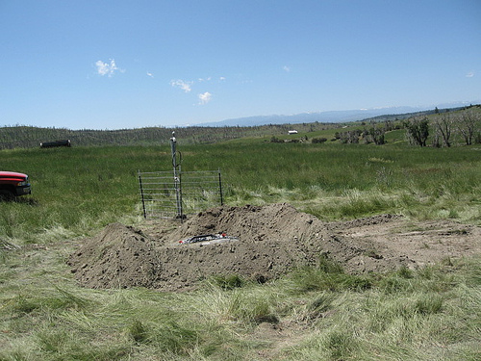
Transportable Array
This soil will be moved to cover the vault.

Slide 36
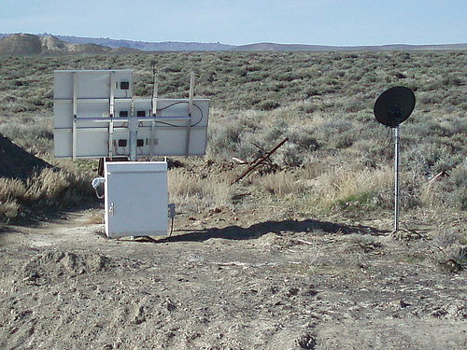
Transportable Array
The vault is completely covered. These are solar panels and a cell phone antenna for telemetry.

Slide 37
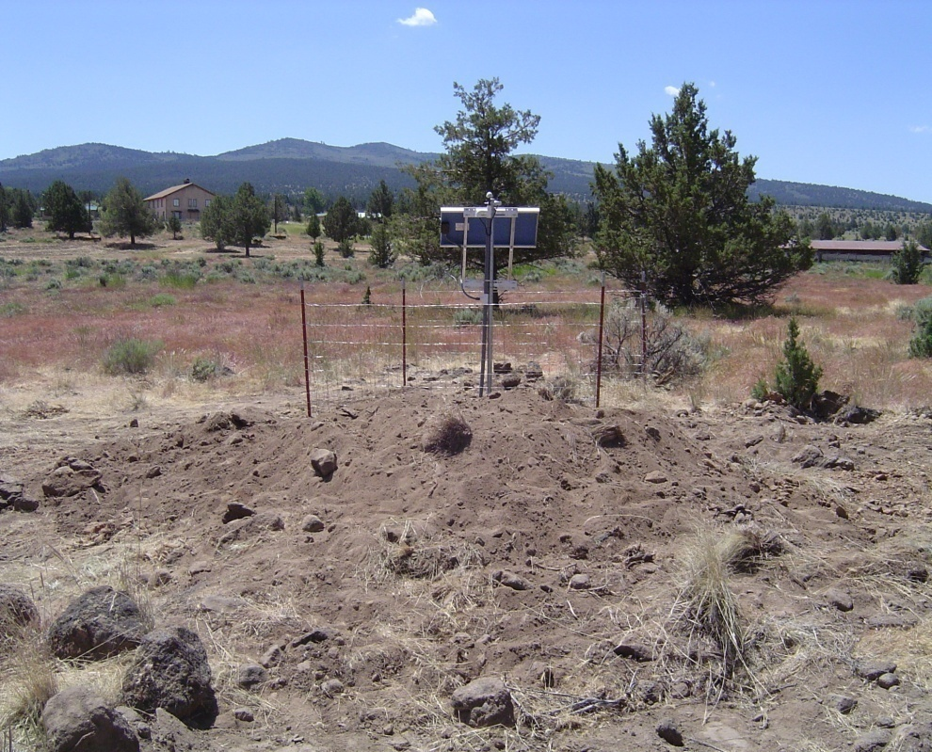
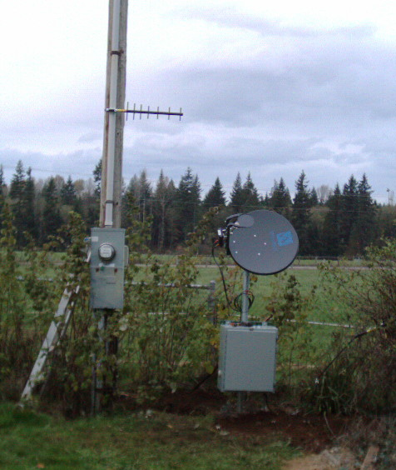
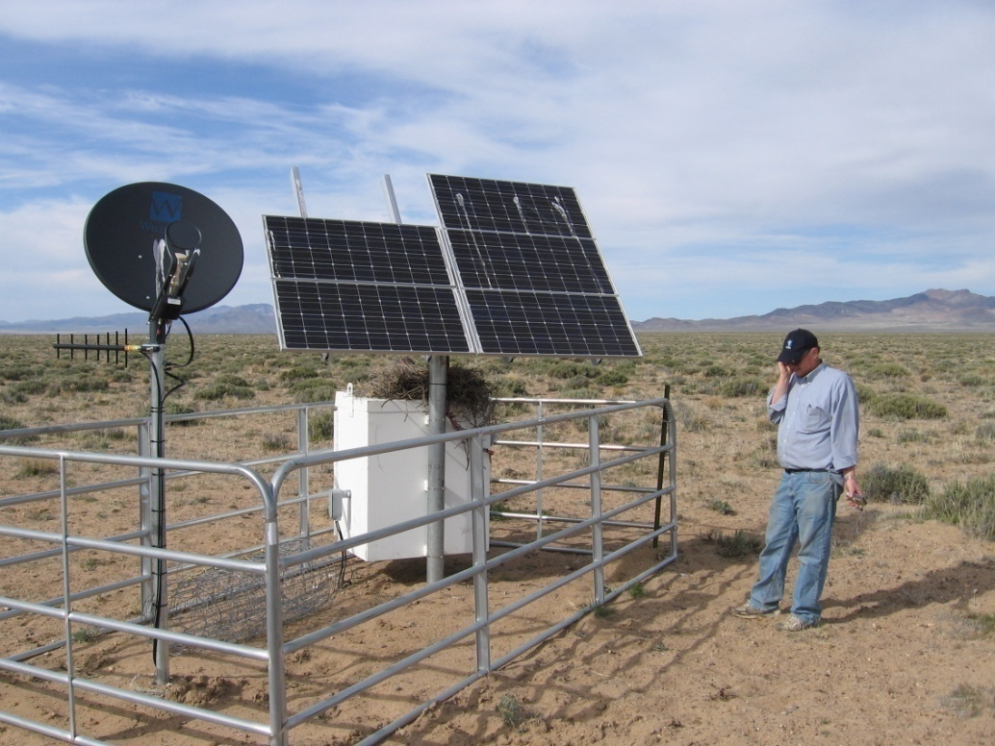
Modularity in Communications
Cellular Modem
AC VSAT or BB provider
Solar VSAT

Slide 38
Please remember:
  place seismometer on bedrock
  create stable temperatures
  avoid human noise sources
  avoid trees or towers
  guard against flooding
  consider security of installation

