Slide 1
Thursday January 12, 15:30

Slide 2
SeisGram2k and SeedLink Data Access: Real-time data
Rick Benson
IRIS DMC

Slide 3
Get SG2K from Anthony Lomax’s site:
http://alomax.free.fr/seisgram/SeisGram2K.html
Also on your USB stick under “SG2K” directory/folder

Slide 4
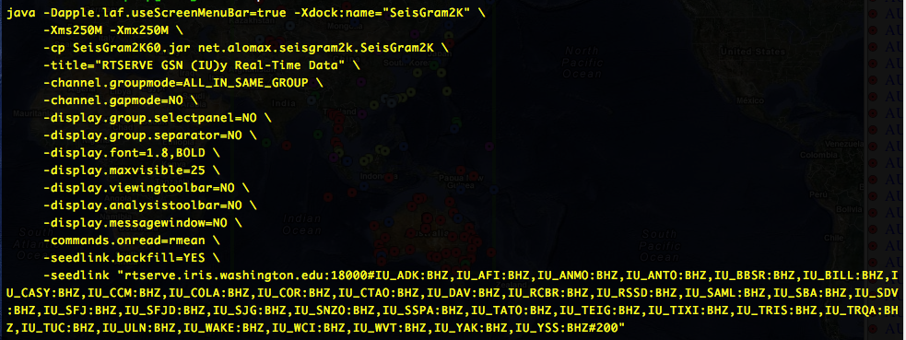
Setting up the display
First follow the script called run.IU.rtserve on your USB stick in the SG2K directory.
Note the rtserve.iris.washington.edu:18000 machine

Slide 5
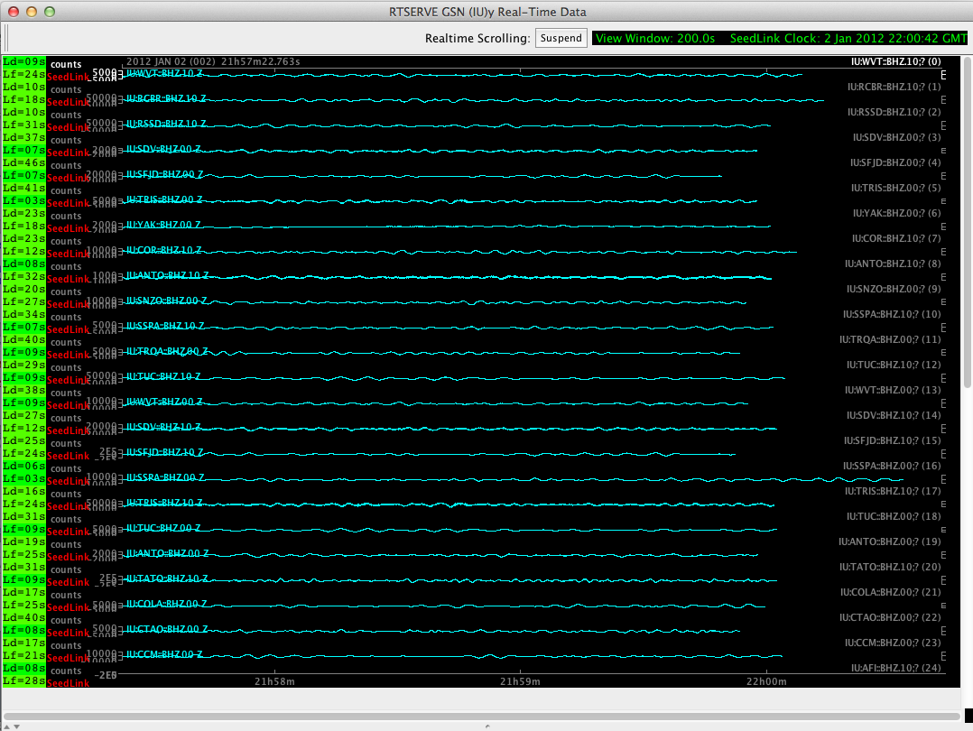
Type this command: ./run.IU.rtserve and view 200 secs of data as it scrolls:

Slide 6
Real-Time Data from IRIS DMC
The DMC runs a publicly accessible SeedLink server on the following host and port:
host: rtserve.iris.washington.edu port: 18000 (default SeedLink port)
All open data that the DMC receives in real-time is available via this SeedLink server.
Data arriving at the DMC more than 48 hours behind real-time are not exported via SeedLink.
Usage Restrictions Users are welcome to any data available via the server as long as client actions do not
inhibit our capability to deliver data to other users.
To view all currently available real-time stations:
http://www.iris.edu/mda/_REALTIME
http://www.iris.edu/gmap/_REALTIME
Currently 2208 stations (On Jan 2, 2012) and >22,000 chans

Slide 7
SeedLink Access from DMC:
http://www.iris.edu/data/dmc-seedlink.htm
Available SoftwareThe following software is available from the DMC at http://www.iris.edu/pub/programs/SeedLink/:
libslink - A SeedLink client library written in C.
slink2orb - SeedLink to Antelope ORB client (licensed Antelope libraries are required).
slink2ew - SeedLink to Earthworm client. Windows binaries available.
slarchive - A SeedLink client that writes all received data to the local disk in user defined directory and file structures.
slinktool - Command line SeedLink client useful for data stream inspection and server testing.
ewexport_plugin - An Earthworm export process plugin (data source) for a seedlink server.
orbplugin - An Antelope ORB plugin (data source) for a seedlink server (licensed Antelope libraries are required).
Other SeedLink related software is available (or referenced by) the GEOFON SeisComP website

Slide 8
Protocol Details
The SeedLink protocol can be summarized as a simple, ASCII-based, data selection phase followed by the streaming of data packets from the server. SeedLink packets are composed of a small header followed by a 512-byte Mini-SEED record (data only SEED). The negotiation phase allows the client to request only specified data from the server for each selected data stream. A data stream is defined by a network and station code pair.
By utilizing sequence numbers for each packet in a data stream the SeedLink protocol allows for connections to be resumed, eliminating most data gaps. The ability to resume data streams is primarily dependant on how much data, time-wise, the remote SeedLink has in its buffer.
Special, out-of-band packets created by a seedlink server and recognized by libslink are used to communicate server details to clients and to implement keep-alive packet swapping. These special INFO packets are XML formatted data embedded in Mini-SEED comment records.
The protocol allows for two different modes of data transmission, uni-station and multi-station modes. Uni-station mode operates by transmitting a single data stream (data from a single station) through one network connection. In this mode the data stream does not need to be specified by the client as it is implied by the internet address and port. Multi-station mode operates by transmitting multiplexed data streams (data from multiple stations) through a single network connection. Almost all connections are negotiated as multi-station, even if only a single station is requested; uni-station mode, for most publicly accessible servers is deprecated.
SeedLink was originally created as the transport layer for the SeisComP package developed by GEOFON.

Slide 9
Real-Time mailing list
To improve communication about real time data issues, the DMC manages a real time mailing list. When problems with real time data flow are observed, messages will be posted to this list as the problems are discovered. Solutions to the problems or information regarding resumption of real time data feeds will also be posted to this list.
You can subscribe to this list at http://www.iris.washington.edu/mailman/listinfo/iris-rtfeeds

