Slide 1
The National Seismological Network of Colombia
Geological Service of Colombia
2014

Slide 2
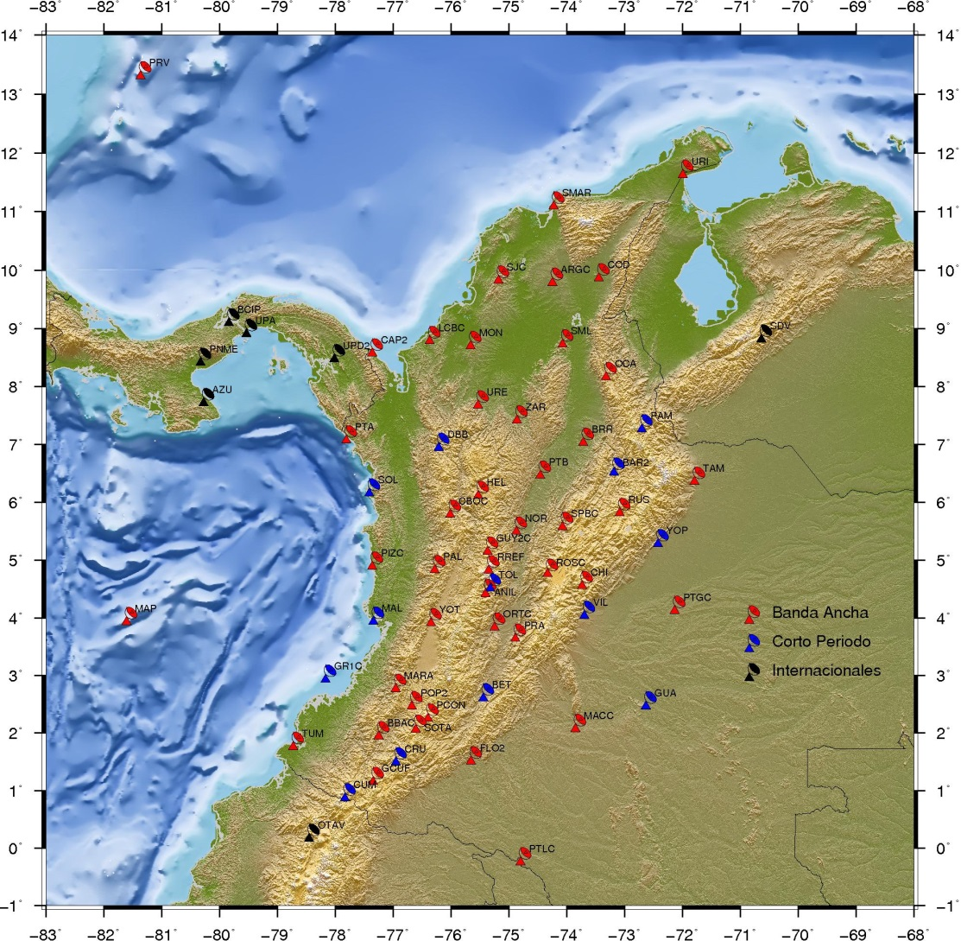
Seismological stations
SGC, RSNC - 2014
Red Sismológica Nacional de Colombia - RSNC

Slide 3
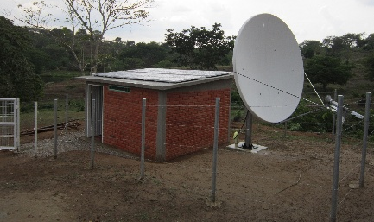
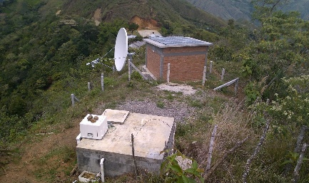
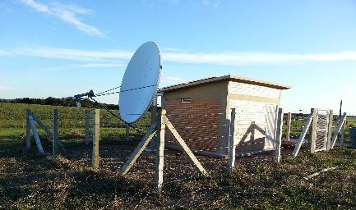
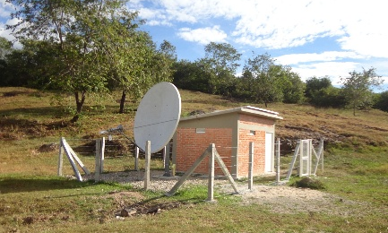
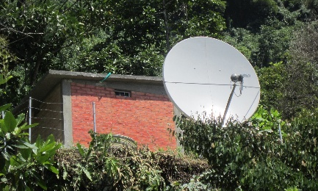
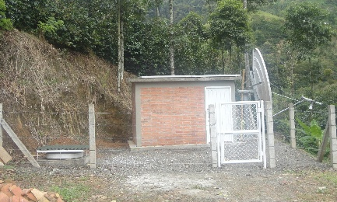
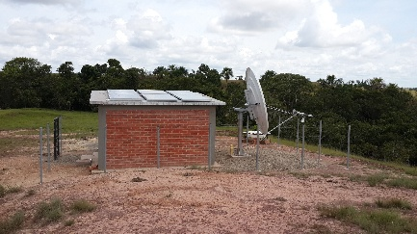
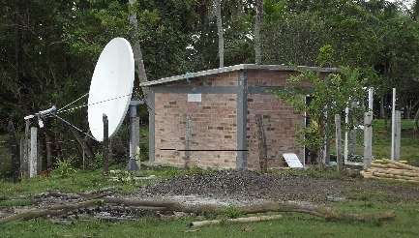
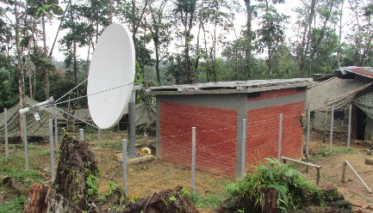
SOME SEISMOLOGICAL STATION FACILITIES
Ariguaní (Magdalena)
Balboa (Cauca)
Macarena (Meta)
Ortega (Tolima)
San Pablo de Borbur (Boyacá)
Ciudad Bolívar (Antioquia)
Puerto Gaitán (Meta)
Los Cordobas (Cordoba)
Pizarro (Chocó)

Slide 4
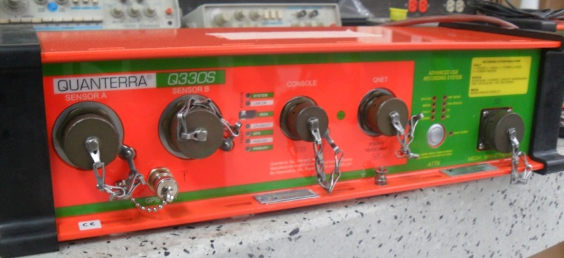
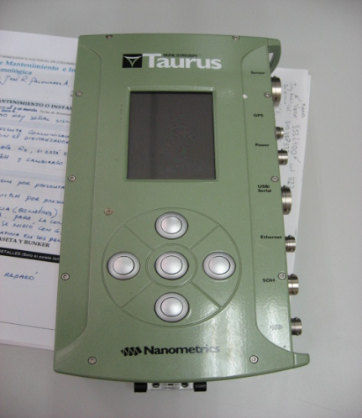
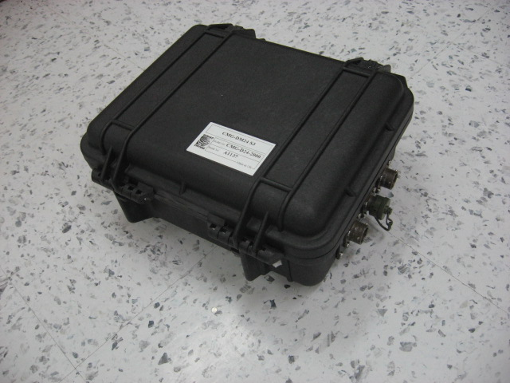
DIGITIZERS EQUIPMENT:
Quanterra Q330
Quanterra Q330S
Guralp CMG-DM24
BASALT
Taurus

Slide 5
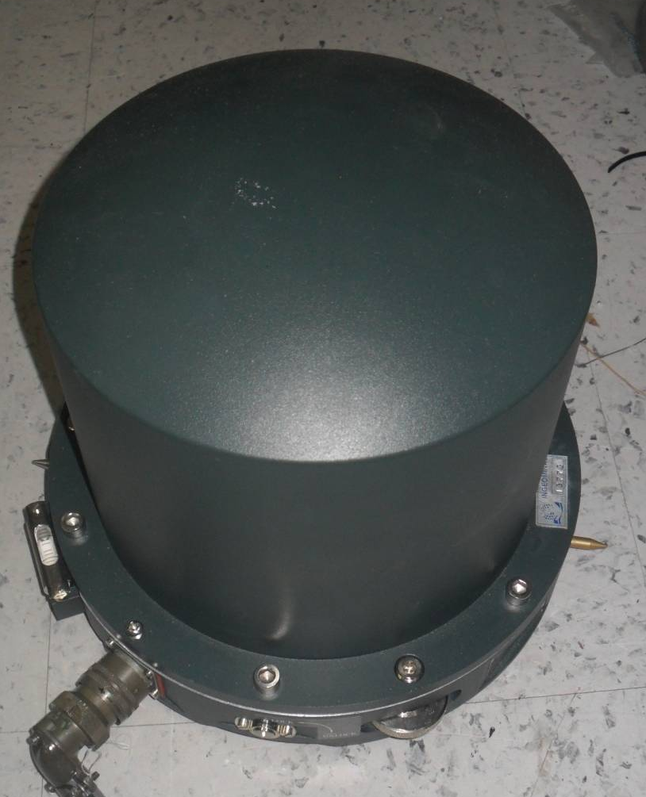
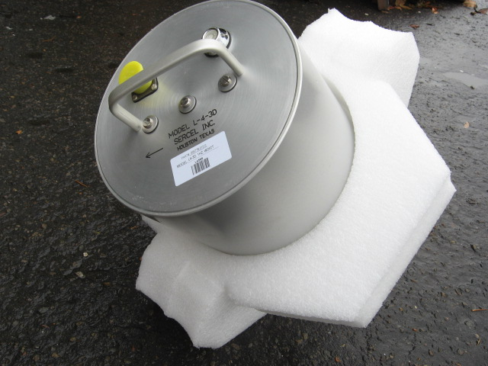
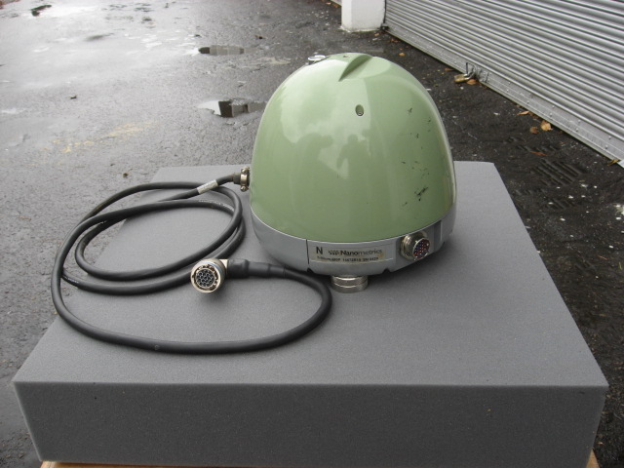
SENSORS:
Sersel L4-3D de corto periodo
Guralp 3T (BB)
Reftek (BB)
Trillium 120 P(BB)

Slide 6
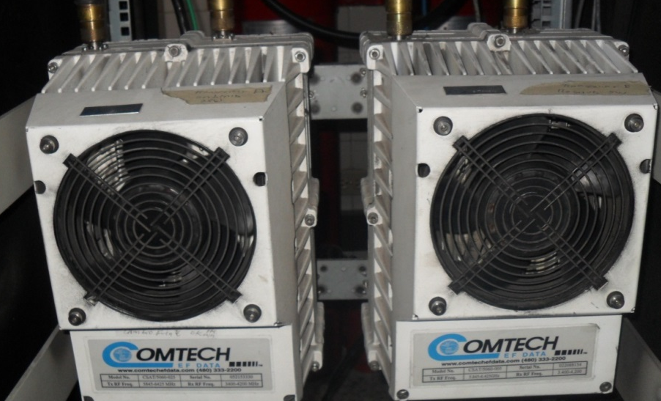
SATELLITAL COMUNICATIONS:
Modem satelital Comtech 550
Modem satelital Comtech 579
Transceiver

Slide 7
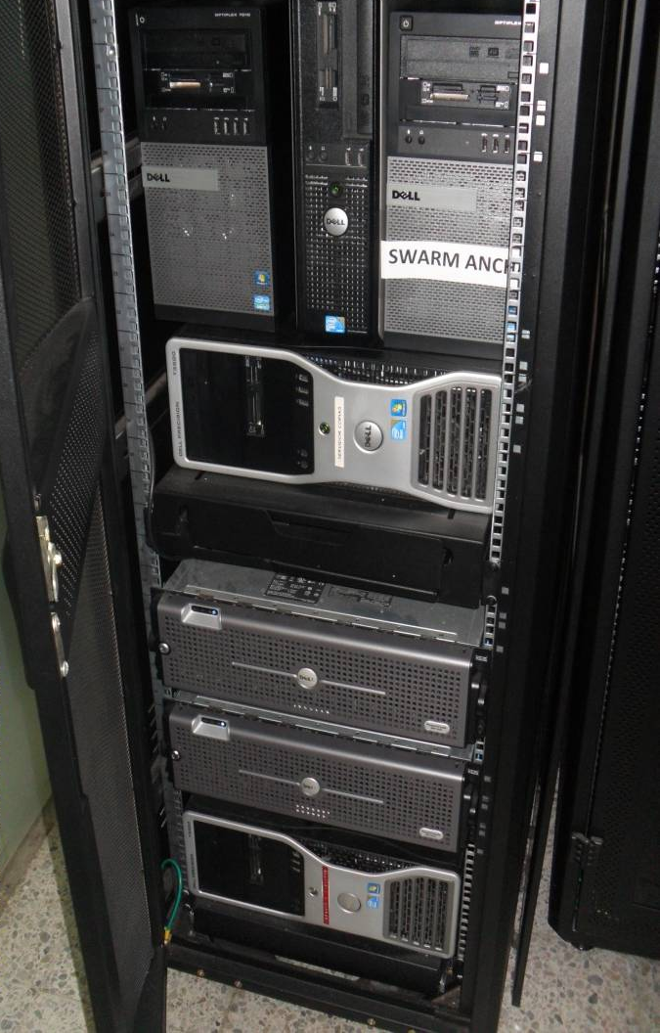
ACQUISITION EQUIPMENT
MONITOR VIEW SEISMIC SIGNAL

Slide 8
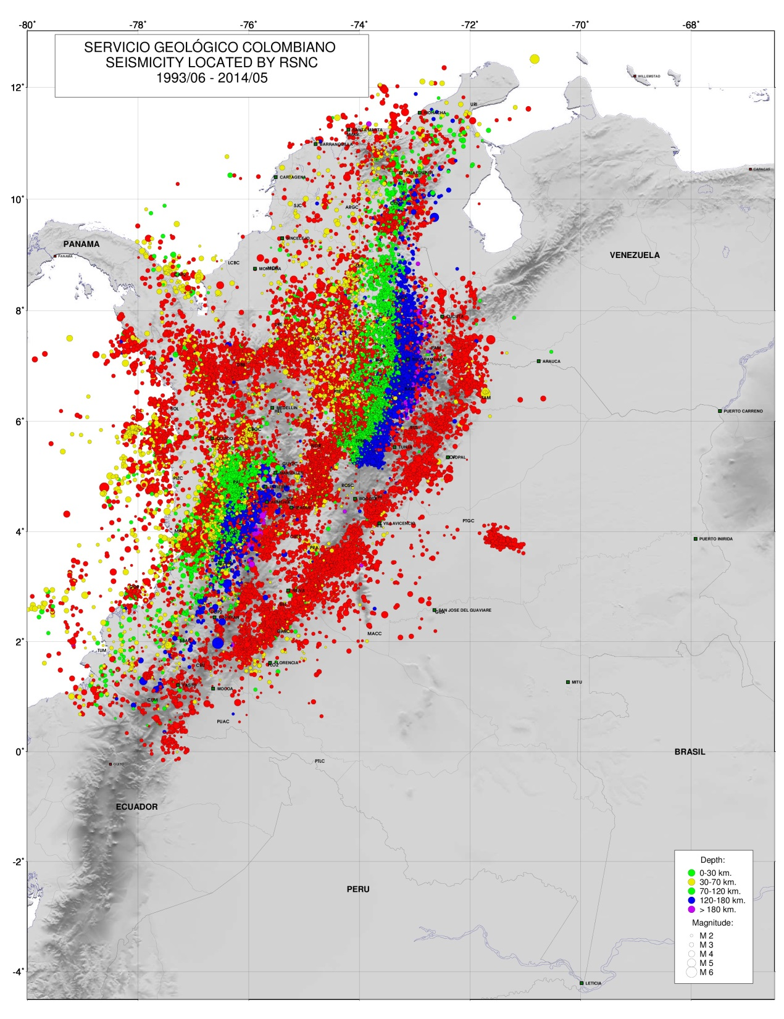
LOCAL SEISMICITY RECORDED

Slide 9
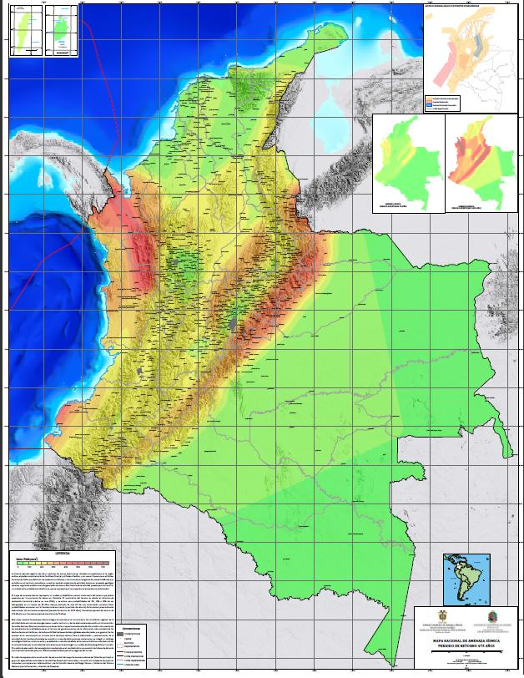
OUTCOME
GEOLOGY
SEISMIC HAZARD

Slide 10
GRACIAS
www.sgc.gov.co

