Slide 1
IRIS Products

Slide 2
Higher Level Products
LEVEL 4
Integrated Research Products
LEVEL 3
Seismological Research Products
LEVEL 2
Derived Information
Standard Processing
LEVEL 1
Quality Controlled Data
LEVEL 0
Raw Data

Slide 3
Products from IRIS http://www.iris.edu/ds/products/
PRODUCT

Slide 4
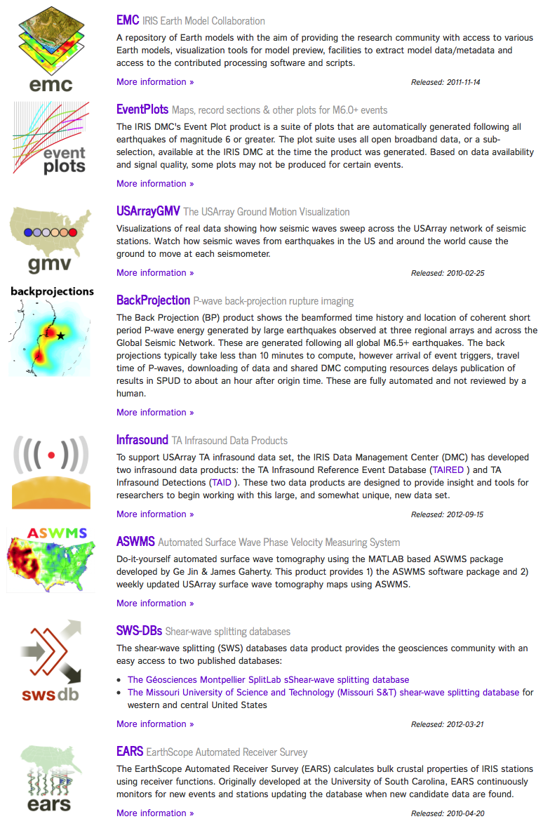
Current Products

Slide 5
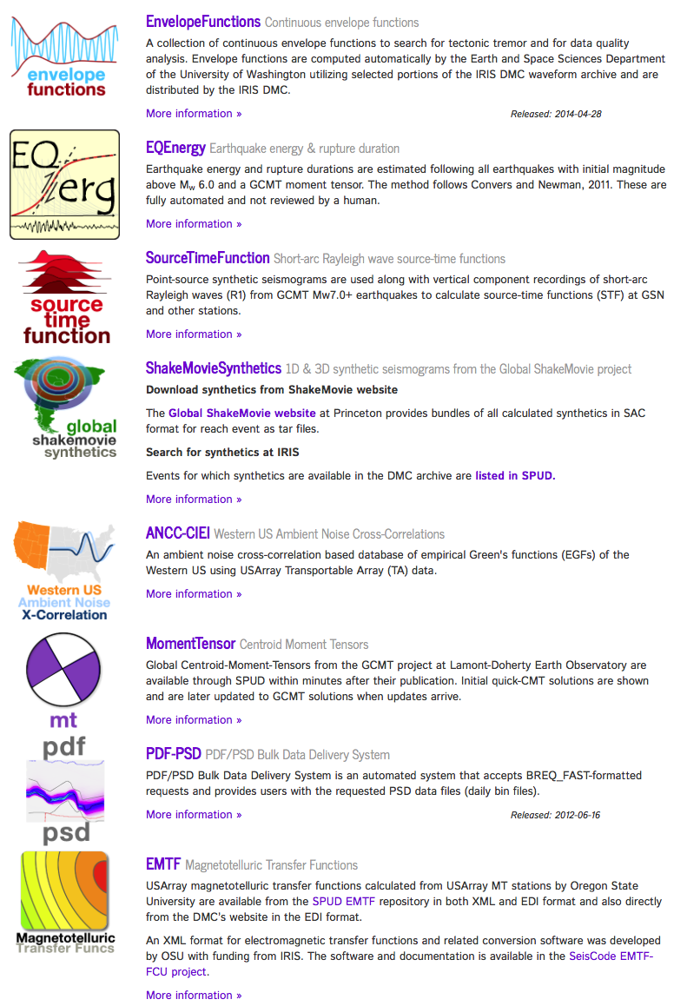
Current Products

Slide 6
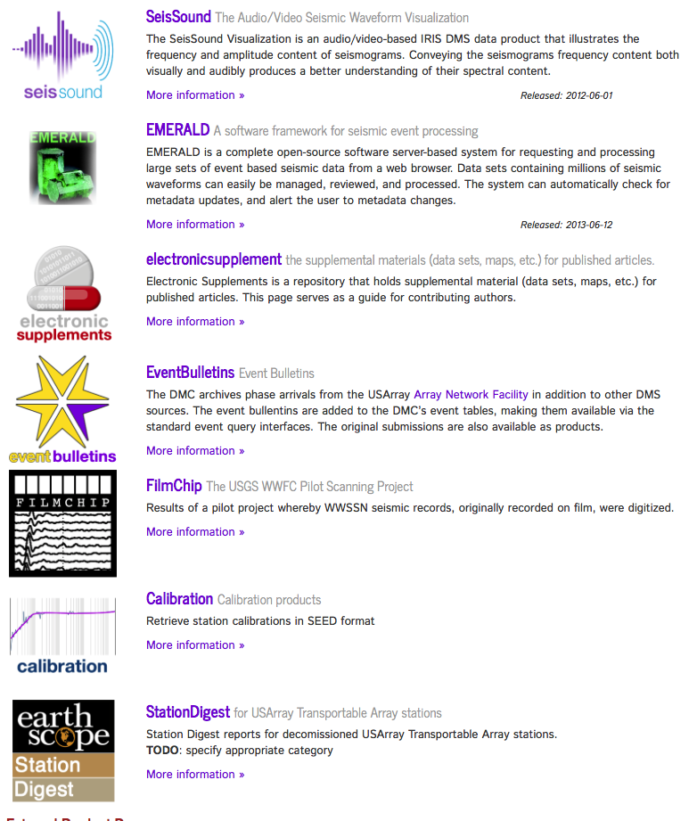
Current Products

Slide 7
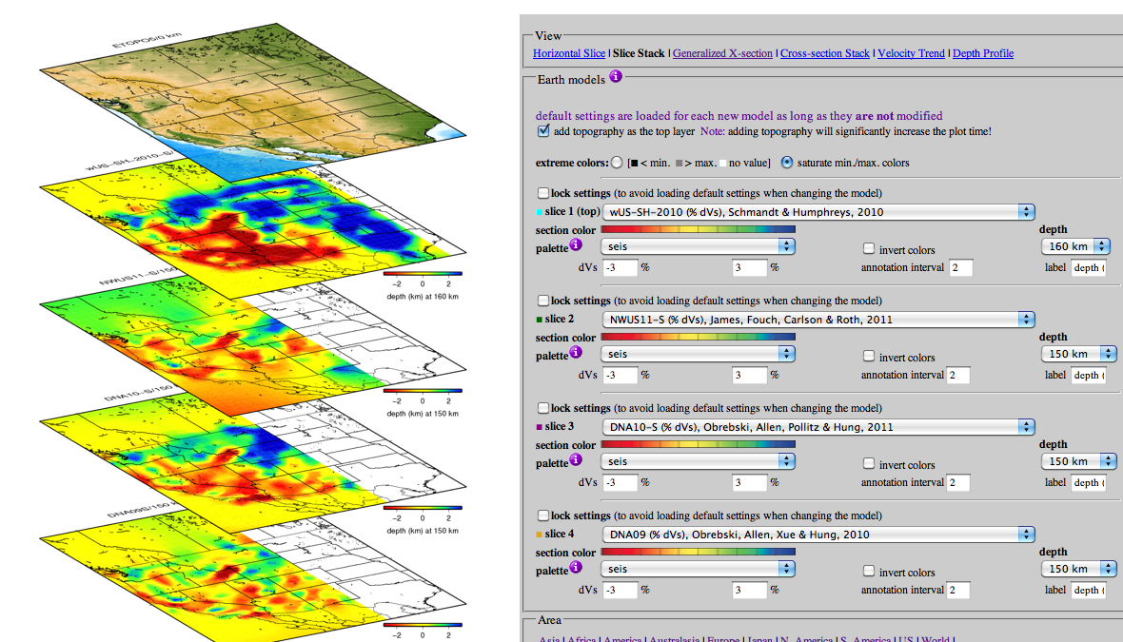

Slide 8
Searchable ProdUct Depository (event products all products)

Slide 9
Special Event Products

Slide 10
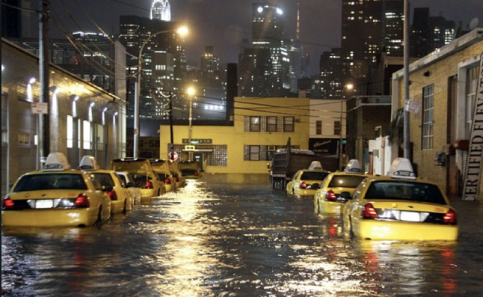
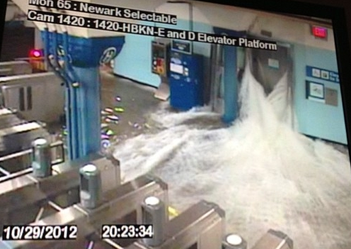
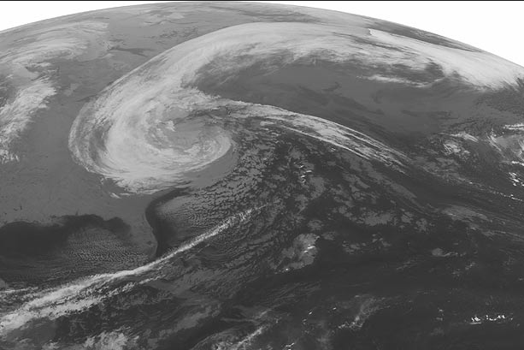
Hurricane Sandy: very bad for New York City, $75B in damage overall

Slide 11
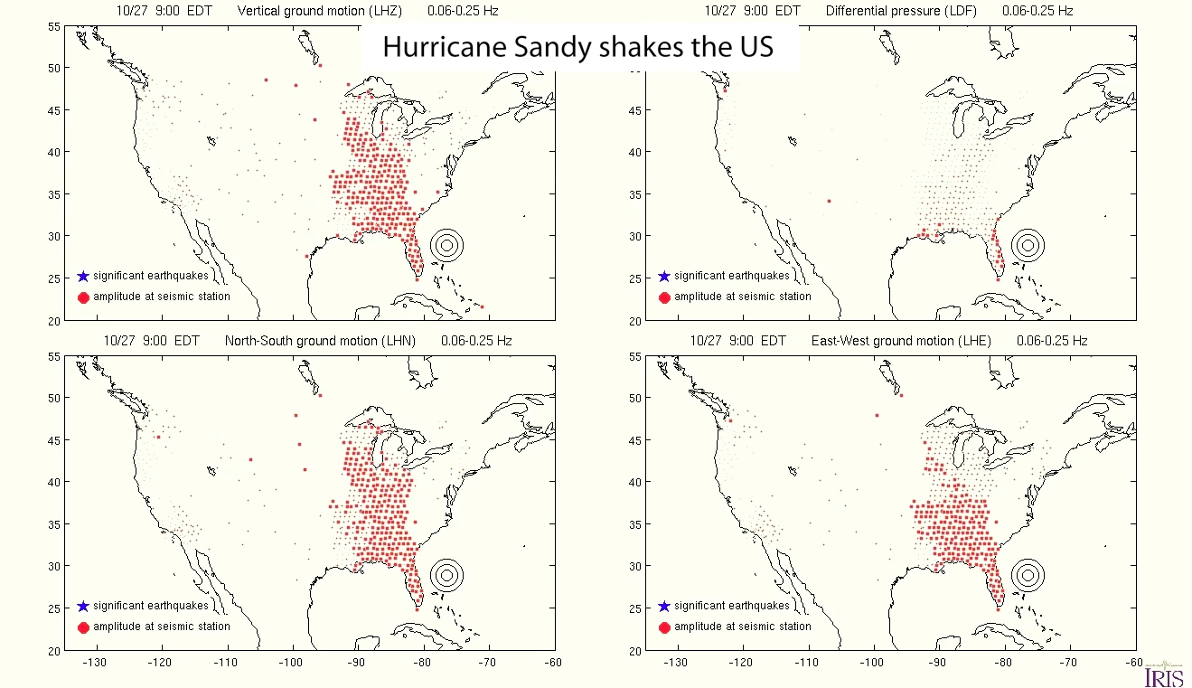
Hurricane Sandy: very interesting seismic noise source
Vertical
Pressure
North-South
East-West

Slide 12
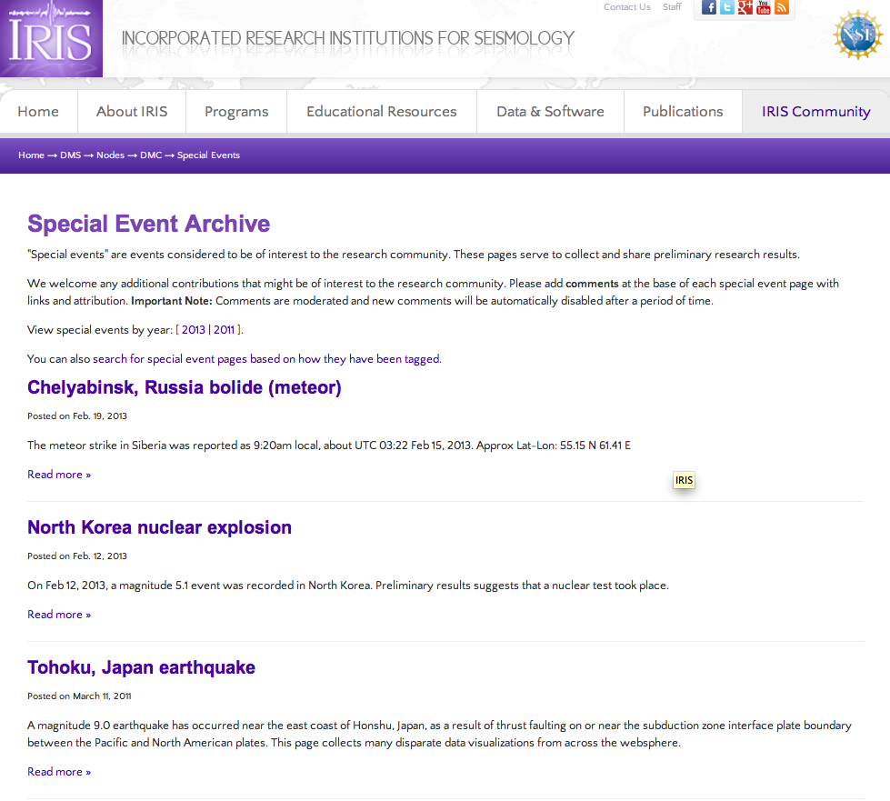

Slide 13
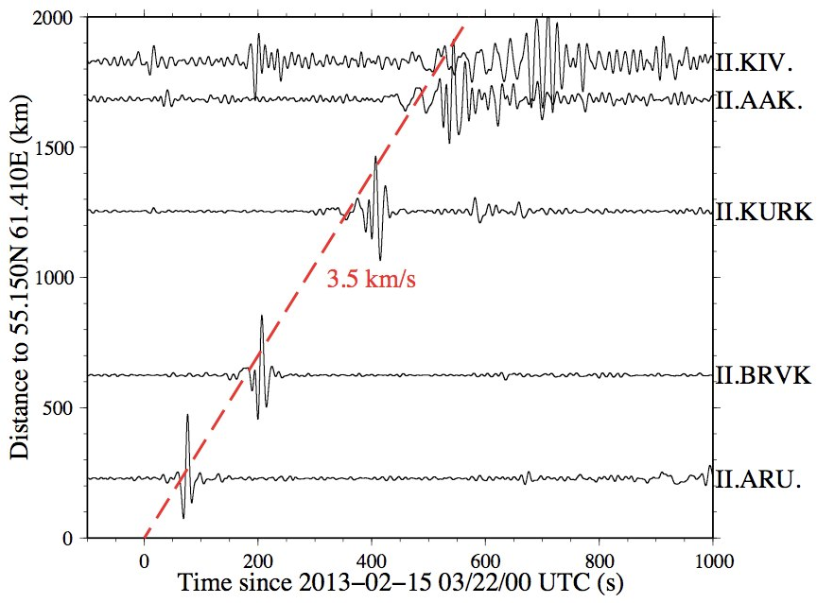
Russian bolide seen by Global Seismic Network stations
(atmospheric to ground coupling generated long period surface waves)
but…..

Slide 14
On-demand synthetic seismograms
We are computing a complete GF database for:
* High resolution 2D axisymmetric SEM (maybe 0.5 Hz?)
* All source depths/distances
* Seven 1D reference models (PREM, AK135, PREMoceanic…
* Available on demand/command line to anyone through IRIS
* Returns synthetic seismograms: filtered, GCMT or any moment tensor convolved
ETH: Tarje Nissen-Meyers, Martin viel Driel, Niloufar Abolfathian
IRIS: Alex Hutko & Chad Trabant

Slide 15
USArray GMVs Ground Motion Visualizations

Slide 16
USArray GMVs Ground Motion Visualizations

Slide 17
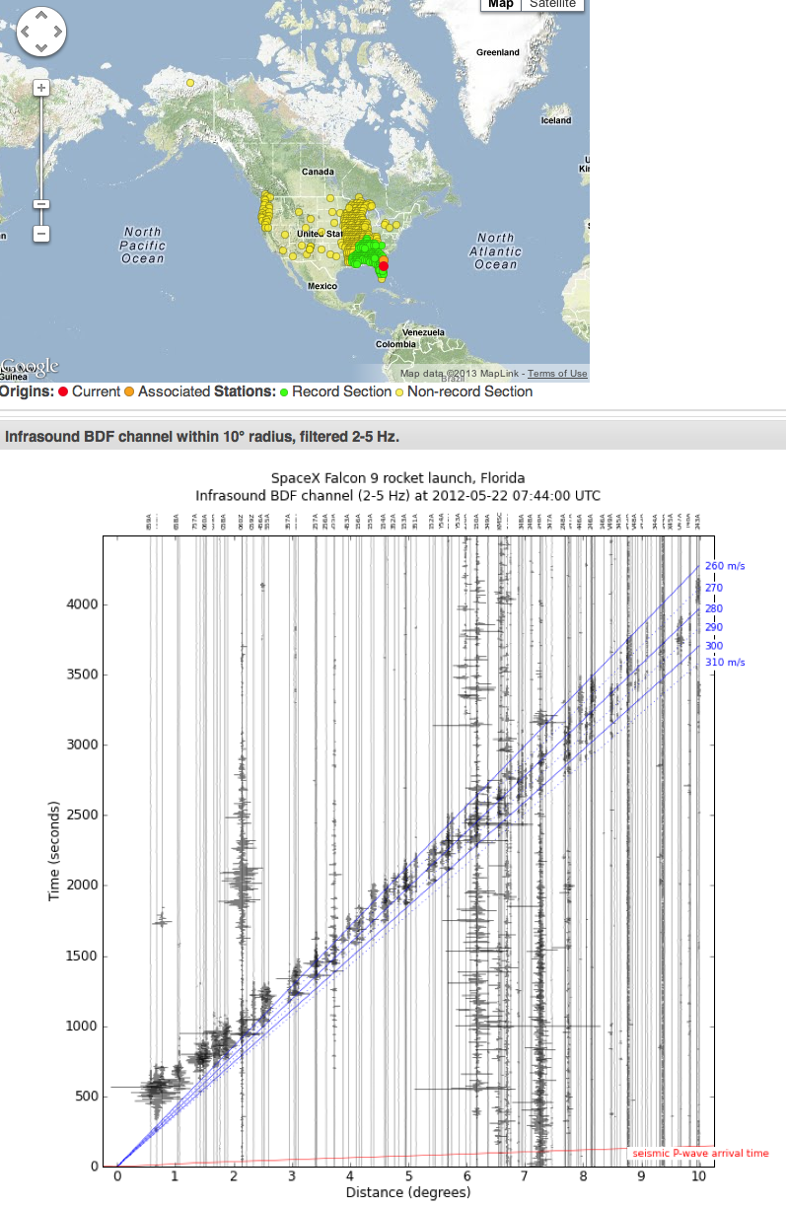
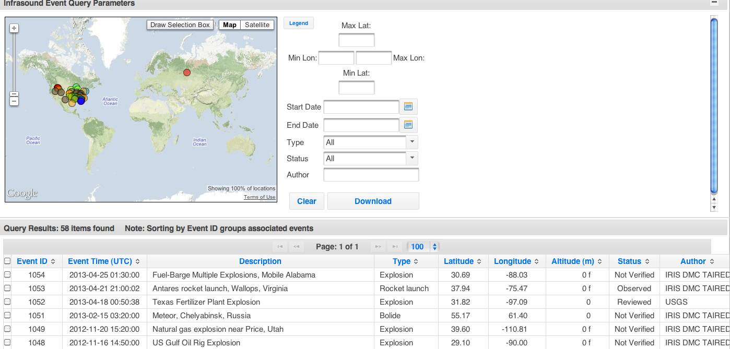

Slide 18
-Continually running infrasound auto-detections

Slide 19
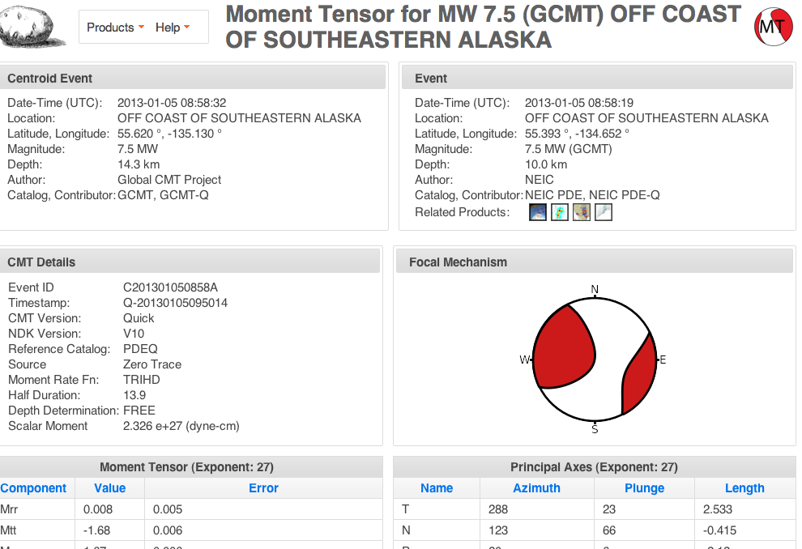
All SPUD products are accessible through a webservice/XML.
Translation: command line download GCMTs
(email product@iris.washington.edu for help)

Slide 20
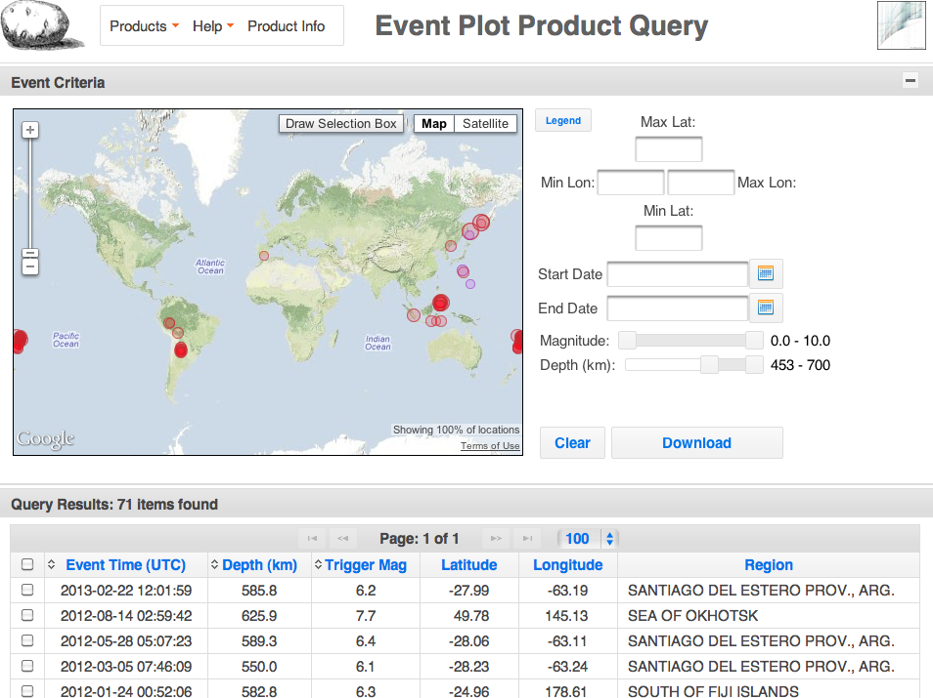

Slide 21
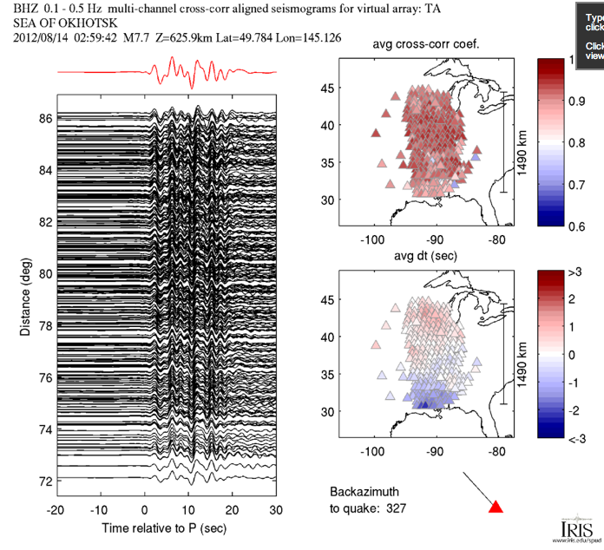
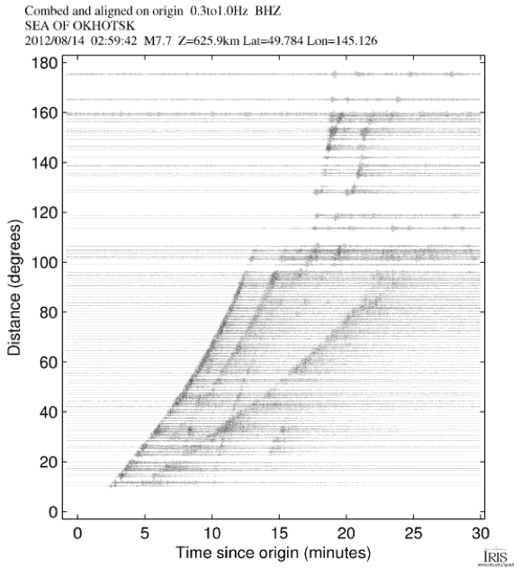
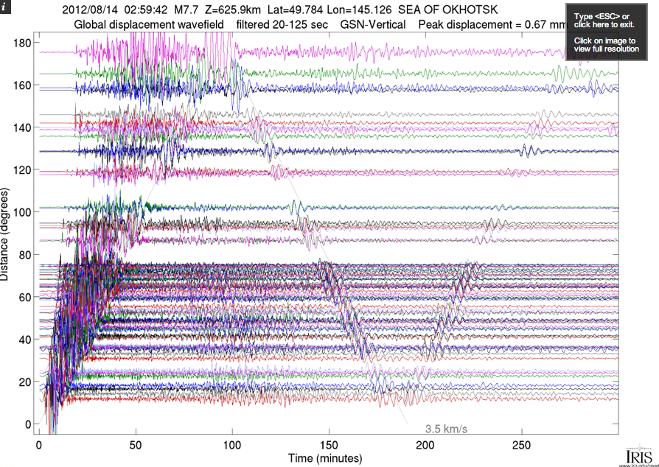
Dozens of record sections

Slide 22
IRIS DS Products
SPUD is a powerful product management system that allows easy access to all products of interest
Most products are event based products
Best experienced by using SPUD directly
www.iris.edu/spud

