Slide 1
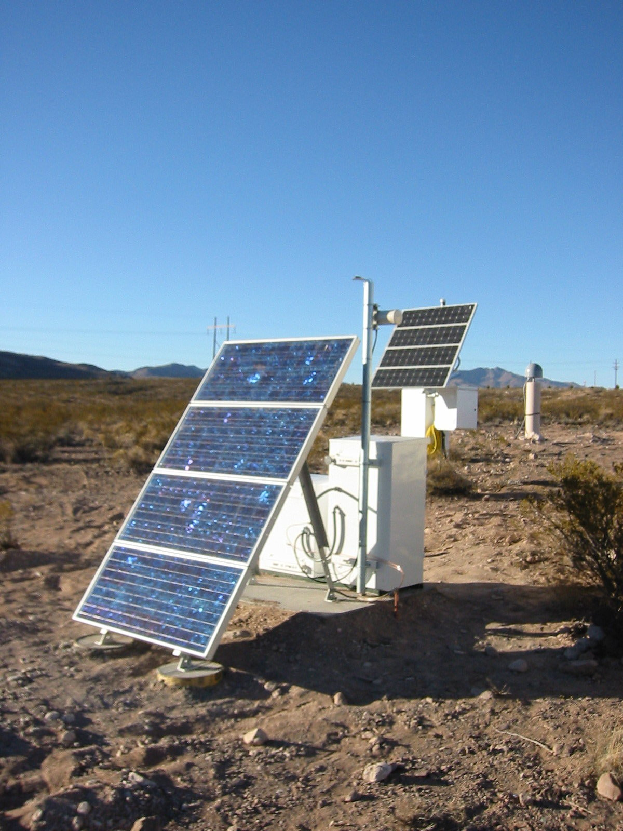
The IRIS Data Management System Operations Overview & Data Curation
Rick Benson
IRIS DMC Operations

Slide 2
IRIS DMS Mission Statement
“To provide reliable and efficient access to high quality seismological and related geophysical data, generated by IRIS and its domestic and international partners, and to enable all parties interested in using these data to do so in a straightforward and efficient manner.”

Slide 3
IRIS DMC Operations
10 People:
4 Dedicated to Archiving and User Request Servicing
(Same since mid-1990’s)
2 System Admins keeping machines working
2 Programmers
1 Database Administrator
Tasks Include:
Ingest Waveform data (Archive)
Synchronization of data holdings with network providers
Manage Waveform data and Metadata
Update/Replace
Process all user requests, except online & real-time data
that are self-service
Transcribe data to new technologies on avg every 4 years
Report data usage to contributing network operators &
Report data usage to users, enabling attribution

Slide 4
Types of Sensor Data IRIS manages
Seismological
Broadband Seismometers
Strong Motion
Buildings
Structures
Free Field
Geophones
Hydrophones
Geophysical
Magnetotelluric
Magnetometer
Electric Field
Strainmeter
dilatational
tensor
Tidal Pendulum
Gravimeter
conventional
superconducting
Tiltmeter
Creep Meters
THE IRIS DMC MANAGES TIME SERIES DATA
FROM MORE THAN TWO DOZEN DIFFERENT
TYPES OF SENSORS
Meteorological
Wind Speed
Wind Direction
Temperature
Humidity
Rain Gauge
Solar Radiaton
Insolation/Pyranometer
Microbarograph
Relative/Absolute
Infrasound
microphones
Water Column
Water Current
Depth
Temperature
Water Level

Slide 5
What does an archive do for you and your data?
Backup/Protect data
Automatically QC data;
Sort data- since it arrives randomly in time/space
Seamlessly integrate it with other data
Events, phase picks, many catalogs, 23 different sensor types (strain, pressure, temp, etc)
Proximal networks, out to global
Virtual Networks
Make it readily available, serve in real-time (Seedlink)
Service customized requests for your data
Provide software and support
Synchronize holdings between disparate archives
Assist with metadata- hosting Nominal Response LIbrary

Slide 6
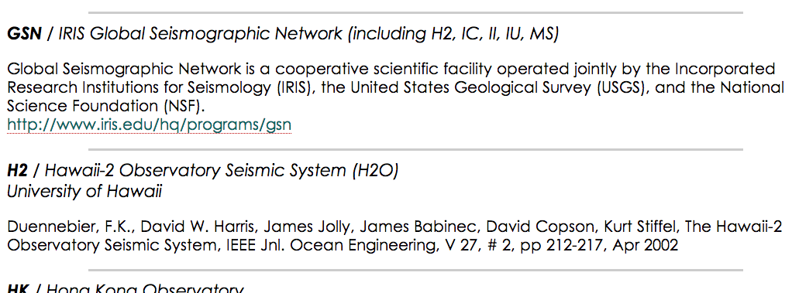
Giving credit for data
www.fdsn.org/citation.htm
www.fdsn.org/citation.htm
Notes:
Also where you can submit your network for citation

Slide 7
An Archive is not just a Backup
Data should not be harder to get out than it was to put in, and now that data is real-time, it’s easier on both ends.
Data are migrated to new technologies on average every 4 years
Perpetually viable (format upgrades), sorted, redundant copies
Standardized interfaces ease access
Updatable, network operators modify/control the holdings
Provides seamless access across multiple domains in 4-D.
An active archive is dynamic, and interfaces should enable transparent discovery of “new” data
Without effective data management, it can become a landfill.

Slide 8
Auxiliary Data Center @ LLNL *1,300 Km from DMC
2013
Create and maintain a reliable, offsite “Active Backup”
for use as failover facility. This is the third offsite loc and we always look ahead for improvement. The current one in use
Is located in Livermore, CA at the Lawrence Livermore National Lab Facility, which has HPC infrastructure.
All data is rsync’d and capable of servicing requests
and archiving data

Slide 9
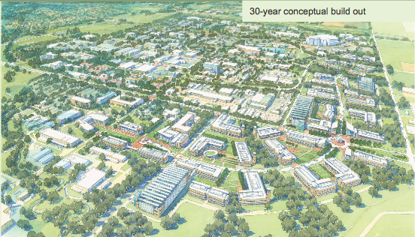
Overview of the -Auxiliary Data Center-

Slide 10
Why an Auxiliary Data Center?
For reasons of data and resource security in the case
of a catastrophic failure of the systems in Seattle.
Work toward providing capability to operate replicated
data centers at multiple geographic locations
Provide required access that DMC staff controls, since most of
the software has been internally developed

Slide 11
Taking Advantage of a New Opportunity: LVOC
Significantly increased bandwidth:
10 Gb uplinks to upstream provider (really 4Gb at
best)
- This could expand to 100Gb+ “relatively” soon
Many more services available, like web services and
other traditional request processing
Virtualized infrastructure, increased reliability, and
much easier maintenance;
Operated autonomously
Significantly increased disaster recovery (failover)
with increase in capabilities if Seattle were
to go offline

Slide 12
What Will Be Available Functionally?
Data Handling Software:
Real Time Data Ingestion (BUD)
Non Real Time Data, miniseed2dmc
BUD to Archive Transfer System (BATS)
Quality Assurance Software
MUSTANG engine
PQLX for use by analysts
Web Services
Systems that draw from Web Services
Breq_Fast
Wilber3
SeismiQuery
IRIS Earthquake Browser (IEB)
MUSTANG

Slide 13
Lastly- A Connection to High Performance Computing
Because the traditional system to manage archived data is not well-suited to Big Data problems in a High Performance
Computing environment, we will collaborate with LLNL
staff to produce a workflow that accesses data using web
services, which will reformat and reorganize the data into different data structures that are better suited for processing
in an HPC environment.
Note: These could be localized to specific HPC environments and not across ALL replicated data centers.

Slide 14
Email Based Data Requesting: 2 examples to show you
GOAL:
Options to get data set for use in ASI

Slide 15
Email Based Data Requesting: 2 examples to show you
GOAL:
Options to get data set for use in ASI

Slide 16
If this is you, we’re here to help……

Slide 17
Batch REQuest FAST (BREQ_FAST)
Purpose: Request large volume of SEED information asynchronously
Scenario: You’re away, and need to get data.
Not at your computer
Slow internet connection
Need large volume of data
Don’t/can’t need to work on it right away
Notes:
We’ve seen a few ways we can access, via browser, command line, and matlab. All of these generally have to be run when and where you are; or on a computer that will do the processing.
Now, here’s a way to separate the request from the processing.

Slide 18
Order SEED now, process later- using BREQ_FAST
Request data
using SeismiQuery
using Email
Uses Robust Queuing
Retrieve via
HTTP
FTP
Advantages
Asynchronous
Large Requests
Batch REQuest FAST
Notes:
BREQ_FAST
Long our standard method of data retrieval. Has a good purpose:
Ask now, get data later.
TRAVELLING?
NOT AT COMPUTER?
NEED LOTS of data?

Slide 19
BREQ_FAST via SeismiQuery
Start here:
http://www.iris.edu/sq
Notes:
SeismiQuery is a collection of web forms that allow you to query the IRIS DMC database.
There are several forms, but much of the functionality is duplicated elsewhere by other services.
One form that is particularly relevant, though, is the BREQ_FAST request form.
It will guide you through the finding of and requesting of timerseries data and metadata.
TRANSITION: Examining the top seciton of the request form, we see fields that help us filter the data.

Slide 20
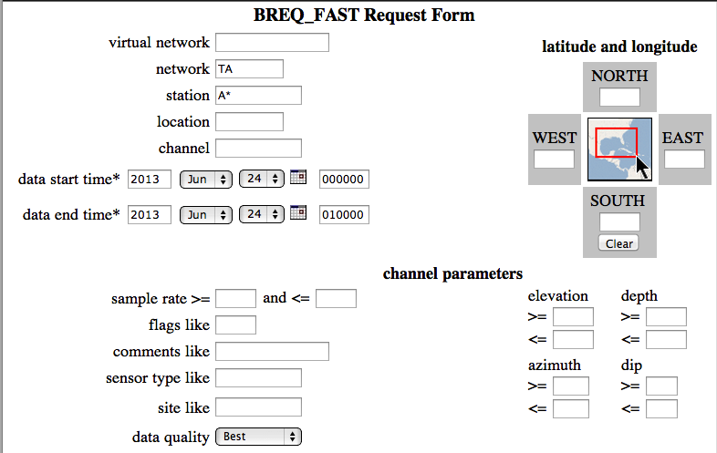
BREQ_FAST via SeismiQuery
Notes:
Describing the station and channel
Request dtimes (Required!)
Geographic filtering
misc. filtering.
Transition.
Once you’ve specified what you’re interested in,

Slide 21
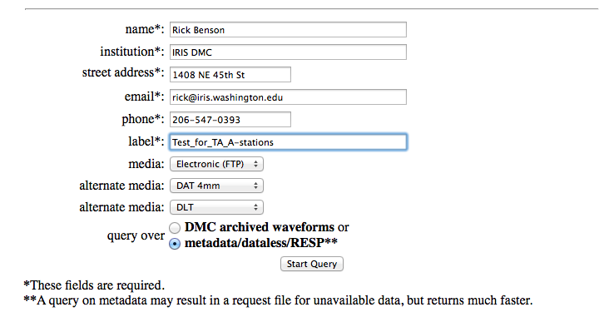
BREQ_FAST via SeismiQuiery
Notes:
provide information about yourself, and at Label., and
Specify what KIND of data you need.
metadata
dataless
RESP
TRANSITION: After filling this out, you hit “Start Query”

Slide 22
BREQ_FAST via SeismiQuiery Results in a new popup window:
Notes:
You see a page containing, essentially, an email you created. (Except for all the “View in MDA” links More about that in a moment.
DESCRIBE THE BODY, and the format of the letter.
TRANSITION: of course, you don’t need to access this via the Seismiquery form.

Slide 23
Request from BREQ_FAST Via Email
Request fullSEED : breq_fast@iris.washington.edu
Request MINISEED : miniseed@iris.washington.edu
Manual: http://www.iris.edu/dms/nodes/dmc/manuals/breq_fast/
.NAME Joe Seismologist
.EMAIL joe@podunk.edu
.MEDIA FTP
.LABEL Earthquake1
.QUALITY B
.END
GRFO IU 1999 01 02 00 18 10.4 1999 01 02 00 20 10.4 1 SHZ
ANTO IU 1999 01 02 02 10 36.6 1999 01 02 02 12 36.6 1 SH?
AFI IU 1999 01 02 02 10 37.1 1999 01 02 02 12 37.1 1 BH? 00
SEE CD 1999 01 02 14 45 08.9 1999 01 02 14 47 08.9 1 SHZ
CASY IU 1999 01 04 02 42 13.4 1999 01 04 02 44 13.4 1 BHZ 10
KMI CD 1999 01 04 02 41 57.5 1999 01 04 02 43 57.5 1 BHZ
SSE CD 1999 01 04 02 18 25.4 1999 01 04 02 20 25.4 2 B?? SHZ
PAS TS 1999 1 4 2 10 49 1999 1 4 2 12 49 3 BH? SHZ L??
Notes:
You can send an email with the same information direclty .
Can be autogenerated.
Can be storedi n a huge list
main advantage is that it submits request for you.
Gives a little bit of a preview of what you're getting
(Batch, can do on the run if you can't send email)
Say, you’re riding on a bus
does alternate media mean anything any more?
Afterward, you will get back emails that tell you how to retrieve your data.

Slide 24
WILBER3, for Event-related waveforms
Purpose: Request event-related SEED data
Scenario: Need waveforms relating to a specific event.
Stations with spread
Choose distances & Azimuths
Preview ability
www.iris.edu/wilber3
Notes:
TRANSITION:

Slide 25
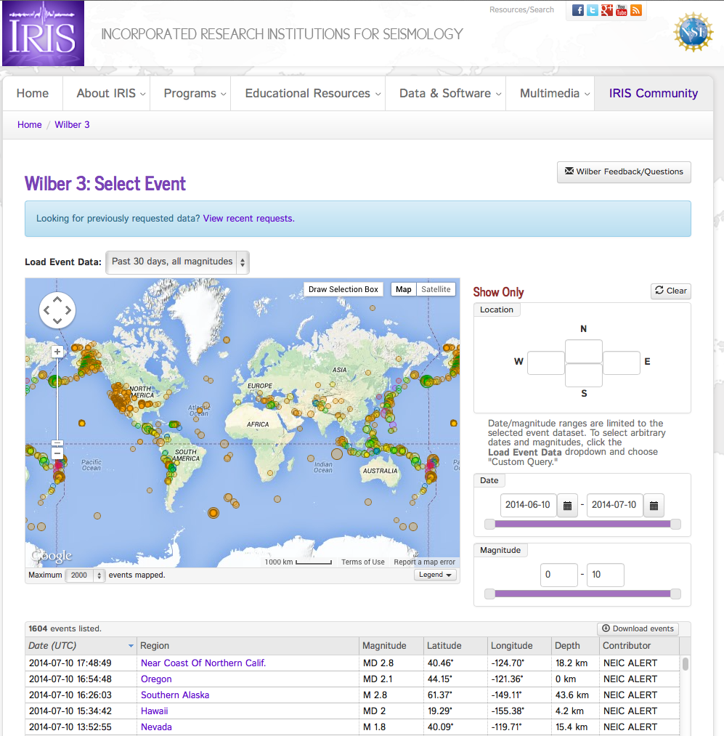
WILBER3- Let’s demo
http://www.iris.edu/wilber3
Notes:
Do a quick demo
“I’ll show you a quick overview, and then give you an exercise where you can try it yourself”
THIS is the initial WILBER3 screen, where you choose an event for which you’d like to receive data.

Slide 26
El Fin

Slide 27
Start here: http://www.iris.edu/sq

Slide 28
Summary
Over 180 Networks on a global scale contribute data to the DMC, generating a homogeneous data warehouse, illustrating extensive cooperation. Currently about 1/3 are PASSCAL network sources.
Requesting data has been simplified and value-added, with ability to simply delimit data by events, phases, source, etc.
Accommodate vast number of data types, compression, multiplexed, etc, and integrating them both in and out with standard, centralized software.
By minimizing access and distribution delays, we support research efforts and accommodate short deployment and acquisition cycles.
We can accommodate increased data flow easily.
Data are requested from throughout the archive, and is very active

Slide 29
BREQ_FAST via SeismiQuiery
(Revisited)
Notes:
What about that VIEW IN MDA stuff?

Slide 30
MDA: MetaData Aggregator http://www.iris.edu/mda/
Notes:
Useful for data discovery and quick access to station information
Demo
----- Meeting Notes (7/18/13 12:32) -----
Really useful to figure out quick details of stations; not made for arbitrary sets.
- STATION MAPS
- What channels do these stations have,
- metadata with navigation
TRANSITION: CLICKING ON THE STATION MAP will bring you to a map like this…

Slide 31
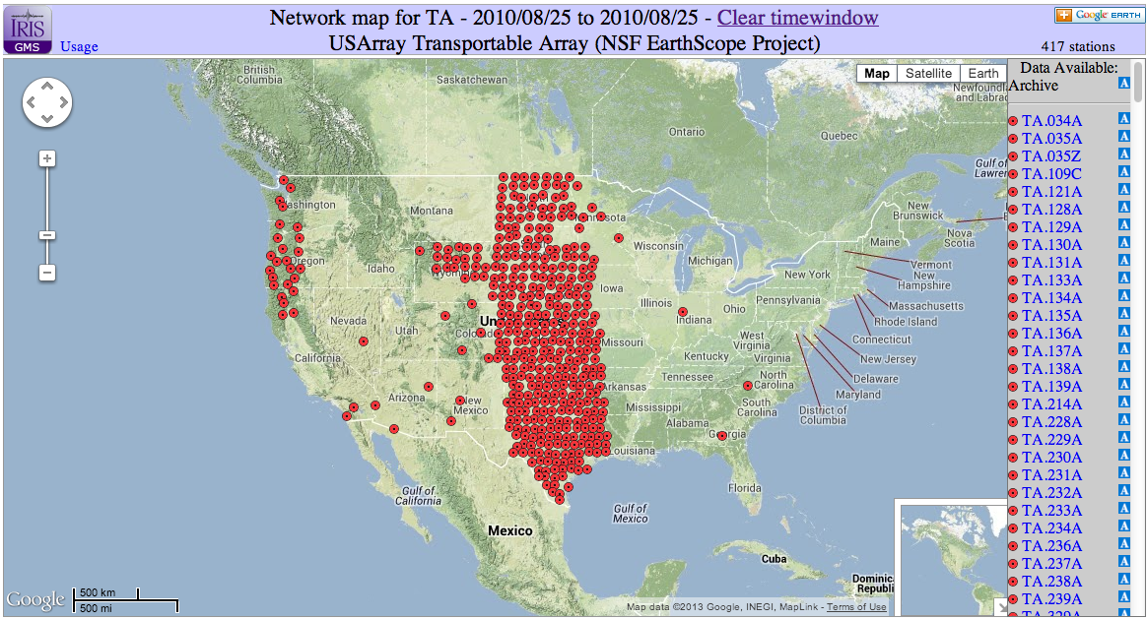
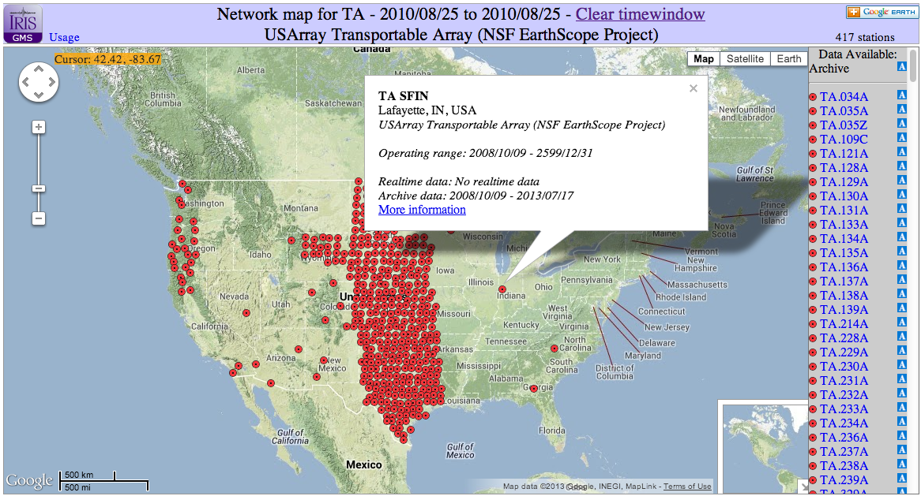
GMap: Google Map Service http://www.iris.edu/gmap/
Usage
Notes:
Useful for data discovery and quick access to station information
Demo
Example: http://www.iris.edu/gmap/TA?timewindow=2010/08/25
TRANSITION: If we go back to the Aggreagator…

Slide 32
MDA: MetaData Aggregator http://www.iris.edu/mda/
Notes:
Notice also the symbols by the channels.
DESCRIBE
What about RESTRICTED data? (Yellow R)
What is meant by Restricted?

Slide 33
Accessing Restricted Data
There are four generalized policies for what data are restricted:
PARTNER | Data should become open …
IRIS/PASSCAL | 2 years after last instrument is pulled from field
OBSIP | 2 years after last instrument is pulled from field
SEIS-UK | 3 years after last instrument is pulled from field
SISMOB-FR | 3 years after last instrument is pulled from field
www.iris.edu/dms/nodes/dmc/data/types/restricted/
Notes:
Some projects will delay the release of their data.
The amount of time depends on the project and agency. During this period of time, the PI and relevant people can still access it via web services using username-password pairs
Metadata refinement, special projects
an important function of the DMC is to collect data, sort it, and make it readily available to a wider research community, especially with short-term temporary experiments (such as from PASSCAL, SEIS-UK, OBSIP, SISMOB-FR, and others) that have multiple partners conducting research with new data, and don’t want to be burdened with distributing data while the research is underway. For this reason, there are data at the DMC that appear to be available in the holdings, but are restricted.
TRANSITION.

Slide 34
Available from IRIS…
Notes:
As you can see from the list, there are a variety of services available thorough the web interface. The ability to retrieve Waveforms, station metadata (and responses), and event information are complimented by services that can do signal processing, compute times and distances, etc. Plus, we have a web interface to the data products area. There you can find Event plots, Global Moment Tensors, Back projections, visualizations, and much more.
All these services can be accessed from the link shown.
Don’t worry about jotting it down right now, as a list of links will be provided at the end of the talk.
----- Meeting Notes (11/8/12 10:02) -----
mention instrument response

