Slide 1
DMC Data Provider Agreements and Usage Reports

Slide 2
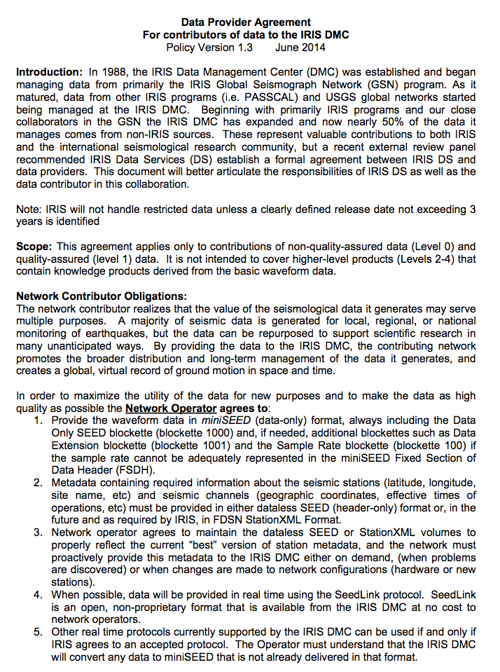
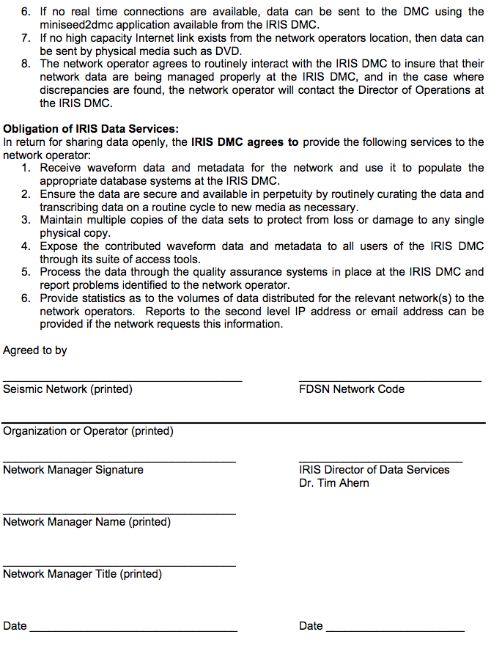
Data Provider Agreements

Slide 3
Data Provider Agreements
Every Country Attending this Workshop submitted a completed Data Provider Agreement
AX-Aruba C&C1 Chile CM&TBD-Colombia
CW-Cuba CY-Cayman Is. EC-Ecuador
JM-Jamaica MG&MX Mexico NU-Nicaragua
ON-Brazil OV-&TC Costa Rica PA-Panama
TBD-Honduras VE-Venezuela WA-Argentina
THANK YOU!!!

Slide 4
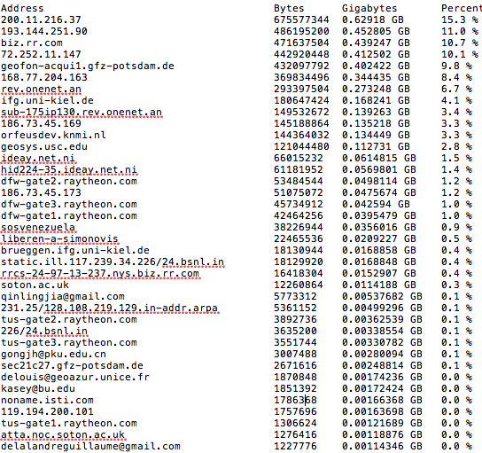
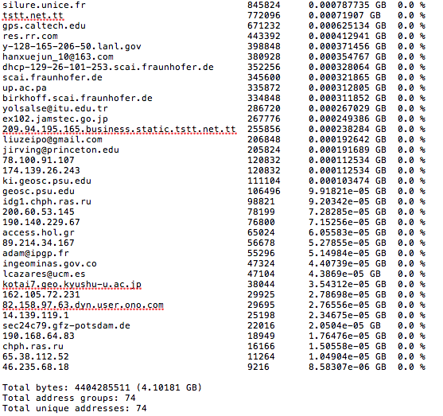
Usage Reports
IP or Email Bytes gbytes % of data
Total bytes sent that month
Total address groups
Total Unique addresses

