Slide 1
Presentation on Bhutan’s Seismic Network System

Slide 2
Presentation Outline
Location of Bhutan
Background
About Seismology Division
Ongoing programs and projects
National Seismic monitoring system
Systematic Data Merge System
Future Plans

Slide 3
Location: Tibet(China)in the north and India in the East West and South
Asian Map Showing the Location of Bhutan(Google map)

Slide 4
Facts about Bhutan
Area : 38,394 sq. Km
Population: approx.
720679 (NSB 2012) with
density 18.8 Square km
Capital :Thimphu
Altitude : Varies from 150m to 7570m above sea level
National Language :
Dzongkha
Climate: Four seasons (Spring, summer, Autumn & Winter)
20 Districts of Bhutan(Source:Kuensel)

Slide 5
Background
Bhutan lies in a region of seismically active zone.
Historically, Bhutan has experienced earthquakes of varying magnitude.
Some of the Past events
1713 somewhere in western Bhutan (Magnitude??---major quake reportedly)
Assam Earthquake in 1950 (magnitude; 8.6)
Nepal-Bihar earthquake in 1934 (mag. 8.1)
Eastern Bhutan in 2009 (mag. 6.1)
Sikkim, India in 2011 (Mag. 6.8)

Slide 6
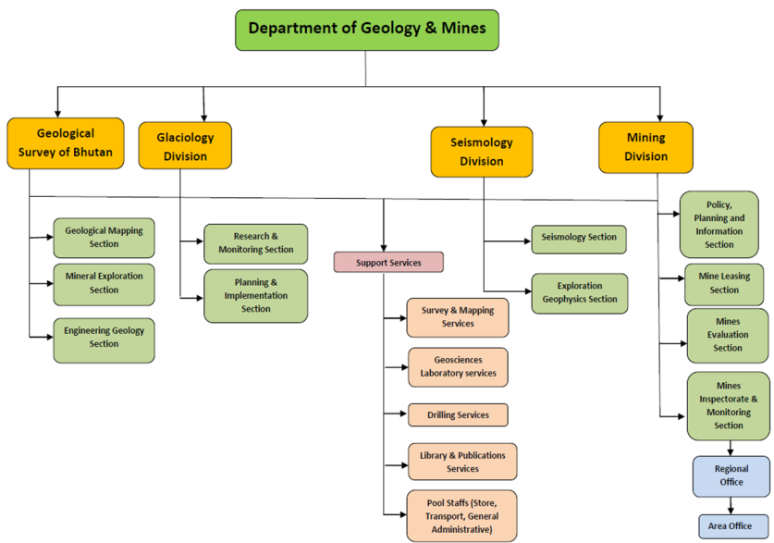
About Seismology Division
Seismology and related studies started very recently in Bhutan
Seismology Division created in 2011

Slide 7
Ongoing Programs/Projects
Risk assessment of geo-hazards
Installation of Earthquake Monitoring system
Geophysical mapping of Main Frontal Thrust (MFT) in southern Bhutan
GPS study to determine the characteristics of under thrusting Indian plate
Marco-seismic hazard mapping of Bhutan; Micro-zonation of 1 pilot area

Slide 8
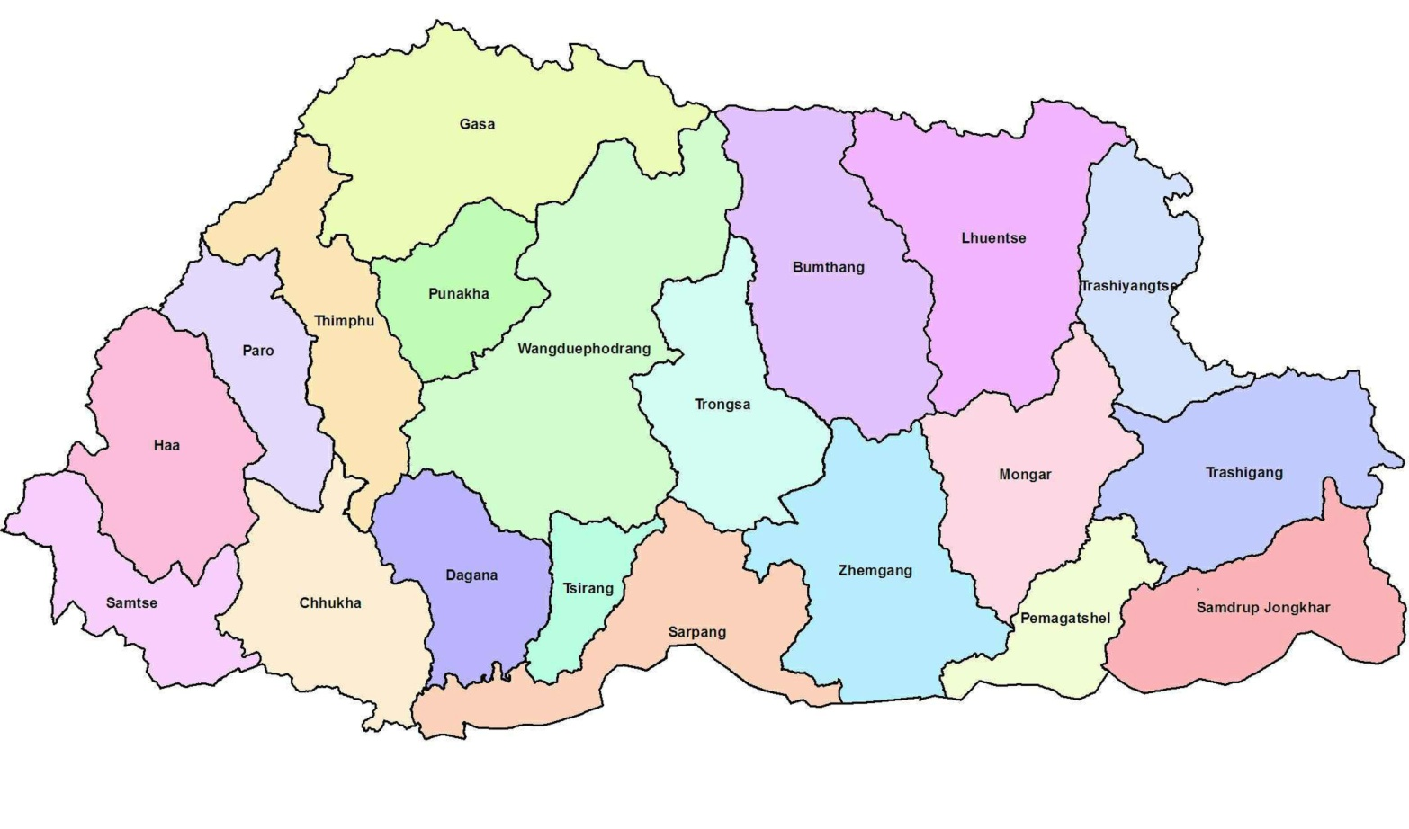
National Seismic Monitoring System
World Bank/DPRI Stations
Phase-I
Installation of 6 numbers of earthquake monitoring stations with support from World Bank, Disaster Prevention Research Institute (DPRI), Kyoto University and National Research Institute for Earth Science and Disaster Prevention (NIED), Tsukuba, Japan
Proposed station location
under RIMES support
Control Center in
DGM Office, Thimphu
Phase-II
Installation of 8 numbers of earthquake monitoring stations with support from RIMES (Regional Integrated Multi-hazard Early Warning System), based in Bangkok Thailand

Slide 9
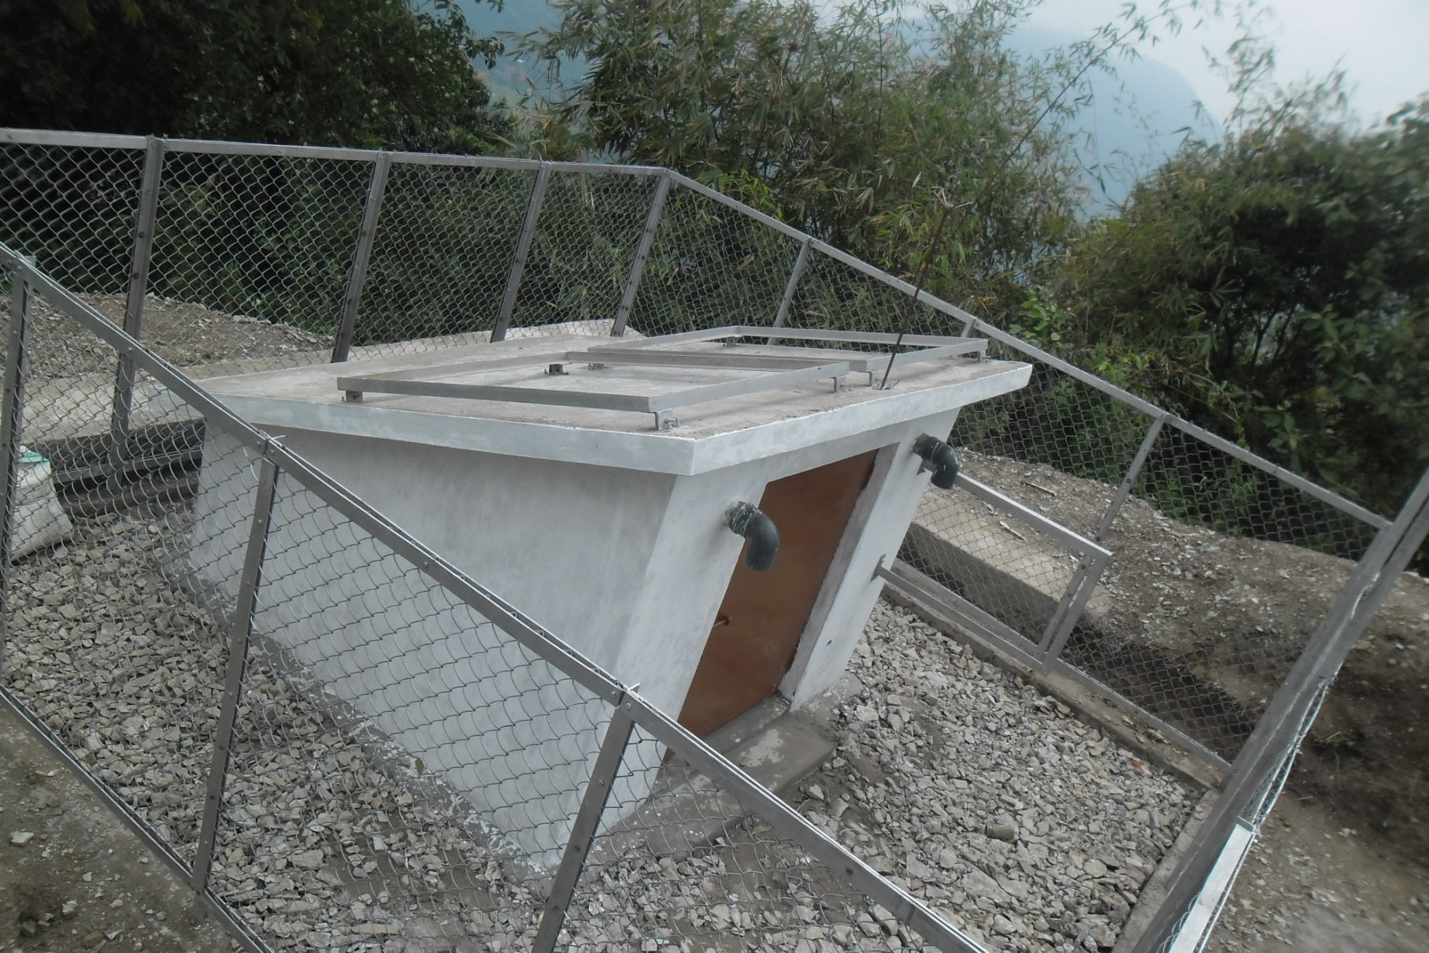
Seismic Station in Samdrup Jongkhar

Slide 10
Datalink between observation site and DGM
LS7000: Data logger of weak and strong motion seismometer, DM24: Data logger of broadband seismometer and GPS: Data logger of GPS

Slide 11
Schematic of Data Merge System
@Bhutan Telecom Office?

Slide 12
Future Plans
Real time seismic monitoring system
Development of damage/shake simulation for rapid response during emergency
Modeling crustal activity and prediction
Feasibility of Earthquake Early Warning
Triggering GLOF and landslides

Slide 13
THANK YOU

