Slide 1
SEISMIC MONITORING FOR INDONESIA
TSUNAMI EARLY WARNING SYSTEM
(InaTEWS)
Presented by:
Setyoajie Prayoedhie
Indonesian Agency for Meteorology, Climatology and Geophysics (BMKG)

Slide 2
Outline
Indonesia Digital Seismic Network
Station Metadata
Seismic Integration System of InaTEWS
Example of InaTEWS Products
Priority Strategic Plan for TEWS

Slide 3
INDONESIA Digital Seismic Network (Total: 164 stations)

Slide 4
Stations Metadata
No. | Code | Station Name | Installation Date | Location |  |  | Status | Digitizer/Sensor | Communication
 |  |  |  | Lat | Lon | Elevations (m)
1 | PSI | Parapat, North Sumatera | 2006 | 2.6952 | 98.9240 | 1076.90 | Used | Europa-GPS-T-1C S/N: 779 STS-2 1500 V/m/s S/N: 90322 | LIBRA
2 | LEM | Lembang, West Java | 2006 | -6.8266 | 107.6175 | 1293 | Used | Europa-GPS-T-1C S/N: 05100006 STS-2 1500 V/m/s S/N: 90314
3 | KAPI | Kappang, South Sulawesi | 1999 | -5.0142 | 119.7517 | 300 | Used | Q330 S/N: 3186 and 3185 CMG3T 1500 V/m/s S/N: T3F55
4 | BATI | Baumata, NTT | 2006 | -10.2065 | 123.6633 | 344.81 | Used | Europa-GPS-T-1C S/N: 364 Trilium 120P S/N: 1085
5 | SIJI | Sorong, West Papua | 2010 | -0.86912 | 131.26605 | 200.91 | Used | Europa-GPS-T-1C S/N: 644 Trilium 120P S/N: 1073
6 | JAY | Jayapura, Papua | 2010 | -2.51447 | 140.70433 | 458.76 | Used | Europa-GPS-T-1C S/N: 373 Trillium 120P S/N: 0480

Slide 5
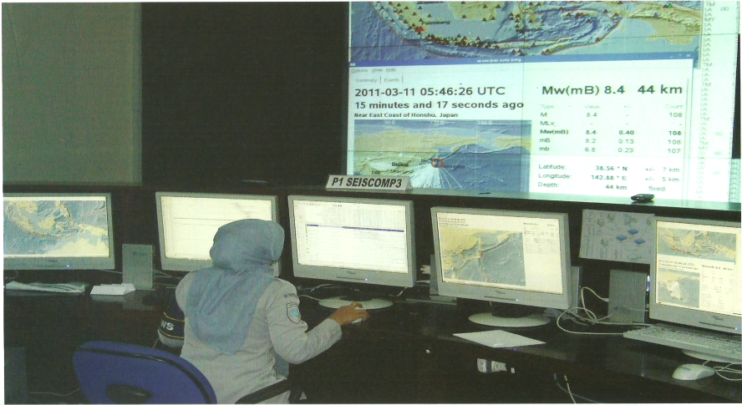
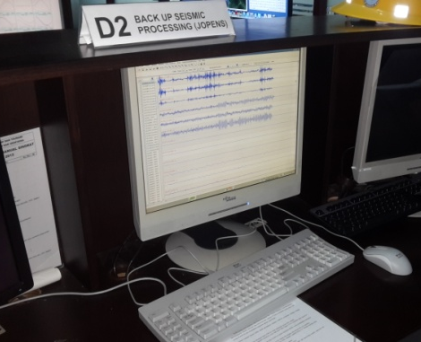
Seismic Integration System of InaTEWS
Indonesia
Network
CTBTO
Network
International
Network
SeisComP3 (Main Processing)
JOPENS (Backup Processing)
Database

Slide 6
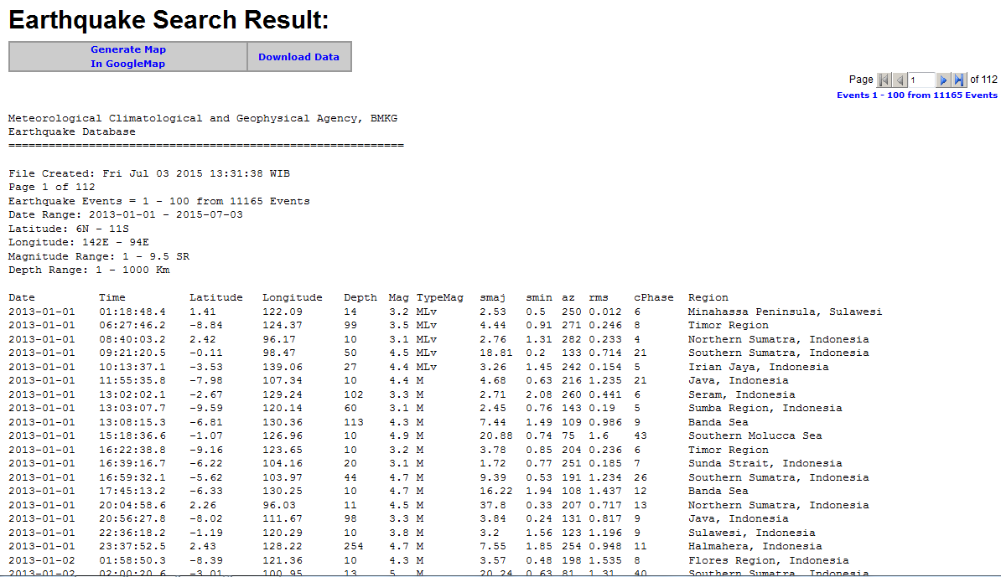
Example of INATEWS Products
Online catalogue : http://repogempa.bmkg.go.id

Slide 7
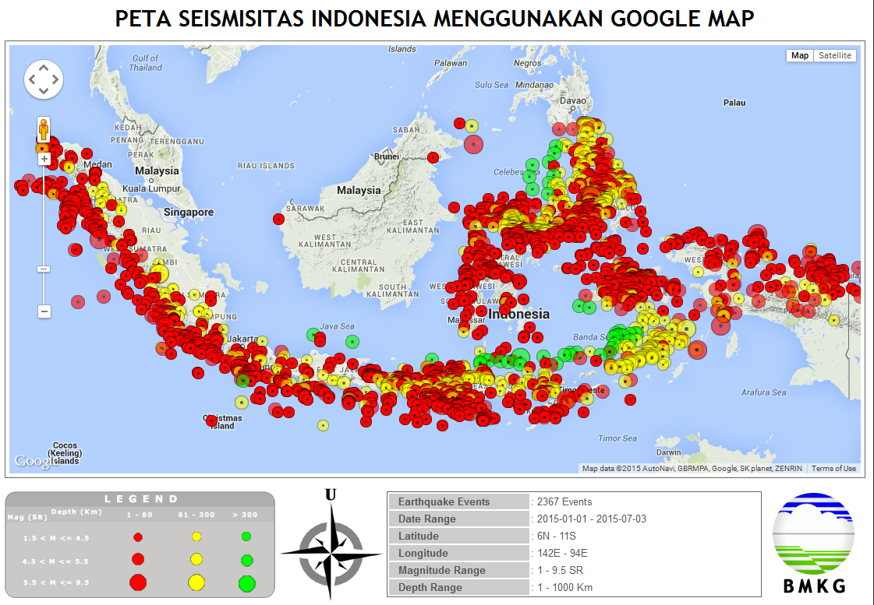
Example of INATEWS Products
Seismicity Map: http://repogempa.bmkg.go.id

Slide 8
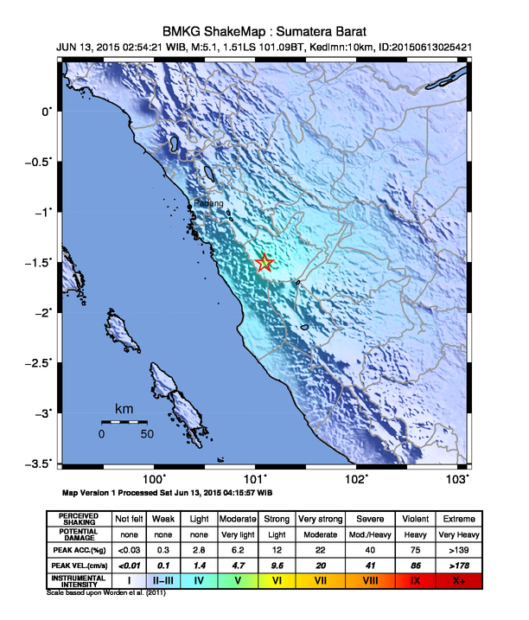
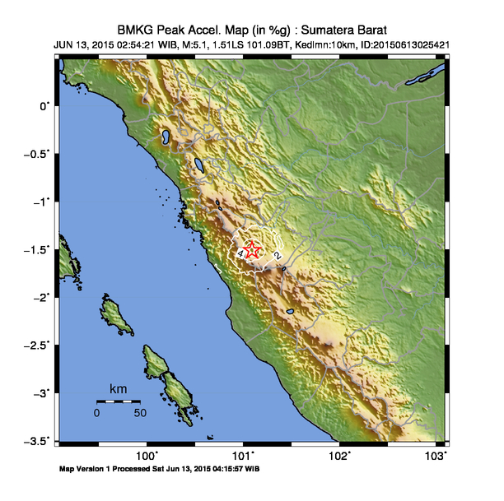
Example of INATEWS Products
Shakemap (http://inatews.bmkg.go.id)

Slide 9
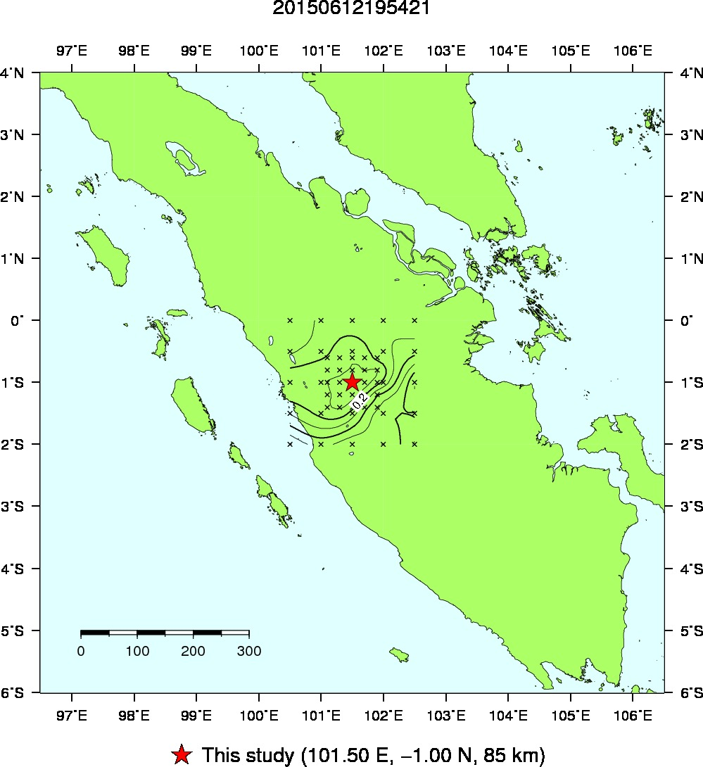
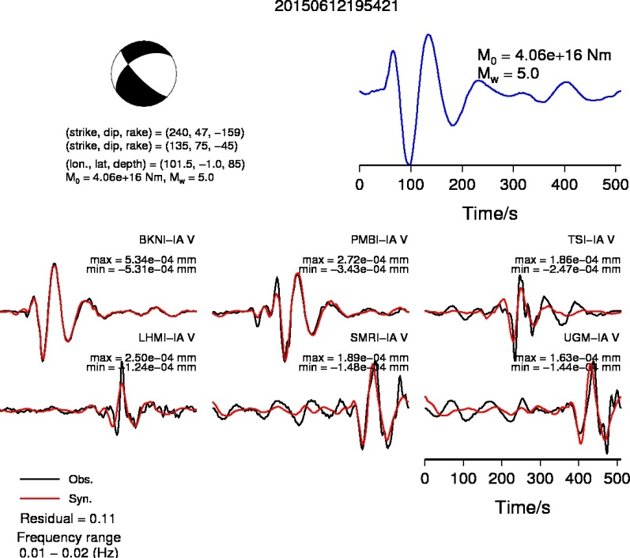
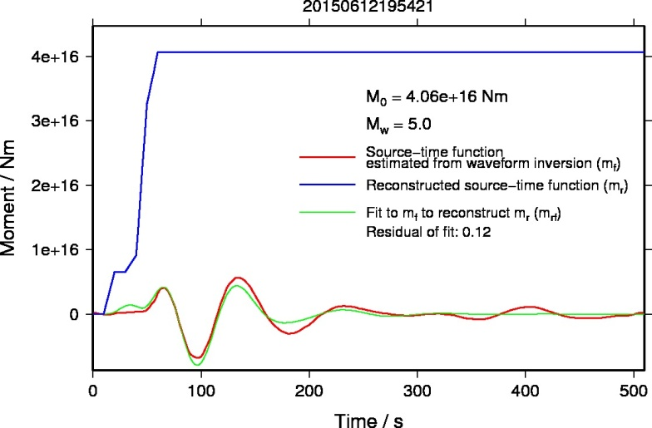
Example of INATEWS Products
Source Mechanism (http://inatews.bmkg.go.id)

Slide 10
Priority Strategic Plan for TEWS (2015-2019)
No. | DEVICE | 2015 | 2016 | 2017 | 2018 | 2019 | TOTAL
1 | BB Seismograph | 0 | 7 | 7 | 6 | 6 | 26
2 | Accelerograph | 81 | 15 | 15 | 15 | 15 | 141
3 | Intensity Meter | 10 | 10 | 10 | 10 | 4 | 44
4 | Tsunami Gauge | 5 | 2 | 3 | 3 | 2 | 15

Slide 11
Thank You
JL. ANGKASA I NO. 2 KEMAYORAN JAKARTA PUSAT – INDONESIA
TEL/ FAX. 62 21 4246321/ 4246703
http://www.bmkg.go.id

