Slide 1
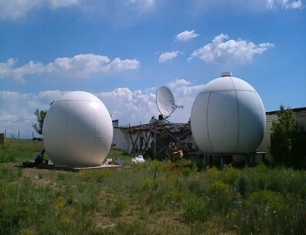
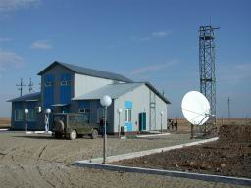
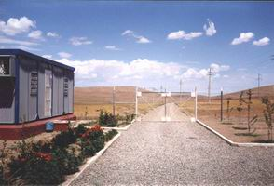
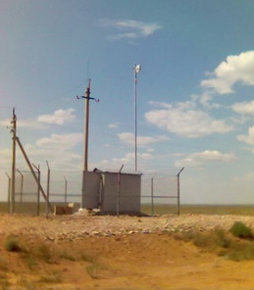
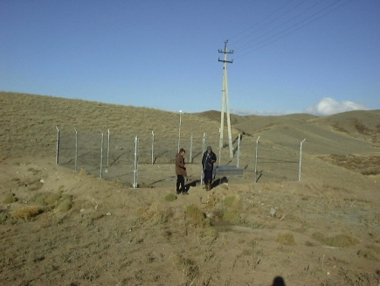
Managing Data from Seismic Networks
Hanoi, Vietnam
Sept. 9, 2015 — Sept. 15, 2015
OBSERVATIONAL NETWORK OF THE INSTITUTE OF GEOPHYSICAL RESEARCH OF THE REPUBLIC OF KAZAKHSTAN (KAZNET)
Reporter:
Inna Sokolova

Slide 2
INTRODUCTION
Geophysical Observatories Aktyubinsk, Borovoye, Kurchatov and Makanchi, created during the Soviet times specially for monitoring nuclear explosions detonated in different parts of the world, made up the basis of the IGR RK seismic observation network. In 1994 they were handed over to the Institute of Geophysical Research RK.
Currently operating IGR RK seismic network is the result of international cooperation on its recovery and modernization.
At the present time the IGR RK observation network includes 8 seismic arrays, 7 three-component stations and 2 infrasound arrays.
Data of this system are used to solve the tasks of global monitoring of nuclear explosions and earthquakes. Data are transferred to International Centers to compile seismic bulletins (REB, ISC, EMSC) and are available to researches from different countries via IRIS/DMC; also, data of this system are used in tasks of Republic system of seismic observations.
The system includes:
- seismic monitoring stations network;
- infrasound monitoring stations;
- Kazakhstan National Data Center in Almaty (KNDC);
- Stations communication system with National and International Data Centers

Slide 3
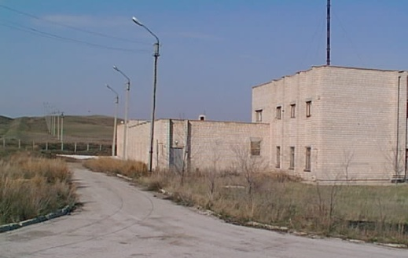
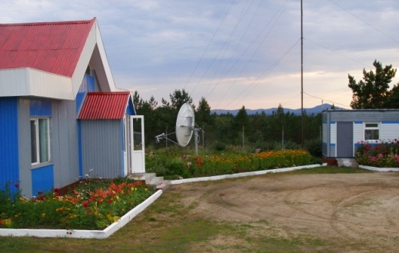
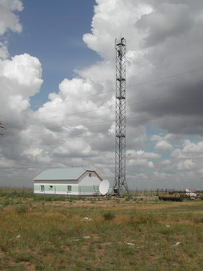
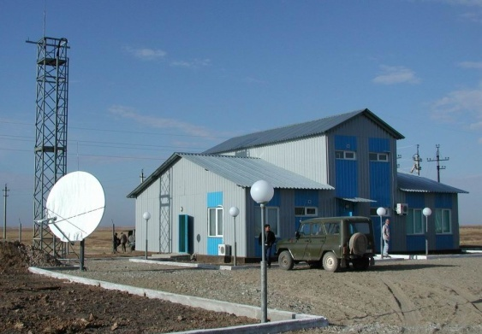
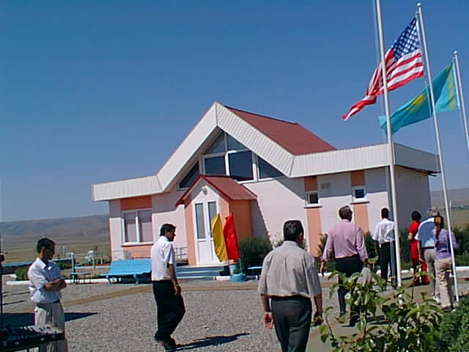
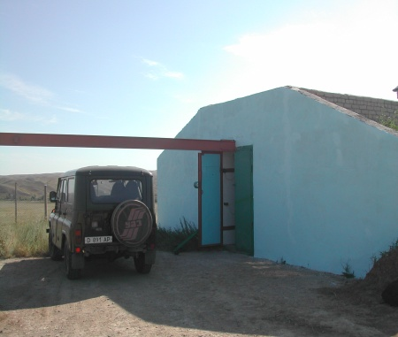
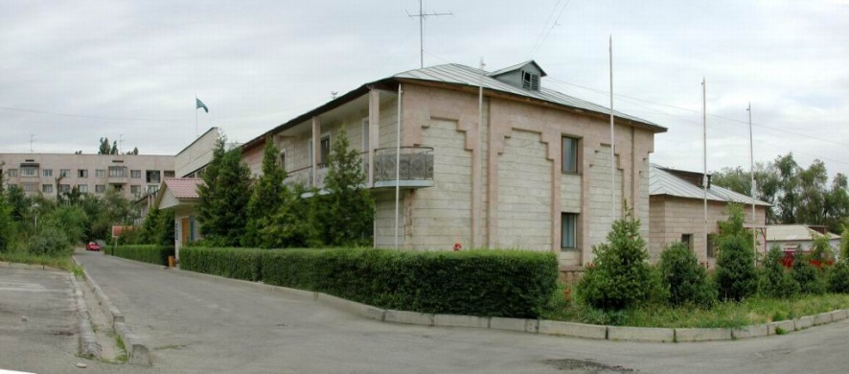
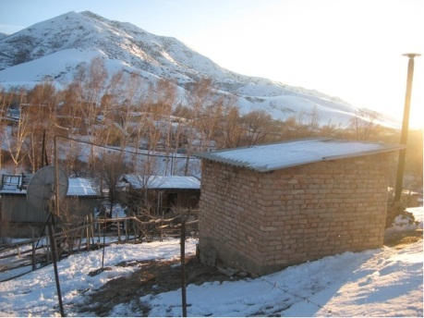
(1999 – 2011) CONSTRUCTED INFRASTRUCTURE FACILITIES OF NUCLEAR MONITORING IN KAZAKHSTAN
PS23 - Makanchi
АS057-Borovoye
АS058-Kurchatov
Akbulak
Karatau
АS059-Aktyubinsk
Total:
■ 15 permanent seismic stations
■ Data Center ■ System of satellite and telemetry communication channels
Data Center in Almaty
PDGK-Podgornoye

Slide 4
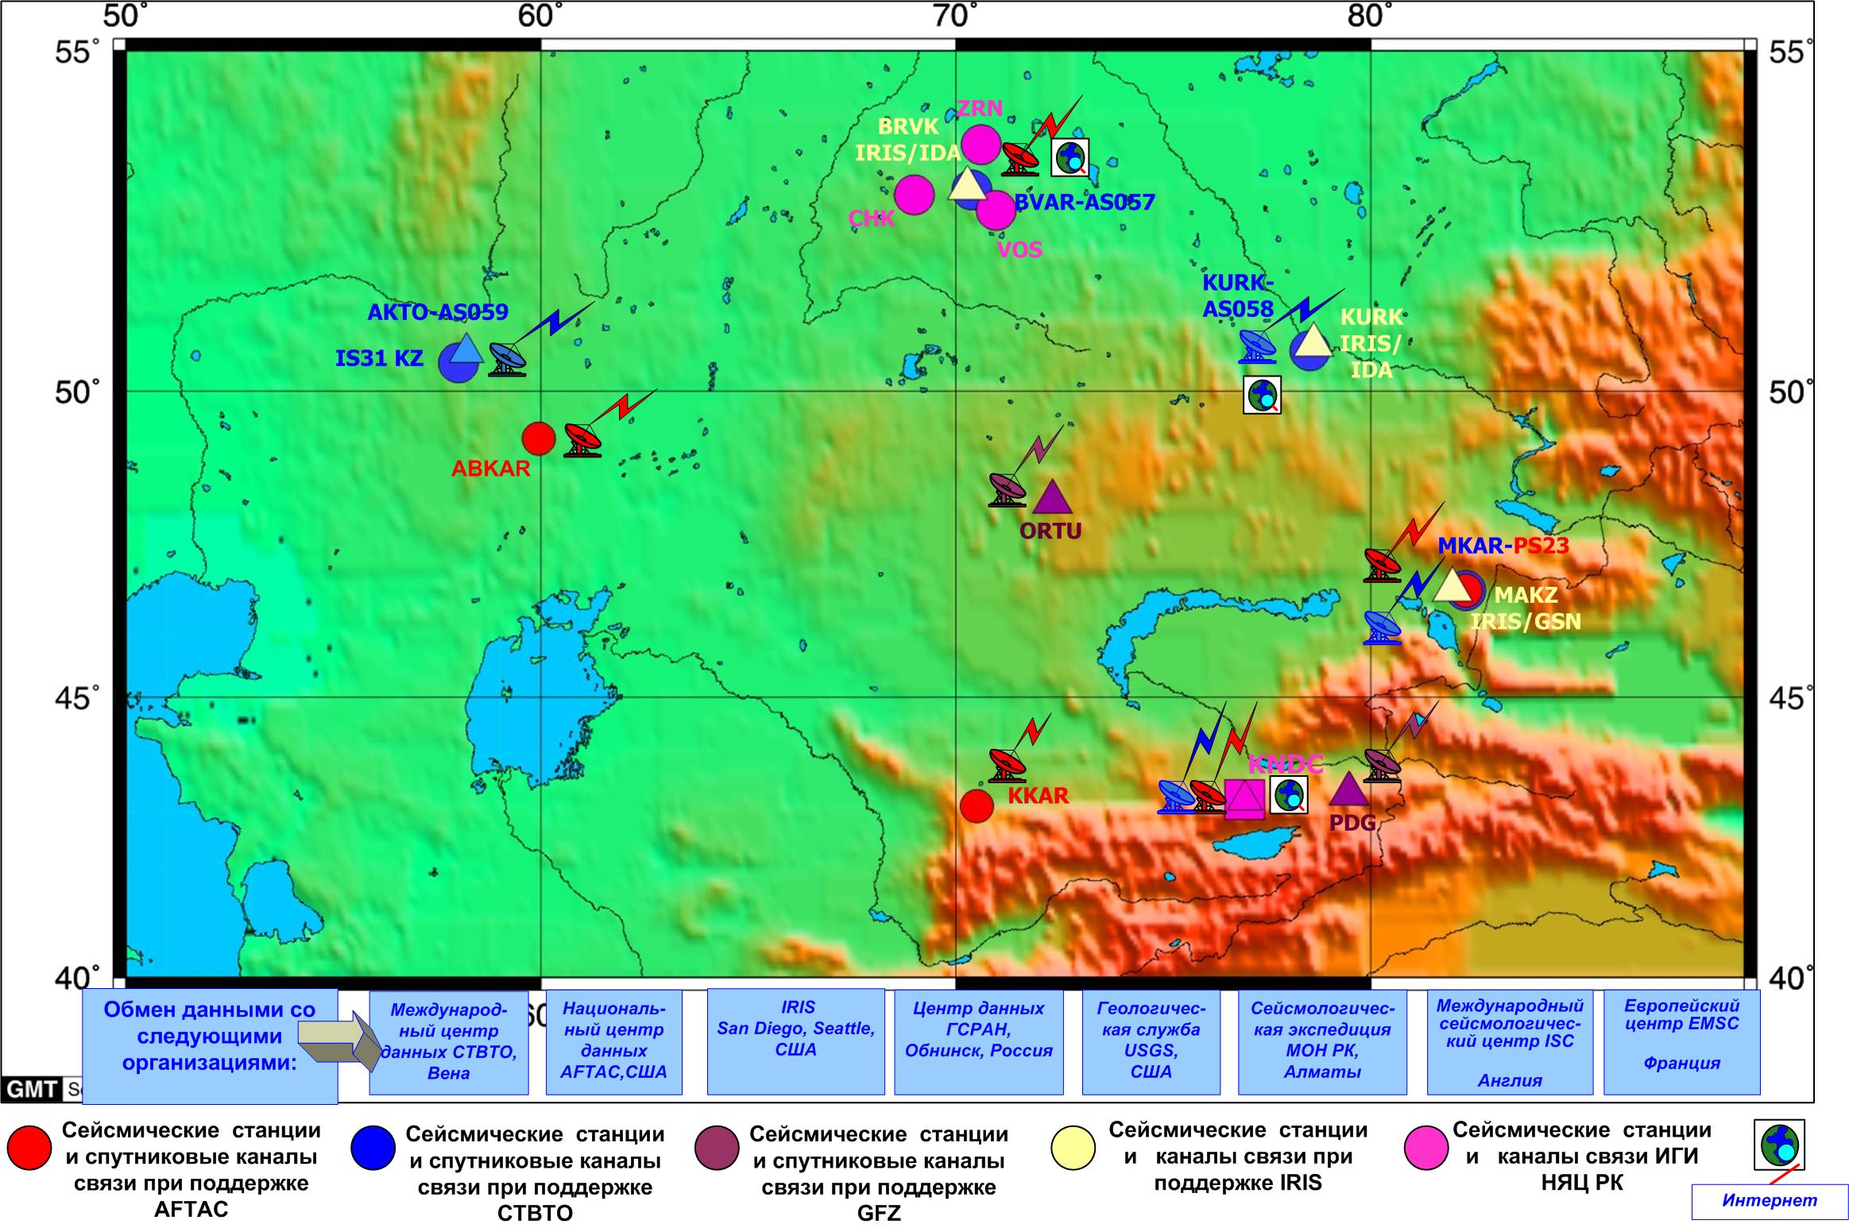
CURRENT ACTIVE MONITORING STATIONS NETWORK FOR NUCLEAR EXPLOSIONS AND EARTHQUAKES IN RK
The map of IGR RK seismic stations location and communication scheme
(8 seismic arrays, 7 3-components stations).

Slide 5
CURRENT ACTIVE MONITORING STATIONS NETWORK FOR NUCLEAR EXPLOSIONS AND EARTHQUAKES IN RK
The main feature of the seismic monitoring system is:
the major part of the stations is seismic arrays;
stations are located mainly throughout the perimeter of Kazakhstan territory;
due to careful geological site selection for stations construction and with relation to seismic noise characteristics, good arrays configuration, and combination of broadband and short-period instruments, all stations are high sensitive to both regional and teleseismic events.
All these features allow to use the system successfully within National and International monitoring.
The models of seismic noise by data of IGR RK network stations ABKAR and KUR21 and world noise models.

Slide 6
Coordinates of IGR RK network stations.*
Station name | Station type | Station code | Latitude | Longitude | Height, m | Network
Borovoye | 3-component | BRVK | 53.0581 | 70.2828 | 330 | IGR, IRIS IDA
Borovoye | array | BVAR | 53.0240 | 70.3880 | 361 | IGR, IMS
Vostochnoye | array | VOS | 52.7232 | 70.9797 | 300 | IGR
Zerenda | array | ZRNK | 52.9510 | 69.0043 | 380 | IGR
Chkalovo | array | CHKZ | 53.6762 | 70.6152 | 120 | IGR
Kurchatov | 3-component | KURK | 50.7154 | 78.6202 | 184 | IGR, IRIS IDA
Kurchatov-Cross | array | KUR01-21 | 50.6222 | 78.5311 | 240 | IGR, IMS
Makanchi | 3-component | MAKZ | 46.8080 | 81.9770 | 600 | IGR, IRIS GSN
Makanchi | array | MKAR | 46.7937 | 82.2903 | 615 | IGR, IMS, AFTAC
Podgornoye | 3-component | PDGK | 43.3275 | 79.4850 | 1277 | IGR, GFZ
Ortau | 3-component | OTUK | 48.24433 | 72.3376 | 750 | IGR, GFZ
Karatayu | array | KKAR | 43.1051 | 70.5067 | 525 | IGR, AFTAC
Aktyubinsk | 3-component | AKTO | 50.4348 | 58.0164 | 379 | IGR, IMS
Akbulak | array | ABKAR | 49.2558 | 59.9431 | 362 | IGR, AFTAC
KNDC | 3-component | KNDC | 43.2172 | 76.9658 | 900 | IGR
* coordinates of 3-component instruments installation are indicated for arrays

Slide 7
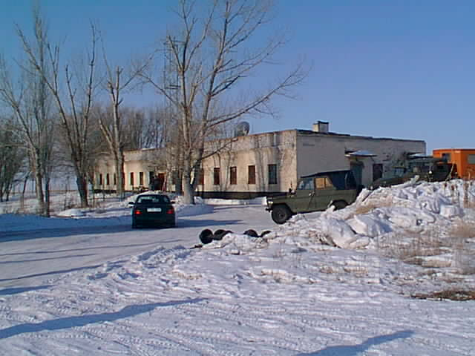
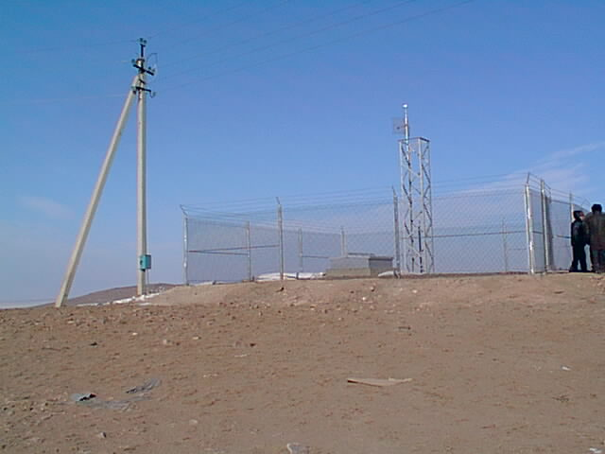
MKAR-PS23 seismic array
The array consists of 9 borehole vertical and two 3-C stations;
Aperture of the array is ~4 km.
Data are continuously transmitted to IDC (Vienna),
KazNDC (Almaty) and from KazNDC to
AFTAC (USA).
BVAR, KKAR and ABKAR arrays are of the similar configuration.

Slide 8
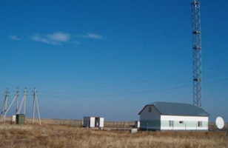
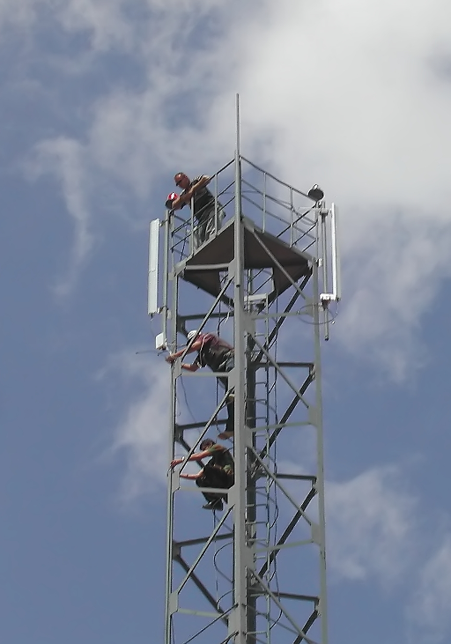
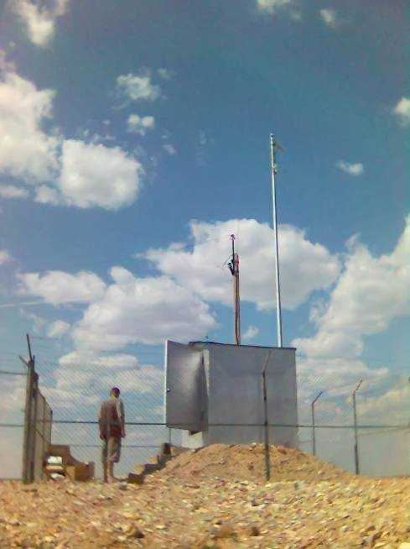
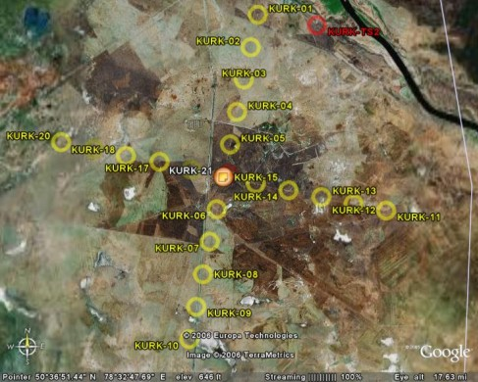
KURK – AS58 teleseismic array.
Kurchatov cross-array consists of 21 borehole vertical and one 3-C broadband seismometers;
Aperture of the array is 22.5 km.
Data are transmitted to IDC (Vienna) on request and to the KazNDC (Almaty) continuously .

Slide 9
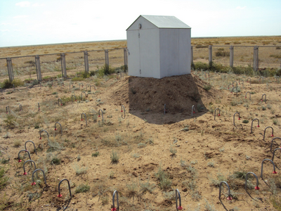
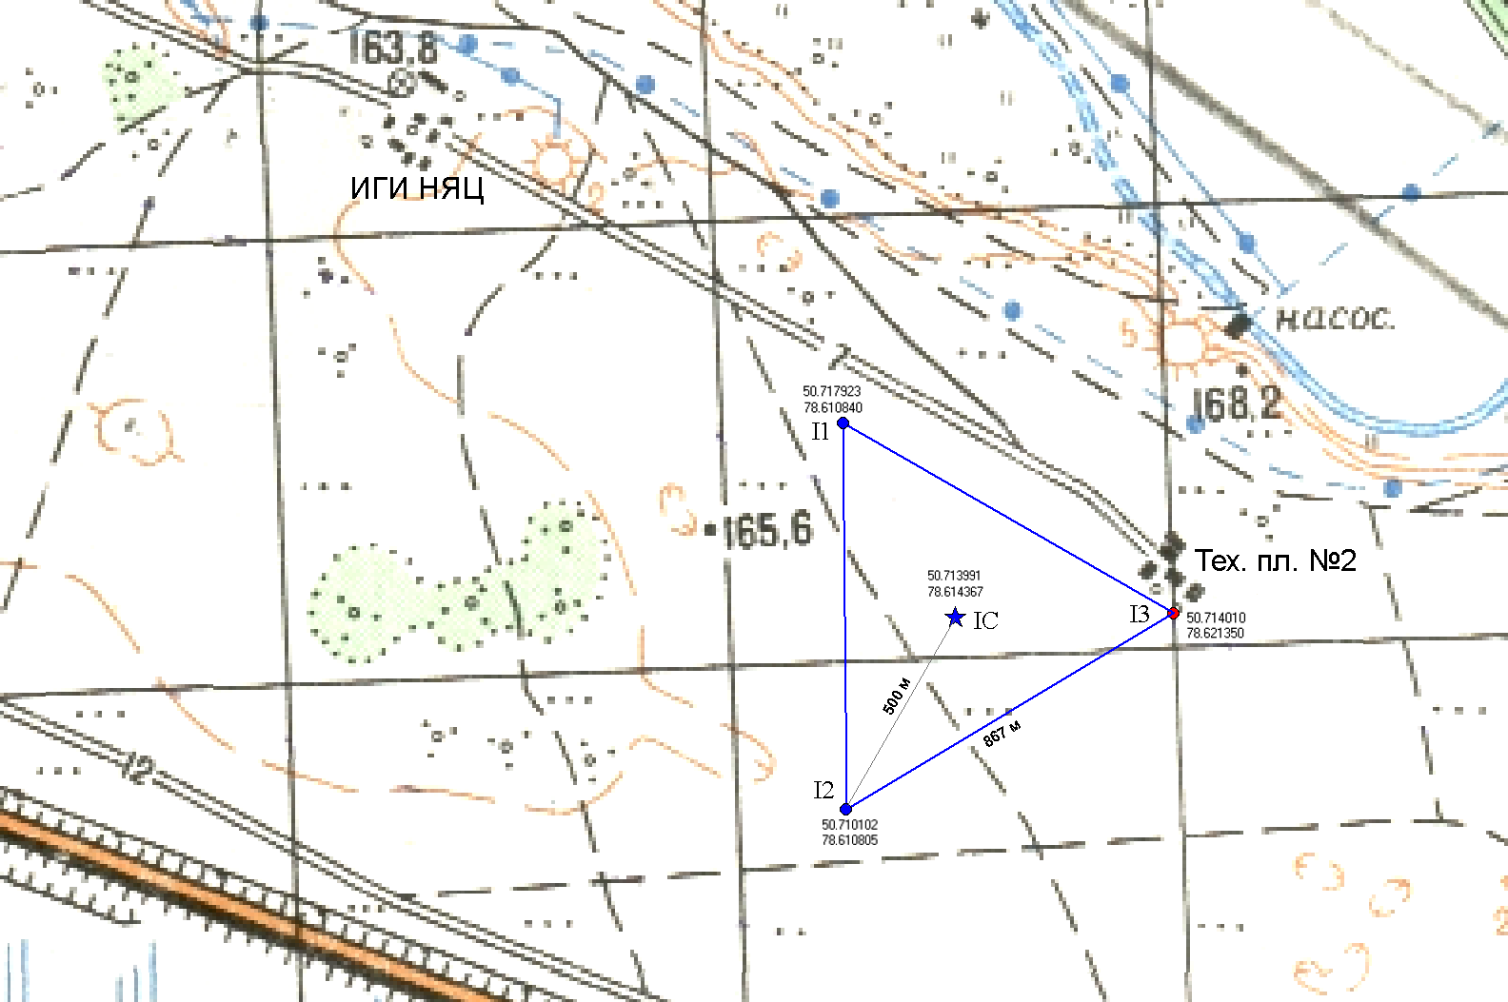
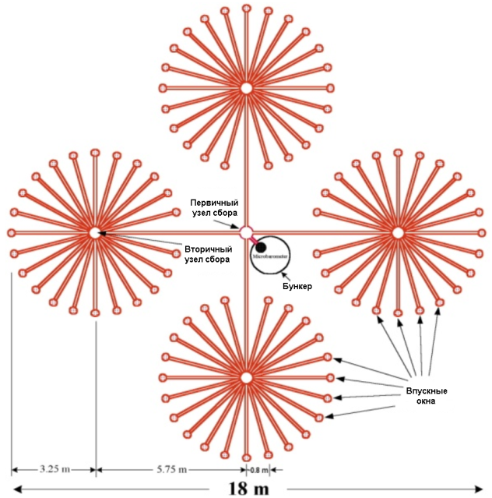
KURIS – infrasound array.
KURIS infrasound station is located at Kurchatov town of East-Kazakhstan region.
Infrasound sensors, microbarometers MB2005 and digitizers CMG-DM24 are installed in bunkers. In total, there are four such equipment vaults. The wind interference suppression devices are connected to the microbarometers inputs. Sample rate: 20 samples/sec/channel. Seismic data are digitized according to GPS. Infrasound data are transferred to the Center Processing Facility via wire modems VDSL. After that the information is transferred to the KNDC via internet channels.

Slide 10
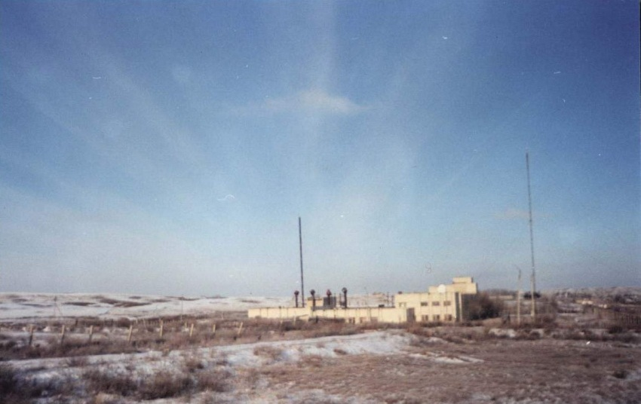
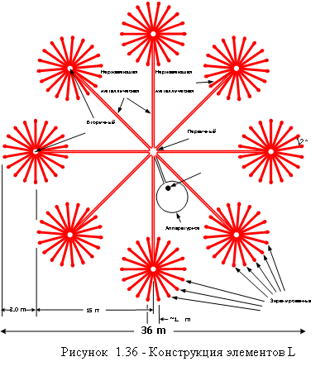
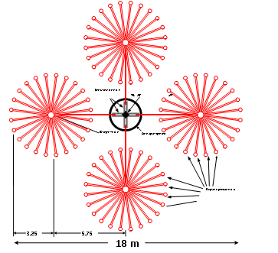
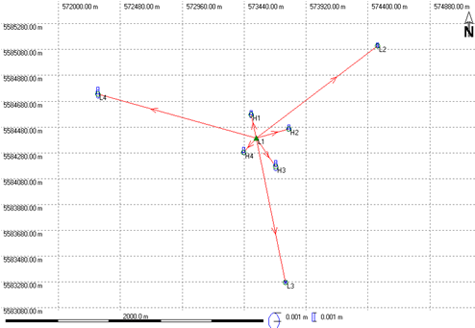
IS31 - infrasound array.
A primary infrasound station of the International Monitoring System (IMS) “Aktyubinsk” IS31 (IS31KZ) is located at Tassay settlement of Chromtayu region, Aktyubinsk area.
Infrasound sensors – microbarometers МВ2000 and Aubrac digitizers are installed in bunkers. In total there are eight such equipment vaults. Systems H and L differ by device construction for wind interference suppression. L1 site, in addition, has a weather station. Sample rate: 20 samples/sec/channel. Seismic data are digitized according to GPS. Infrasound data are transferred to the Center Processing Facility via radio modems, and then together with seismic data of AKTO station to the IDC via a satellite channel.

Slide 11
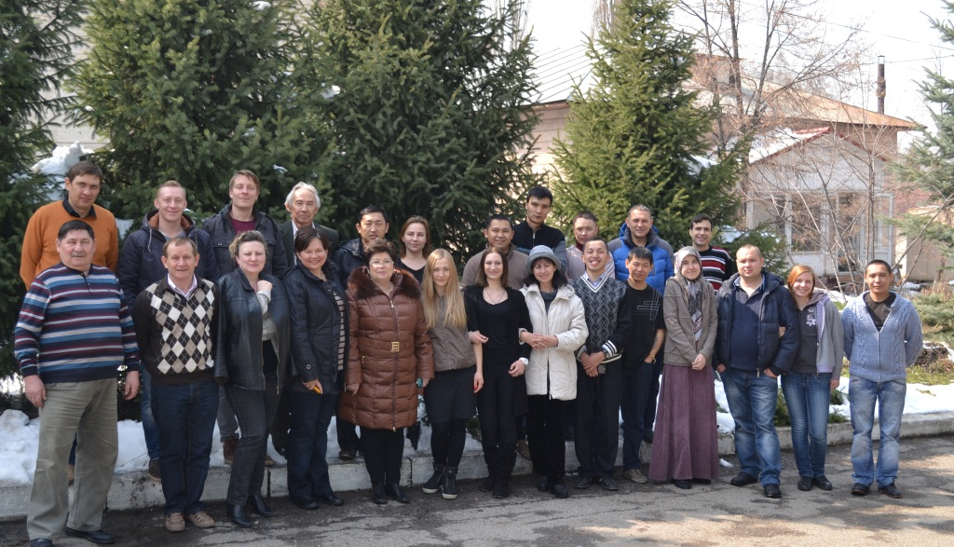
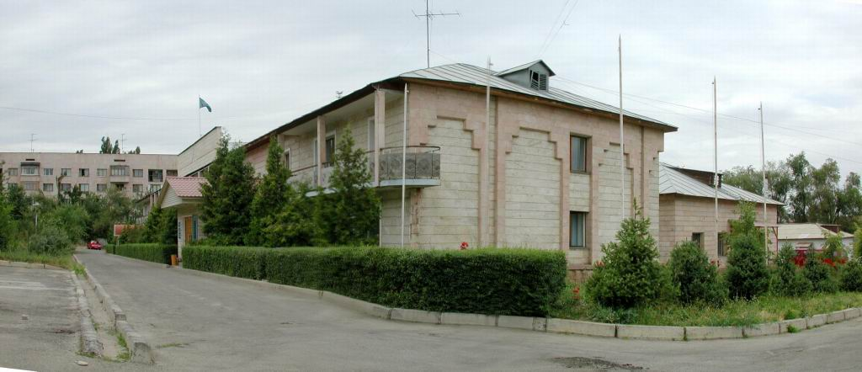
CENTER FOR ACQUISITION AND PROCESSING OF SPECIAL SEISMIC INFORMATION (ALMATY)
Information products of KNDC (bulletin with more than 20 thousand events per year):
● Urgent reports
● Automated seismic bulletin (accessible on the web-site);
● interactive seismic bulletin (accessible on the web-site);
● Joint seismic bulletin (data of IGR and SEME MES RK) available on request. ● Database of earthquakes and explosions (after events nature discrimination) ● Automated infrasound events bulletin
Databases in KNDC
11

Slide 12
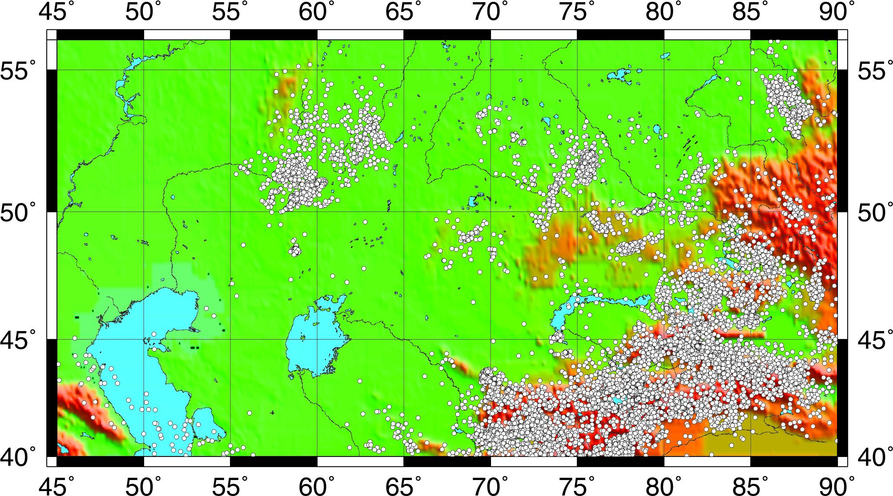
SEISMIC EVENTS MONITORING ON CENTRAL ASIA TERRITORY
● More that 16 000 events are processed per year at regional distances.
The map of earthquakes epicenters recorded in 2014 by data of the IGR RK network data. In total, there were 16360 events recorded. Explosions - 5366,
earthquakes - 10994

Slide 13
Kazakhstan Data Center conducts active data exchange with many scientific Organizations of Kazakhstan and the whole world.
Data exchange is conducted with the following Organizations:
- Raw data in real time are transferred to IDC (Vienna), USA NDC (Florida, USA), IRIS (USA).
- Automatic seismological bulletin – EMSC (France).
- Interactive bulletin – ISC (England).
- Summary bulletin – Institute of Seismology of Kazakhstan.
- Reports on large teleseismic events – GS RAS (Obninsk).
- SEED-volumes –IRIS/DMC
- KNDC data are transferred to NORSAR (Norway), to SEA/DASE on demand.
Gygabytes shipped by KZNET to IRIS DMC

Slide 14
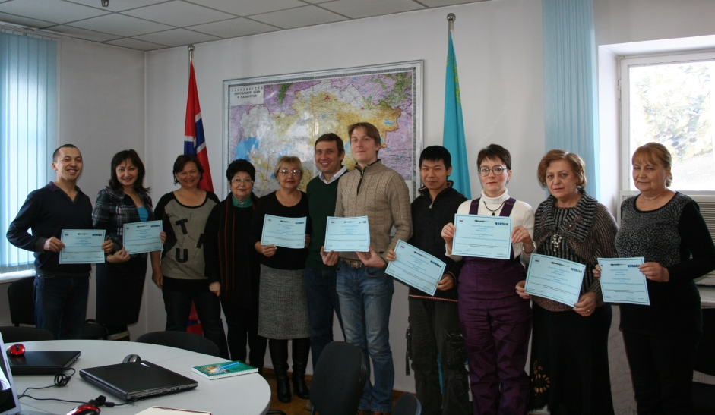
OPENING OF THE INTERNATIONAL TRAINING CENTER IN SUPPORT OF THE CTBTO
The International Training Center was established at the premises of KNDC in Almaty (Kazakhstan) under financial and methodical support of the Norwegian MFA and NORSAR. Since 2010, for the specialists of five Central Asia countries there were 12 one-month courses on interpreting and processing of seismograms in support of the CTBTO, 4 seminars on techniques of analog seismograms digitization and technical maintenance of monitoring stations, and courses on GEOTOOL operation. In total, 90 specialists participated in the training courses. Lectures and practical exercises for the trainees are given by the KNDC staff having large practical experience on working with seismological data, and some lectures are given by specialists invited from abroad. The seismologists from different countries mastered the common data formats for storage and exchange of information, and the techniques on source location and discrimination of events nature.

Slide 15
CONCLUSION
Modern monitoring system for nuclear explosions and earthquakes created in Kazakhstan allows to conduct scientific researches in different directions:
- Operative notification to the Ministry for Emergency Situations of RK about occurred earthquakes.
- Seismic hazard assessment;
- Investigation of seismic regime;
- Investigation of geodynamic processes in Central and South Asia;
- Discrimination of seismic events nature;
- Urgent processing and data presentation about industrial catastrophes (rockets fall, pipelines burst etc.) on the basis of seismic and infrasound records processing.
Investigation of lithosphere structure and upper mantle, etc.
Data of this system are used for the tasks of nuclear explosions and earthquakes global monitoring. Data are transferred to International Centers to create world seismic bulletins (REB, ISC, EMSC) and to carry out scientific investigations by researchers from different countries
In the nearest time, it is planned to upgrade the large-aperture Borovoye array, and to construct infrasound array in Makanchi.

