Slide 1
Introduction to the Broadband Array in Taiwan for Seismology (BATS)
Presenter: Min-Hung Shih
2015/09

Slide 2
Broadband Array in Taiwan for Seismology (BATS)
Broadband
Array in
Taiwan for
Seismology
IES: 26 stations
CWB: 34 stations
GSN: 1 stations

Slide 3
Seismometers

Slide 4
Datalogger - Q680, Q4120, Q330, and Q330HR

Slide 5
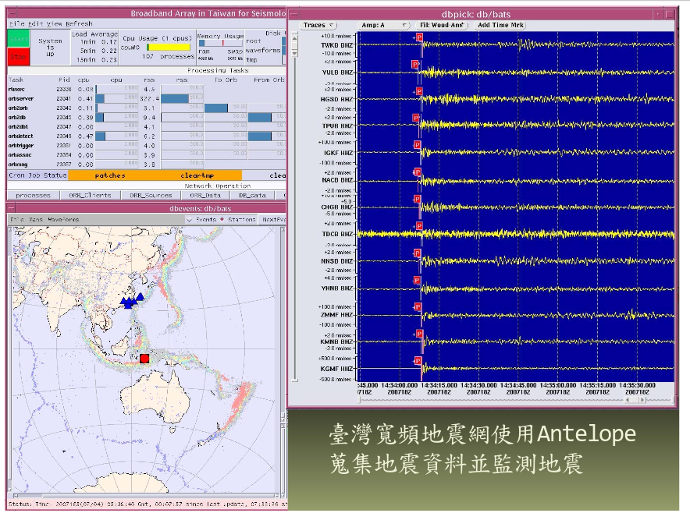
BATS Real-Time System

Slide 6
BATS website (http://bats.earth.sinica.edu.tw)

Slide 7
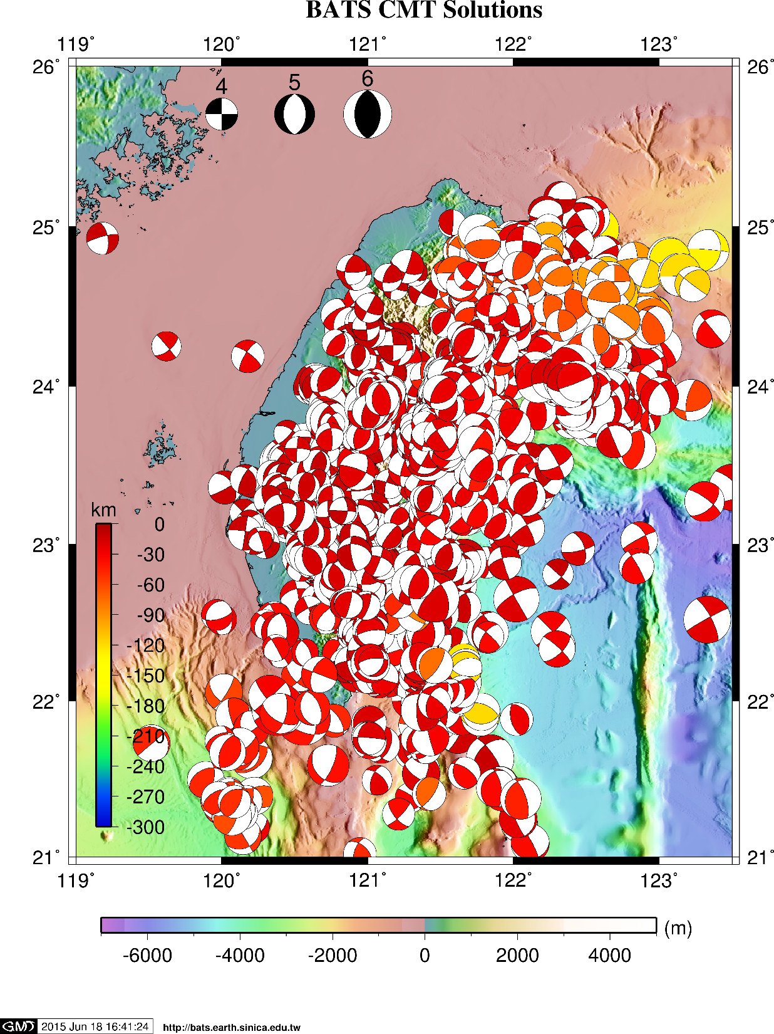
BATS CMT Catalog
Date 1995-07-05~ 2015-06-18
Mw: 3.0 ~ 8.0
Depth: 0~ 300
Latitude : 20.0 ~ 27.0
Longitude: 119.0~124.0

Slide 10
Thank you !!!

