Slide 1
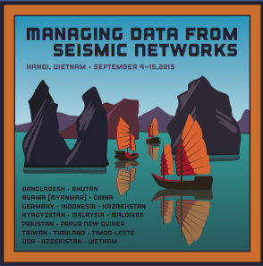
Managing Data from Seismic Networks
Hanoi, Vietnam
9-15 September 2015

Slide 2
Sincere Appreciation to the
Workshop Hosts
Local Hosts and Organization
Vietnam Academy of Science & Technology
Dr. Nguyen Xuan Anh
Vietnam Institute of Geophysics
Mr. Dinh Quoc Van
Regional organizer
RIMES ( Regional Integrated Multi-Hazard Early warning System for Africa and Asia)
Logistics
Gale Cox from the IRIS DMC

Slide 3
Workshop Sponsors
International-Sponsors
IRIS
US National Science Foundation
IASPEI
FDSN
IES, Academia Sinica
TEC
CEA-IGP

Slide 4
Workshop Objectives
Present state-of-the-art seismic network design principles to network operators
Improve the understanding of modern seismic instrumentation
Understand how modern data have both monitoring and scientific uses
Training in tools enabling the production of waveform data and metadata using the FDSN standards
Building connections between network operators in Asia and the Western Pacific
Encourage sharing of seismic data with neighboring countries and internationally with the FDSN Data Center at IRIS

Slide 5
Introduction of Lecturers and facilitators
Tim Ahern
Rick Benson
Peter Davis
Emile Okal
Mary Templeton
Joachim Wasserman
Bernd Weber

Slide 6
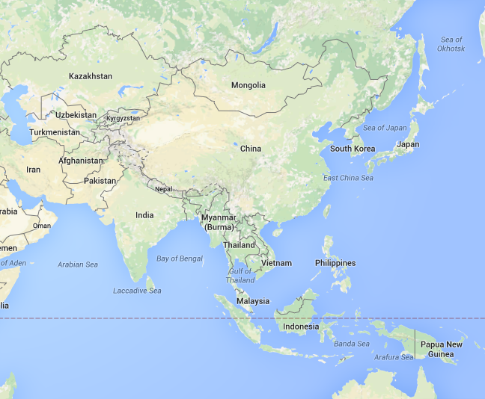
Representatives from
Asia Pacific Region
38 participants from 19 countries are represented
Germany
USA

Slide 7
Network Reports
Network Reports
We have 20 network reports
12 minutes + 3 minutes
Workshop Logistics contact
Mr. Dinh Quoc Van

Slide 8
Introduction of Participants
Name
Organization
Country
Your role in your organization
Please Leave Details to your Network Report

