Slide 1
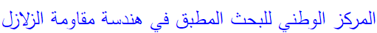

Centre National De Recherche Appliquée En Génie Parasismique
National Center for Applied Research in Earthquake Engineering
CGS seismic Networks
CHIKH Moad
Rue Kaddour Rahim Prolongée B.P.252 (en face la poste) Hussein day – ALGER - ALGERIA
Phone: +2013 23 77 58 15 / 26
Web: www.cgs-dz.org
Email: cgsd@wissal.dz - cgsd@cgs-dz.org

Slide 2
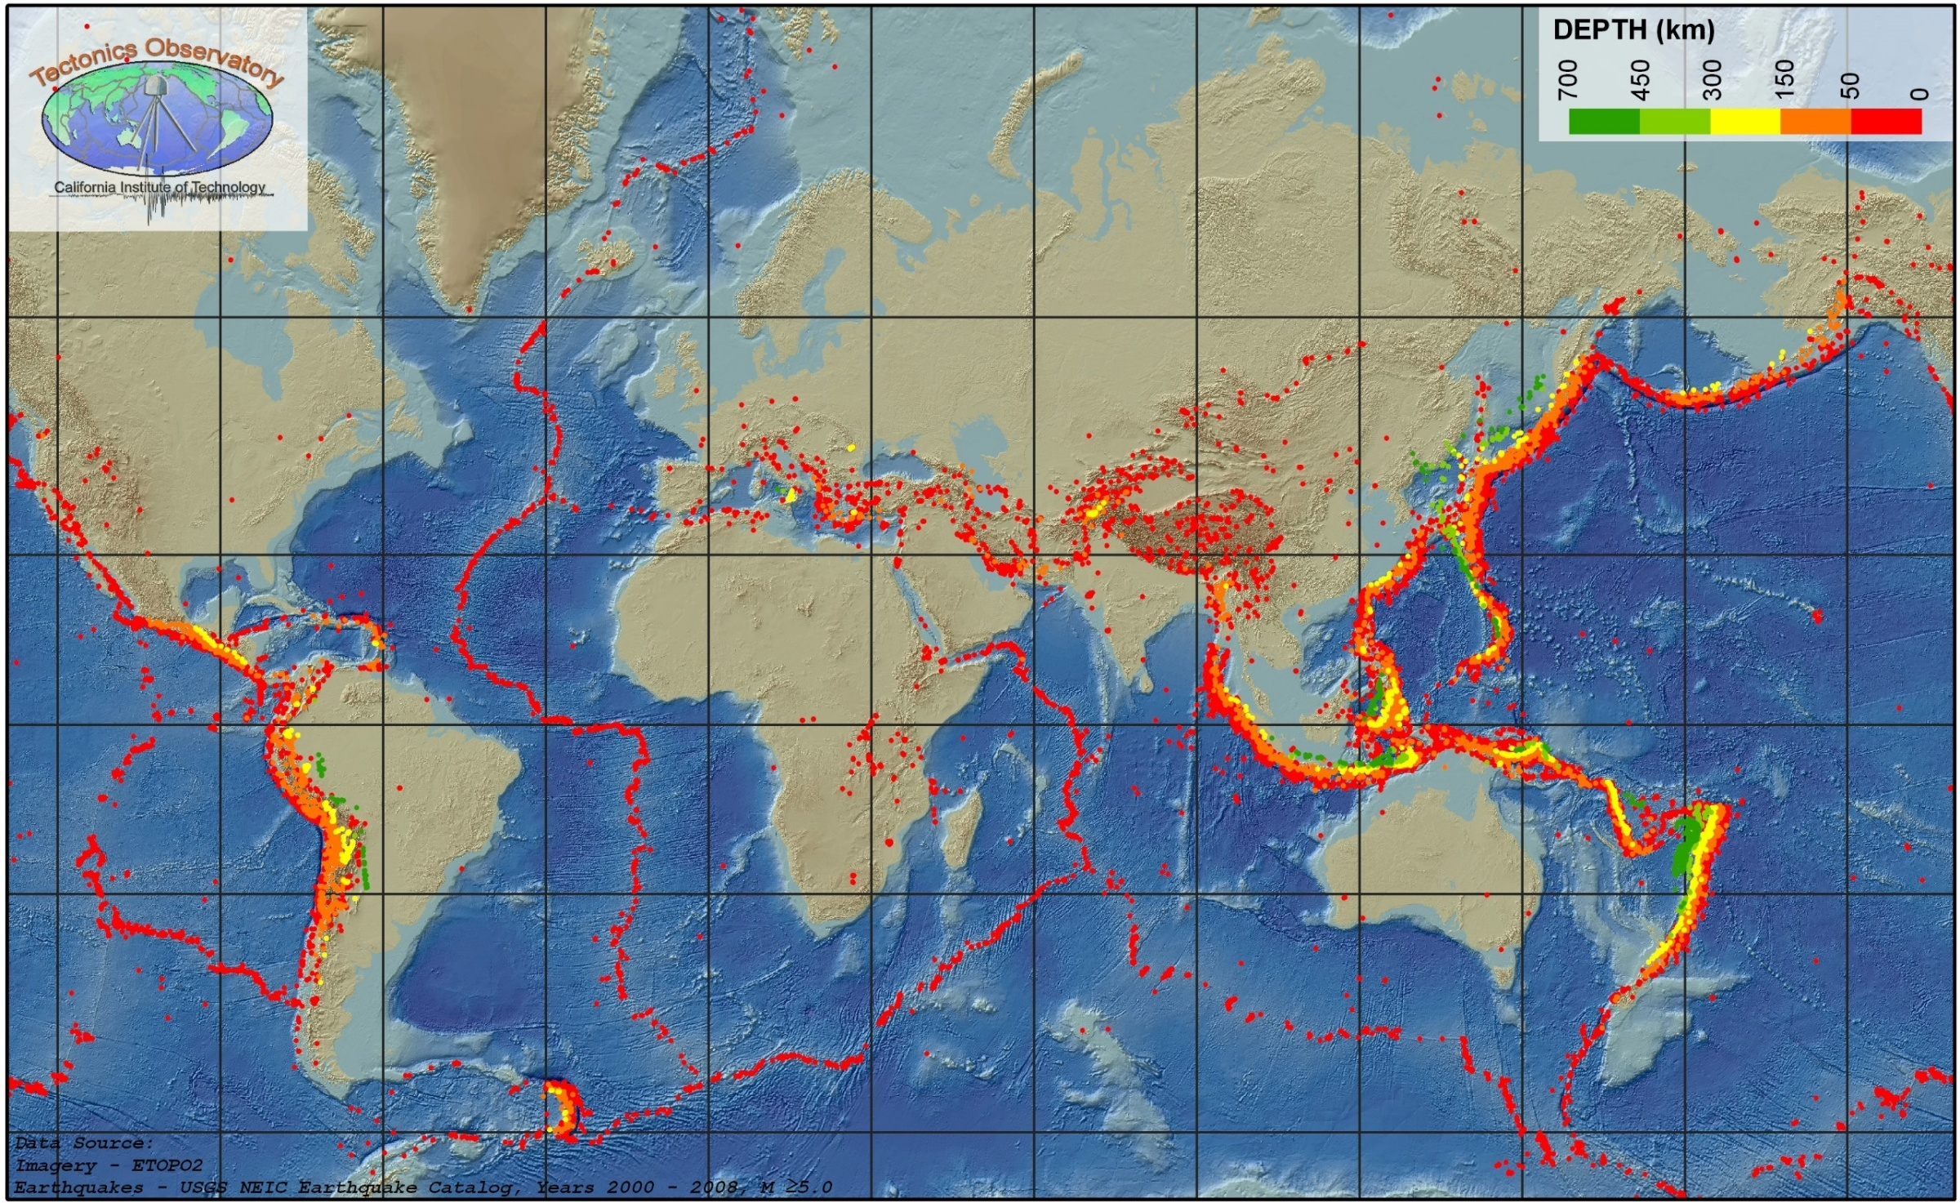
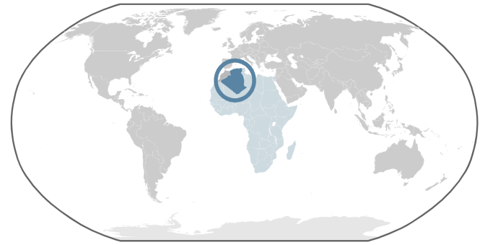
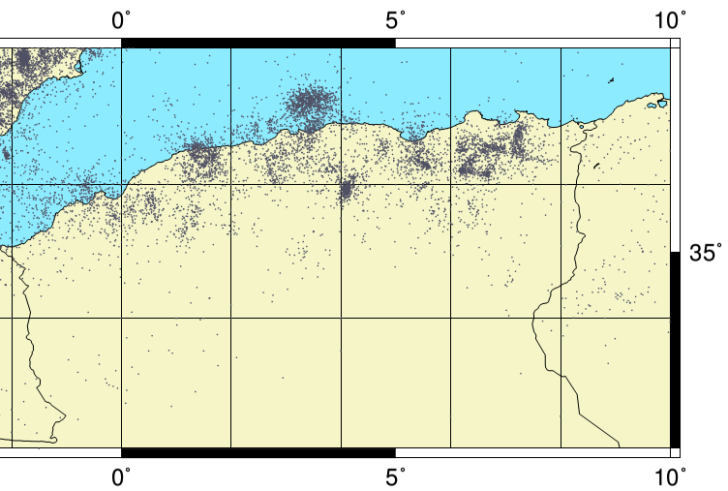
Global seismicity Map
http://www.nsf.gov
Map from (Argus et al. 1991).
The westernmost Mediterranean deformation is a tectonic expression of north south convergence between Eurasia and Africa plate since 70 million years (Philip, 1983 ; Mc Kenzie, 1972). This convergence is expressed by continental collision responsible of moderate to strong earthquakes strike north-west of Africa (ex : El Asnam, 1980 Mw = 6.8 ; Zemmouri, 2003 Mw = 6.8 and El Hoceima, 2004 Mw = 6.4).
The epicentres distribution shows that earthquakes occur mostly in northern part of Algeria.
The seismicity is concentrated in areas such as Oran-Beni Chougrane, Chellif-Ain Defla, Algiers-Tipaza, Babor-Hodna bassin and the region of Constantine-Guelma.
Seismicity distribution in north Algeria
Data from ISC International Seismological Centre, On-line Bulletin, from 1910 to October 2014
2

Slide 3
Northern Algerian seismotectonic map (BELJOUDI 2011)
1790 Oran earthquake (I₀=X MSK).
the El Asnam area (1891 (I₀=X), 1934 (I₀=IX MSK), 1954 (I₀=X–XI MSK) and 1980 (Mw=6.8);
Algiers and Boumerdes zone 1365 (I₀=X EMS98), 1716 (I₀=IX EMS98) Algiers and 2003 Boumerdes (Mw=6.8)
Djijelli zone 1856 (I0=X EMS98) that was located offshore.
Earthquakes in Northern Algeria occur mostly at shallow depths (<10 km).
3

Slide 4
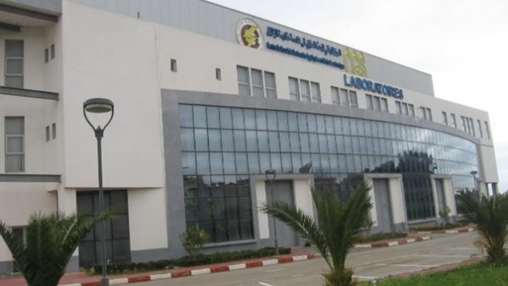
Centre National de Recherche Appliquée en Génie Parasismique (CGS)
CGS objective is to develop, implement and disseminate scientific knowledge and technical engineering to help reduce seismic risk in Algeria.
CGS is also involved in the adoption and enforcement of building codes and future development planning at the regional and local levels, as well as the development of appropriate plans for disaster prevention and response .
4

Slide 5
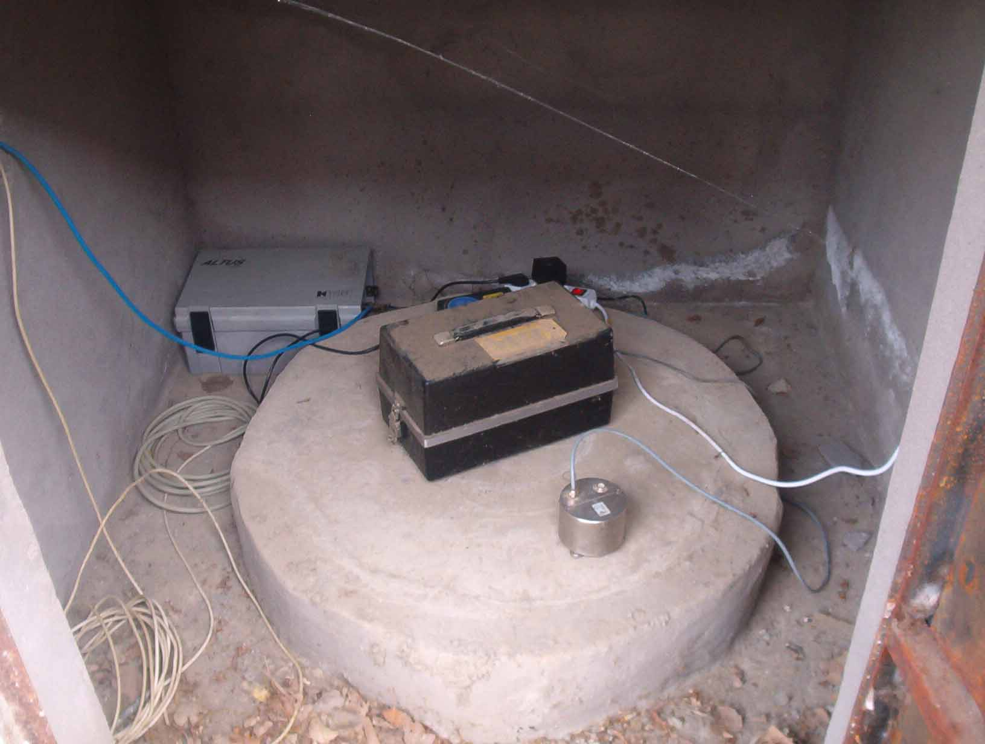
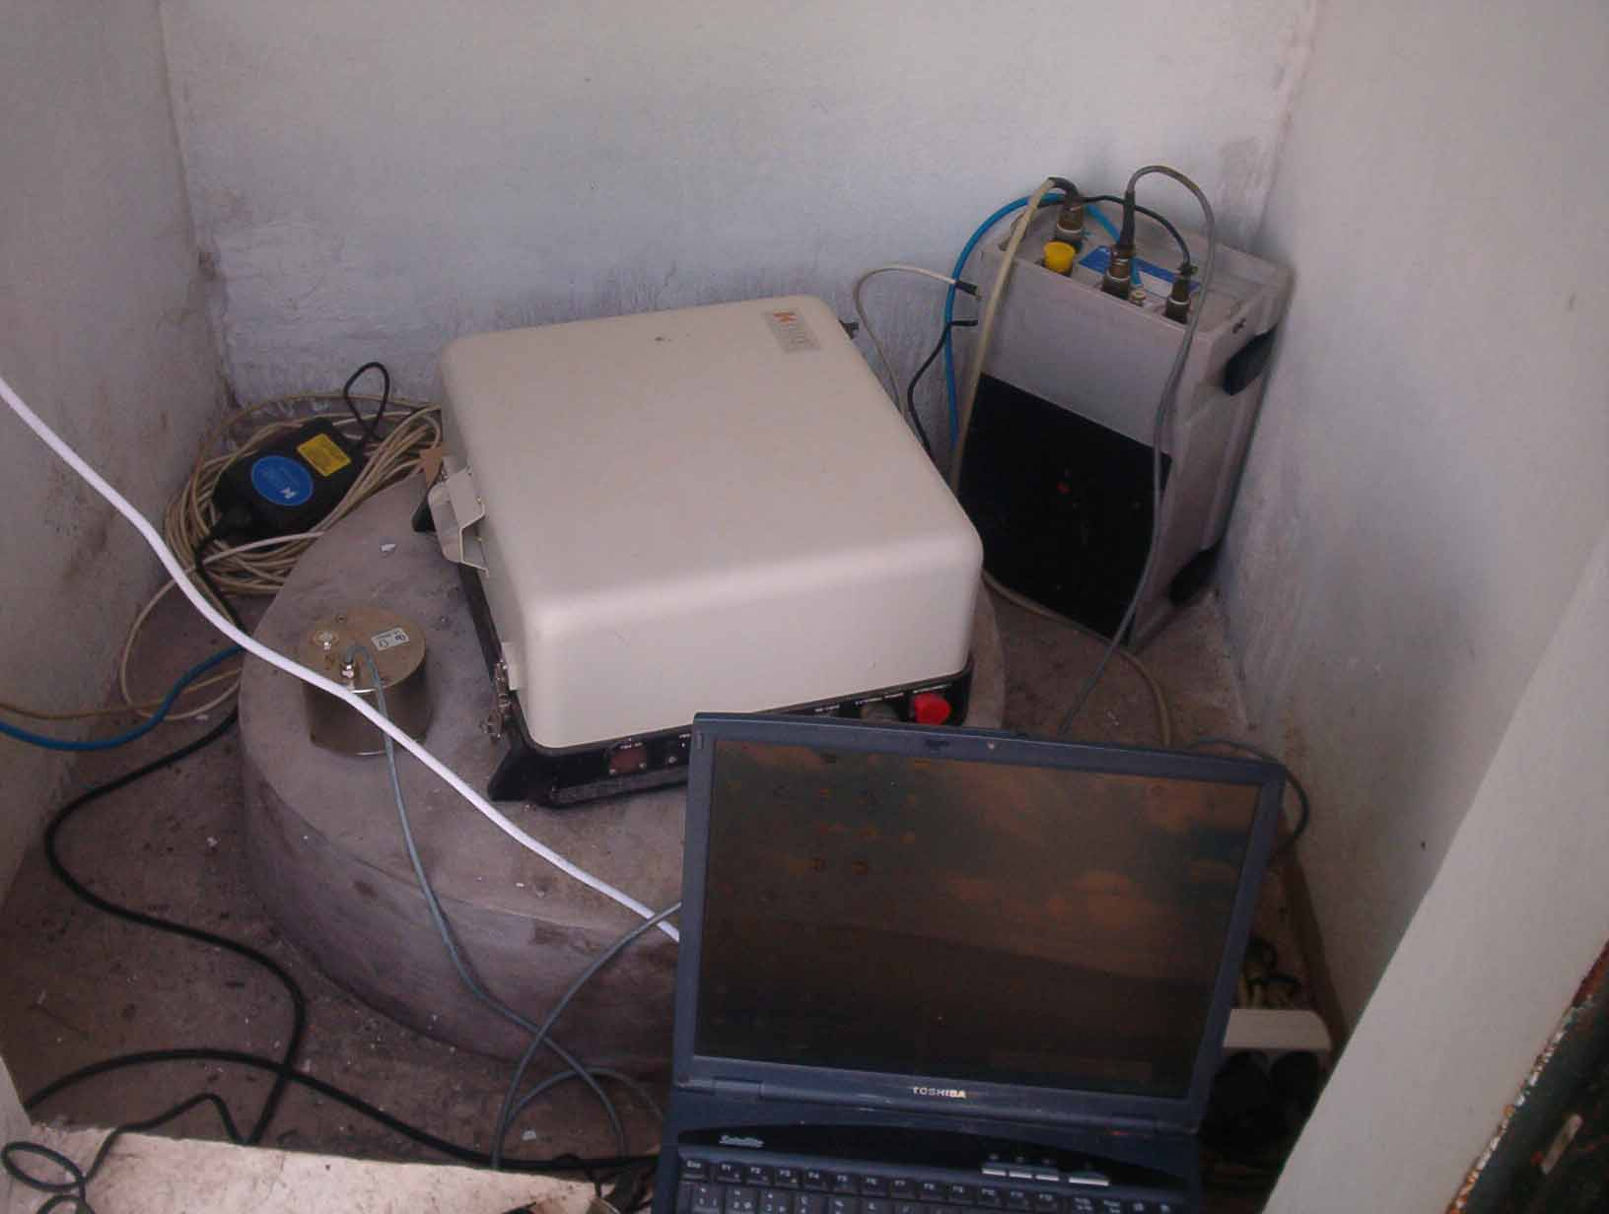
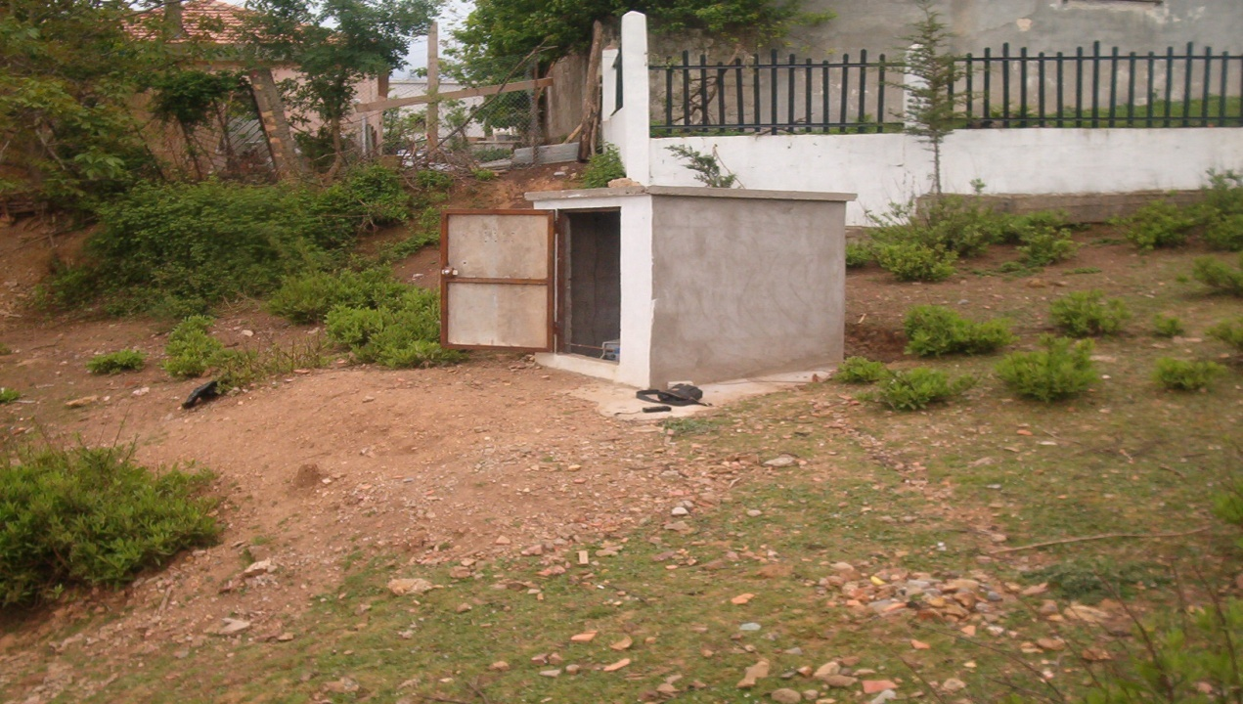
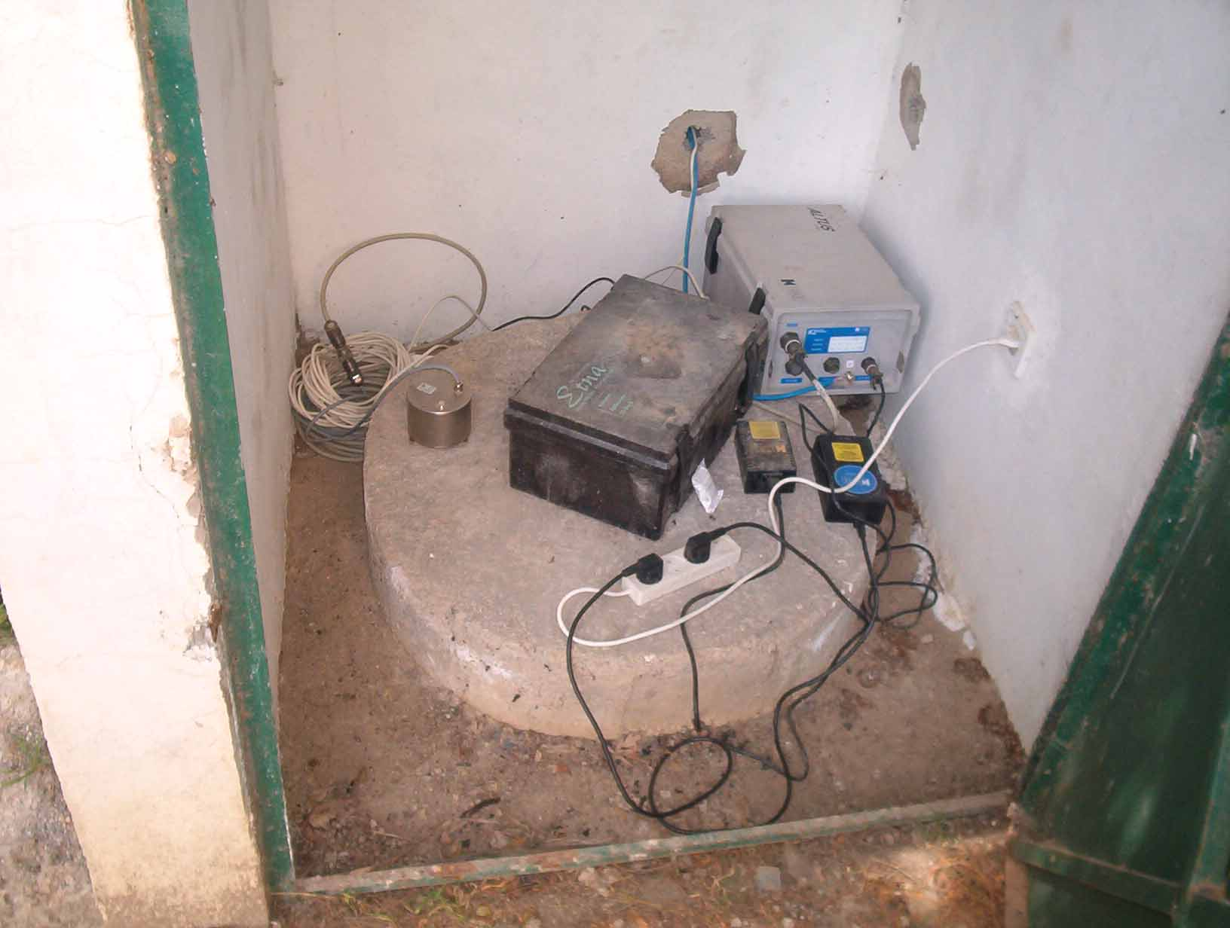
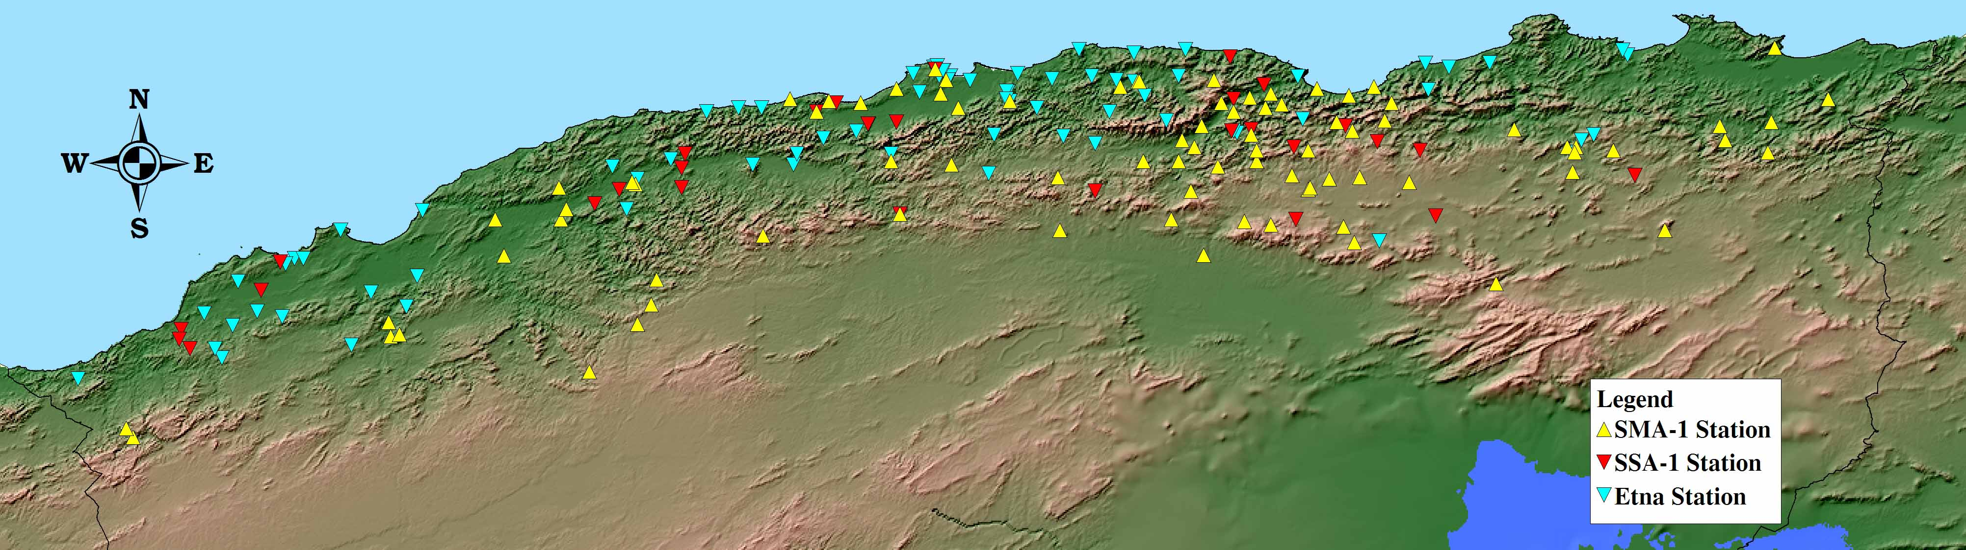
170 analog stations SMA-1
40 digital stations SSA-1
125 digital stations Etna
Free field Accelerometric station installation
Accelerograph shelter (TEXANA-JIJEL)
Algerian Accelerometric Network distribution

Slide 7
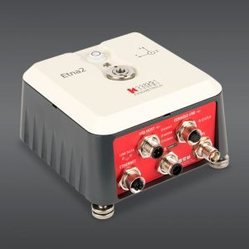

The CGS acquired 160 Kinemetrics ETNA 2 digital stations in 2017. These stations are intended for the modernization of the national network for the monitoring of strong motion by replacing the analogue stations (SMA-1).
Sensor
Type: Triaxial EpiSensor force balance accelerometers,
orthogonally oriented, i nternal
Full scale range: User selectable at ±1g, ±2g or ±4g
Bandwidth: DC to 200 Hz
Dynamic range: 155 dB+
Oﬀset: Factory set, software re-zeroing
Digitizer
Channels: 3 sensor channels for the internal sensors
Dynamic range: ~130 dB at 100 sps (defned as RMS clip to RMS shortedinput noise) o r
~139 dB at 100 sps (defned as full scale peak to peak
to RMS shorted-input noise)
Primary sample rates: 1, 10, 20, 50, 100, 200, 250, 500 sps

Slide 8
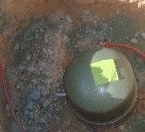
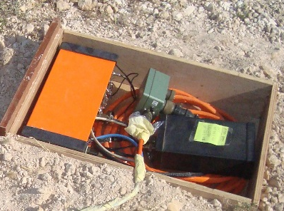
5 broadband stations (National network)
10 short period stations (aftershock’s recording).
Broad Band station:
Quanterra Q330 Baler Model 14D, Streckeisen STS-2
Short period station : .
Kinemetrics K2, Lennartz LE-3Dlit
Continues mod recording
1Hz, 40Hz and 100Hz sampling.
Trigger mod recording (STA/LTA).
100Hz sampling

Slide 9
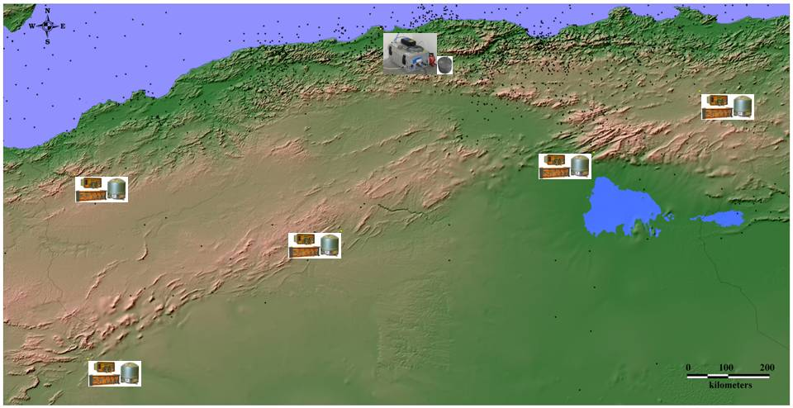
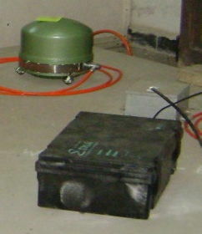
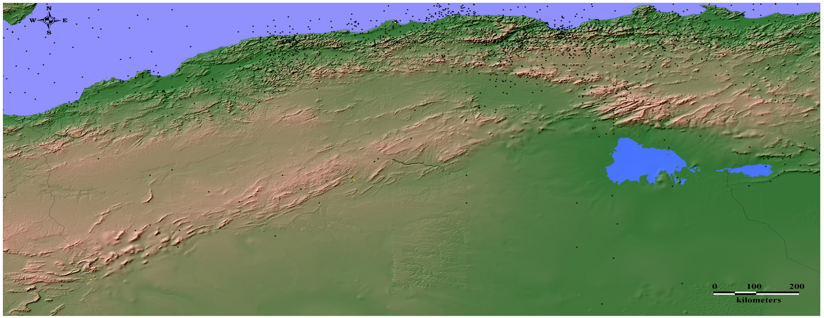
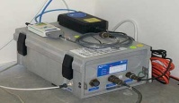




Seismic stations distribution (CGS National Network)
University of Algiers
Targelt (Souk-Ahras)
M’chounech (Biskra)
Terni (Tlemcen)
(Laghouat)
Beni-Ounif (Bechar)

Slide 10
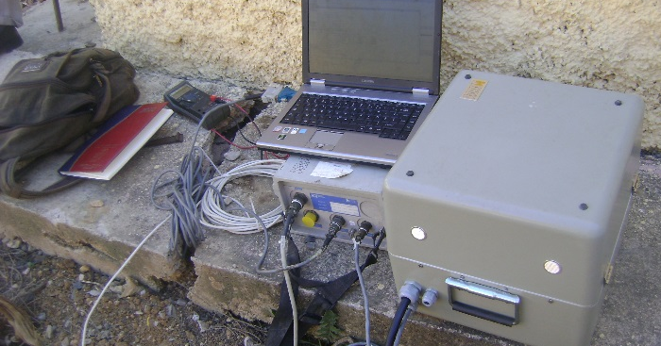
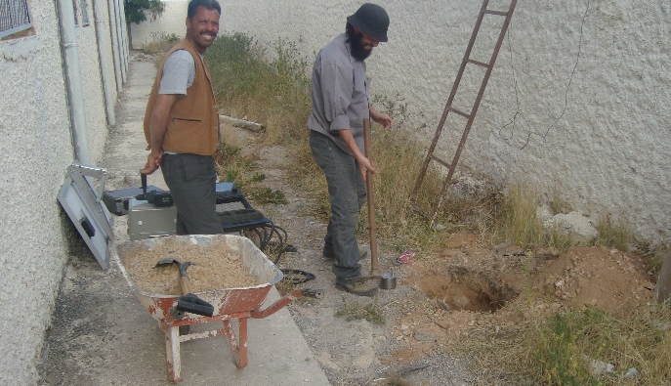
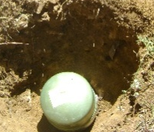
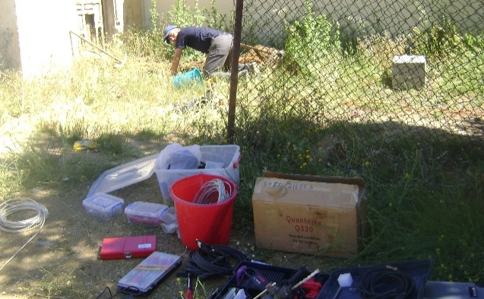
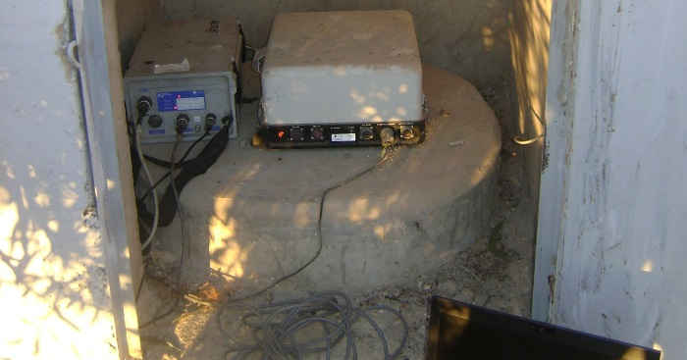
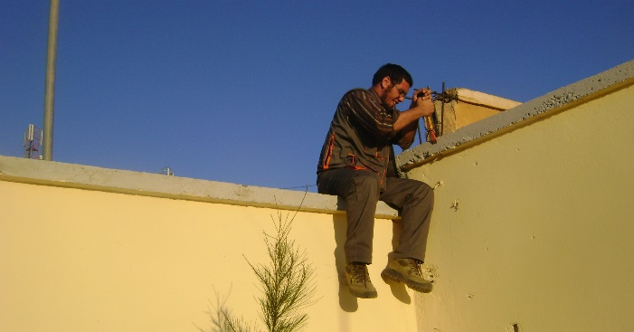
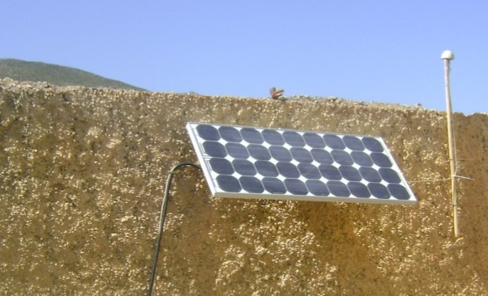
Free field station installation
Short period sta.
Broadband sta.
Broadband sta.
SP station coupled with Accelerograph
GPS antenna installation
Solar panel (autonomy power supply)

