Slide 1
ISPAQ IRIS System for Portable Assessment of Quality
Laura Hutchinson
IRIS Data Management Center

Slide 2
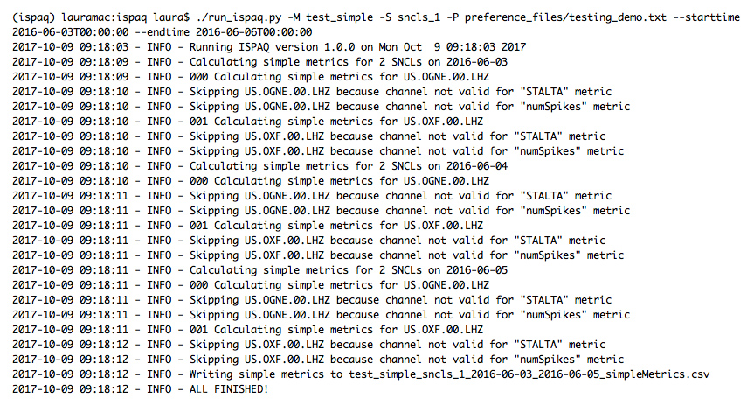
What is ISPAQ?
ISPAQ is a portable version of our MUSTANG metrics
Runs on your machine using local data or any FDSN data
Metric code in R (available through CRAN) and wrapped in python
Runs on MacOS or Linux as a command-line utility

Slide 3
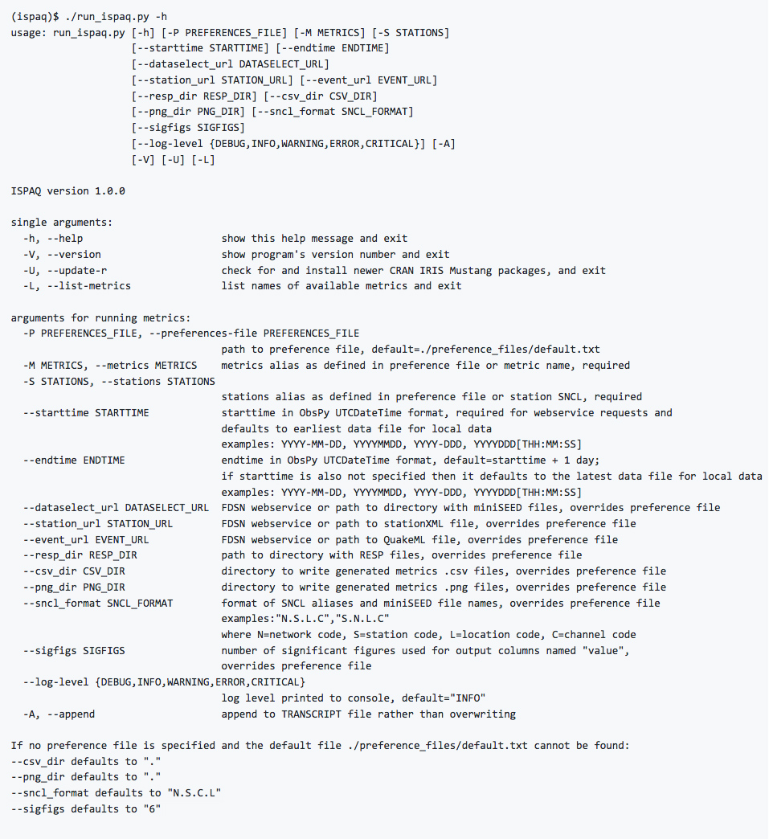
Running
Command line tool
useful for scripting
Before running, always: source activate ispaq
For options:
./run_ispaq.py -h
There are two general ways of running ISPAQ:
With preference file
Without preference file

Slide 4
Options and Arguments
Single arguments: informational or update R code (metrics)
Required: metrics, stations, start, end, where to find data, events, metadata
Defined in preference file
Command line arguments can override the preference file
Note: if only date included, defaults to 00:00:00

Slide 5
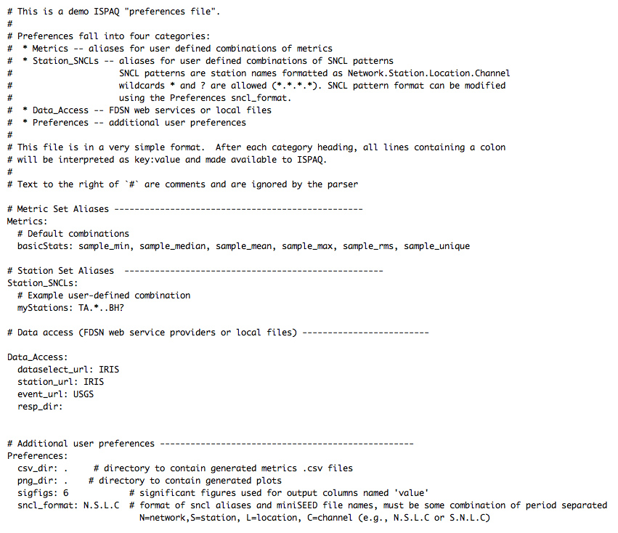
Preference File
Purpose:
Make running easier
Increase flexibility
Metric alias – name given to a combination of metrics
Station alias – name given to a combination of SNCLs
Data access – where to look for data, metadata, events, response information
Preferences – directories and sigfigs for output; SNCL format for local data

Slide 6
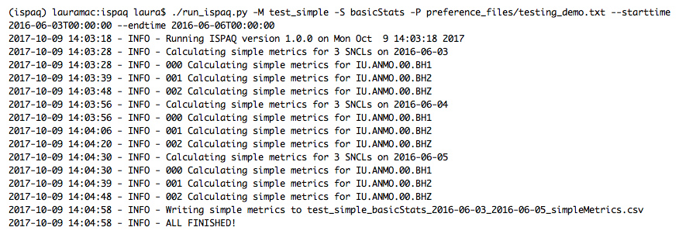
Running – Web Services
source activate ispaq
./run-ispaq.py …
With preference file
Must specify metrics, station, and start time
Optionally: end time (if greater than 1 day), preference file (if not default.txt), log level
Overwriting preference file
Anything in the preference file can be overwritten by including it as a command argument
Without preference file
You must specify (nearly) everything via command line. Some things will have default values, including csv_dir (.), png_dir (.), sncl_format (N.S.C.L.), and sigfigs (6)

Slide 7
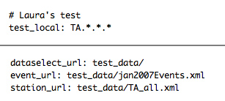
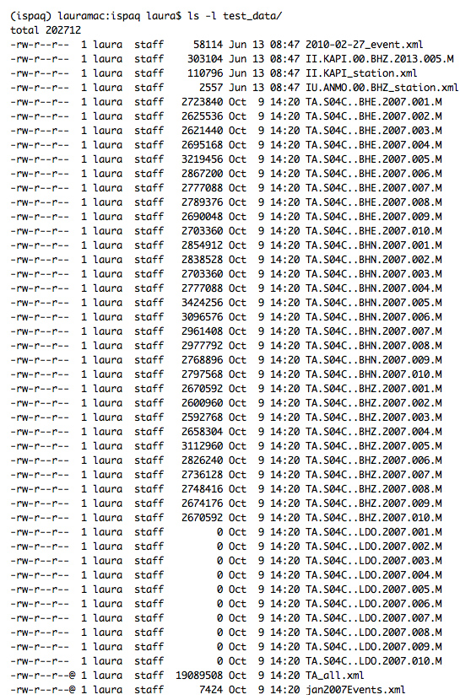
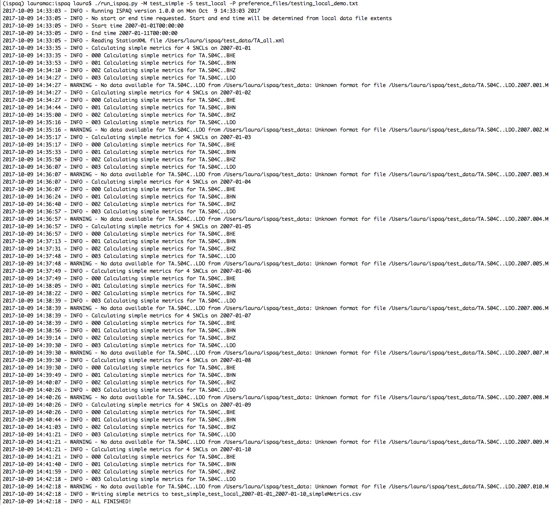
Running – Local Data
Essentially the same as running with Web Services, except:
Must specify metrics and stations, everything else is optional
If dates are not specified, will run for all available data

Slide 8
Local Data Format
It is important that the data is in day-long miniSEED files, one for each SNCL.
The filename must be N.S.L.C.Y.j.Q, or as noted in the sncl_format field
One useful tool is Dataselect, available here: https://github.com/iris-edu/dataselect
Ex. dataselect -Sd -A %n.%s.%l.%c.%Y.%j.%q inputfiles
Local metadata must be in stationXML format (http://www.fdsn.org/xml/station/) at the channel level
Useful tool for converting from dataless SEED file:
https://seiscode.iris.washington.edu/projects/stationxml-converter
Local event information must be in QuakeML format (https://quake.ethz.ch/quakeml)
Local response files: RESP format (http://ds.iris.edu/ds/nodes/dmc/data/formats/resp/)
Useful tool for converting from dataless SEED file:
http://ds.iris.edu/ds/nodes/dmc/manuals/rdseed/

Slide 9
Output
csv files are named with this structure:
metricAlias_stationAlias_start_end_metricCodeName.csv
plots are named as
N.S.L.C_day_metric.png
Files will be in the directories dictated by the preference file (if it exists)

Slide 10
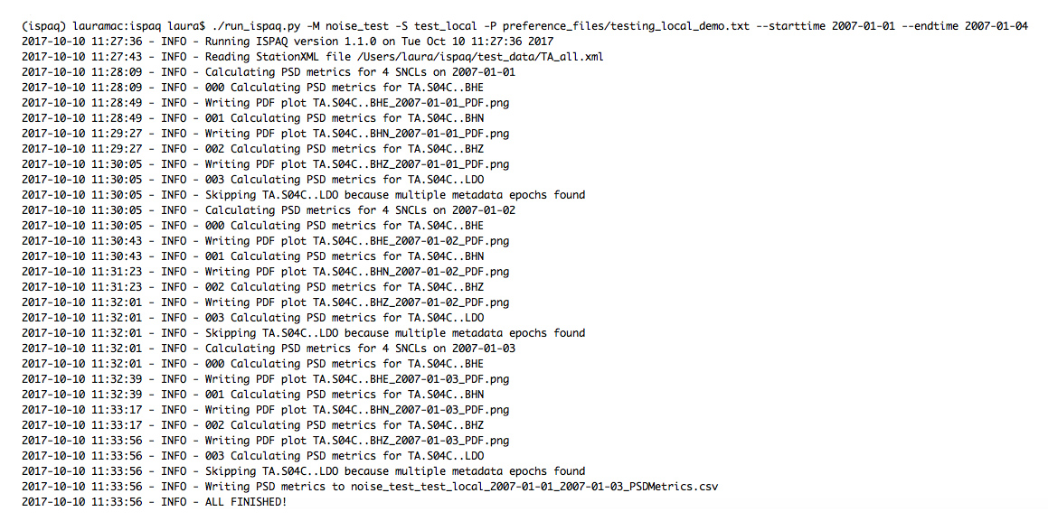
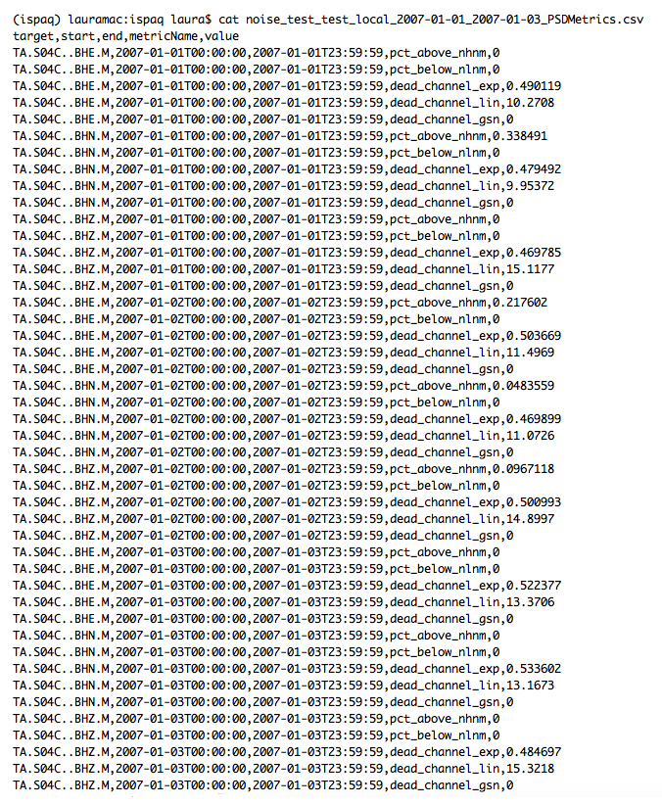
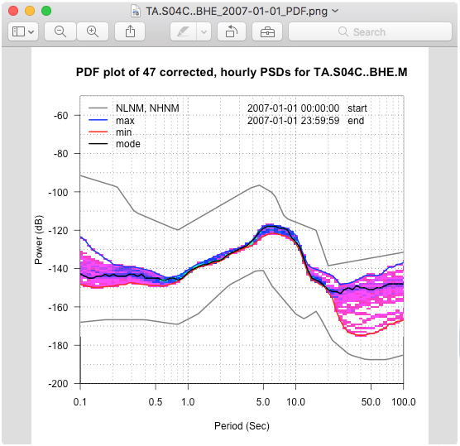
Output

Slide 11
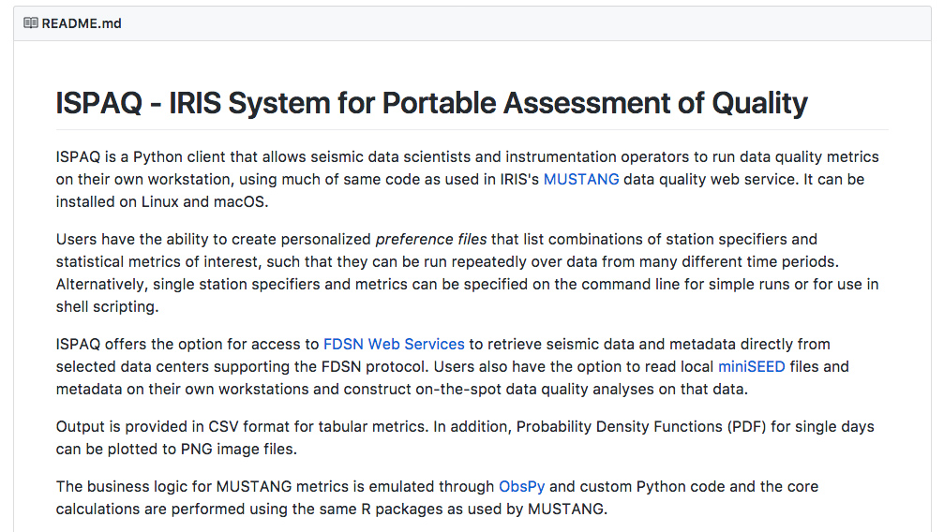
How to Get ISPAQ
To download:
ISPAQ is available for download on github
Install the git software on your machine
(https://git-scm.com/downloads)
Type git clone https://github.com/iris-edu/ispaq.git
To install:
Follow the instructions
in the README file
Get ISPAQ code
Create conda virtual
environment
Install R packages

