Slide 1
The iLoc Location Algorithm
István Bondár
Research Centre for Astronomy and Earth Sciences, Hungarian Academy of Sciences
Training in Network Management Systems and Analytical Tools for Seismology
Baku, Azerbaijan, 23-27 October 2017

Slide 2
iLoc
Based on the ISC location algorithm (Bondár and Storchak, 2011)
While retaining the main features of the ISC locator, iLoc focuses on the needs of
local and regional network operators
NDCs
global location studies
iLoc is open source
Available for download from the ORFEUS seismological software library
http://www.orfeus-eu.org/website_until_17aug2016/software.html
http://www.seismology.hu/data/iLoc/
Current version is 1.60

Slide 3
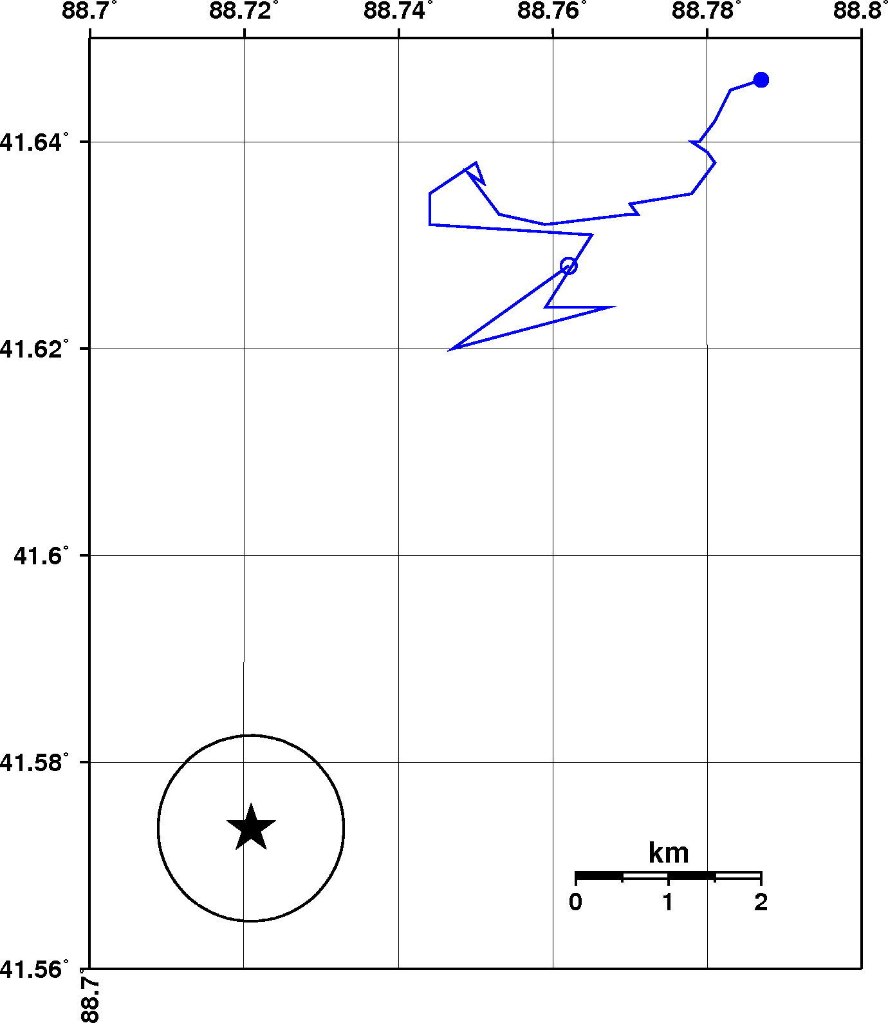
Motivation
Lop Nor nuclear explosion, 10/7/1994: mislocation, error ellipse and GT coverage with increasing number of stations
Error ellipses are often unreliable due to the violation of assumptions of independent, Gaussian errors.
Similar ray paths introduce correlated systematic travel time prediction errors!
Ignoring correlated errors results in
Underestimated error ellipses
Increasing location bias with increasing number of stations
network
mislocation
GT1
90% error ellipse area
GT coverage
Coverage is less than 1 if GT location falls inside the error ellipse

Slide 4
The locator in a nutshell (ISC algorithm)
Uses most ak135 (Kennett et al., 1995) phases in location
Elevation and ellipticity corrections (Dziewonski and Gilbert, 1976; Kennett and Gudmundsson, 1996)
Depth-phase bounce point corrections (Engdahl et al., 1998)
Accounts for correlated travel-time prediction errors
Initial guess from Neighbourhood Algorithm search (Sambridge, 1999)
Linearised inversion using a priori estimate of the full data covariance matrix (Bondár and McLaughlin, 2009)
Attempts for free-depth solution only if there is depth resolution
Default depth is derived from historical seismicity
Independent depth estimate from depth-phase stacking (Murphy and Barker, 2006)
Robust mb, MS magnitude estimates with uncertainties
Gutenberg-Richter and Veith-Clawson depth-distance corrections for mb
Support for the ISC database schema
Support for IMS1.0 and ISF1.0 bulletin formats

Slide 5
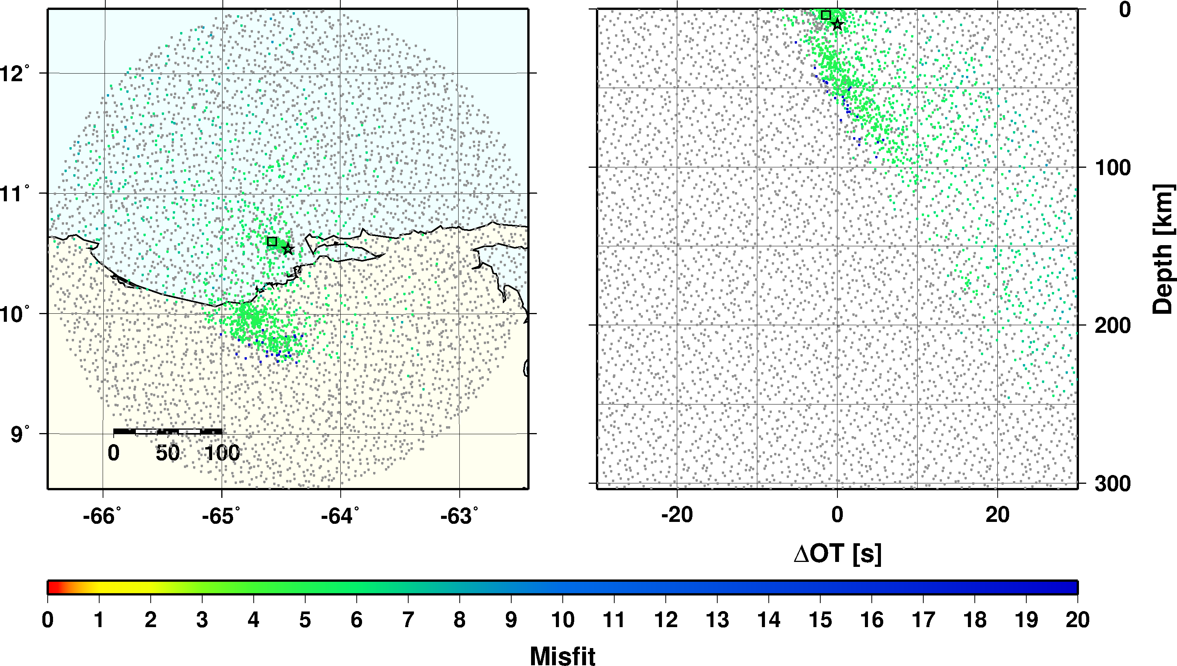
Initial Hypocentre
Reported hypocentres may exhibit a large scatter
Neighbourhood Algorithm (Sambridge and Kennett, 2001) to get an initial hypocentre
Grid search around the median of reported hypocentre parameters
NA explores the search space and rapidly closes in on the global optimum
Once close to the global minimum, we switch to the linearised inversion algorithm to obtain the final solution and formal uncertainties

Slide 6
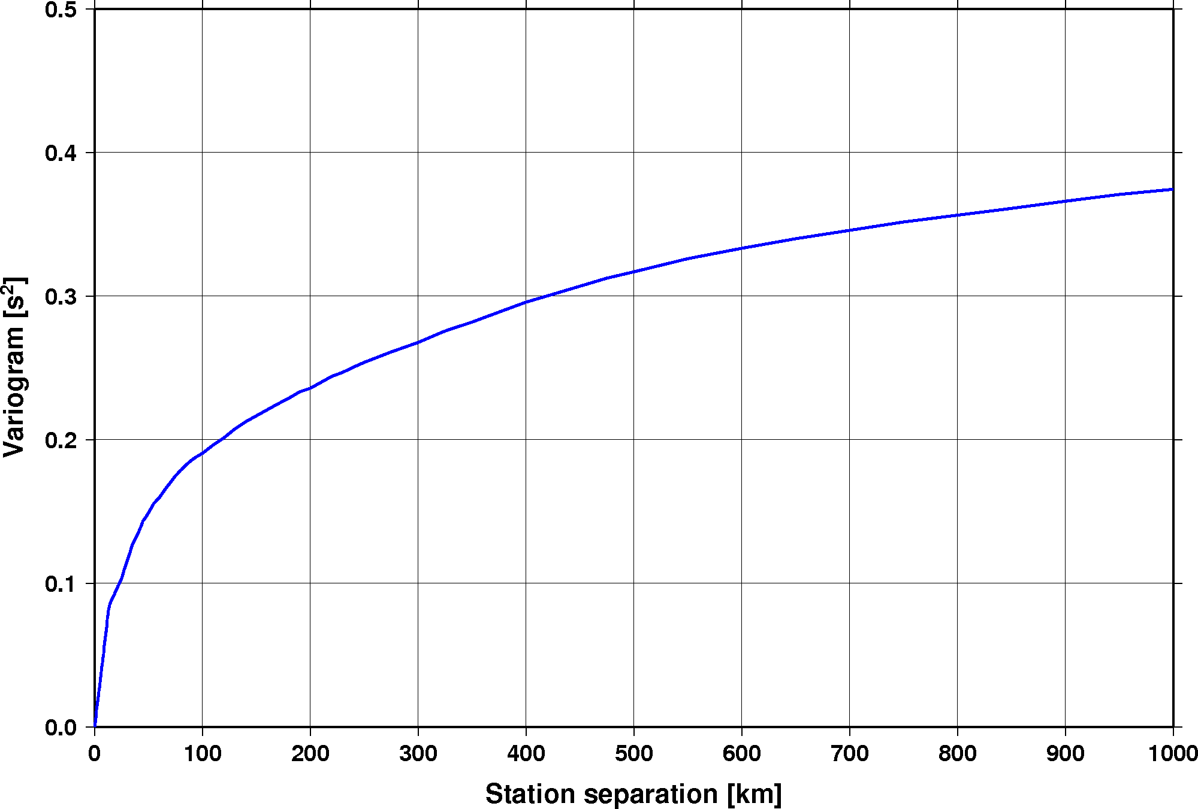
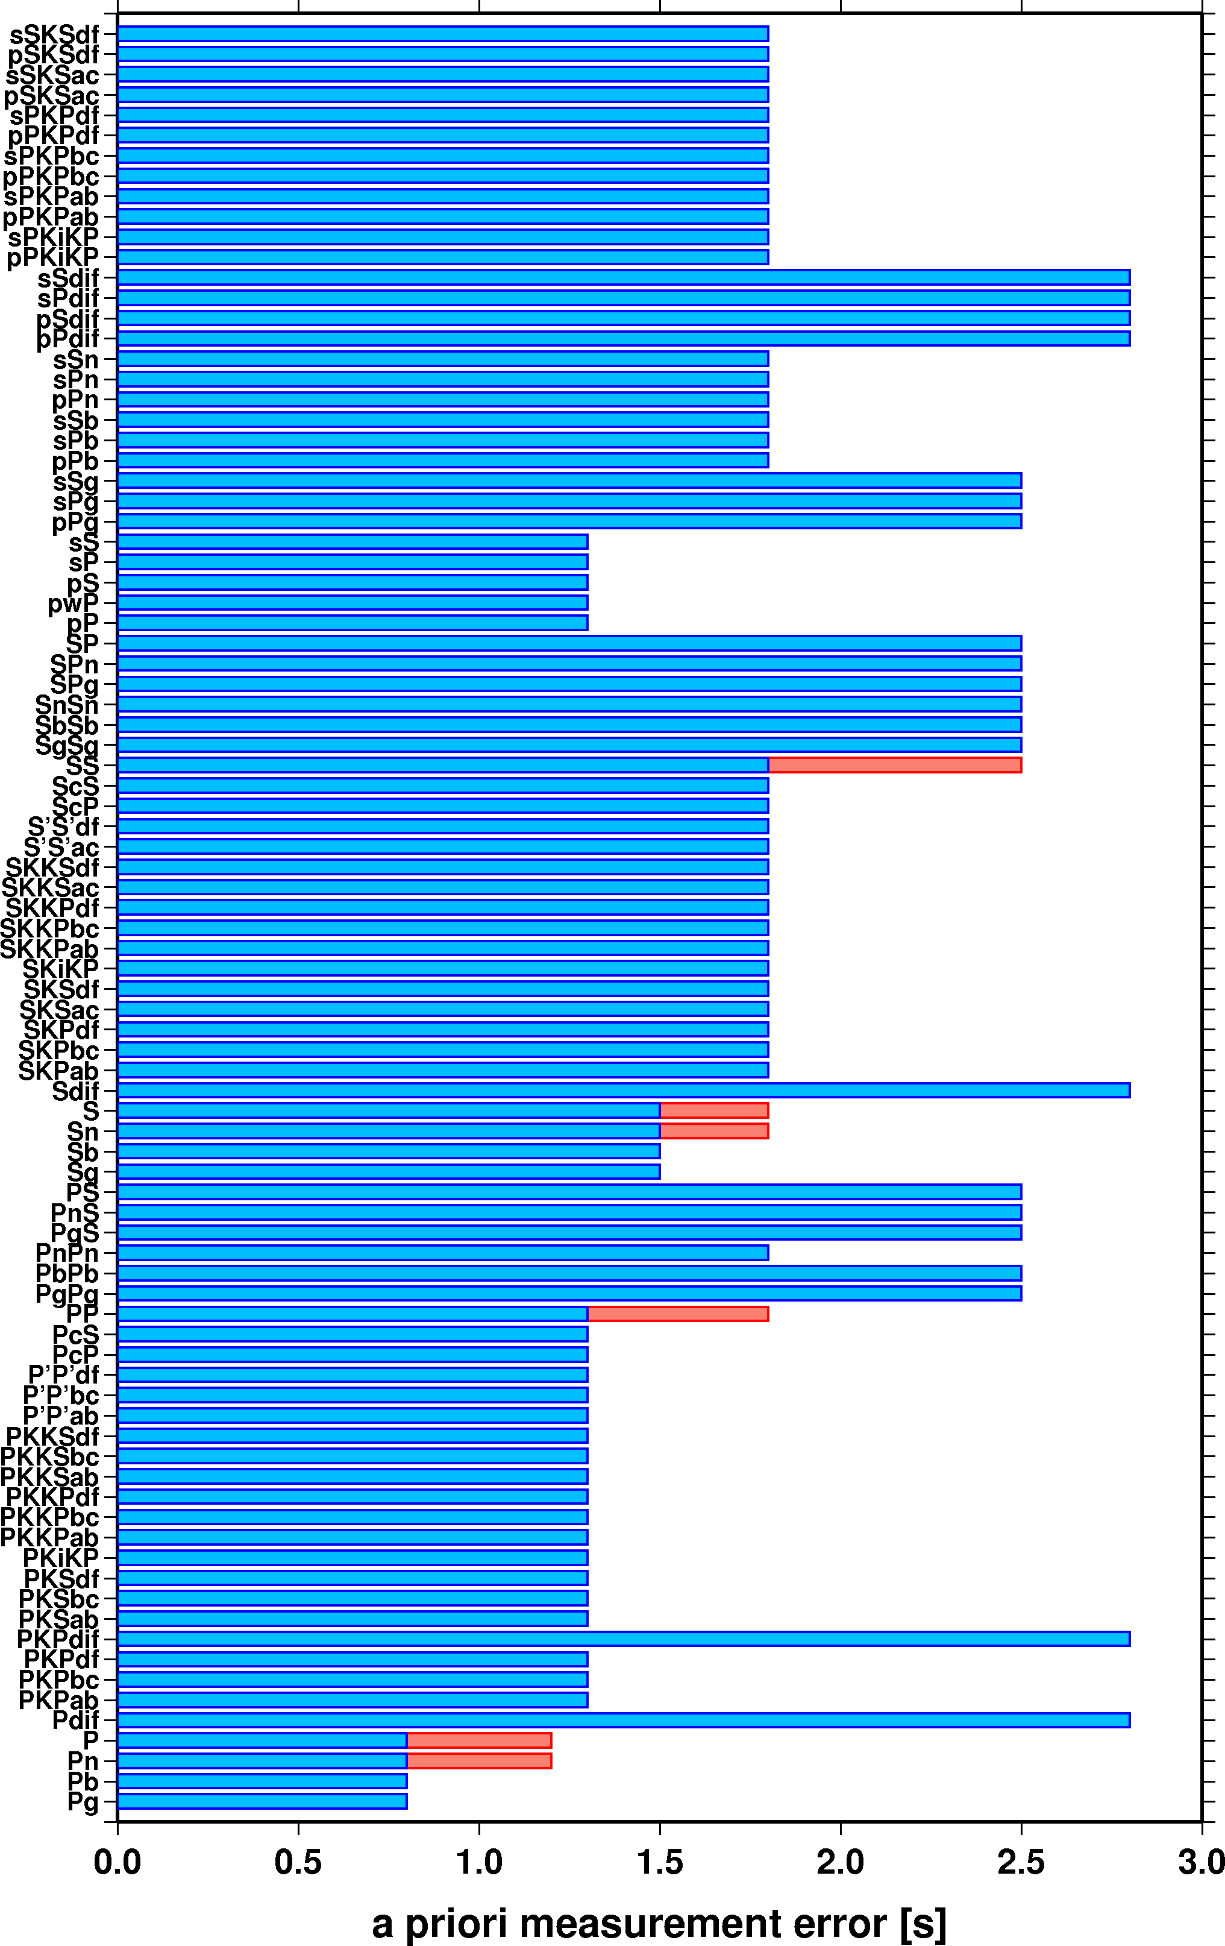
Data Covariance Matrix
When correlated errors are present, the data covariance matrix is no longer diagonal
Off-diagonal elements account for correlated travel-time prediction errors due to similar ray paths
Estimated by an isotropic stationary variogram (Bondár and McLaughlin, 2009) derived from GT residuals
The a priori picking error variances add to the diagonal
Generic variogram model

Slide 7
Location Algorithm
A priori data covariance matrix describes both the picking errors and the correlated model error structure
We solve the equations in the eigensystem where the observations are independent (Bondár and McLaughlin, 2009; Bondár and Storchak, 2011)
Projection matrix
Obtained from the inverse of the data covariance matrix
Needs to be calculated only once
Orthogonalises the data set and projects redundant observations to the null space
Reduces the effective number of freedoms
Iterative linearised least squares using SVD
Accounting for correlated travel-time prediction errors
Reduces location bias
Provides reliable uncertainty estimates

Slide 8
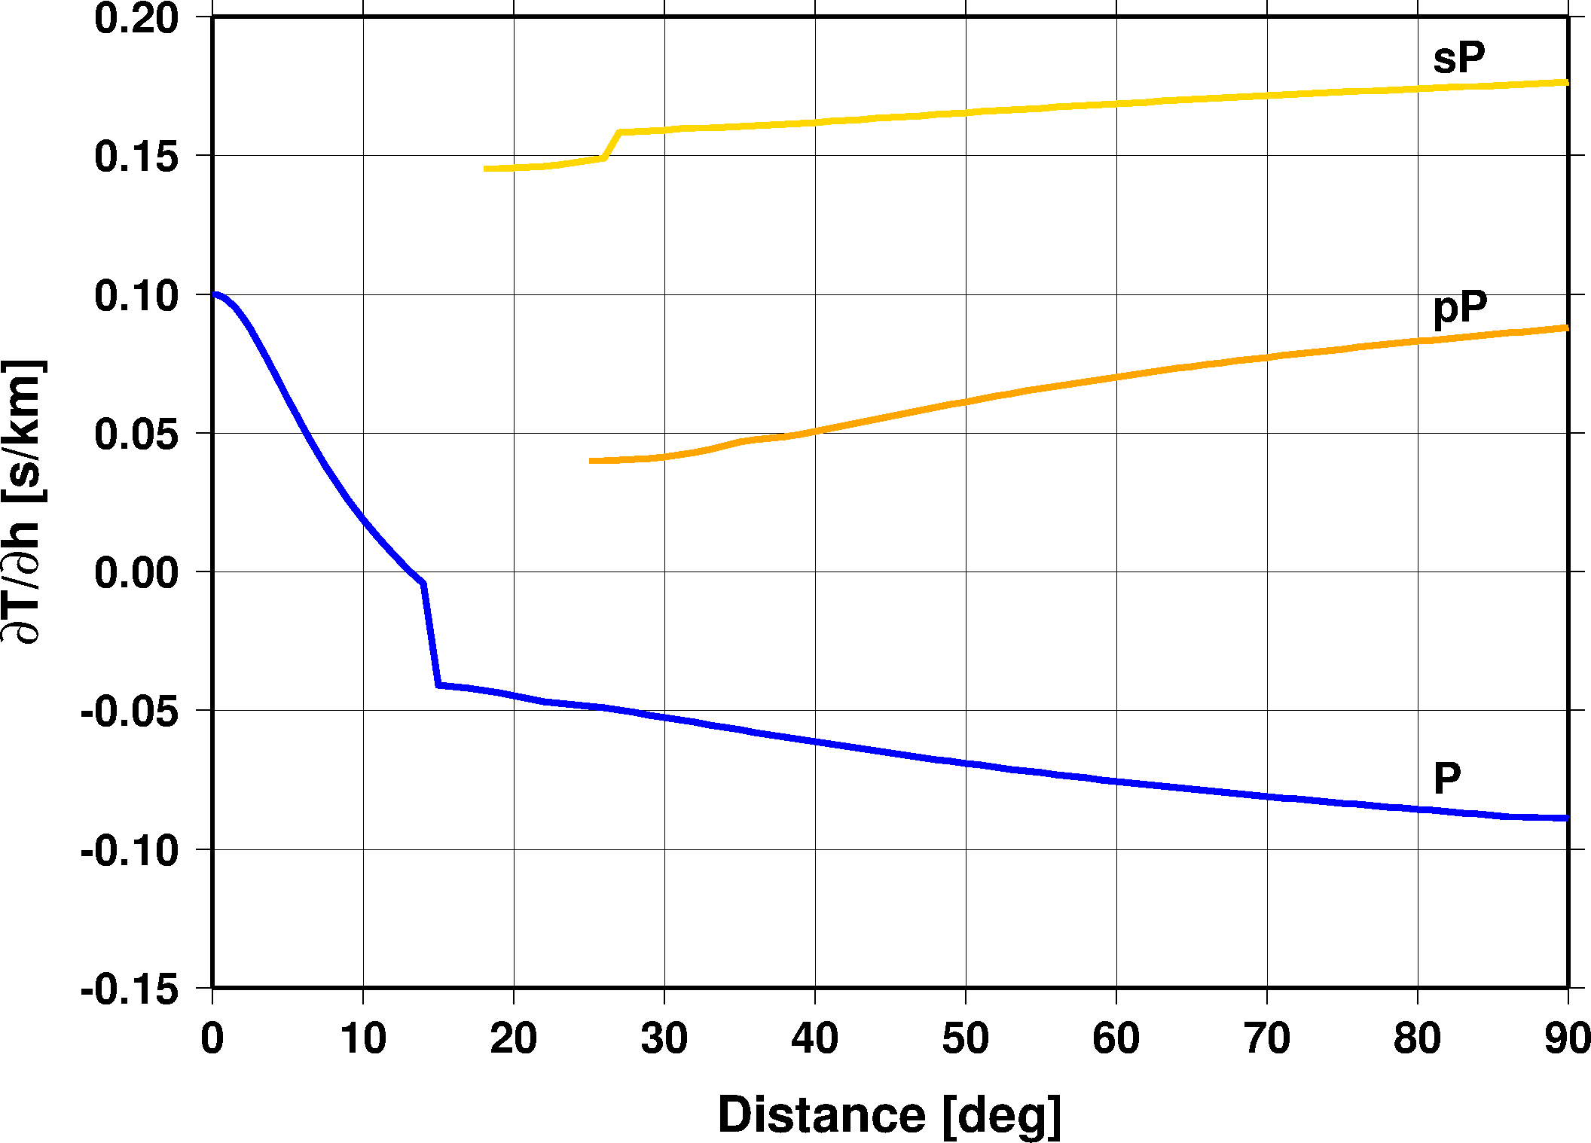
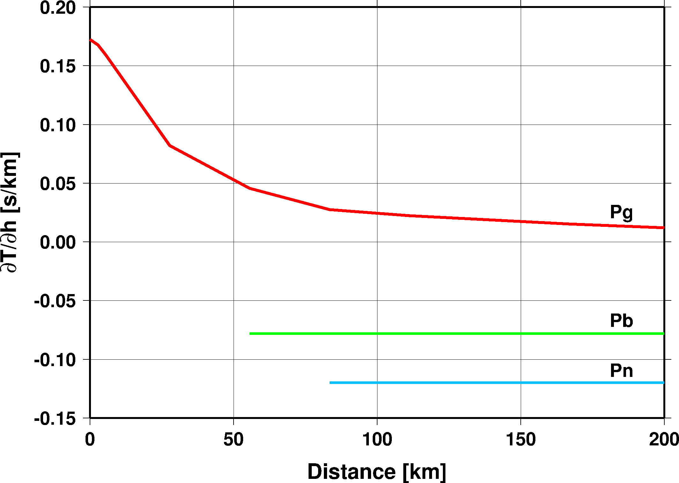
Depth Resolution
Attempt free-depth solution only if there is depth resolution
We have depth resolution if
There is a local network
one or more defining stations within 0.2°
Or there are sufficient number of depth phases
3 or more defining depth phases reported
Or there are sufficient number of core reflections
3 or more defining core reflections (PcP, ScP)
Or there are sufficient number of local/near-regional S
3 or more defining S and P pairs within 3°
Otherwise fix the depth to region-dependent default depth
Anthropogenic events are fixed to the surface
h=15 km
h=600 km

Slide 9
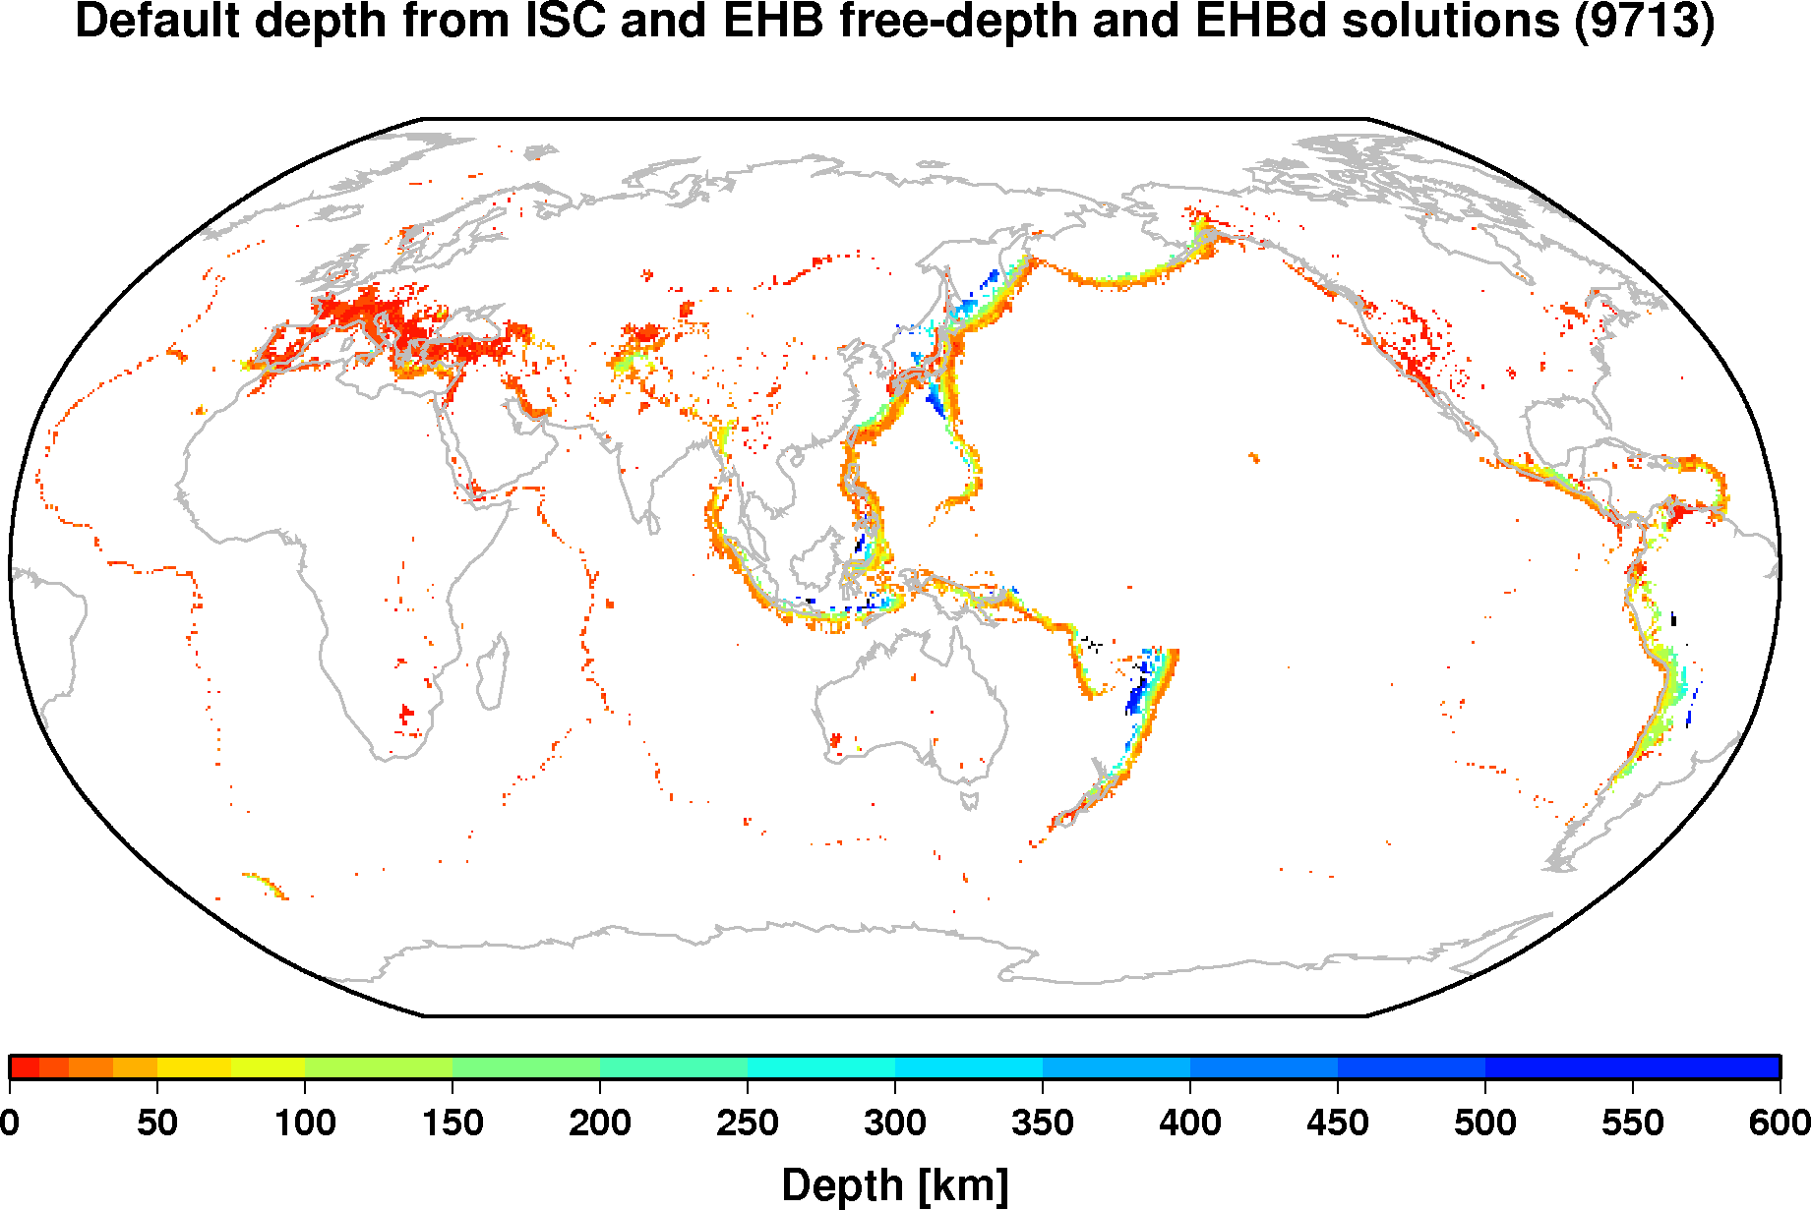
Region-Dependent Default Depth
Defined on a 0.5x0.5 degree grid
Obtained from EHB and ISC (relocated with the new locator) free-depth solutions (~800K events)
Provides a reasonable default depth where there is seismicity

Slide 10
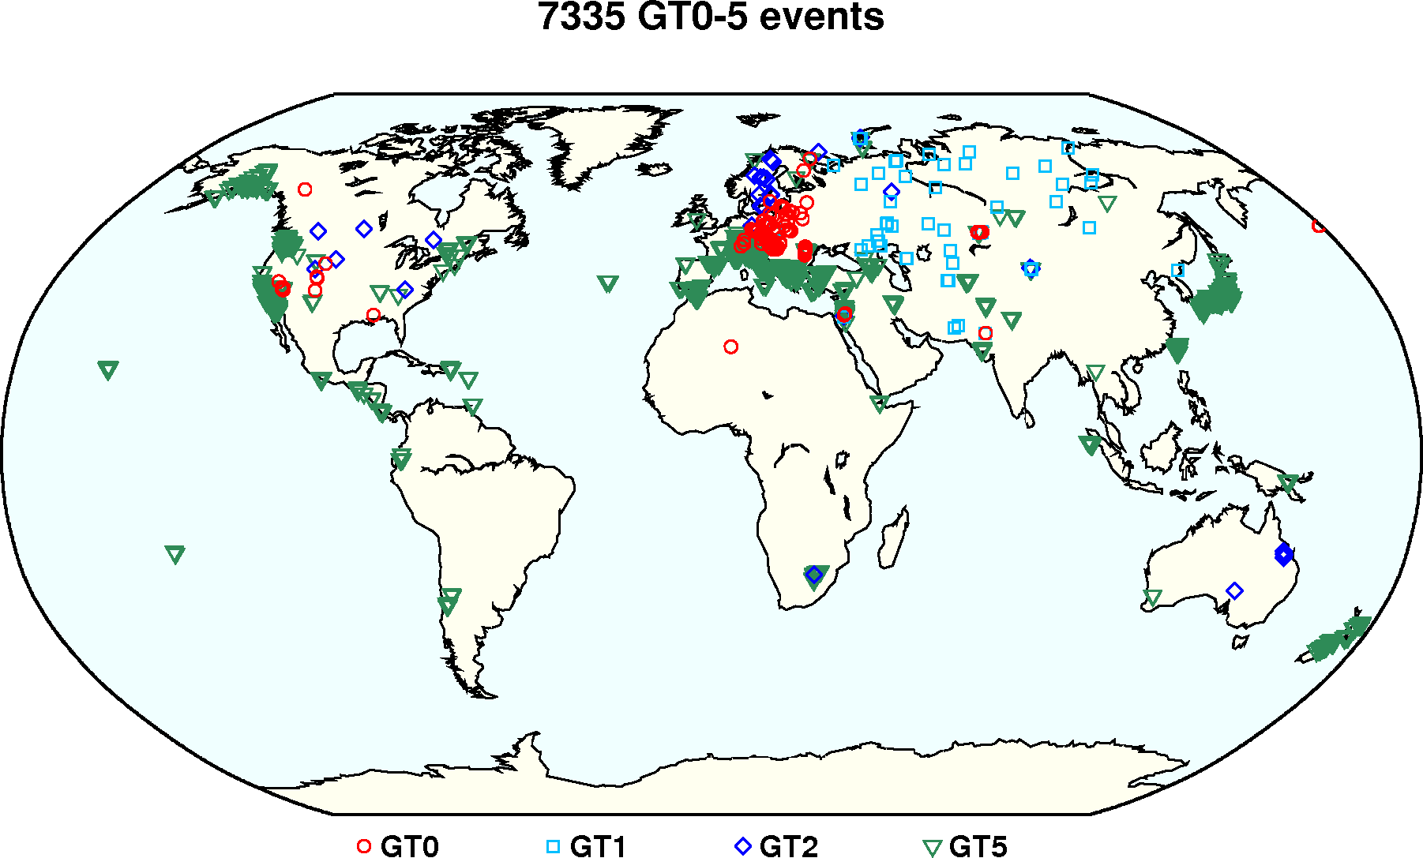
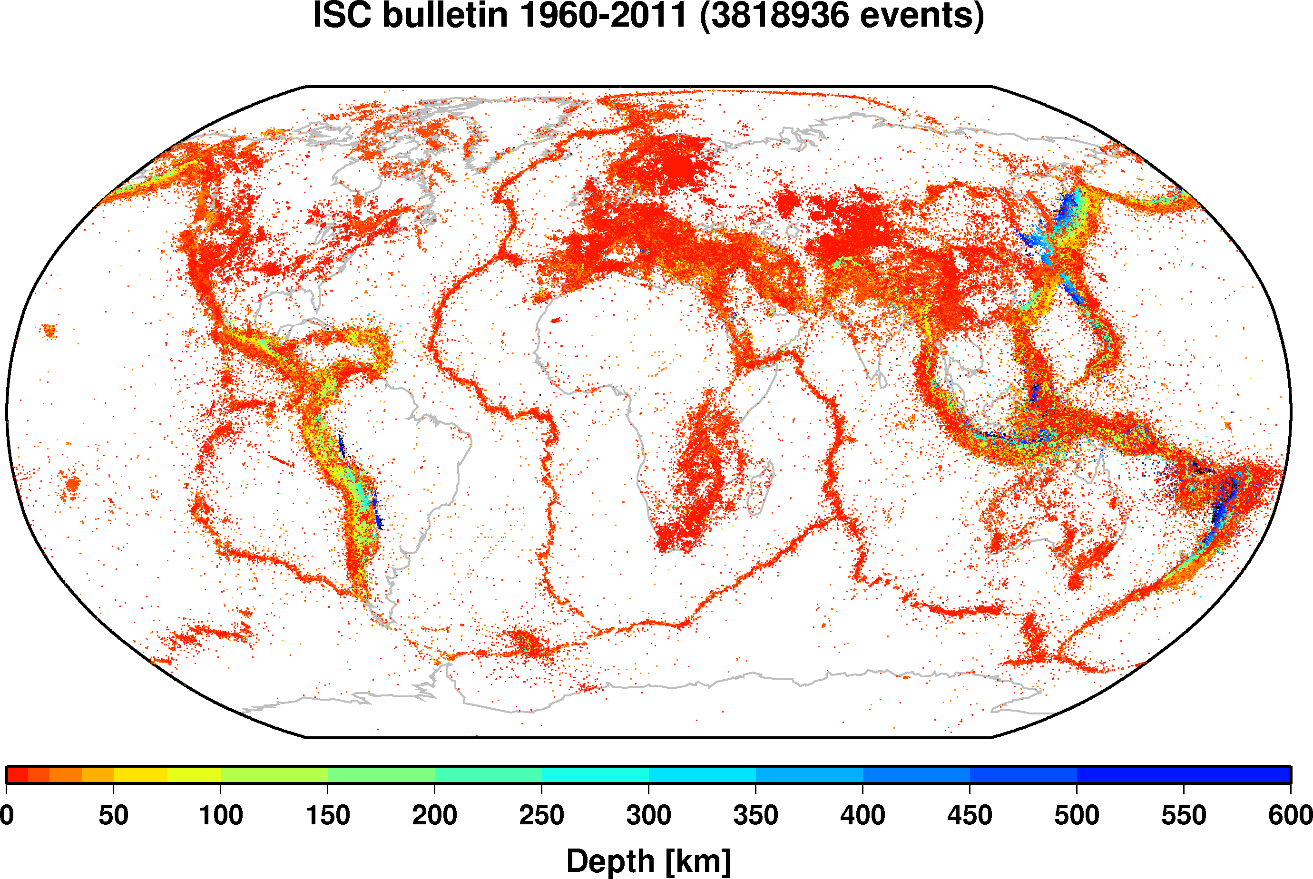
ISC Locator Validation Tests
Relocation of the IASPEI Reference Event List
~7,200 GT0-5 events
Typically very good azimuthal coverage
Relocation of the entire ISC bulletin (1960 – 2008)
Good, bad and ugly network geometries
IASPEI Reference Event List
ISC bulletin

Slide 11
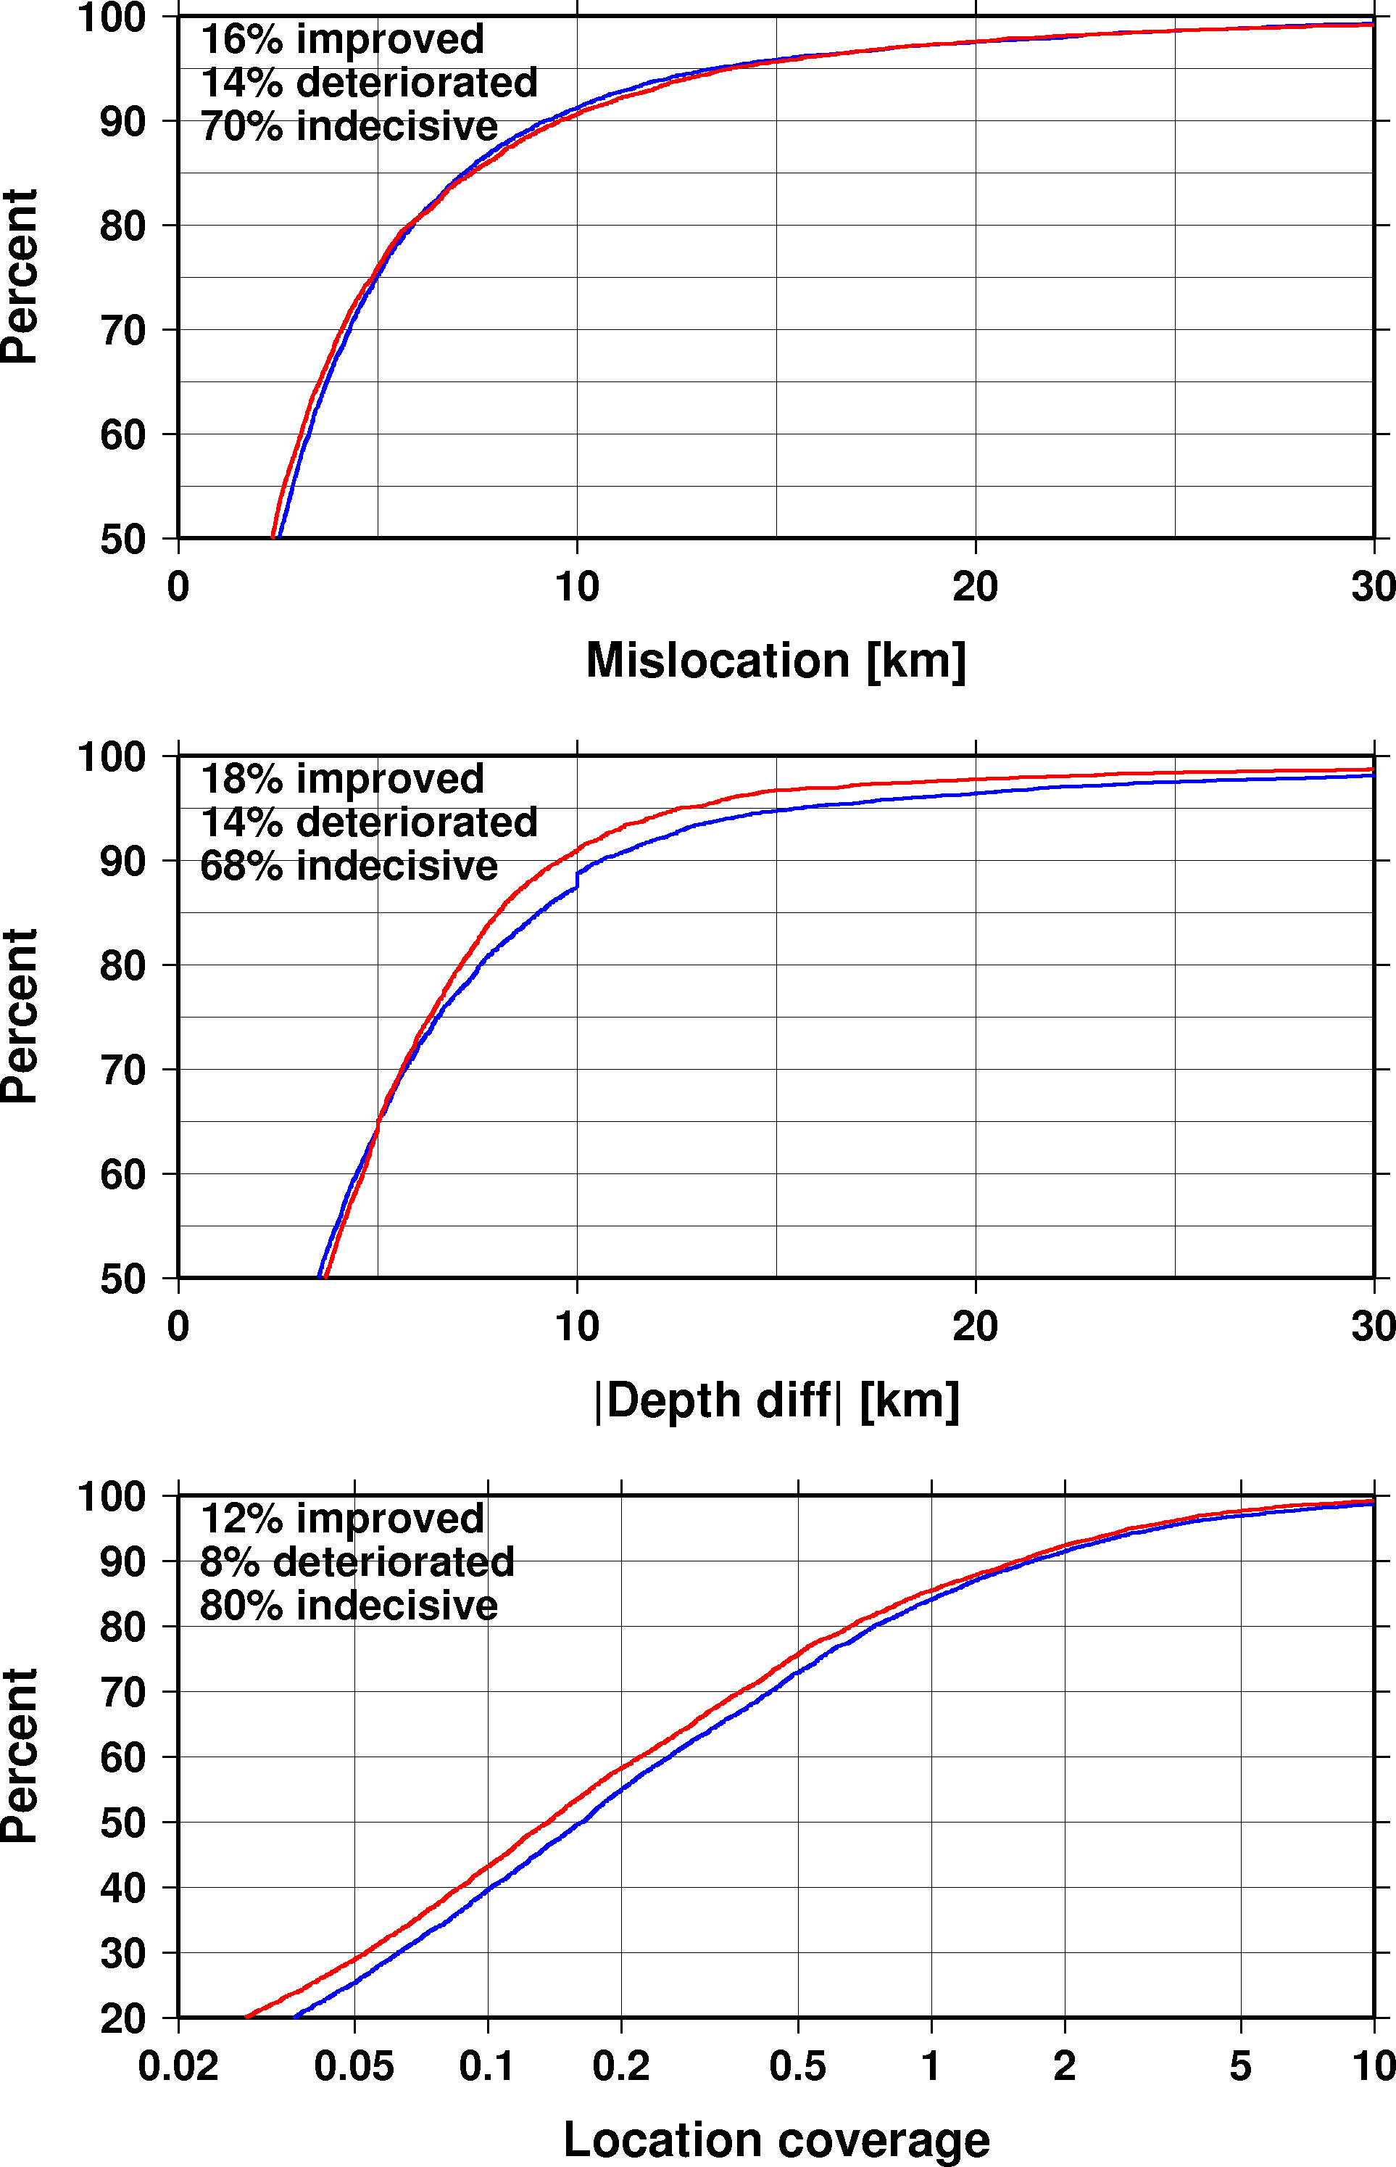
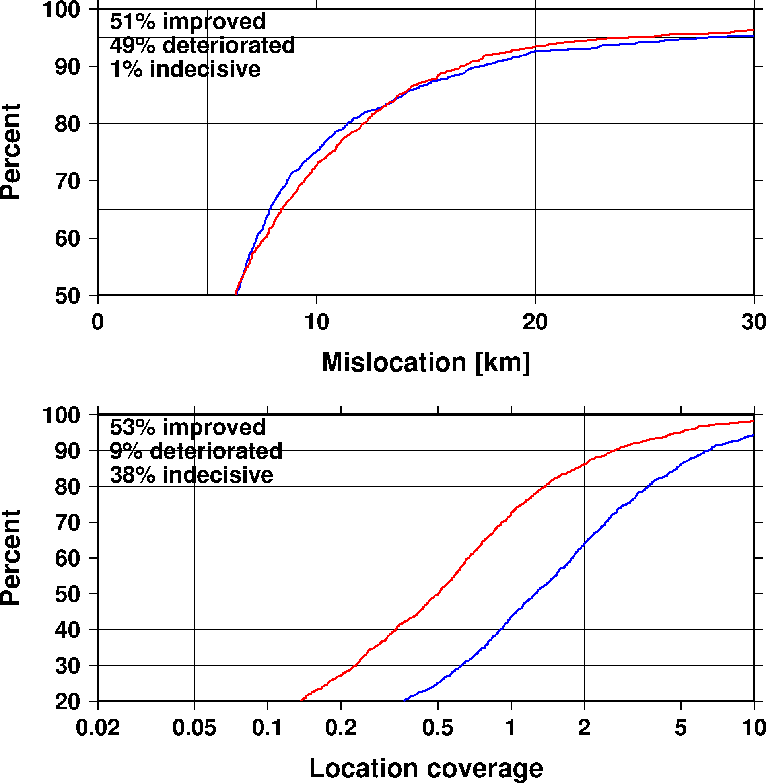
GT Relocations
Earthquakes (6,003)
Explosions (1,180)
New
Old
Minor improvements in location
Improvements in depth
Significant improvements in error ellipse coverage

Slide 12
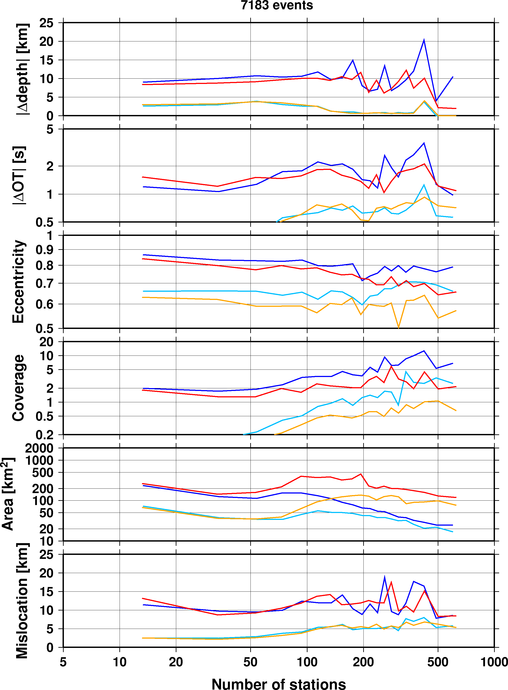
Accounting for Correlated Errors
New
Old
With increasing number of stations:
Area of error ellipse does not vanish
Actual coverage is maintained
Shape of error ellipse becomes more circular
Location and depth bias is reduced for large number of stations
90% percentile
50% percentile

Slide 13
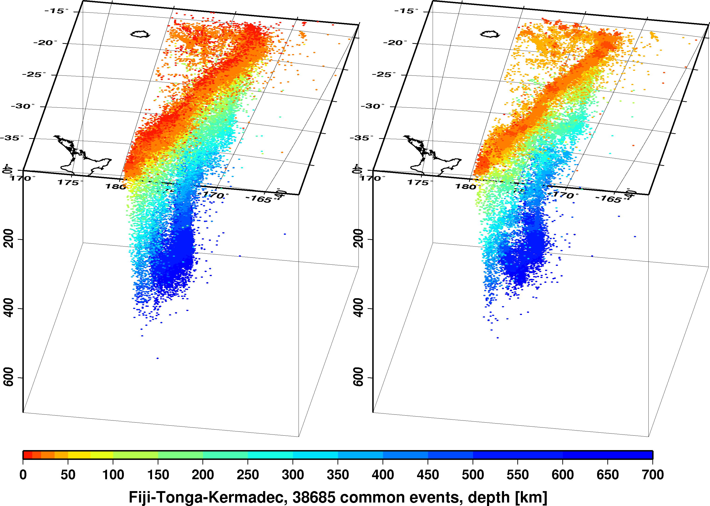
Fiji – Tonga - Kermadec
Reviewed ISC bulletin
Unreviewed locations with the new ISC locator

Slide 14
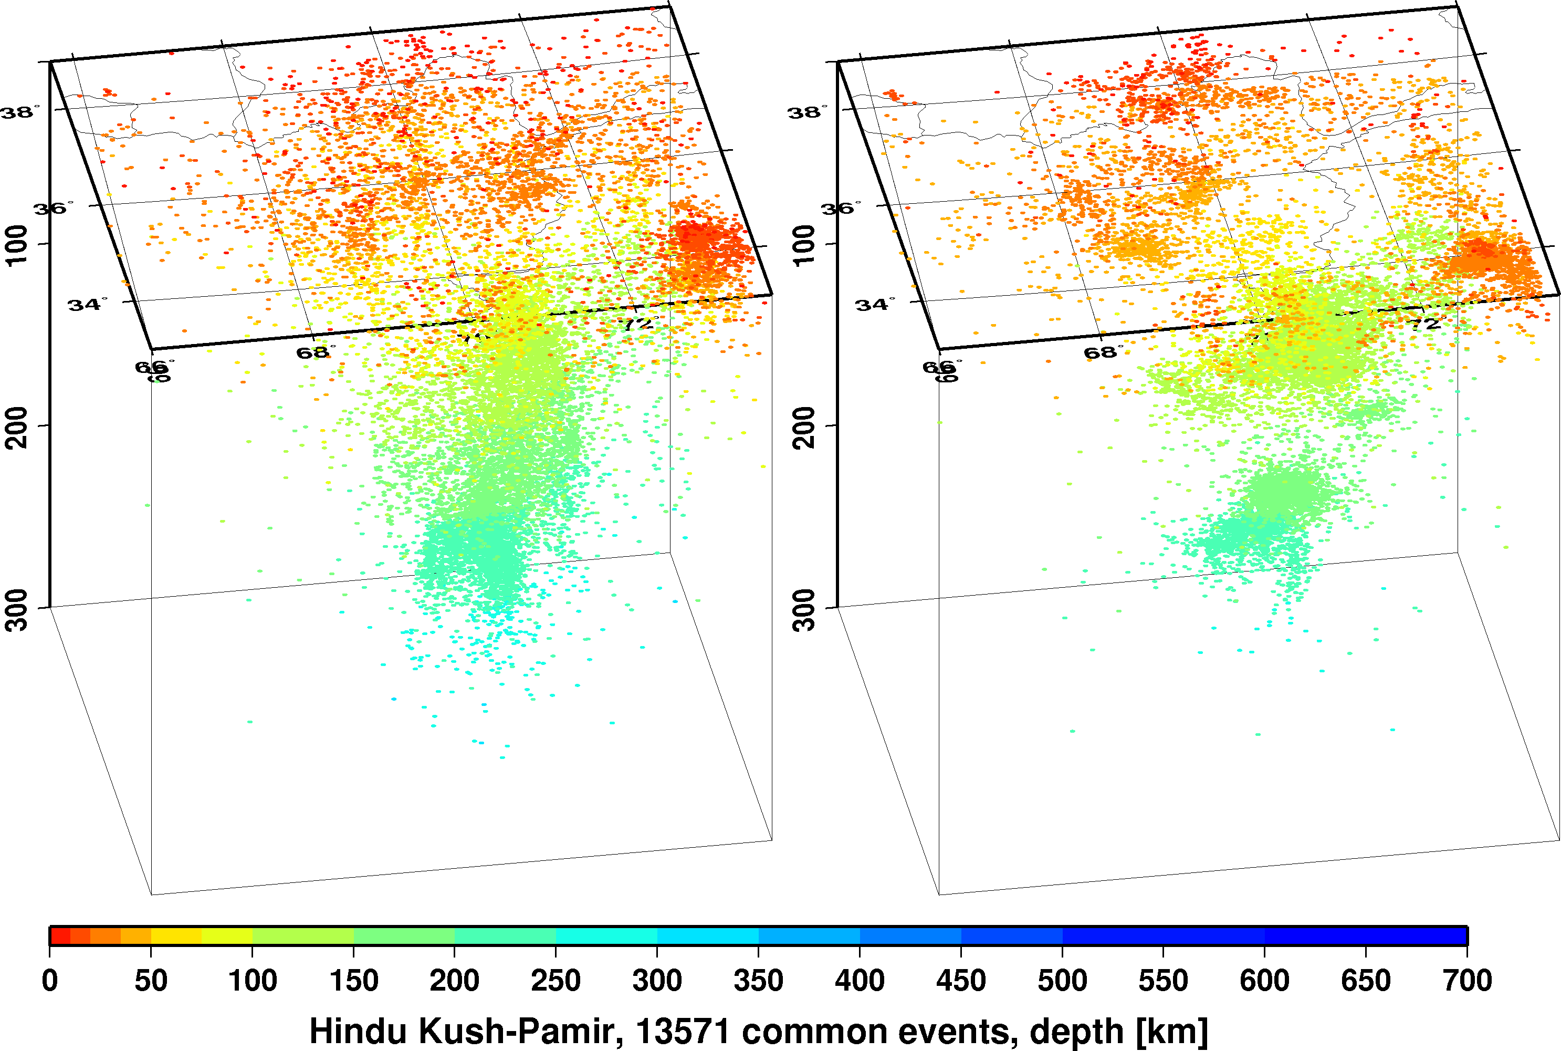
Hindu Kush - Pamir
Reviewed ISC bulletin
Unreviewed locations with the new ISC locator

Slide 15
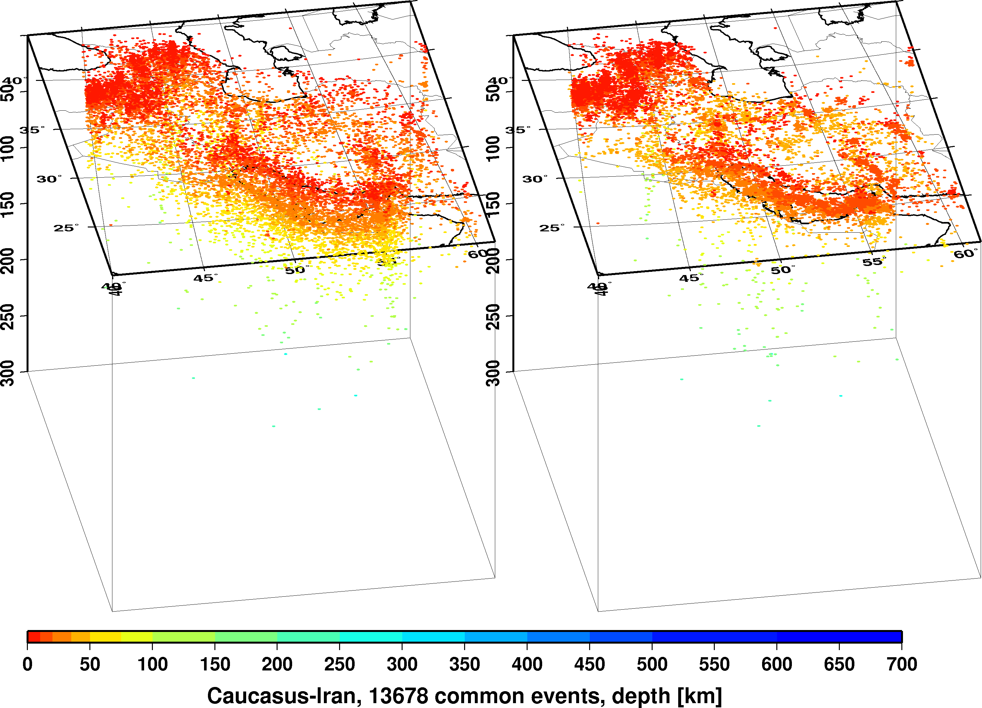
Caucasus - Iran
Reviewed ISC bulletin
Unreviewed locations with the new ISC locator

Slide 16
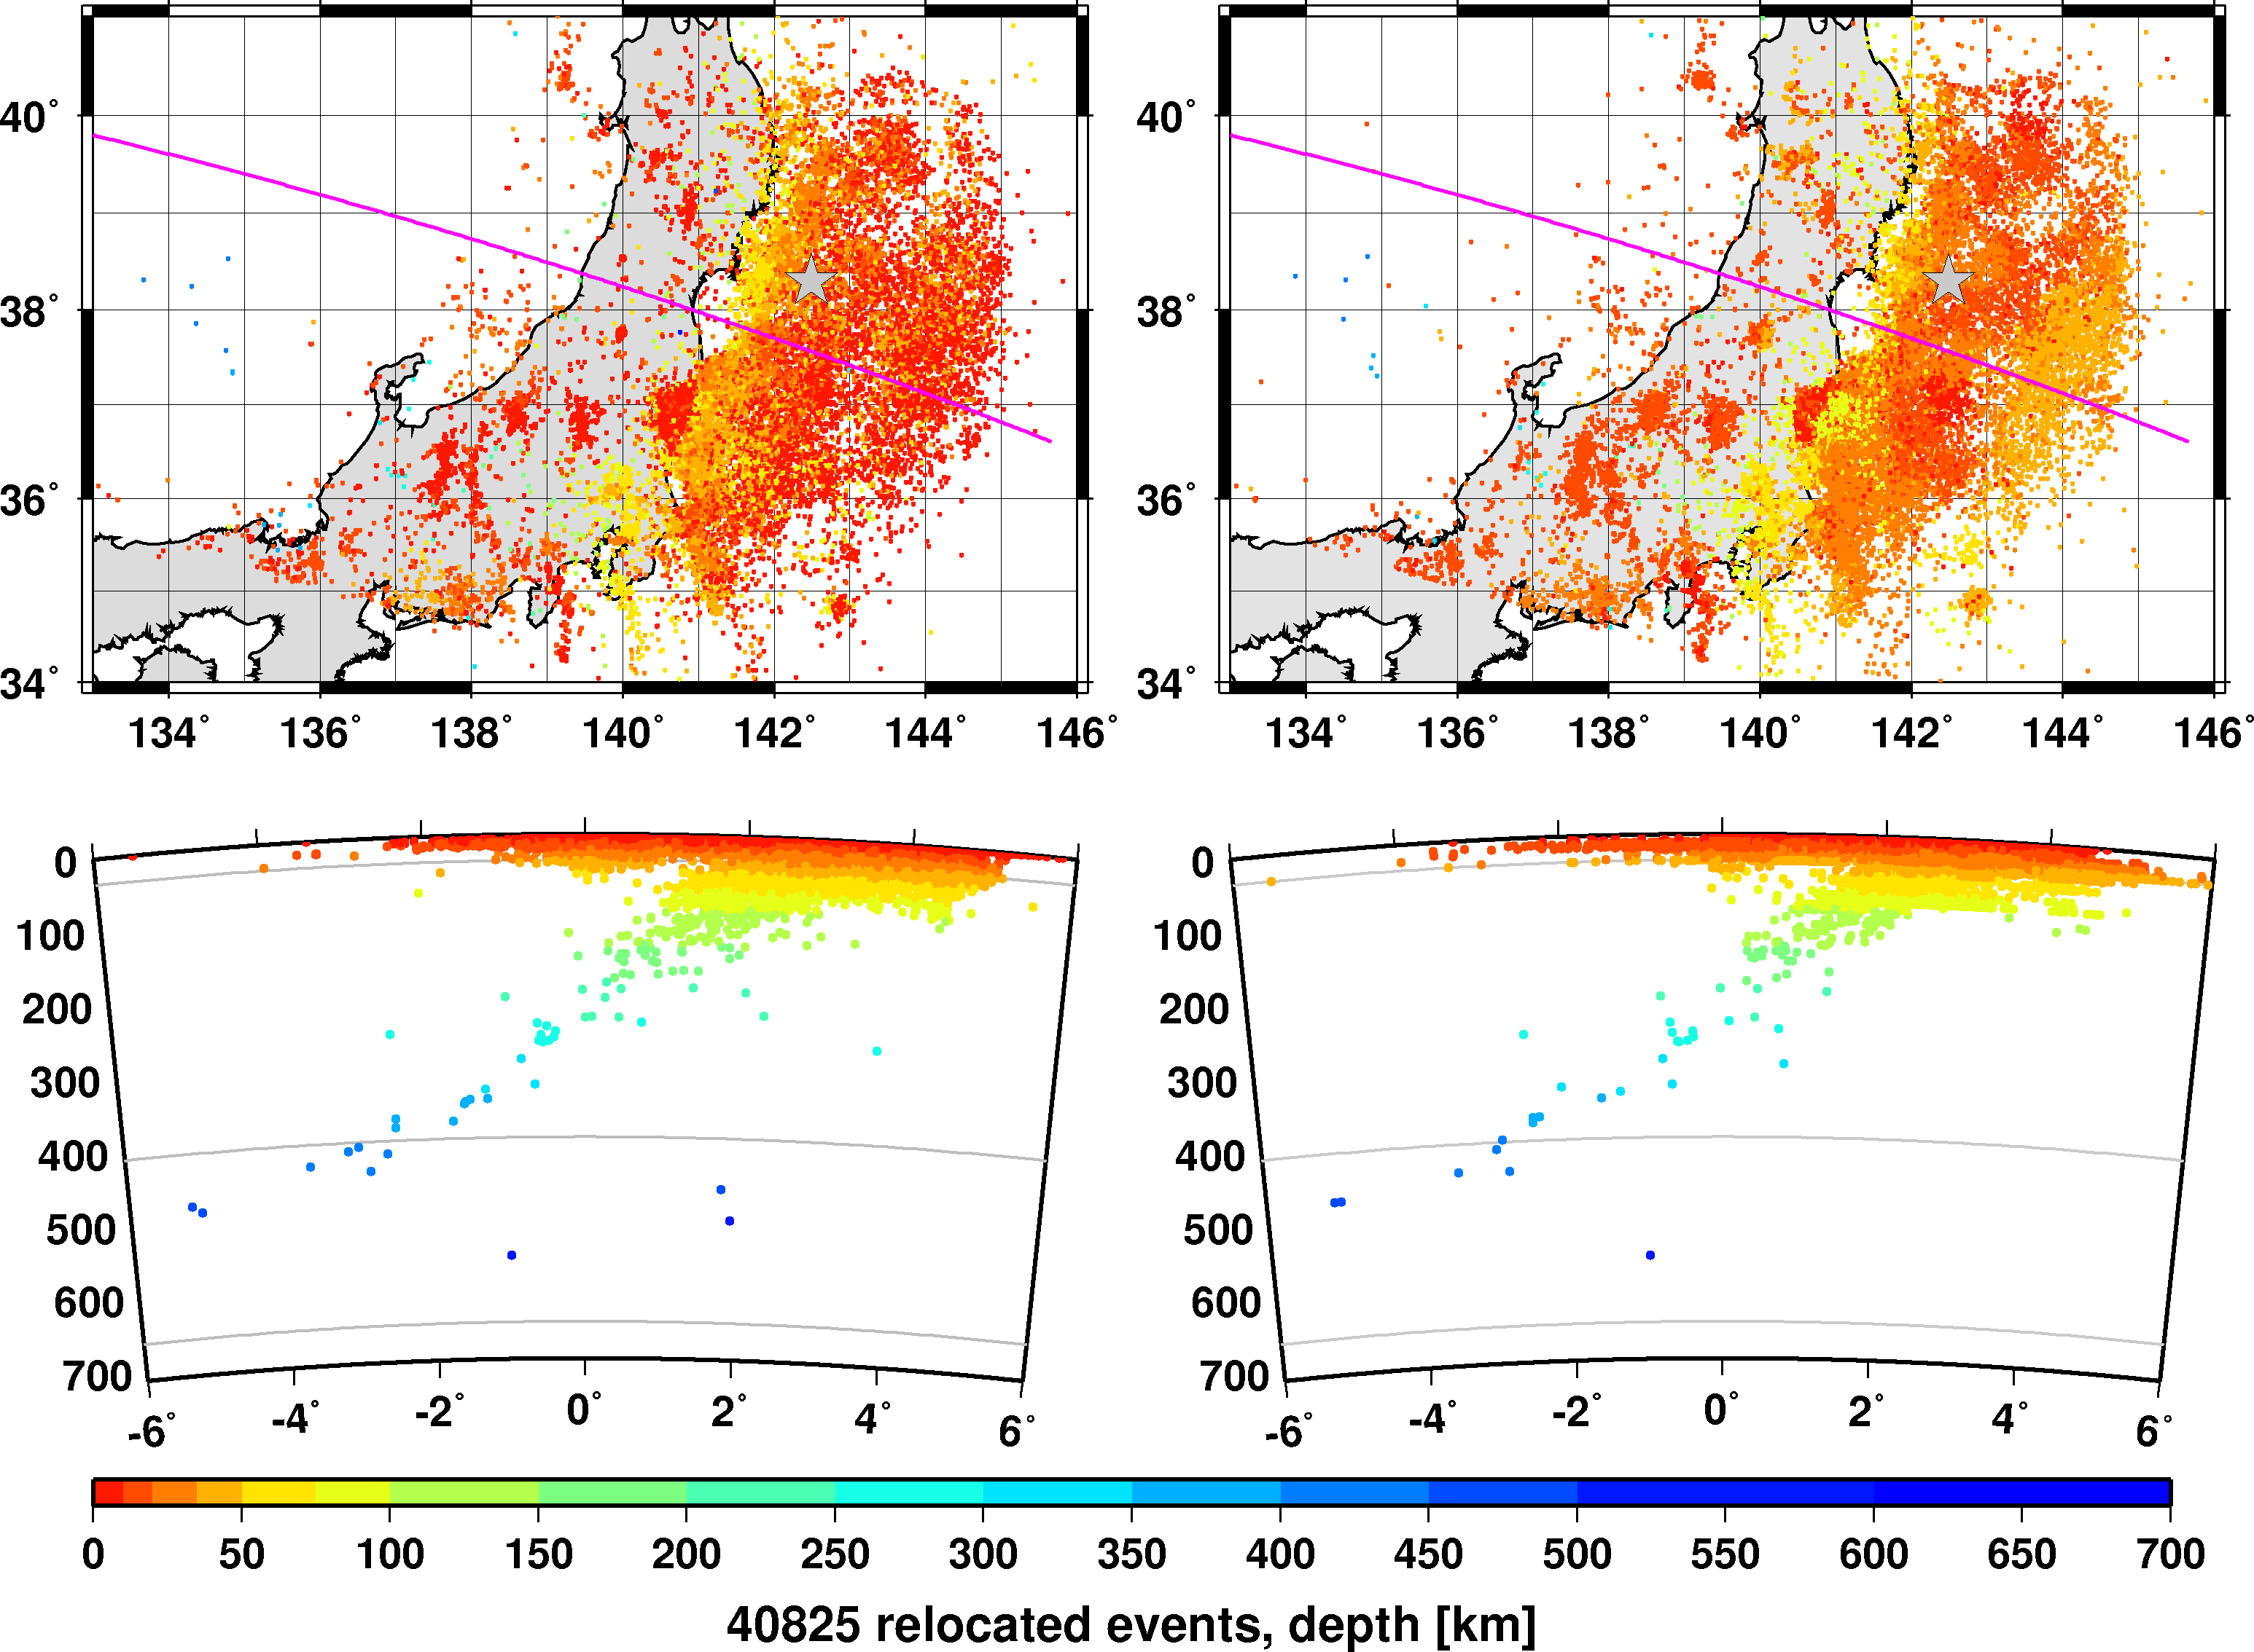
Tohoku, March – May, 2011

Slide 17
iLoc features
Integrated RSTT travel-time predictions (Myers et al., 2010)
RSTT predictions are used by default
Pn/Sn and Pg/Lg travel time predictions can be turned on and off
Local velocity model
Predictions for local phases are calculated up to a 3 degrees (default), beyond that iLoc switches to ak135/RSTT predictions
Local phase TT predictions are calculated for Pg/Sg/Lg, Pb/Sb, Pn/Sn
Local ML and broadband mB magnitudes
Murphy-Barker depth-distance corrections for mB
Support for the SeisComp3 database schema
iLoc can read/write SeisComp3 MySQL database schema tables
Support for the new International Registry of Seismographic Stations conventions (FDSN standard A.D.S.L.)
Agency.Deployment.Station.Location
Support for the new International Seismic Format (ISF2)
Output file is always written as ISF2

Slide 18
Regional Seismic Travel-Times (RSTT)
The RSTT rapid ray-tracing capabilities allow the use of realistic 3D models in routine operations
RSTT package (Myers et al., 2010)
Developed by DoE labs LLNL, LANL and Sandia
Global 3D upper mantle velocity model
Crust: unified model in Eurasia and the Americas, Crust2.0 elsewhere
Utilities for model tweaking
Travel-time prediction utilities for regional (Pn/Sn) and first-arriving crustal (Pg/Lg) phases up to 15°
RSTT is fully integrated into iLoc
The virtual machine contains both iLoc and RSTT

Slide 19
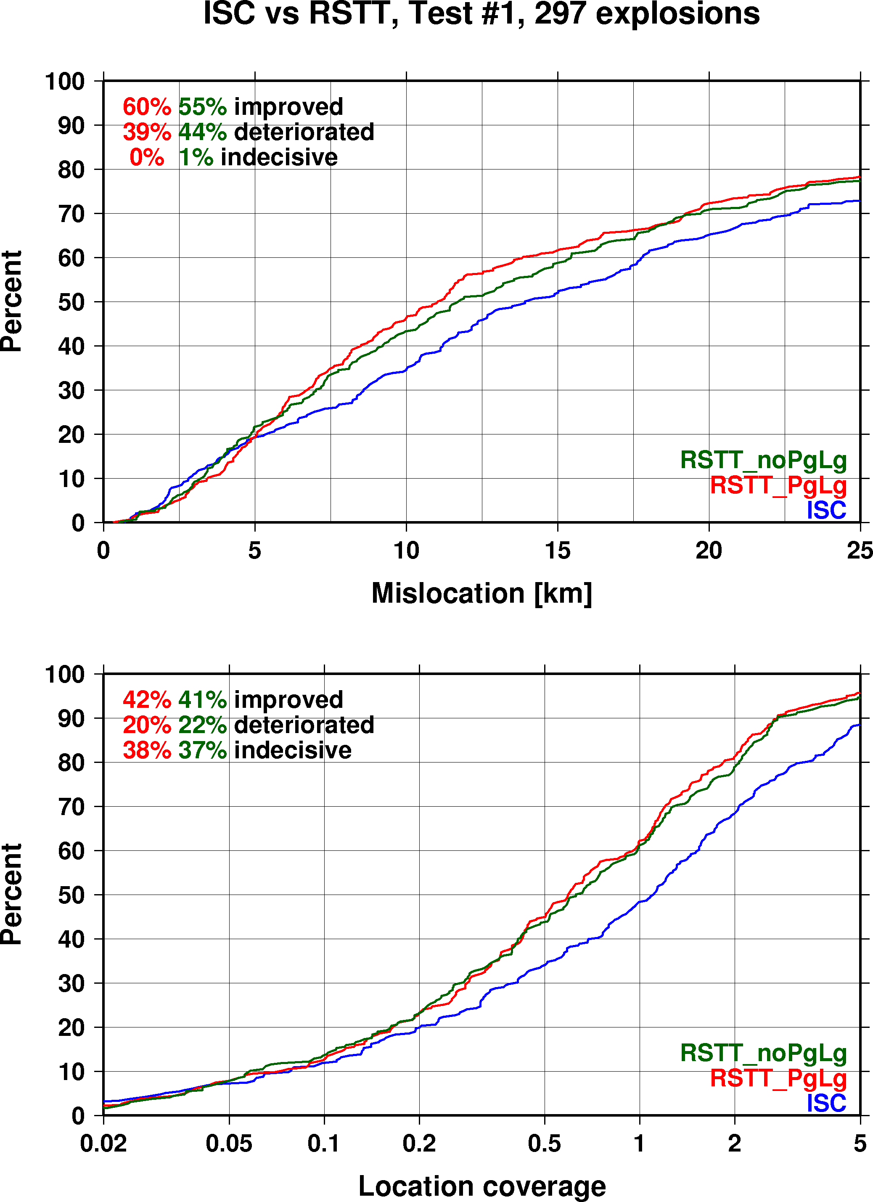
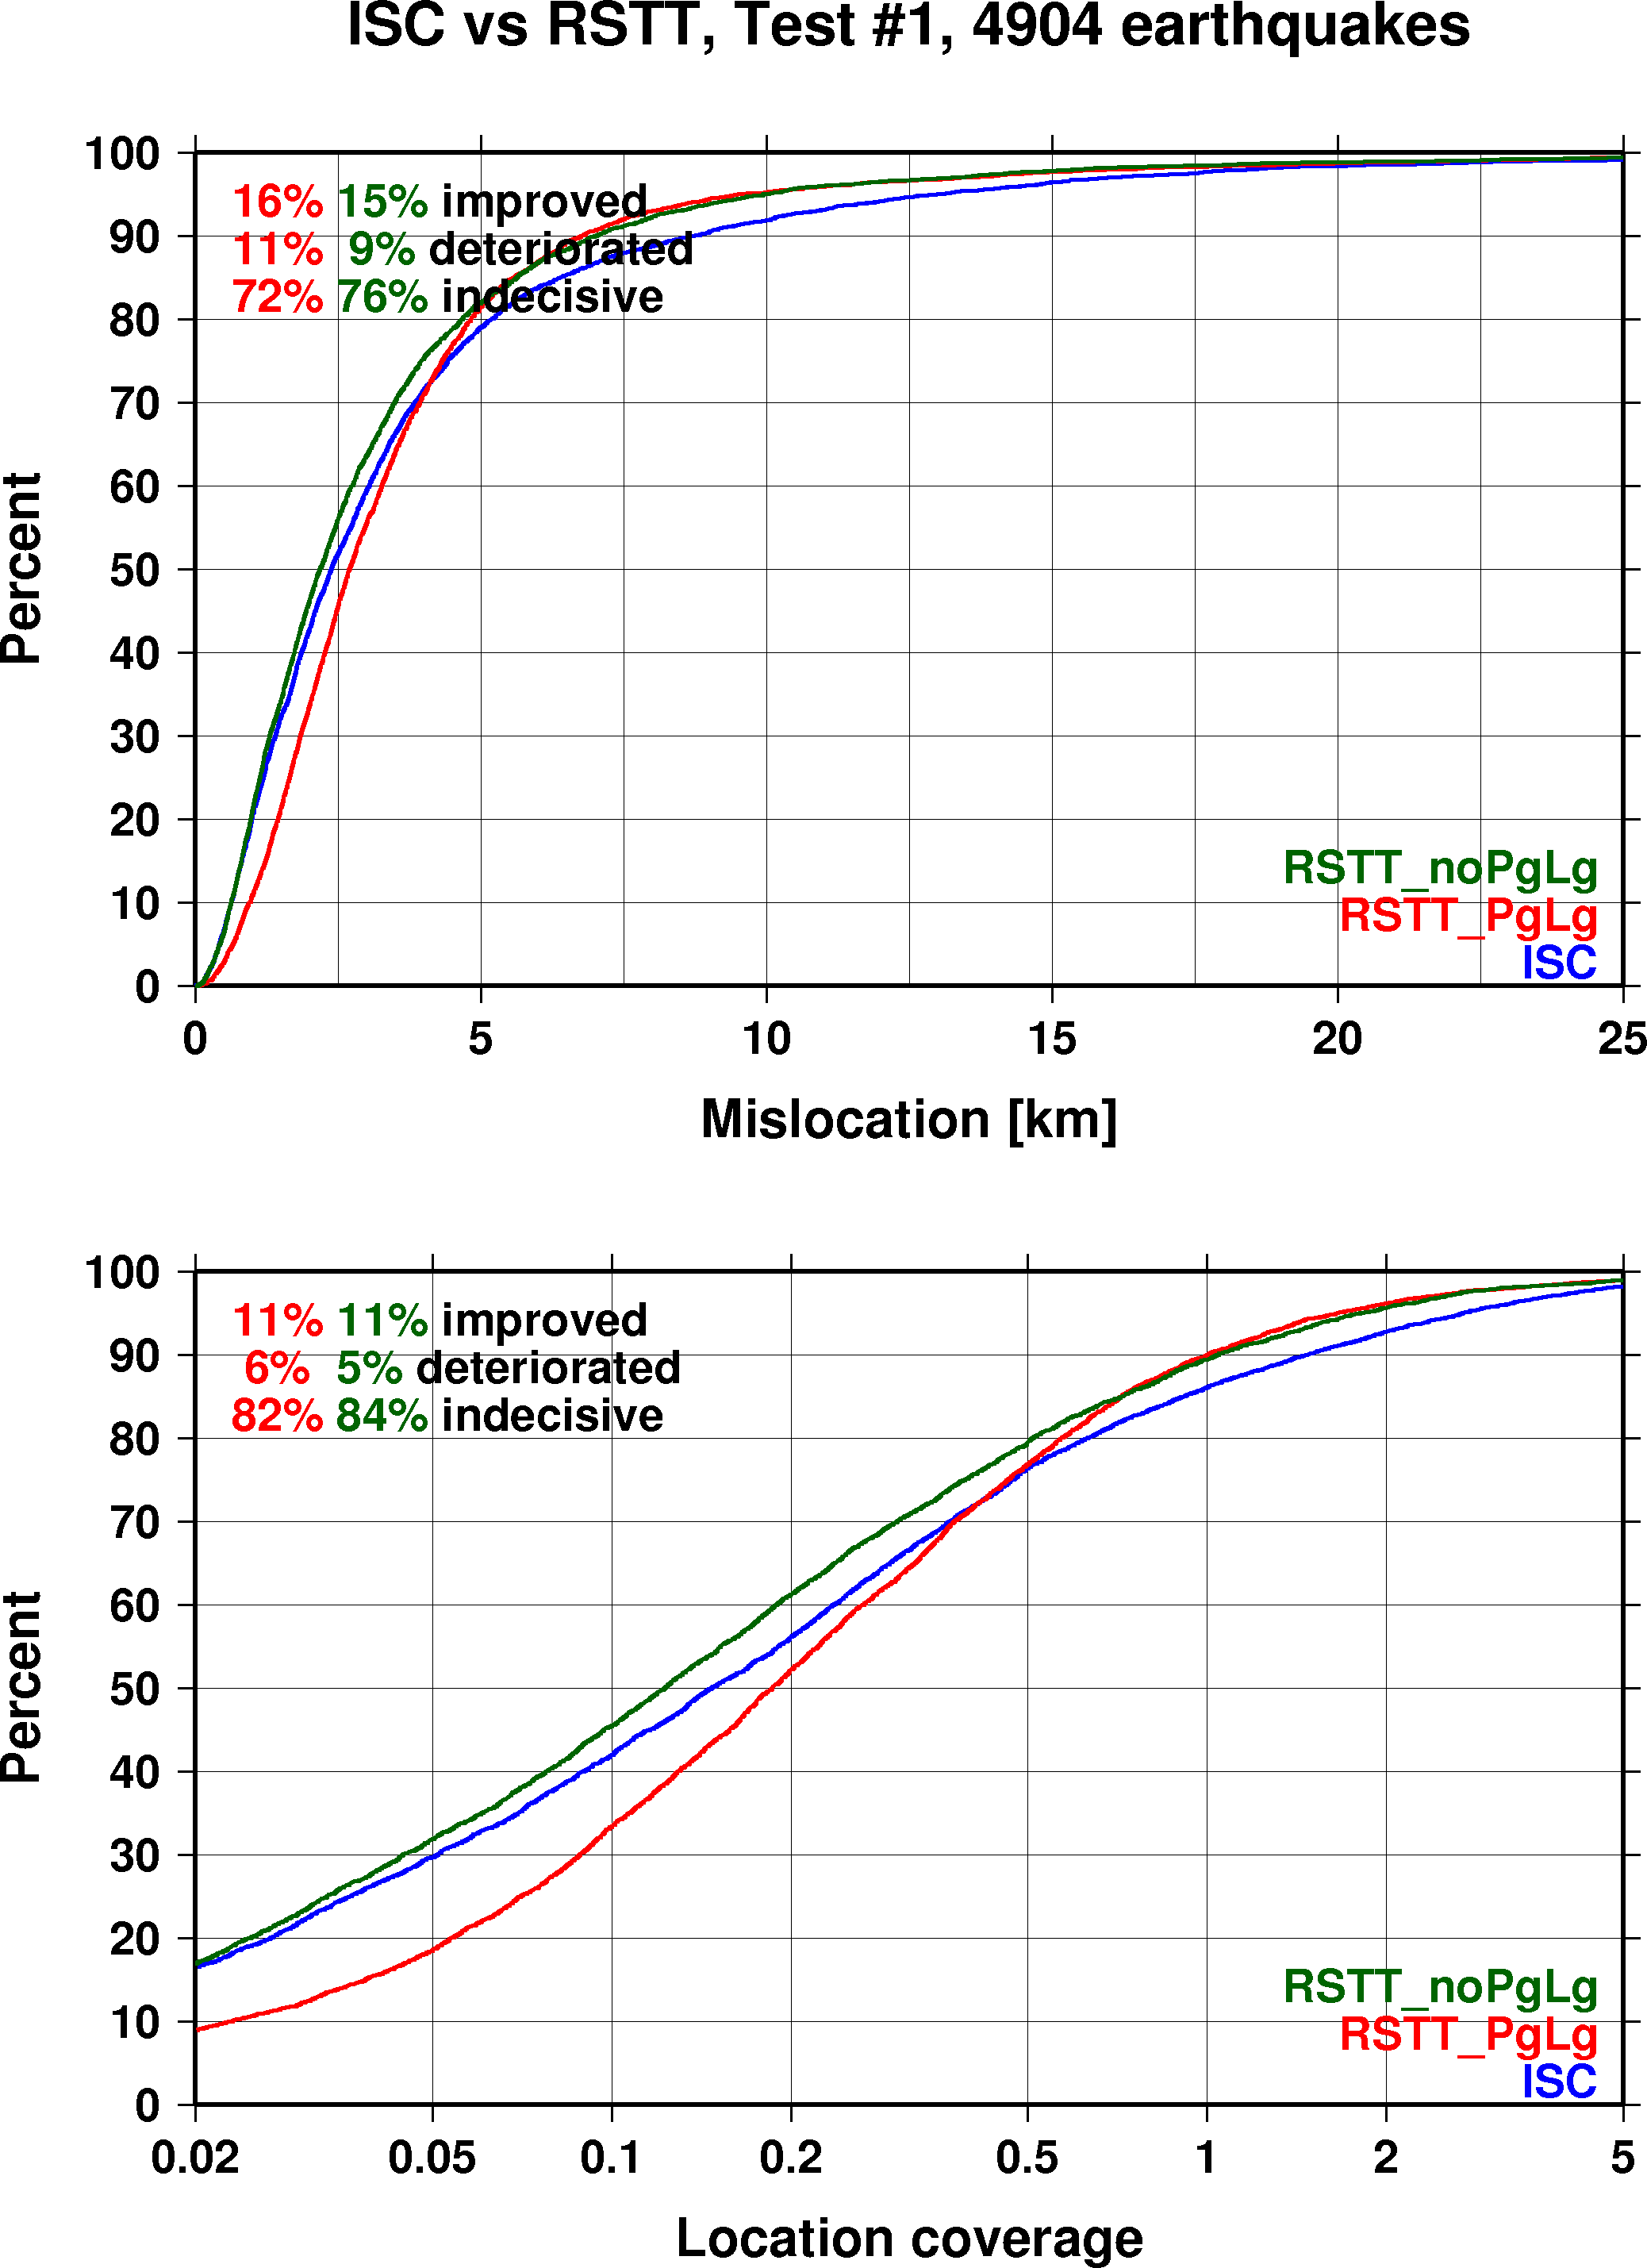
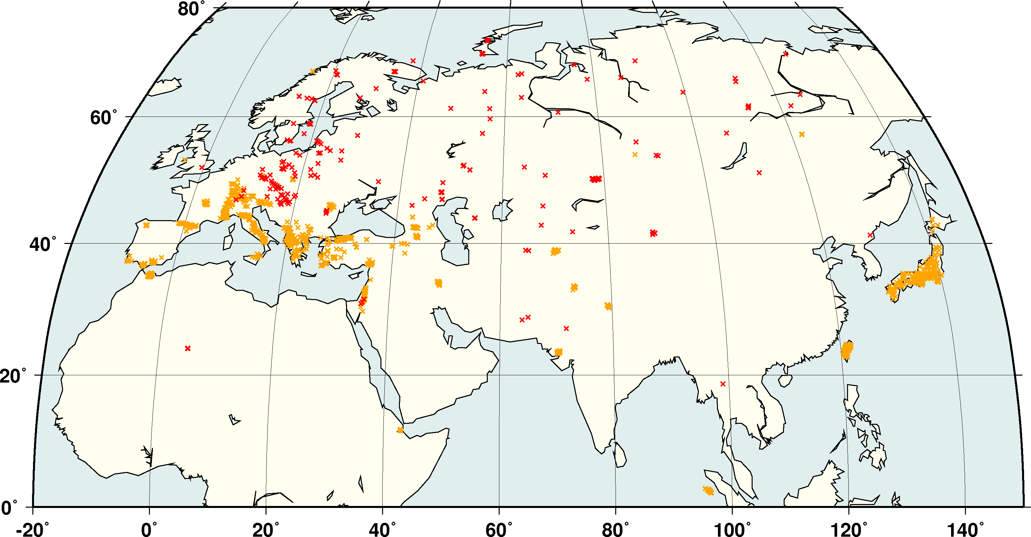
RSTT Relocation Tests
Relocated some 5,600 GT0-5 events in Eurasia
Most GT5 evens are very well recorded
improvements are expected only in the tails
Clear improvements for GT0-2 explosions

Slide 20
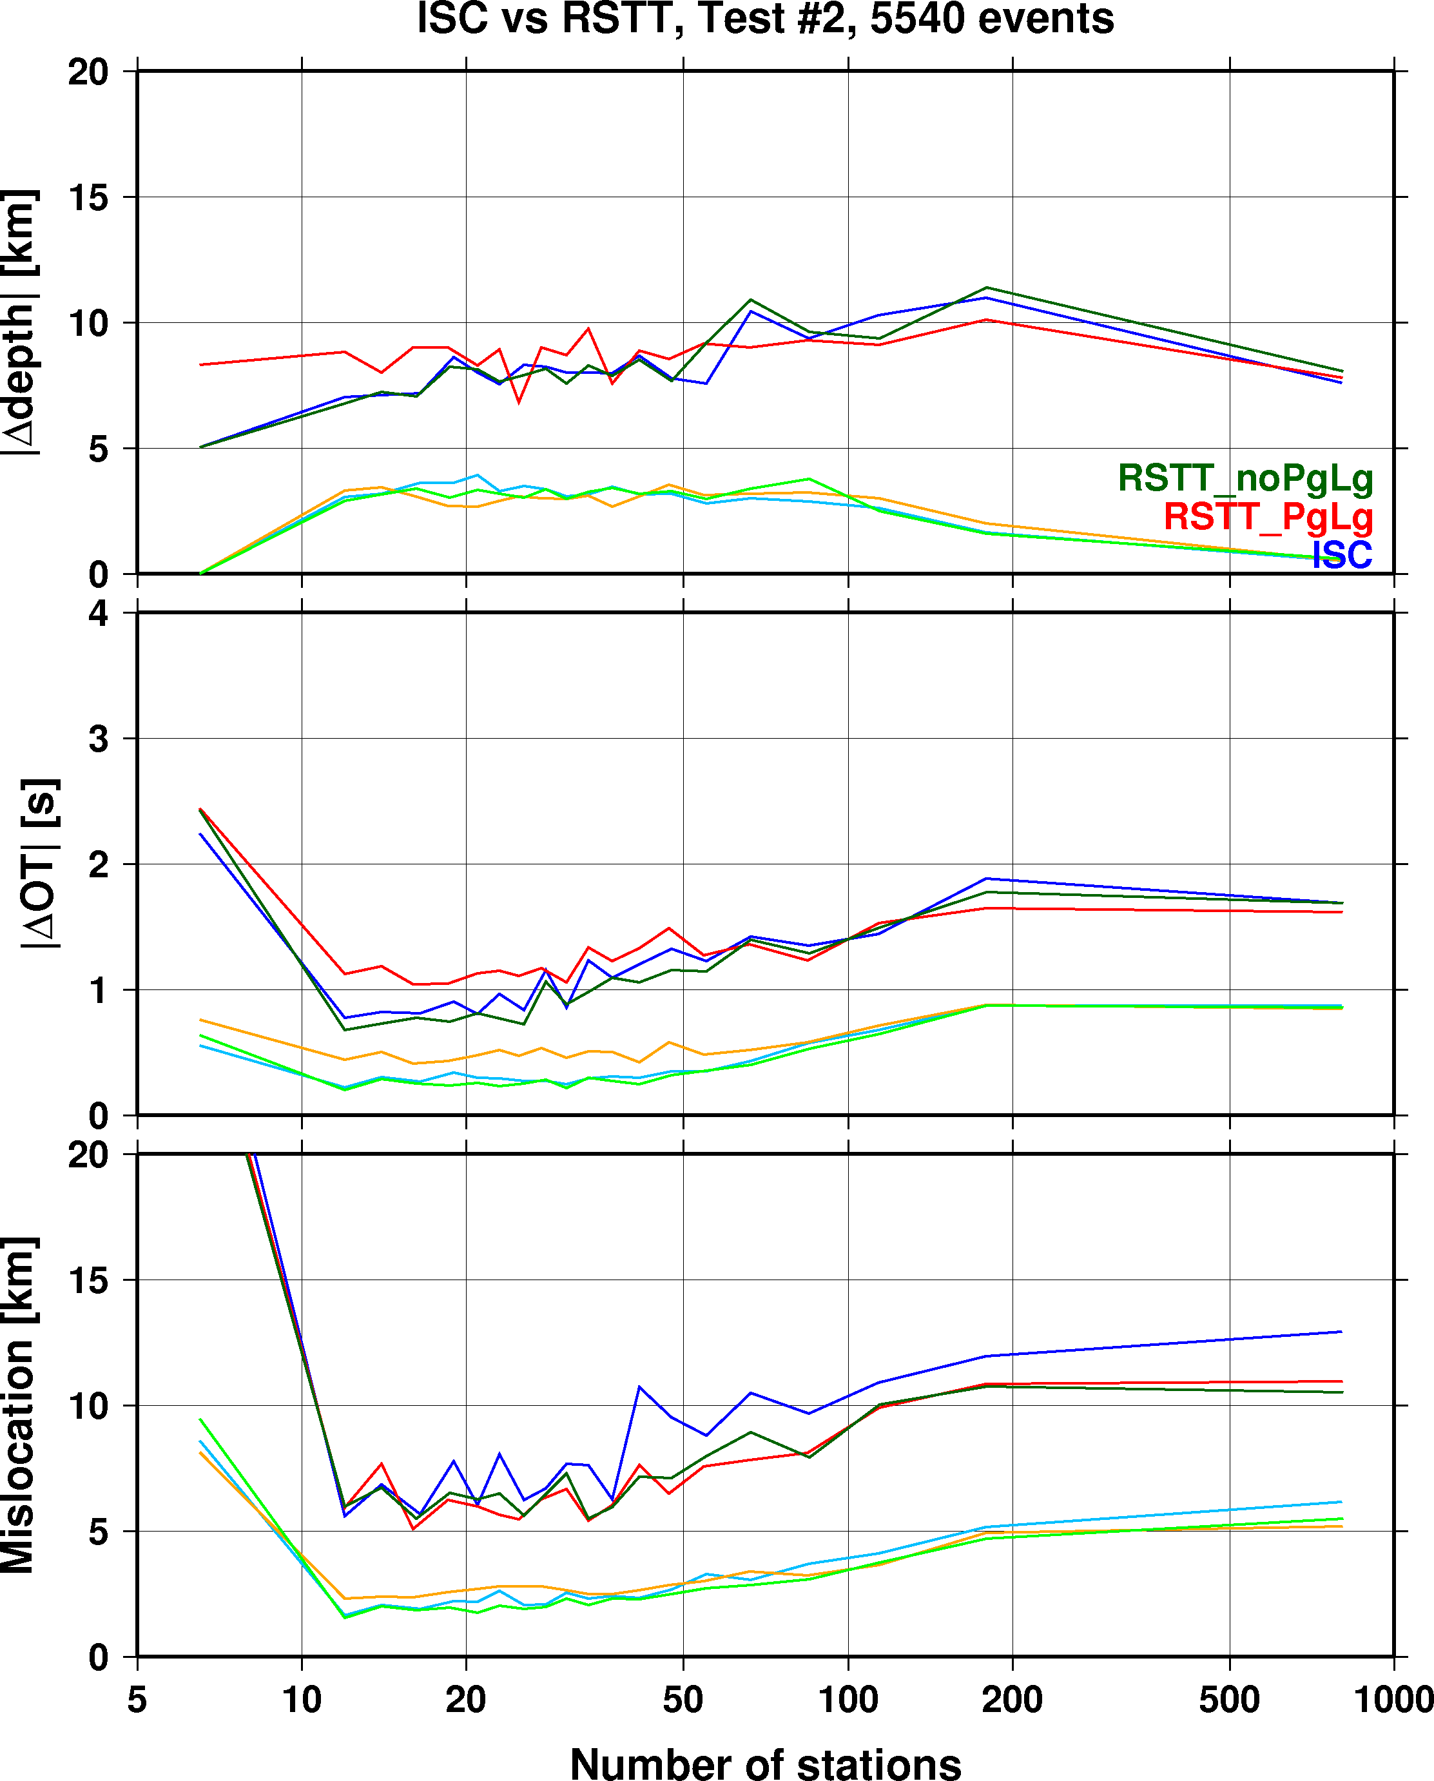
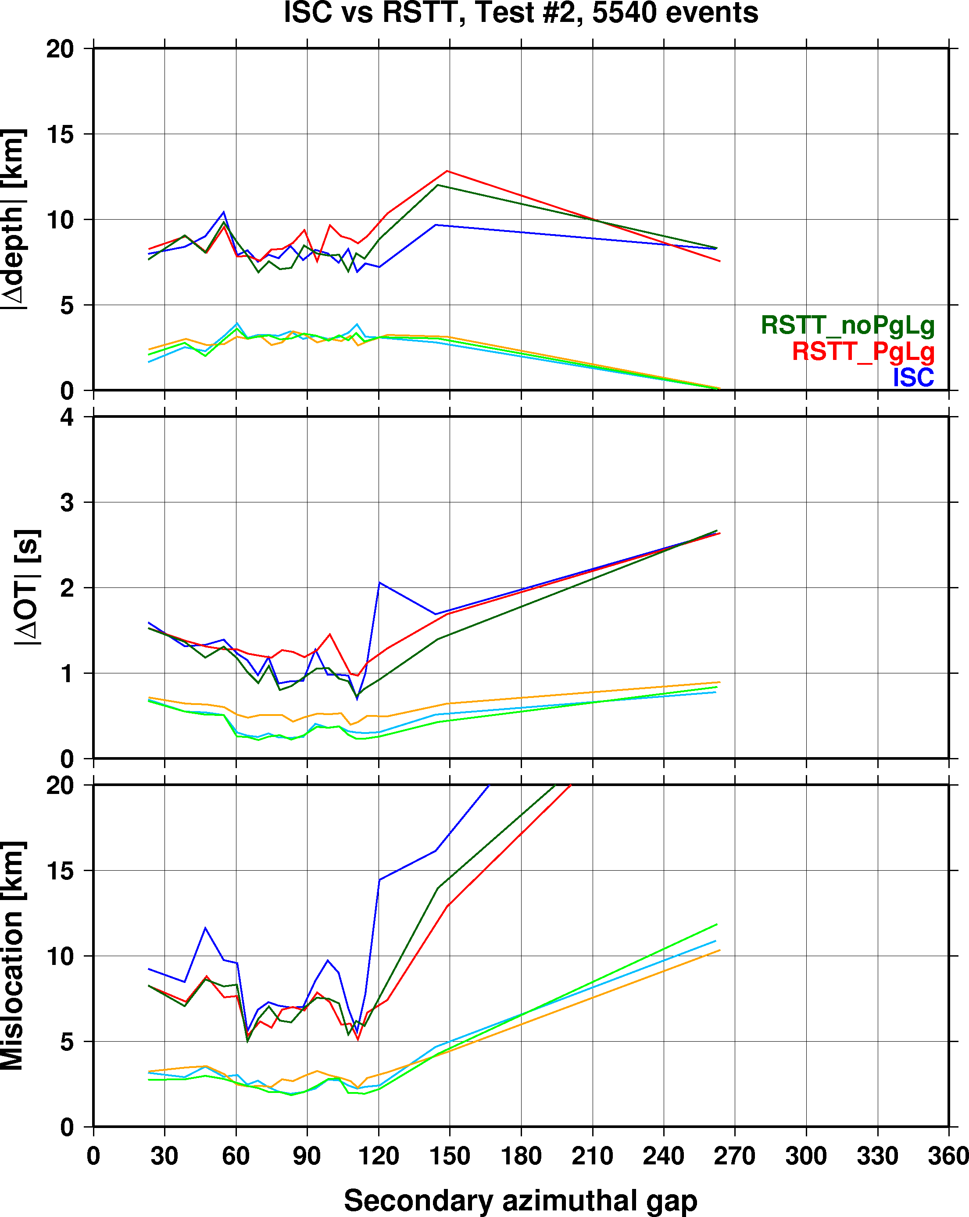
Improvements due to RSTT
90% percentile
median
More pronounced improvements with increasingly unbalanced networks

Slide 21
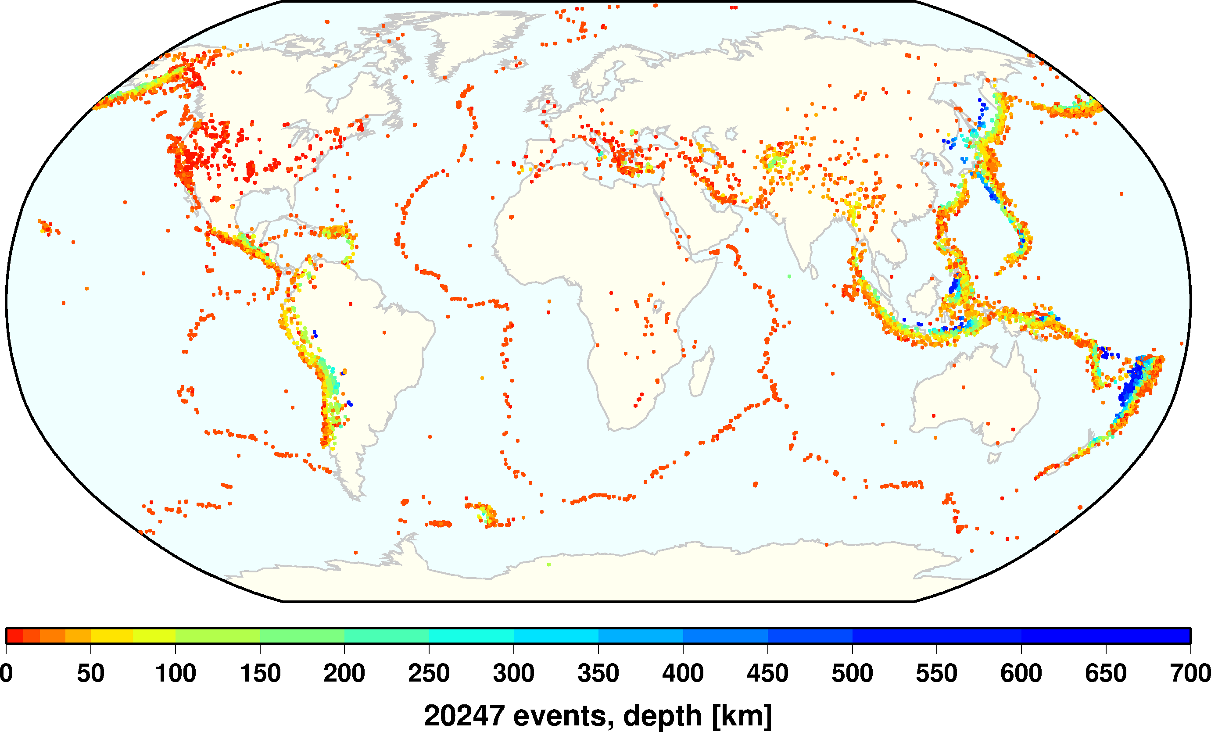
NEIC PDE relocations with iLoc
The performance of iLoc was tested on the NEIC PDE bulletin from 2013-07-23 to 2014-05-21, altogether 10 months worth of data with more than 20 thousand events.
The PDE bulletin was relocated with ak135 travel-time predictions (NEIC also uses ak135) to compare the performance of iLoc and the NEIC locators, as well as with RSTT Pn/Sn predictions to see the improvements due to a 3D velocity model.

Slide 22
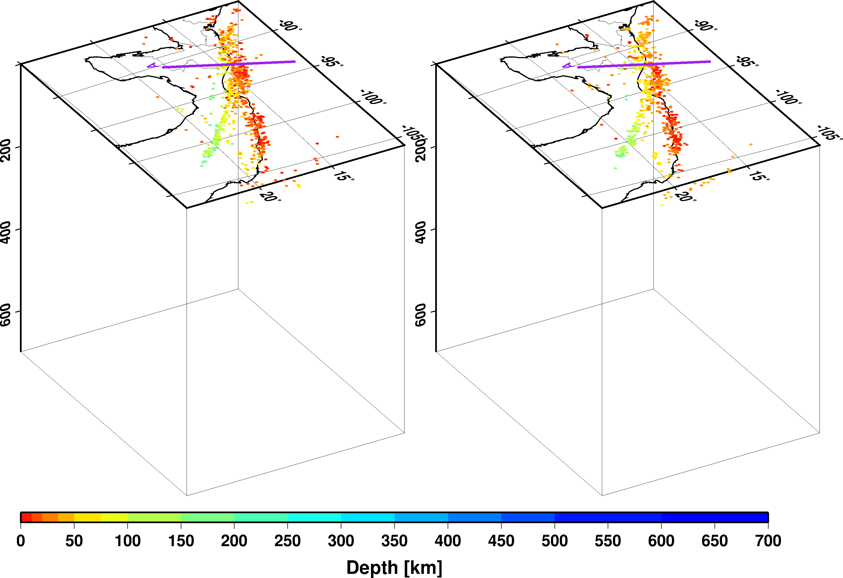
Guatemala-Mexico border region
PDE
iLoc RSTT

Slide 23
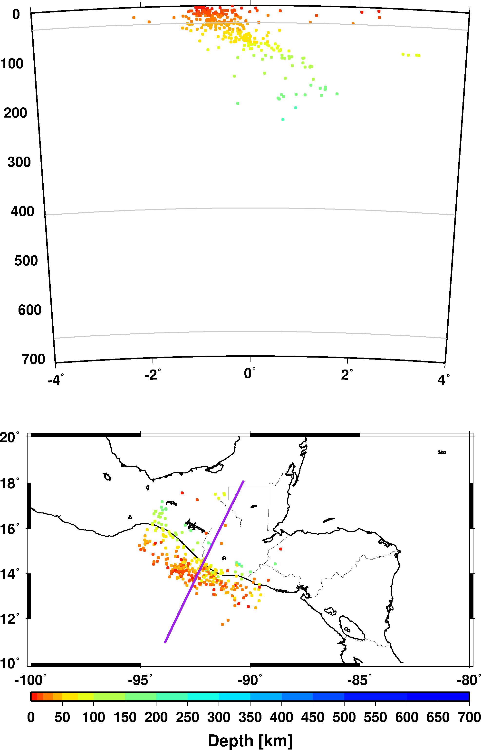
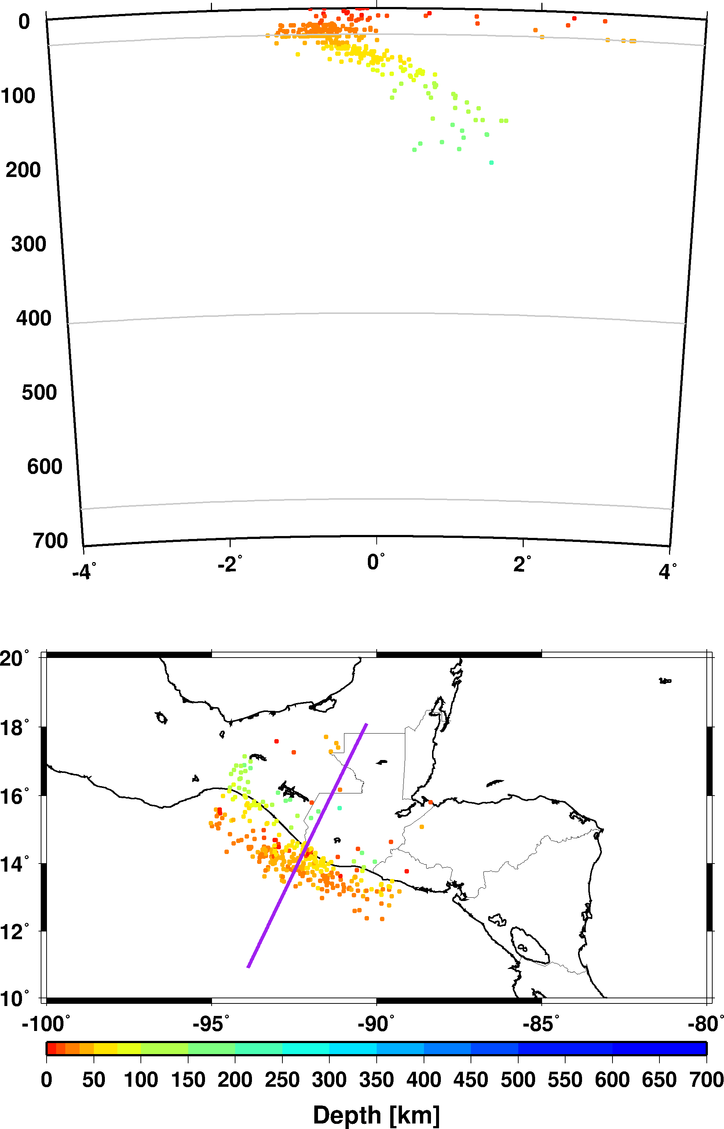
Guatemala-Mexico border region
PDE
iLoc ak135
iLoc RSTT
Better resolved subducting slab with RSTT predictions

Slide 24
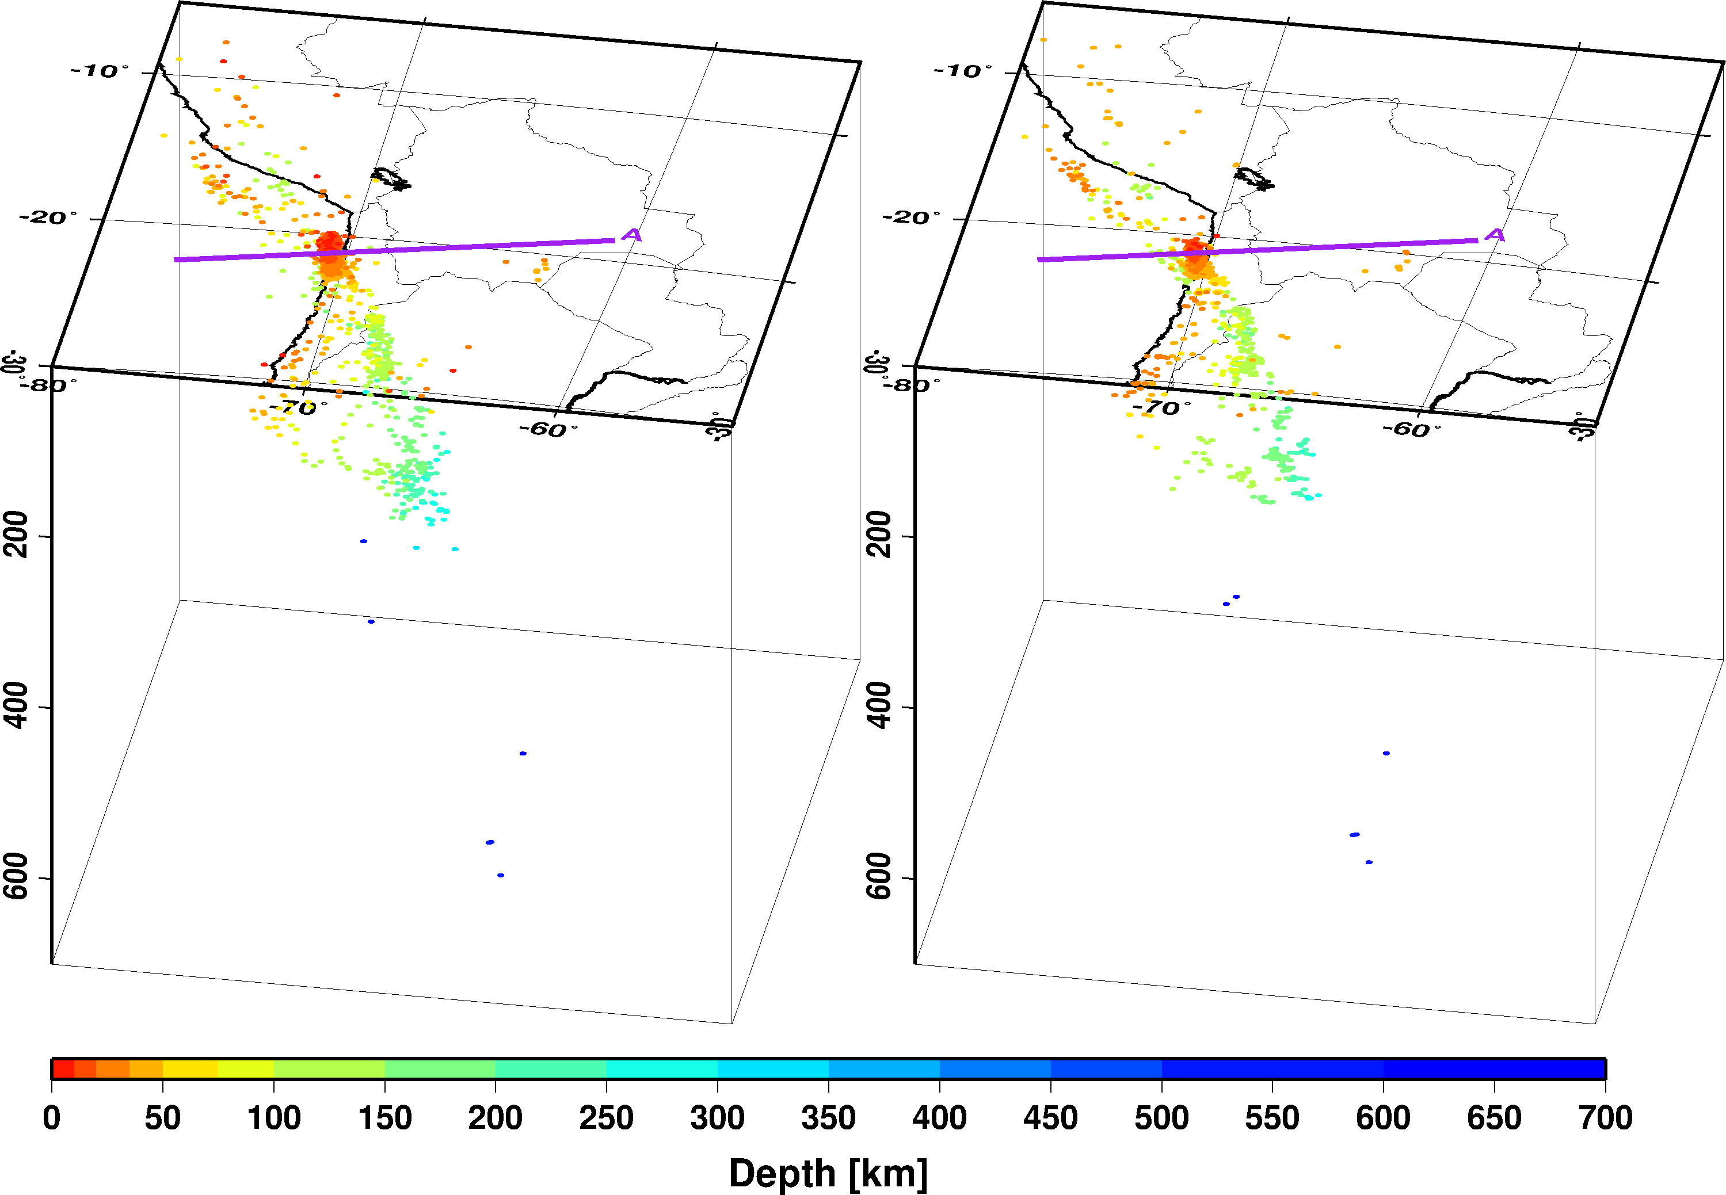
Chile-Peru-Bolivia border region
PDE
iLoc RSTT

Slide 25
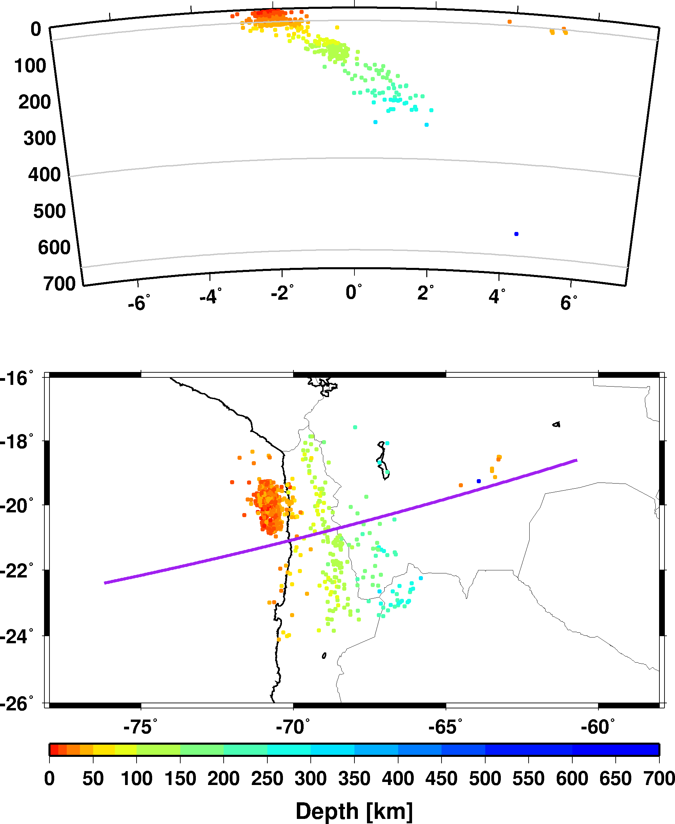
Chile-Peru-Bolivia border region
PDE
iLoc ak135
iLoc RSTT
Further improvements over ak135 due to RSTT predictions

Slide 26
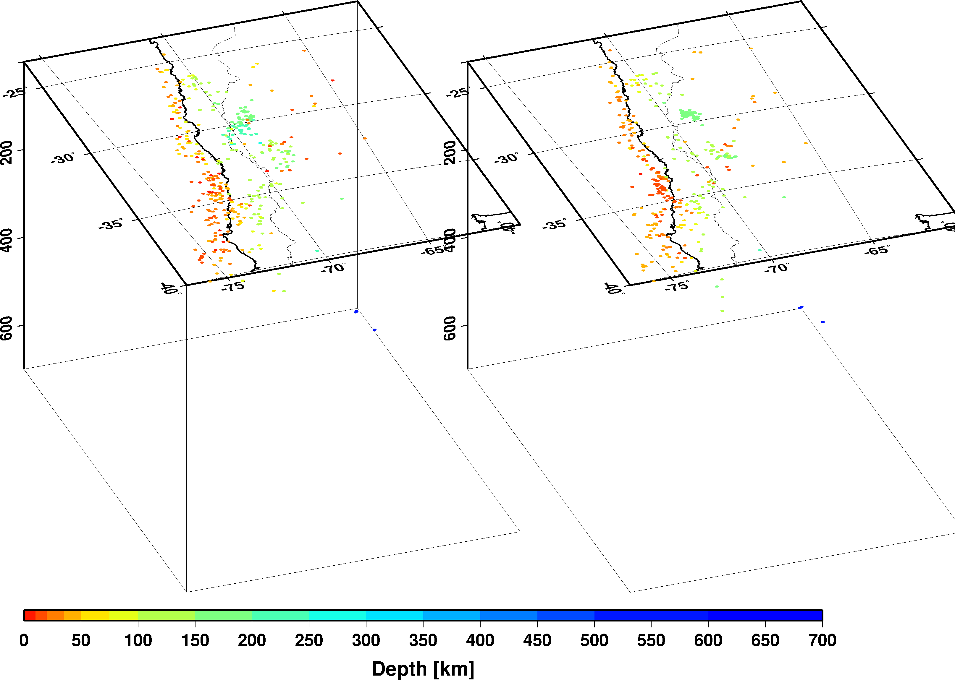
Chile-Argentina border region
PDE
iLoc RSTT

Slide 27
Conclusions
The ISC locator
Operational since January 2011 (events since January 2009)
Provides honest ~85-90% actual coverage
Reduces location bias due to correlated travel-time prediction errors
Better clustered event locations provide an improved view of the seismicity of the Earth
Development continues as project iLoc
iLoc uses RSTT predictions by default
iLoc supports local velocity models
iLoc is open source, available for download at ORFEUS
RSTT evaluation
Pn/Sn predictions provide location improvements
Mixing regional RSTT and teleseismic ak135 TT predictions does not introduce baseline differences

