Slide 1
MUSTANG Clients
Interacting with MUSTANG metrics in different ways

Slide 2
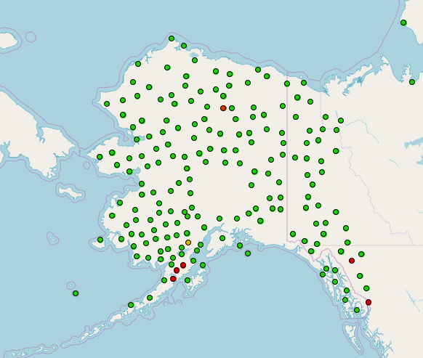
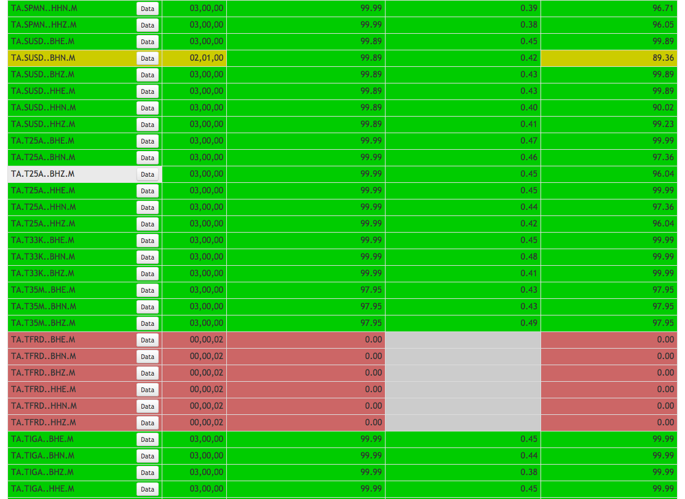
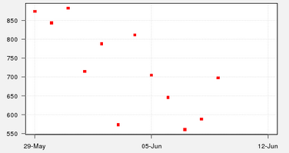
MUSTANG Clients
Clients are tools used to interact with MUSTANG web services, so that…
The metrics can be combined and manipulated in fun and interesting ways
You don’t have to do it yourself
The three clients described here provide different ways to visualize the metrics, which can be easier to digest than in tabular form
Databrowser
MUSTANGular
LASSO
If you like what these do, or think that they are lacking, you can let us know. Or better, make your own clients and share them with us!

Slide 3
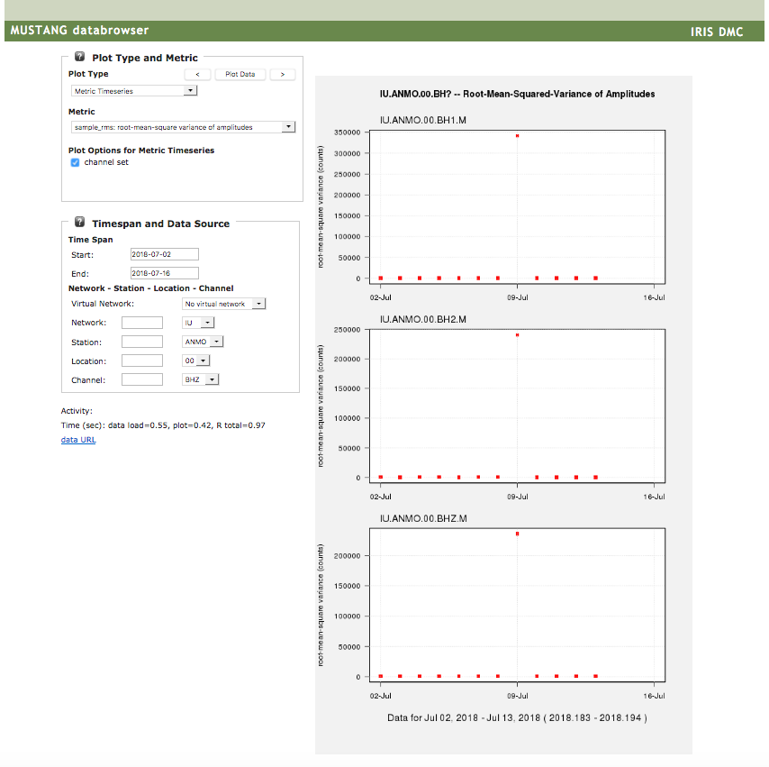
MUSTANG Clients
Databrowser
Databrowser
http://ds.iris.edu/mustang/databrowser/
Produced by IRIS Data Services
Graphical display of MUSTANG metrics
Time Series – series of daily metric values
Grouped with similar channels
Grouped with similar metrics
Boxplots – distribution of metric values
By station for one network
By channel for one station
Can scale by instrument sensitivity
Seismic trace
PDF
PDF Noise Mode Timeseries

Slide 4
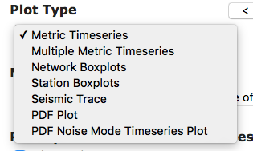
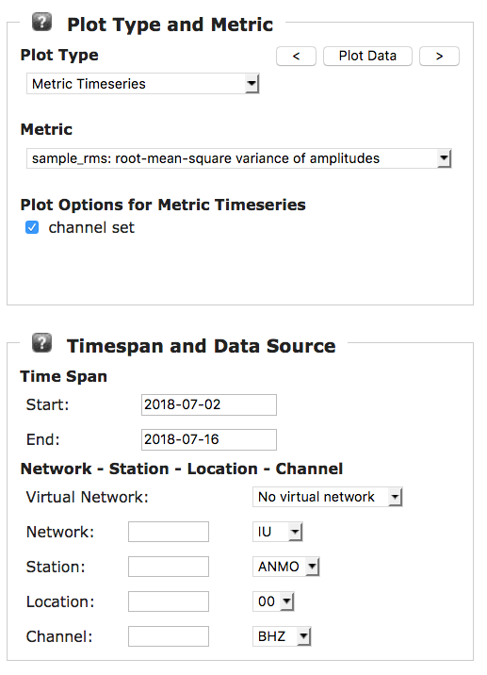
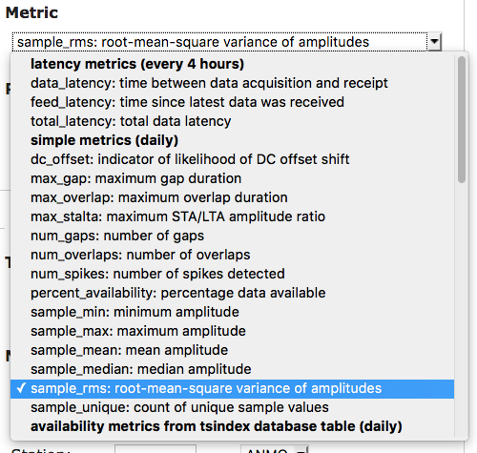
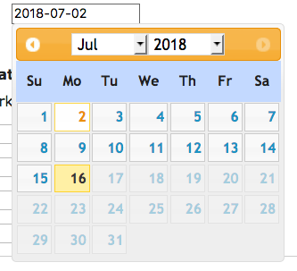
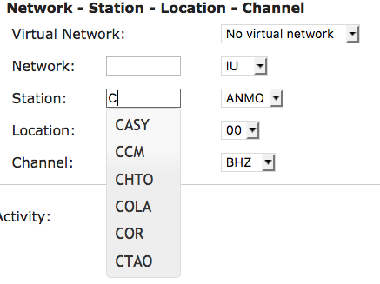
Databrowser
MUSTANG Clients
Databrowser

Slide 5
Hands On: Databrowser
MUSTANG Clients
Databrowser
http://ds.iris.edu/mustang/databrowser/
Generate a boxplot of the percent above the NHNM for BHZ channels for the entire IU network, for the month of July
Generate a plot of the percent availability per day for IU.PMG.00.BHZ for September 2017
What does the channel set option do? “Scale by sensitivity”? When does the sensitivity option appear?
Using the Multiple Metrics option, get the amplitude values for IU.BILL.00.BHZ for September 2017
Plot the seismic trace for that period too – note the subsampling
Something is wrong. Find out when the problem began and ended.
Look at the PDF Noise Mode Timeseries plot for the same period to compare

Slide 6
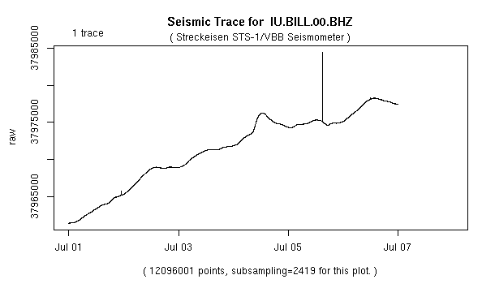
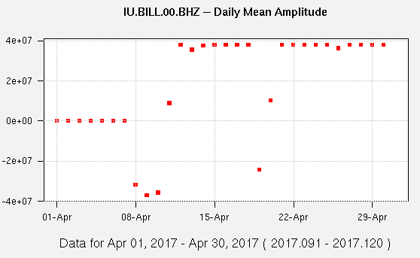
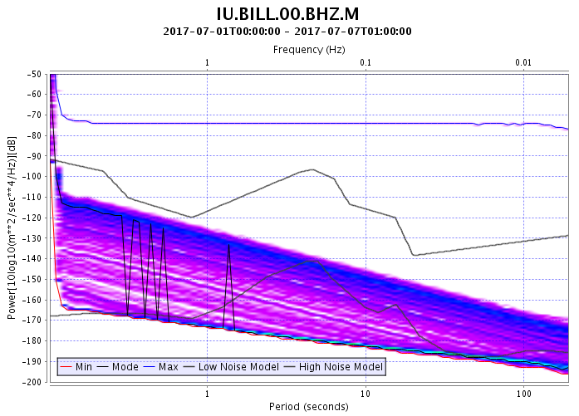
An example:
MUSTANG Clients
Databrowser
Seismic trace: drift is confirmed
Metric Timeseries:
Drift began April 8, 2017
PDF Plot: Seismic energy is absent

Slide 7
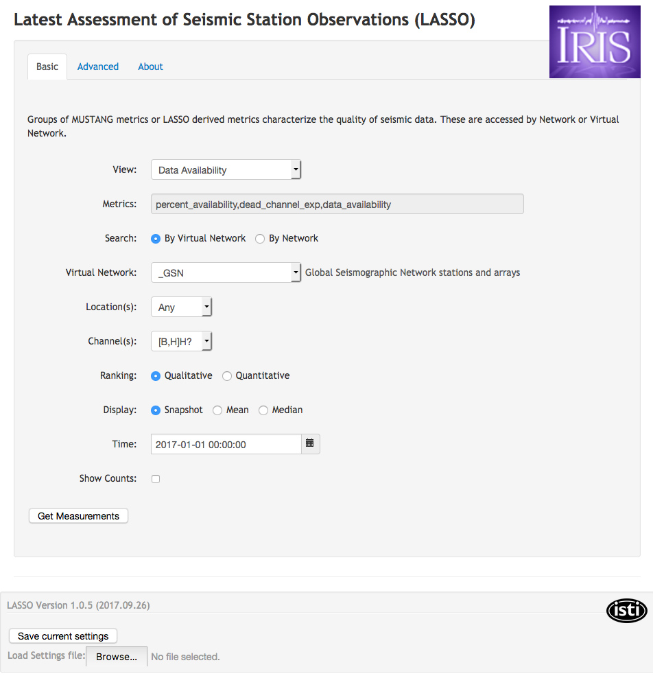
LASSO
MUSTANG Clients
LASSO
http://lasso.iris.edu/
Developed by ISTI and IRIS Instrumentation Services
Displays MUSTANG metrics in either
Control-panel
Time series
Ranks data based on metric values
Multiple metrics for virtual networks
Derived metrics

Slide 8
LASSO - basic
MUSTANG Clients
LASSO
Choose from 6 sets of metrics
Data Availability
Mass Positions
Noise Power
Signal Quality
Metadata Validity
Time Series Integrity
Quantitative ranks channels From 0 (all metrics poor) to 100 (all metrics good).
Qualitative lists a count of good, fair and poor metrics.

Slide 9
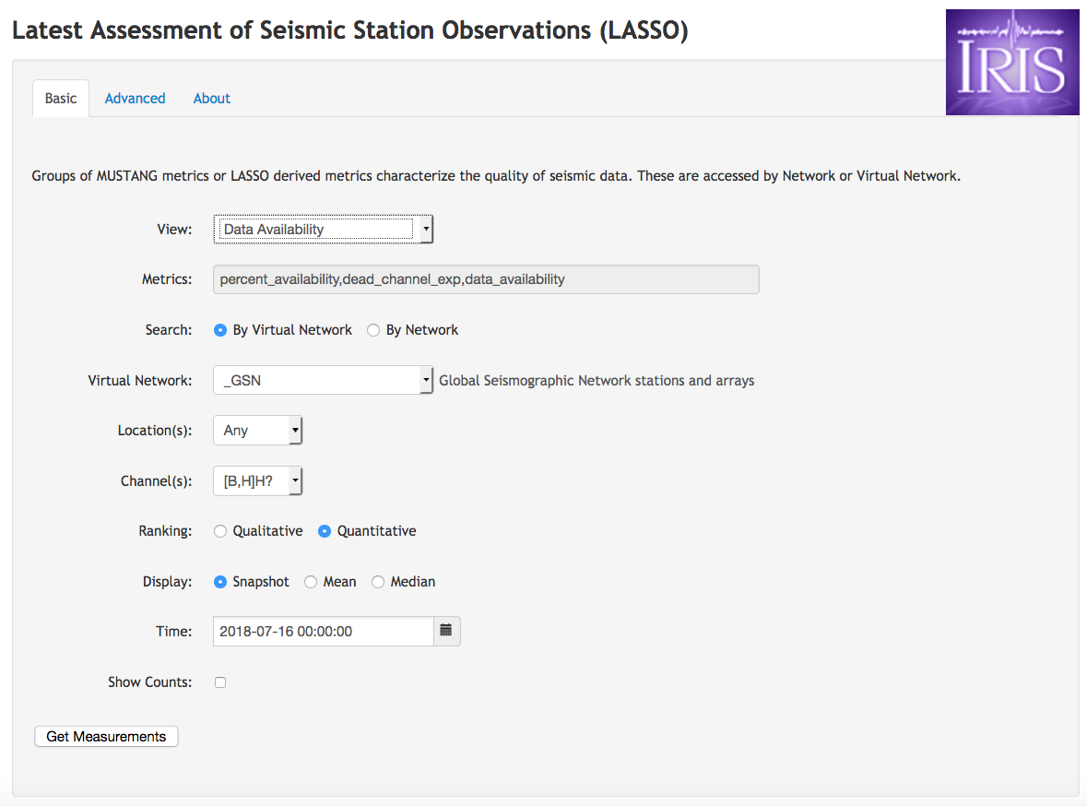
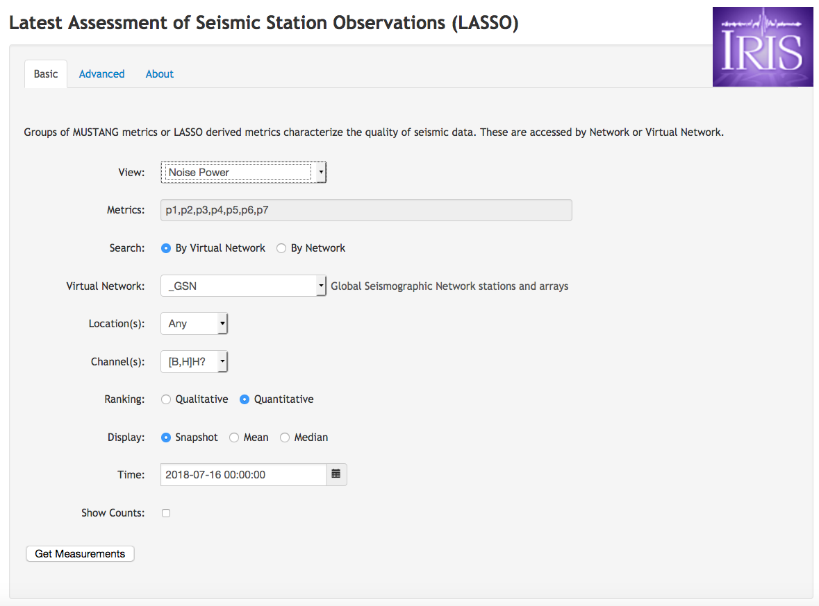
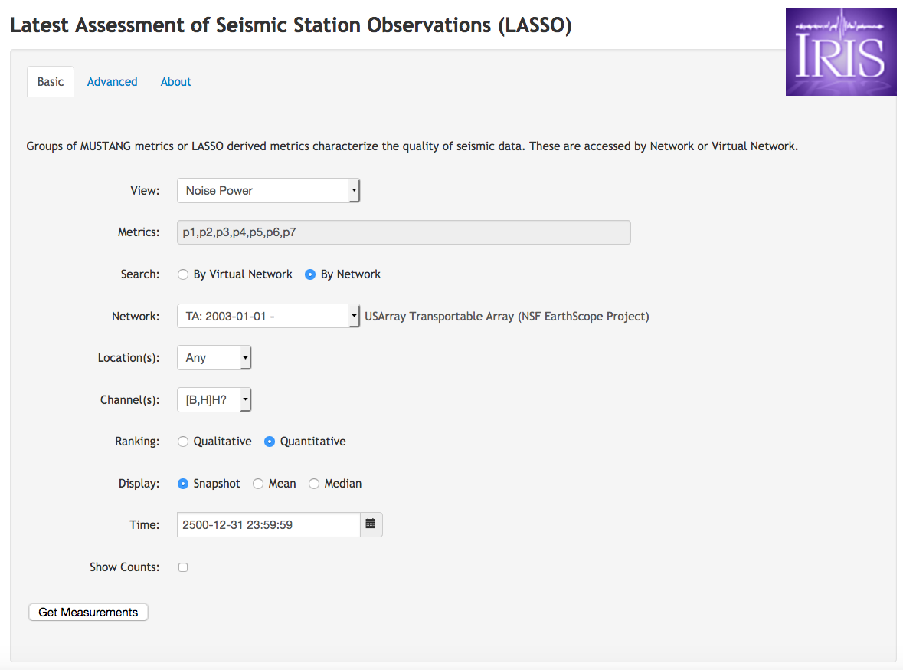
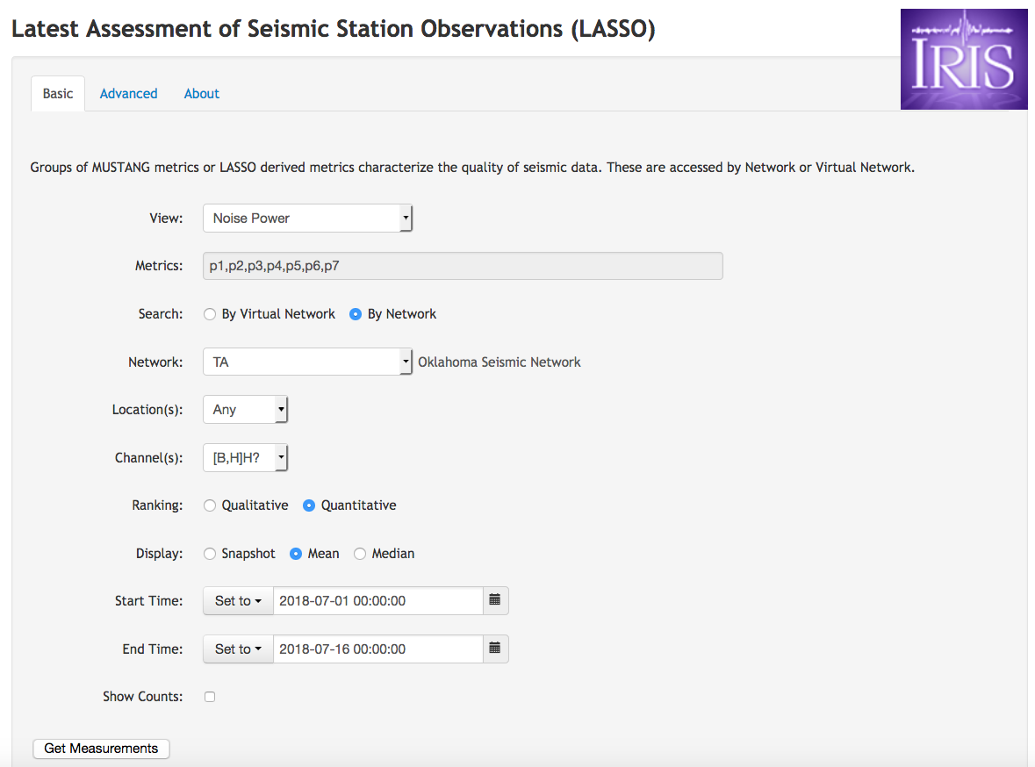
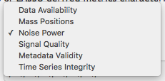
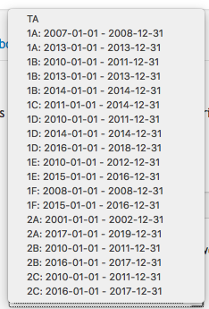
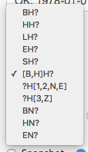
LASSO - basic
MUSTANG Clients
LASSO

Slide 10
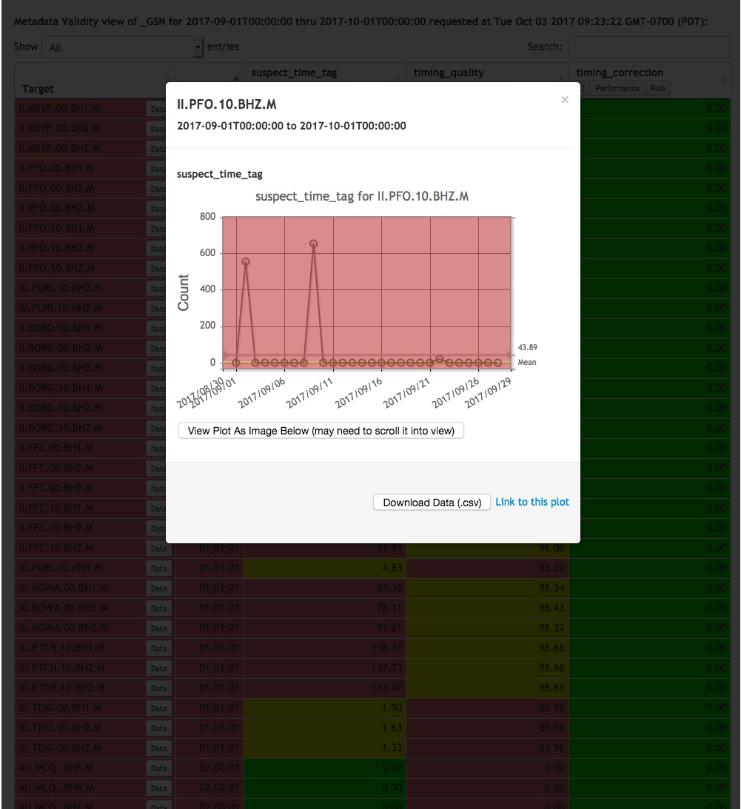
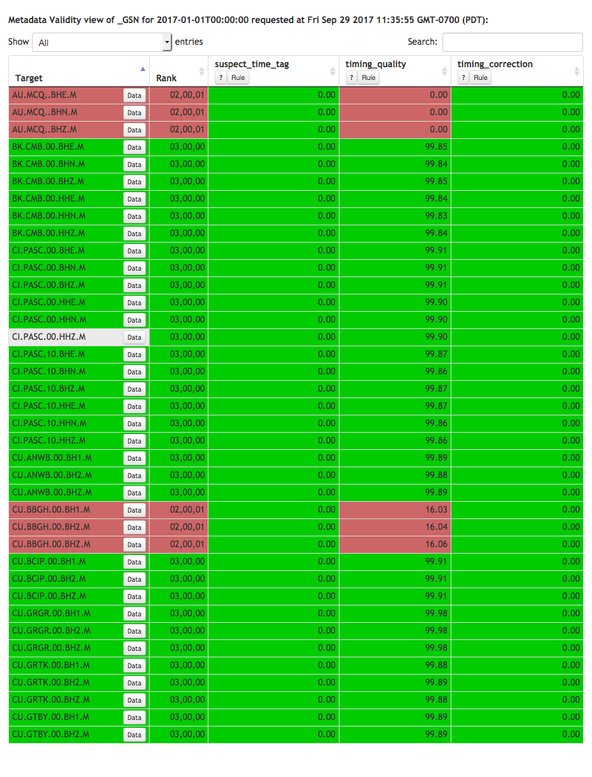
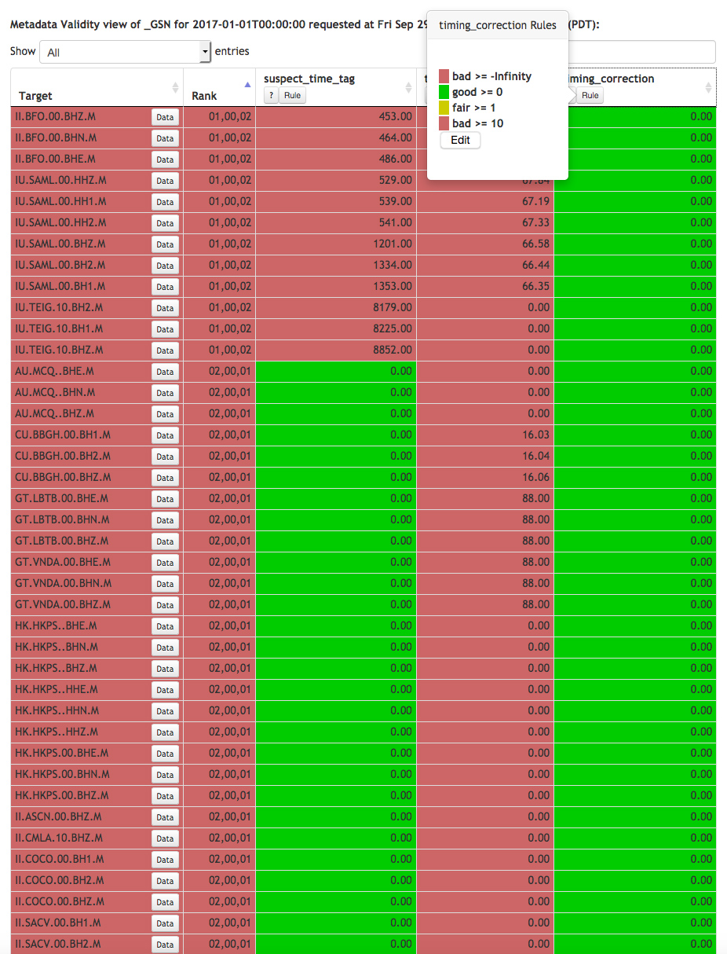
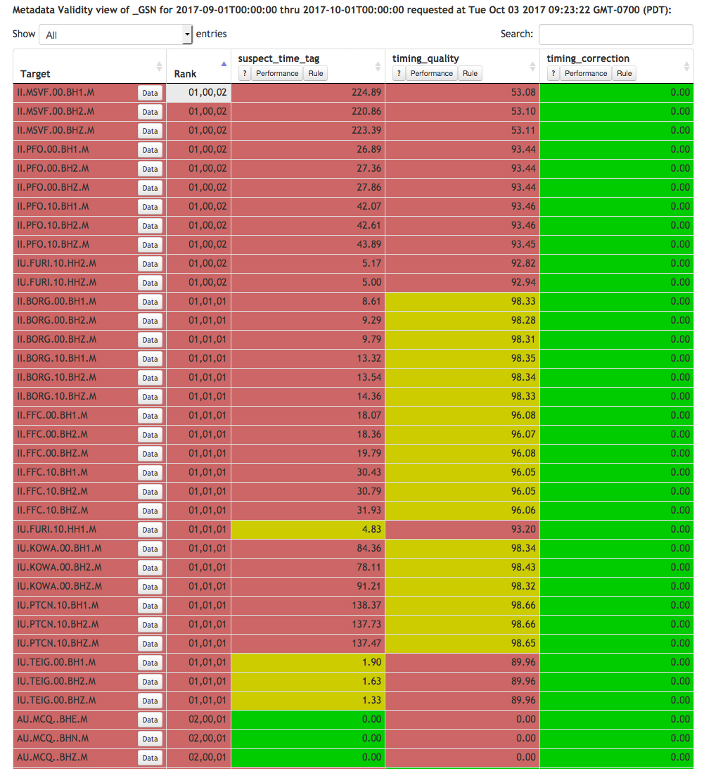
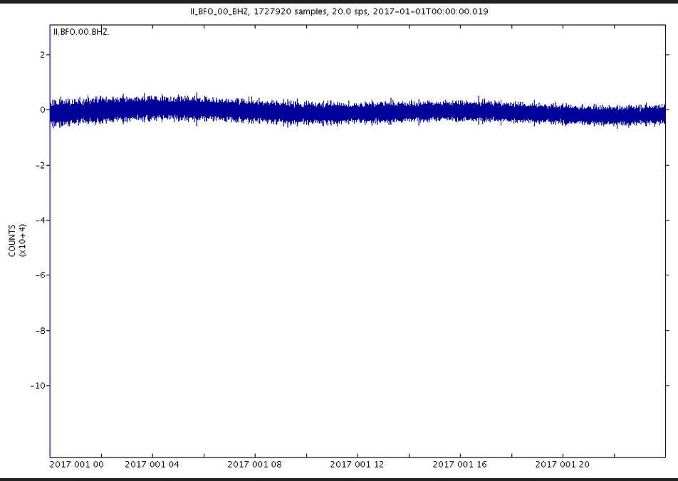
LASSO - basic
MUSTANG Clients
LASSO
Choose from 6 sets of metrics
Data Availability
Mass Positions
Noise Power
Signal Quality
Metadata Validity
Time Series Integrity
Quantitative ranks channels From 0 (all metrics poor) to 100 (all metrics good).
Qualitative lists a count of good, fair and poor metrics.

Slide 11
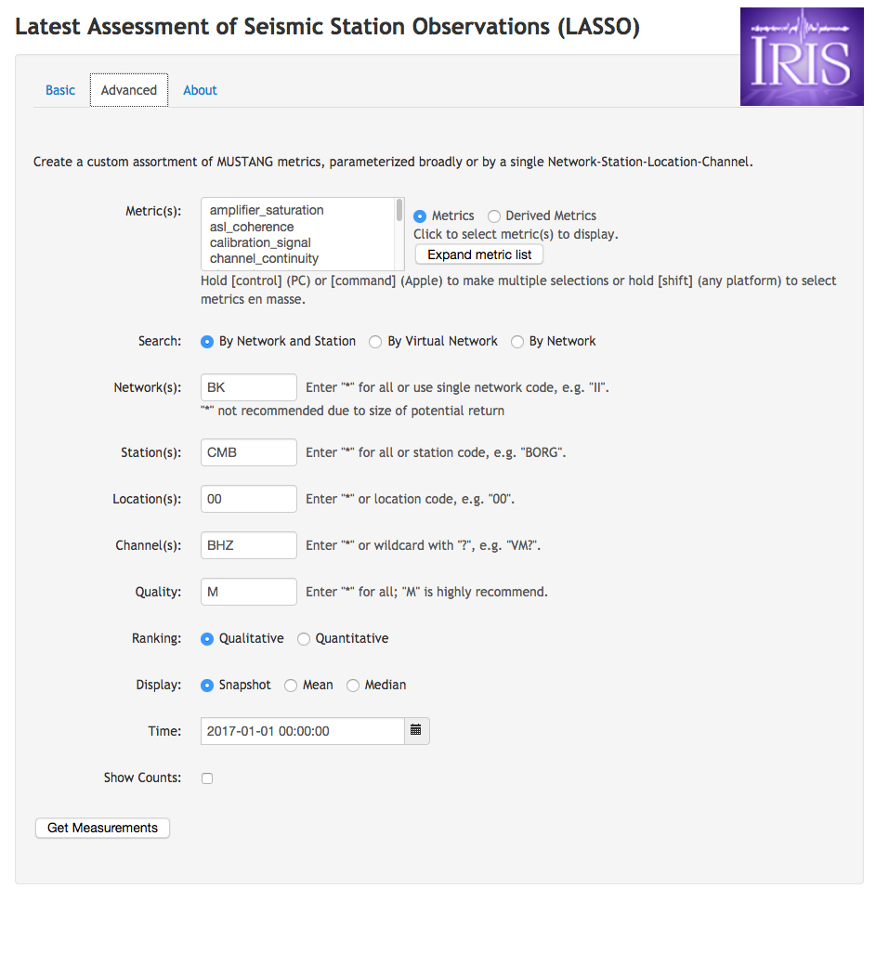
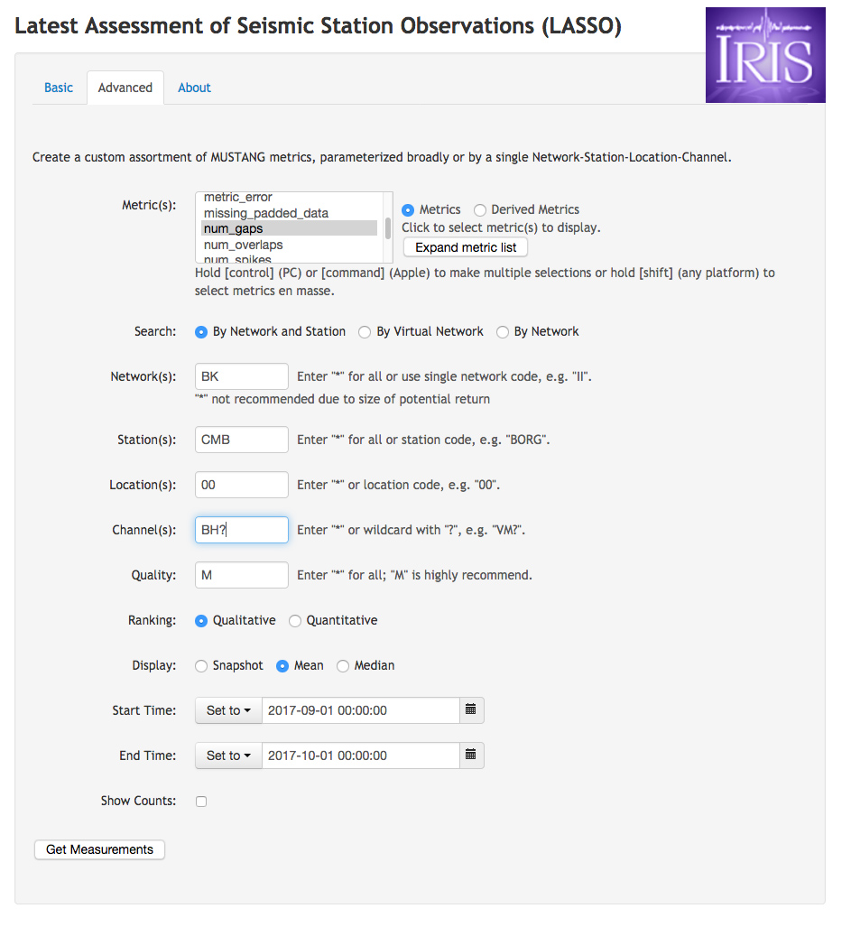
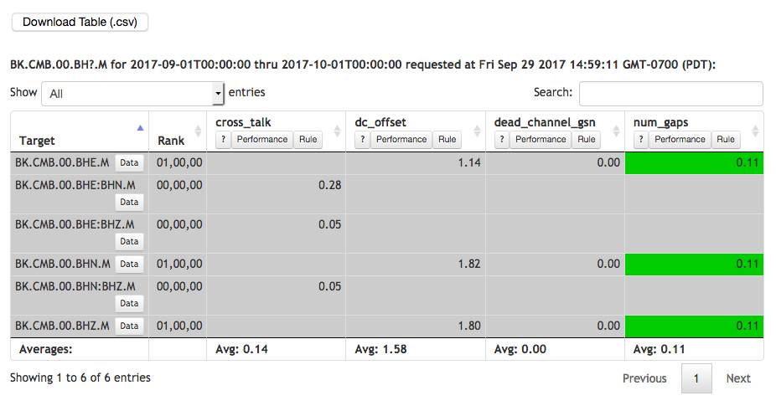
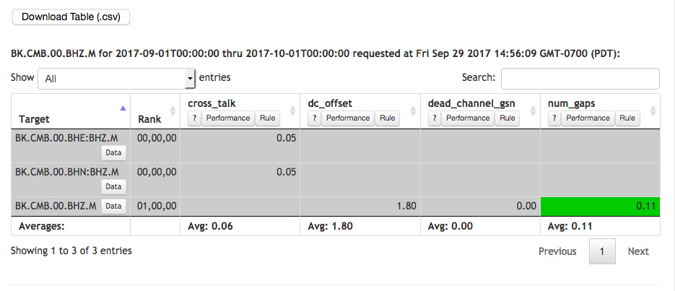
LASSO - advanced
MUSTANG Clients
LASSO
Custom metric combinations
Increased customizability in SNCLs

Slide 12
Hands-on: LASSO
MUSTANG Clients
LASSO
http://lasso.iris.edu/
Pull up the Noise Power for the extent of your network
Sort it by Quantitative rank
Compare what you see here to the PDFs to get a feel for how the two relate
ex: http://service.iris.edu/mustang/noise-pdf-browser/1/breakout?target=TA.C23K..BHE.M&interval=all&format=html
Change it to just the last month to see a more current state of the network
Pull up the waveforms for one of the SNCLs
Look at the time series metrics plots for one of the SNCLs
Play around with the advanced tab – select some metrics, choose a network or virtual network and a time range, and see what you can find.

Slide 13
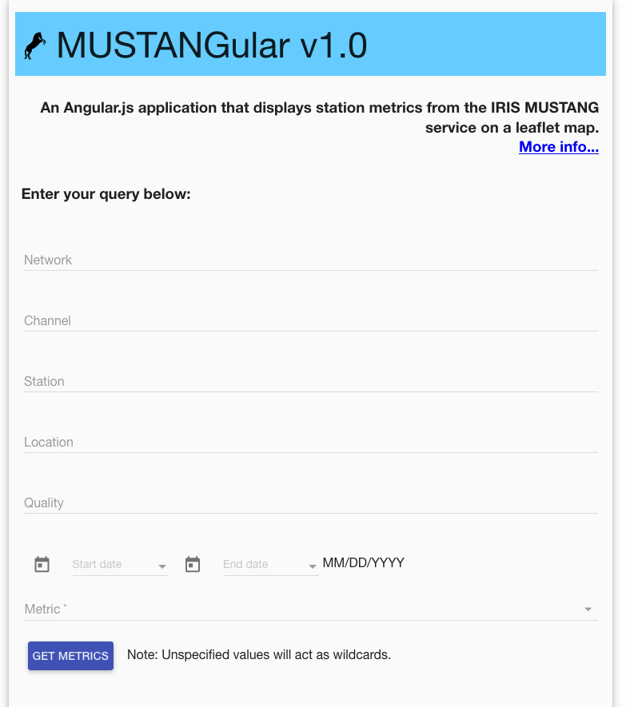
MUSTANG Clients
MUSTANGular
MUSTANGular
http://ds.iris.edu/mustang/mustangular/
Map-based plotting client
Created by the Pacific Northwest Seismic Network

Slide 14
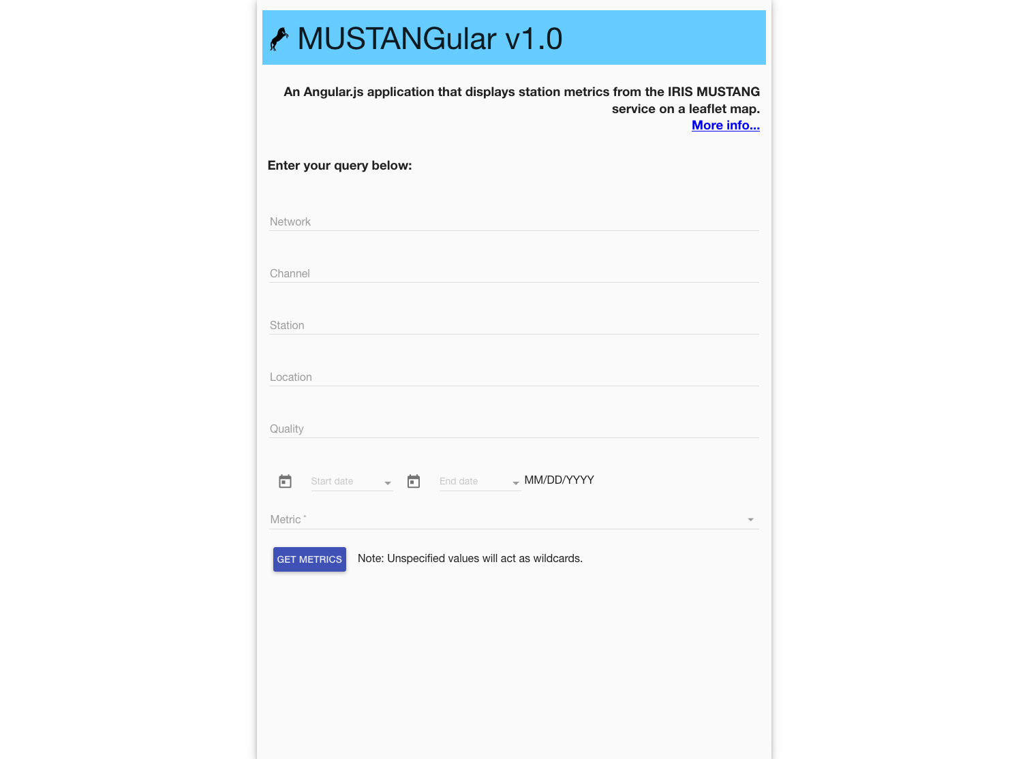
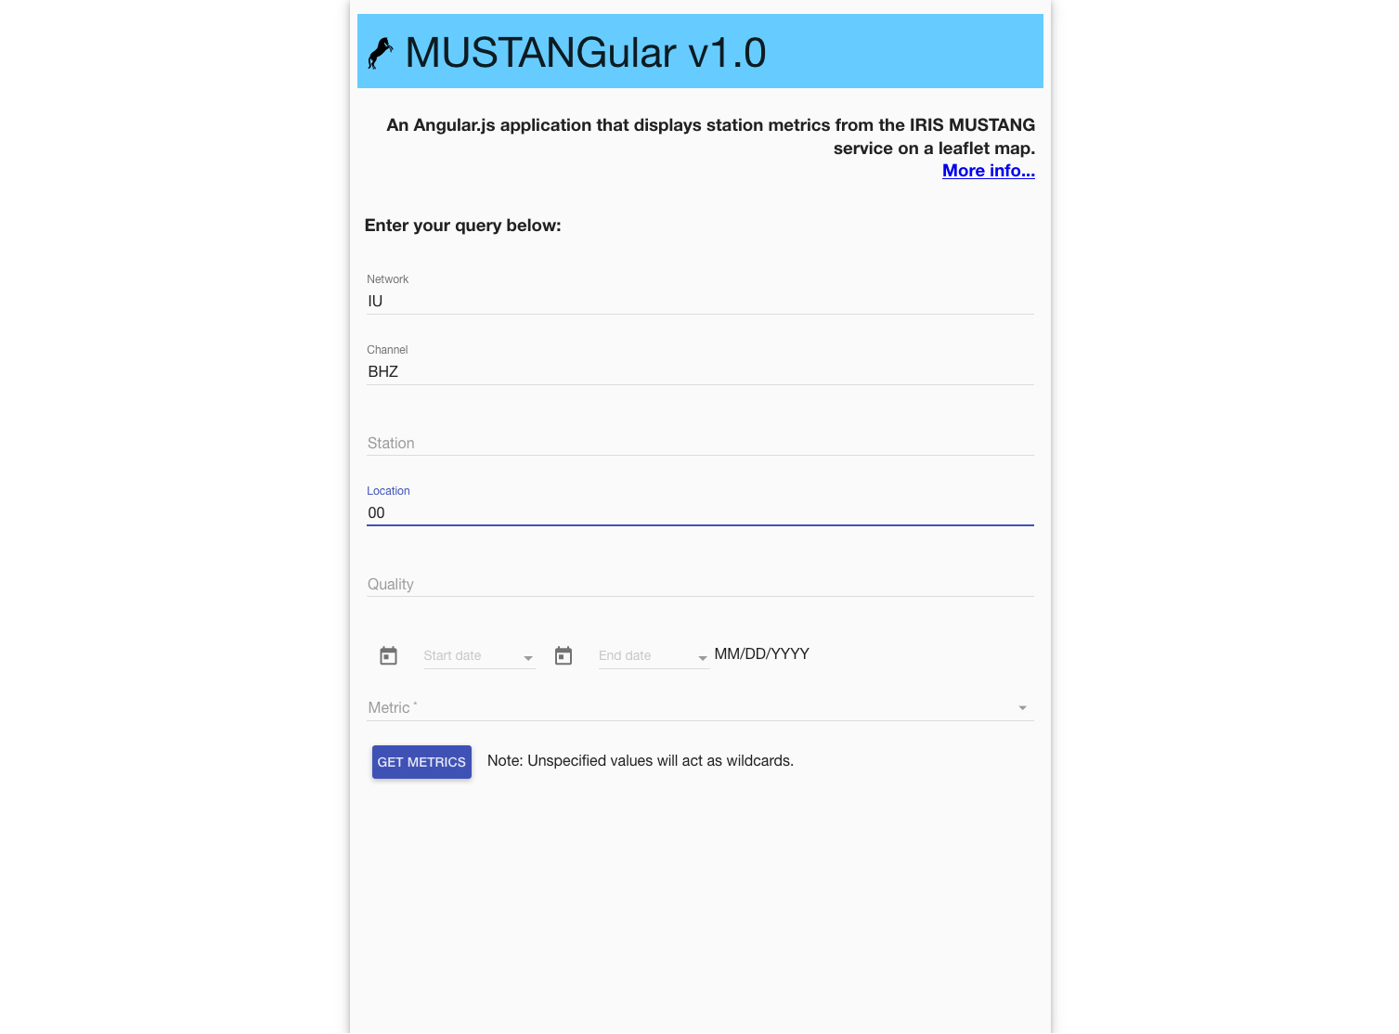
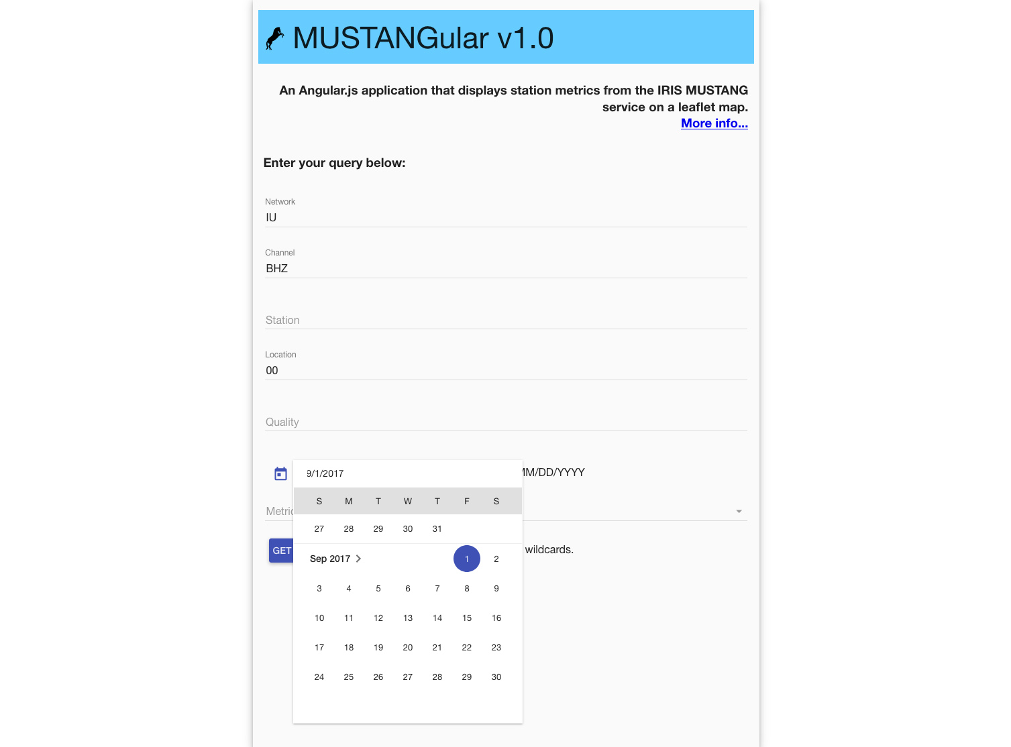
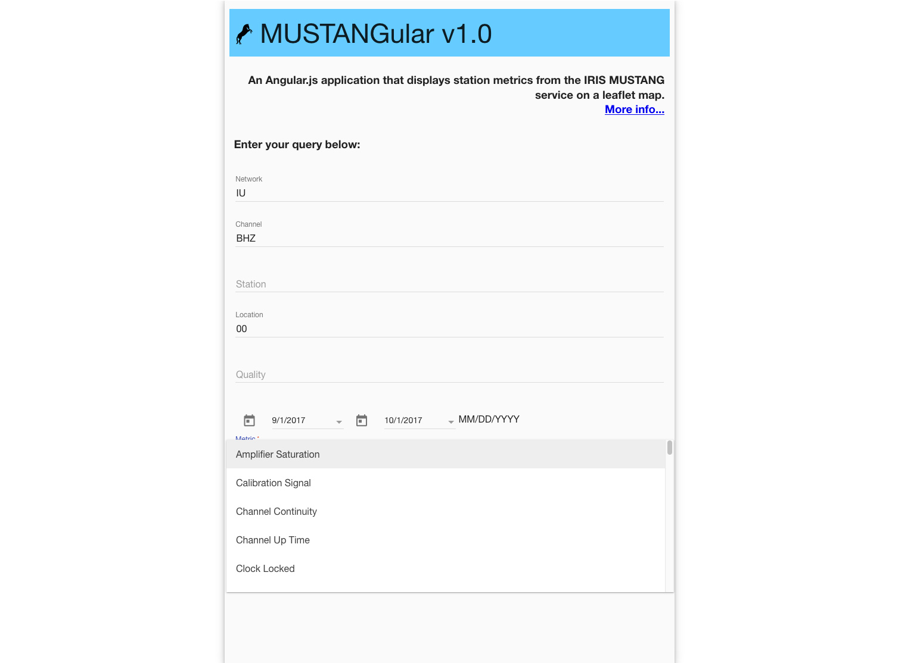
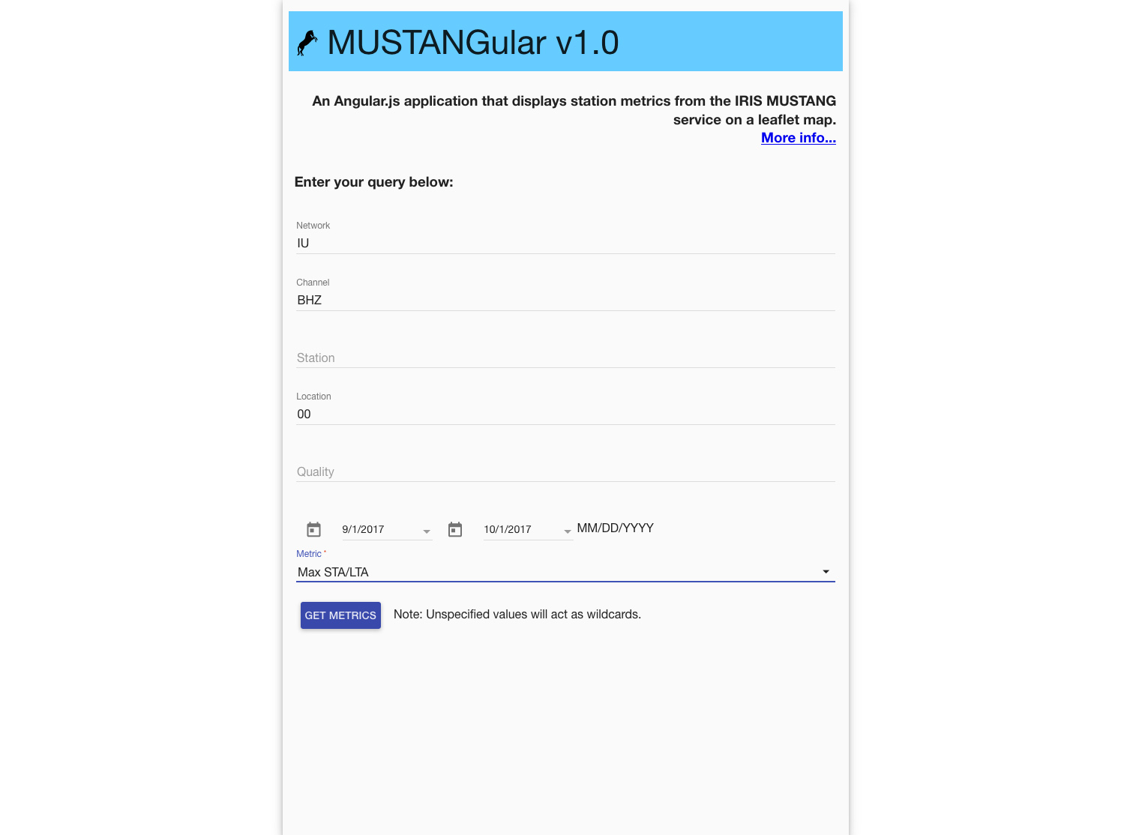
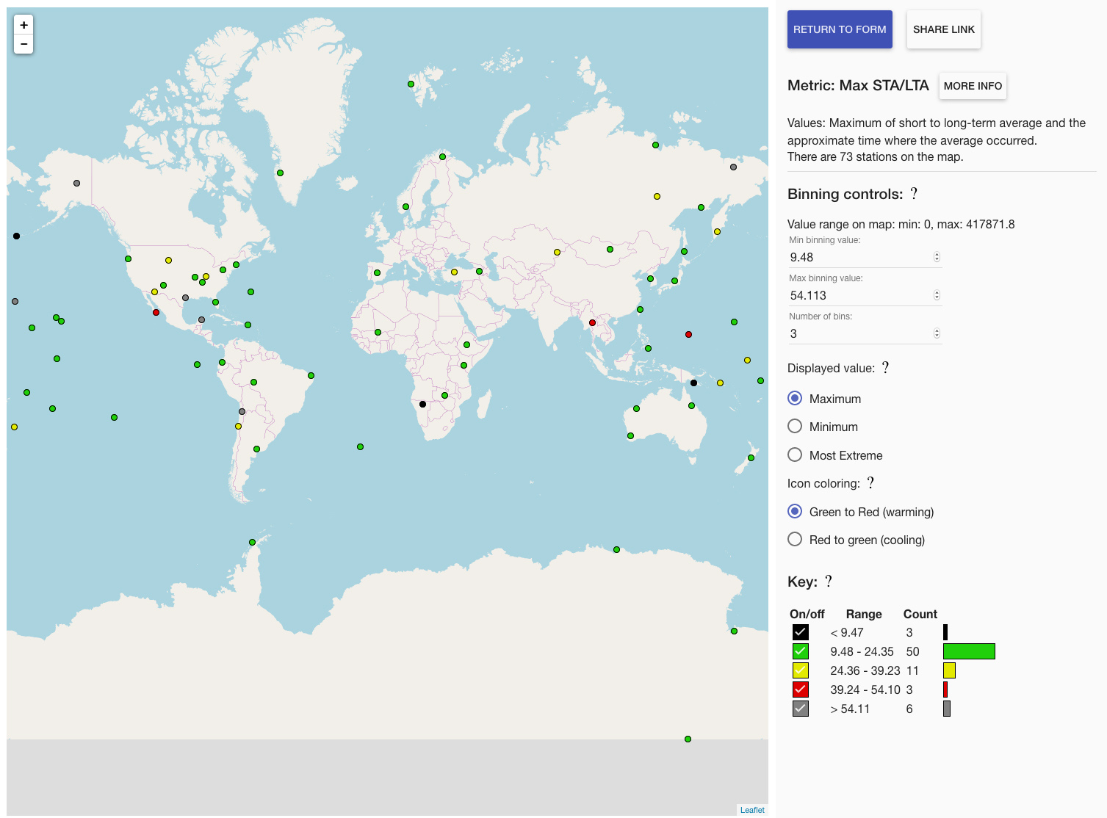
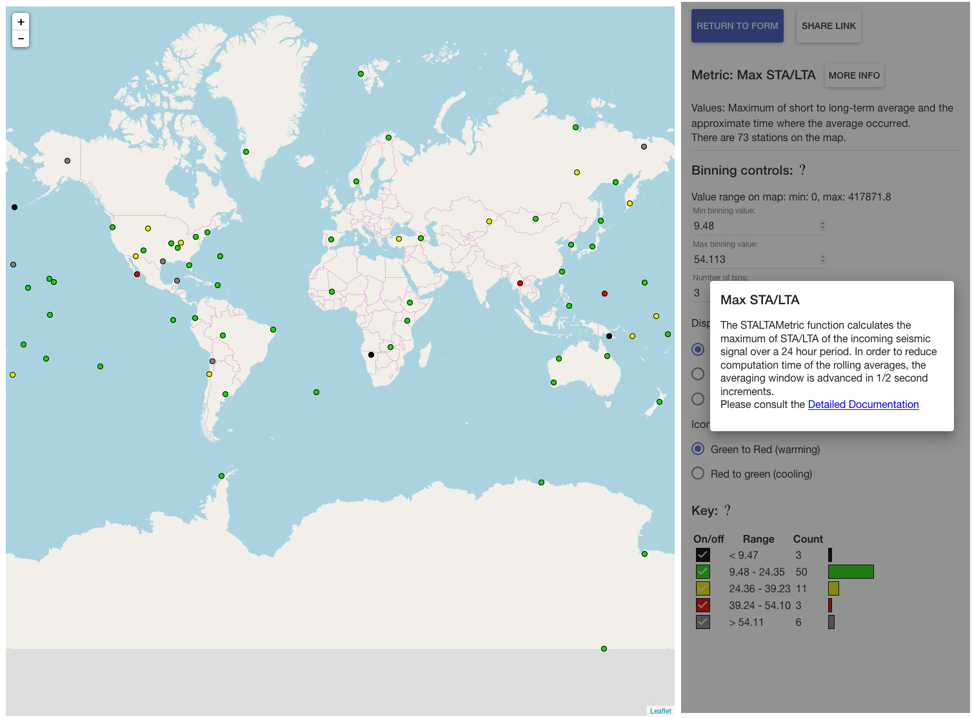
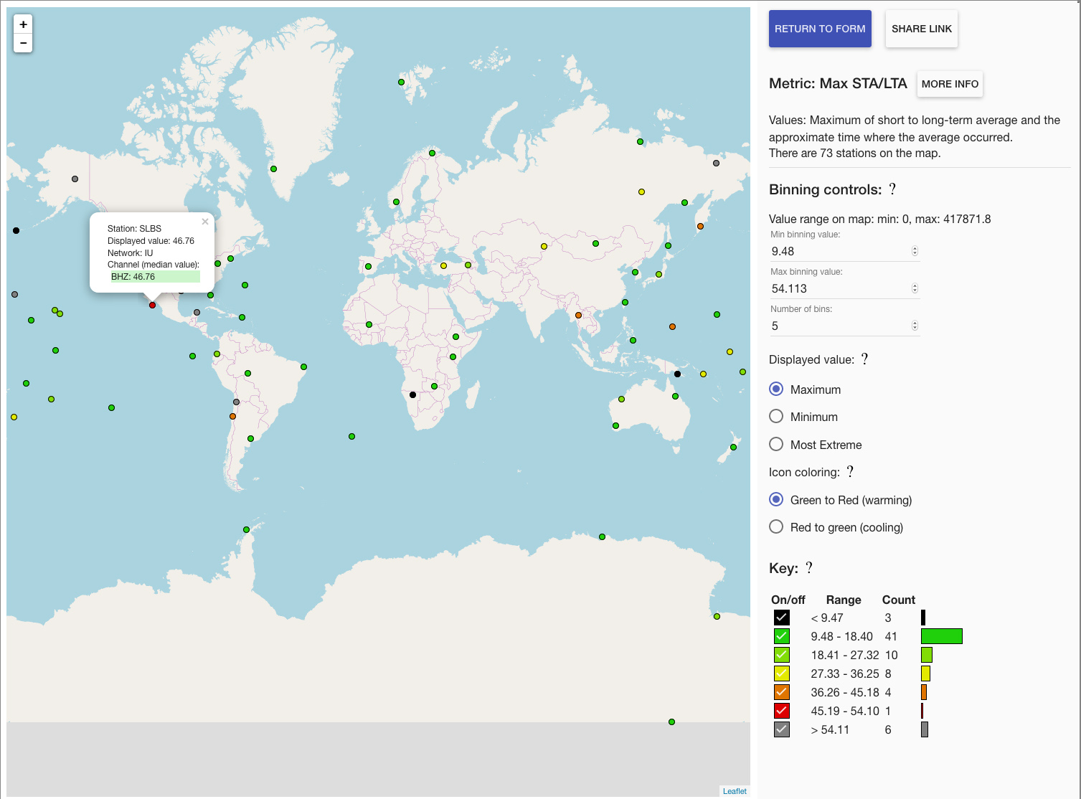
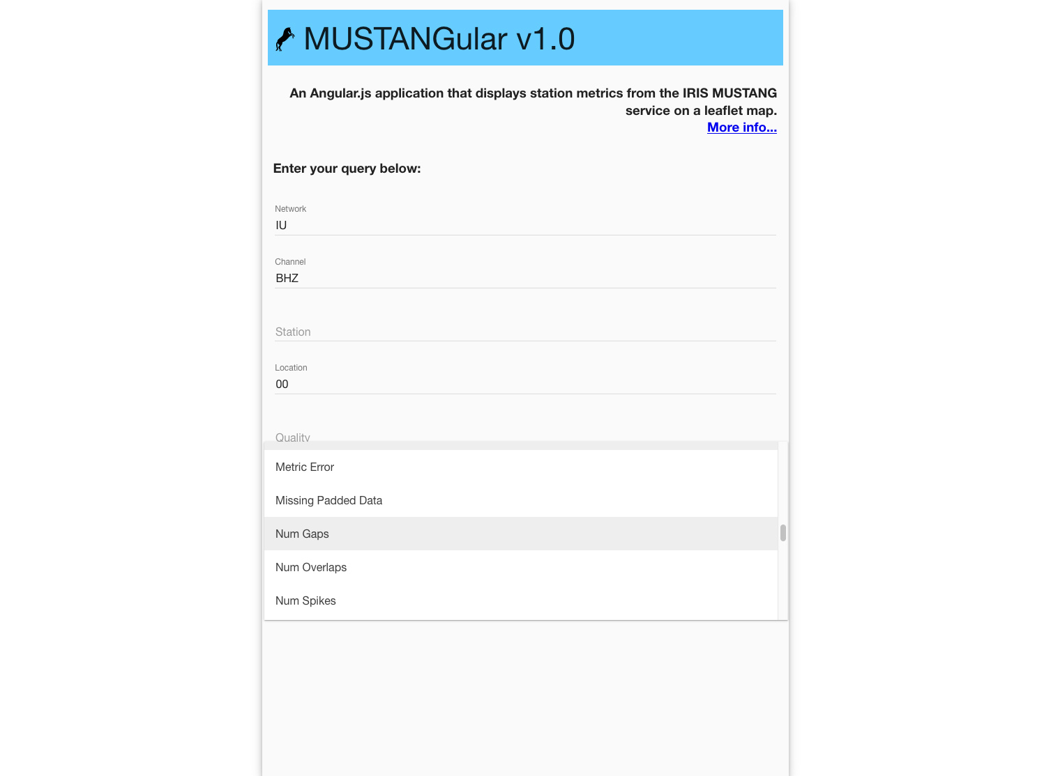
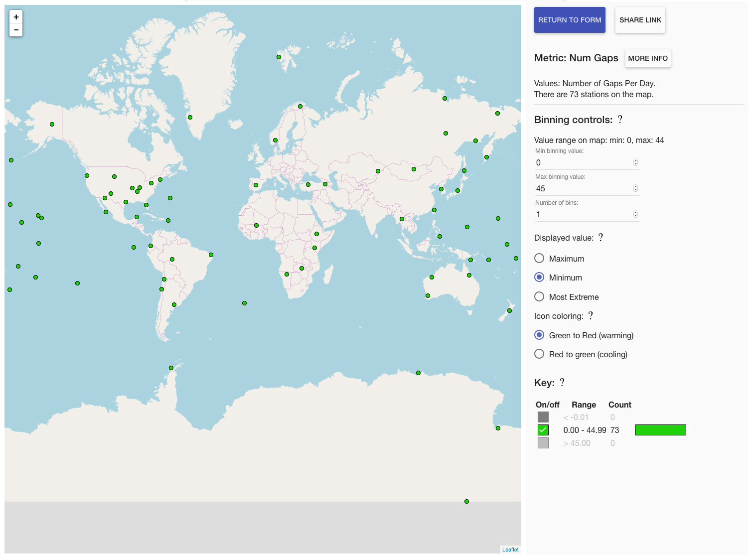
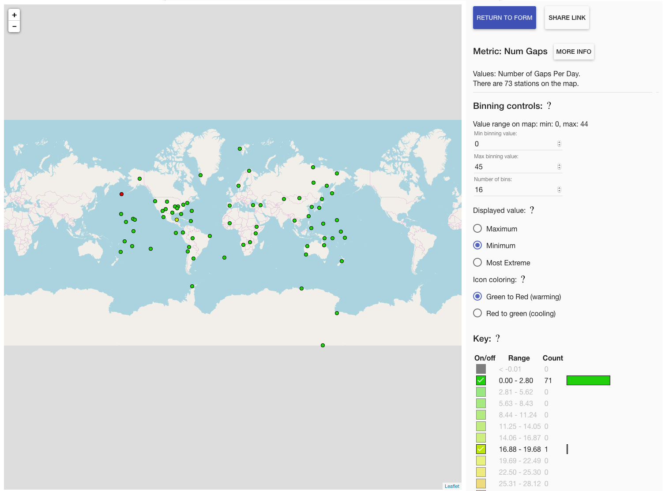
Blanks taken to be wildcard
http://ds.iris.edu/mustang/mustangular/mustangular_map.html?bincount=5&binmax=54.113&binmin=9.48&chan=BHZ&coloring=warming&loc=00&metric=num_gaps&net=IU&timewindow=2017-09-01T07:00:00,2017-10-02T06:59:59&view=min
http://ds.iris.edu/mustang/mustangular/mustangular_map.html?chan=BHZ&loc=00&metric=max_stalta&net=IU&timewindow=2017-09-01T00:00:00,2017-10-01T23:59:59

Slide 15
MUSTANG Clients
MUSTANGular
Hands-on: MUSTANGular
http://ds.iris.edu/mustang/mustangular/
Plot your network for percent above the New High Noise Model (NHNM) in 2017
Increase the number of bins to get a better sense of the distribution
Click on a station to see the median value for the time period
Plot the Data Latency for TA network for Jan 2018
What does the Data Latency metric measure?
Note spatial patterns

Slide 16
Q: Who can create clients?
MUSTANG Clients
Answer: Anyone who wants to.
Use your favorite language to grab MUSTANG measurements and manipulate them into something beneficial for you (and others?).
Some tutorials to help you learn more:
Seismic Data Quality Assurance Using IRIS MUSTANG Metrics
http://ds.iris.edu/ds/nodes/dmc/tutorials/seismic-data-quality-assurance-using-iris-mustang-metrics/
R Class for Seismologists
http://ds.iris.edu/ds/nodes/dmc/tutorials/r-class-for-seismologists/

